Slide 1
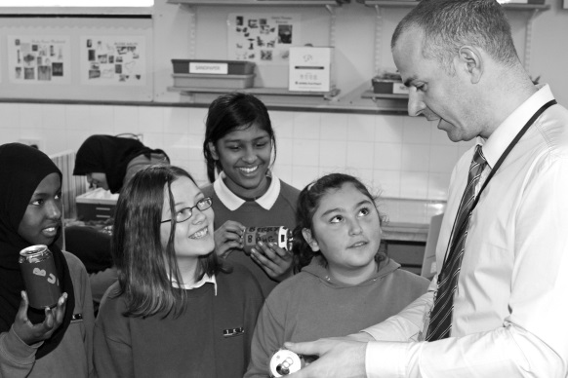
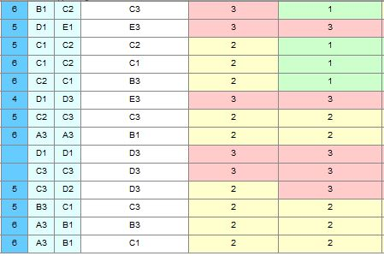
Sources of
by
Visit: www.bit.ly/POTteaching
Images: http://www.studyblue.com & melisaandryun.com
Notes:
This presentation by @TeacherToolkit ( Ross Morrison McGill ) and is licensed under a Creative Commons Attribution-NonCommercial-NoDerivs 3.0 Unported License.
Based on all work published at www.teachertoolkit.me
@TeacherToolkit Limited.

