Slide 1
Contact
by
TeacherToolkit@me.com
@TeacherToolkit
www.TeacherToolkit.me
Notes:
This presentation by @TeacherToolkit ( Ross Morrison McGill ) and is licensed under a Creative Commons Attribution-NonCommercial-NoDerivs 3.0 Unported License. Based on all work published at www.teachertoolkit.me
@TeacherToolkit Limited.

Slide 2
Context
by
This slideshow forms part of a formal presentation to be given in person, to a group of your students in an assembly setting.
This has been produced to promote
World Book Day on Thursday 6th March 2014
There are several slides that are personal and need to be adapted to suit
You (the presenter) and your own school context.
Sources and useful YouTubevideos have been linked on the last slide.
DISCLAIMER
This is a free download from www.teachertoolkit.me
Images have not been credited where possible and no revenue has been generated from this resource as a result.
You will need to source your own images to suit the types of books you have read / wish to present yourself.
@TeacherToolkit
(Feedback appreciated)
Notes:
This presentation by @TeacherToolkit ( Ross Morrison McGill ) and is licensed under a Creative Commons Attribution-NonCommercial-NoDerivs 3.0 Unported License. Based on all work published at www.teachertoolkit.me
@TeacherToolkit Limited.

Slide 3
Start of presentation
Notes:
Blank slide

Slide 4
Can you read this?
Notes:
This presentation by @TeacherToolkit ( Ross Morrison McGill ) and is licensed under a Creative Commons Attribution-NonCommercial-NoDerivs 3.0 Unported License. Based on all work published at www.teachertoolkit.me
@TeacherToolkit Limited.

Slide 5
According to research at Cambridge
I cnduo't bvleiee taht I culod aulaclty uesdtannrd waht I was rdnaieg. Unisg the icndeblire pweor of the hmuan mnid, aocdcrnig to rseecrah at Cmabrigde Uinervtisy, it dseno't mttaer in waht oderr the lterets in a wrod are, the olny irpoamtnt tihng is taht the frsit and lsat ltteer be in the rhgit pclae. The rset can be a taotl mses and you can sitll raed it whoutit a pboerlm. Tihs is bucseae the huamn mnid deos not raed ervey ltteer by istlef, but the wrod as a wlohe.
Notes:
This presentation by @TeacherToolkit ( Ross Morrison McGill ) and is licensed under a Creative Commons Attribution-NonCommercial-NoDerivs 3.0 Unported License. Based on all work published at www.teachertoolkit.me
@TeacherToolkit Limited.

Slide 6
Some facts
There is overwhelming evidence that literacy has a significant relationship to people's life chances.
A person with low literacy is more likely to have reduced work-opportunities.
Notes:
This presentation by @TeacherToolkit ( Ross Morrison McGill ) and is licensed under a Creative Commons Attribution-NonCommercial-NoDerivs 3.0 Unported License. Based on all work published at www.teachertoolkit.me
@TeacherToolkit Limited.

Slide 7
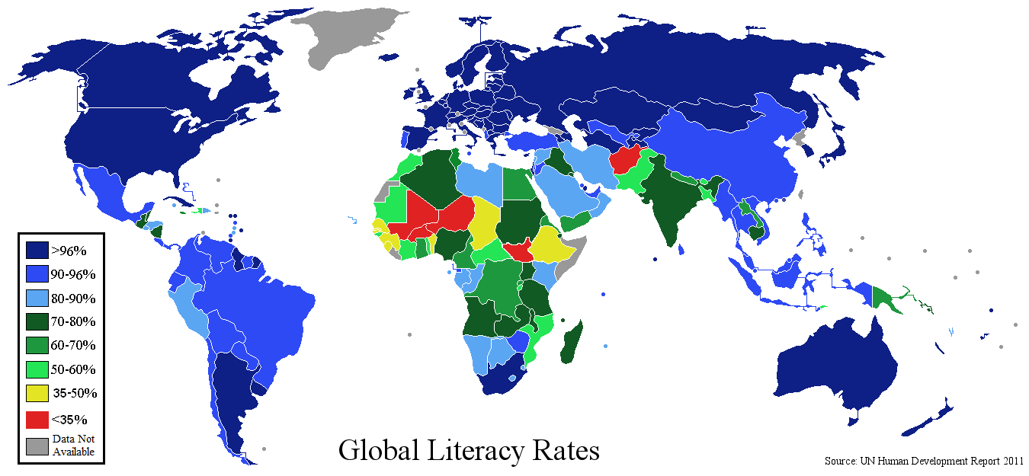
Literacy across the world
Notes:
This presentation by @TeacherToolkit ( Ross Morrison McGill ) and is licensed under a Creative Commons Attribution-NonCommercial-NoDerivs 3.0 Unported License. Based on all work published at www.teachertoolkit.me
@TeacherToolkit Limited.

Slide 8
Verbal literacy
Watch this video…
Notes:
This presentation by @TeacherToolkit ( Ross Morrison McGill ) and is licensed under a Creative Commons Attribution-NonCommercial-NoDerivs 3.0 Unported License. Based on all work published at www.teachertoolkit.me
@TeacherToolkit Limited.

Slide 9
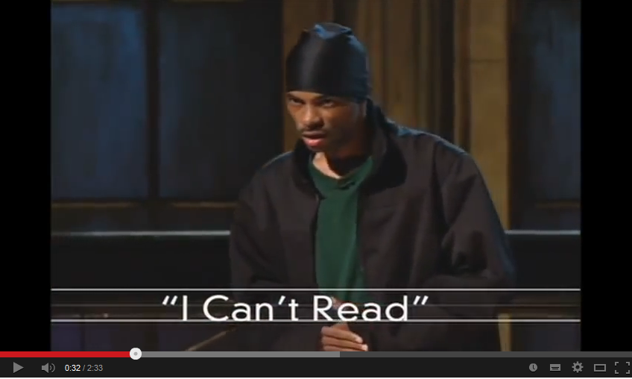
(I Can't Read) HBO Def Jam Poetry
http://youtu.be/lByDfPOG0LA?t=22s
Notes:
http://youtu.be/lByDfPOG0LA?t=22s
This presentation by @TeacherToolkit ( Ross Morrison McGill ) and is licensed under a Creative Commons Attribution-NonCommercial-NoDerivs 3.0 Unported License. Based on all work published at www.teachertoolkit.me
@TeacherToolkit Limited.

Slide 10
Some facts
Parents / teachers are the most important reading role models for children and young people.
Only 1 in 5 parents easily find the opportunity to read to their children.
10 to 16 year-olds who read for pleasure do better at school.
Notes:
This presentation by @TeacherToolkit ( Ross Morrison McGill ) and is licensed under a Creative Commons Attribution-NonCommercial-NoDerivs 3.0 Unported License. Based on all work published at www.teachertoolkit.me
@TeacherToolkit Limited.

Slide 11
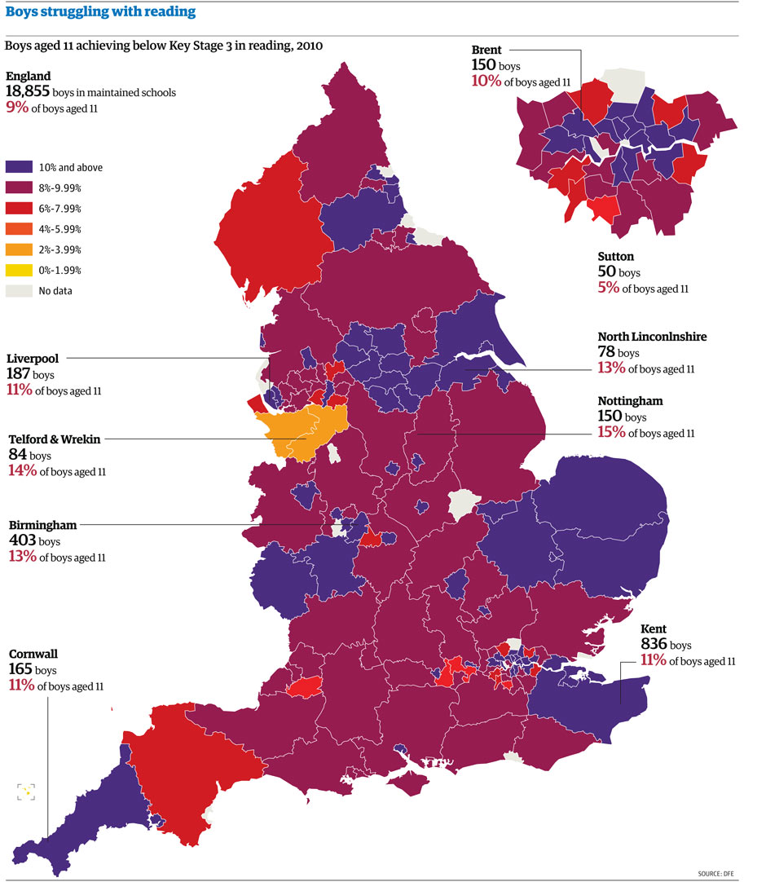
Notes:
This presentation by @TeacherToolkit ( Ross Morrison McGill ) and is licensed under a Creative Commons Attribution-NonCommercial-NoDerivs 3.0 Unported License. Based on all work published at www.teachertoolkit.me
@TeacherToolkit Limited.

Slide 12
Vote now!
Notes:
QUESTION: How many people enjoy reading?
http://readingagency.org.uk/news/reading-facts003/
This presentation by @TeacherToolkit ( Ross Morrison McGill ) and is licensed under a Creative Commons Attribution-NonCommercial-NoDerivs 3.0 Unported License. Based on all work published at www.teachertoolkit.me
@TeacherToolkit Limited.

Slide 13
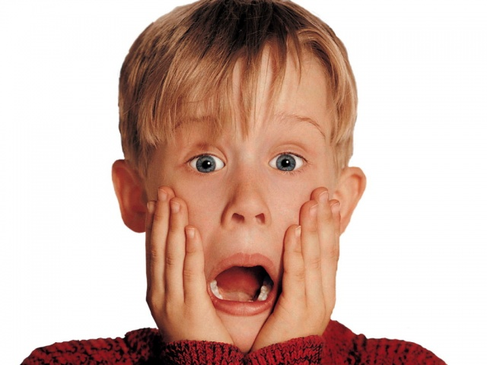
Only 40% of England's
ten year olds,
have a positive attitude
to reading.
Notes:
How many people enjoy reading?
http://readingagency.org.uk/news/reading-facts003/
This presentation by @TeacherToolkit ( Ross Morrison McGill ) and is licensed under a Creative Commons Attribution-NonCommercial-NoDerivs 3.0 Unported License. Based on all work published at www.teachertoolkit.me
@TeacherToolkit Limited.

Slide 14
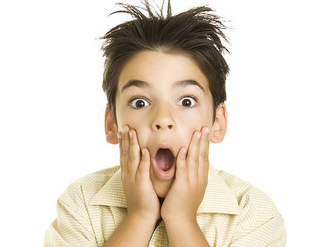
46% of
16 to 24 year olds
don't read
for pleasure…
Notes:
How many people enjoy reading?
http://readingagency.org.uk/news/reading-facts003/
This presentation by @TeacherToolkit ( Ross Morrison McGill ) and is licensed under a Creative Commons Attribution-NonCommercial-NoDerivs 3.0 Unported License. Based on all work published at www.teachertoolkit.me
@TeacherToolkit Limited.

Slide 15
Non verbal literacy
Notes:
This presentation by @TeacherToolkit ( Ross Morrison McGill ) and is licensed under a Creative Commons Attribution-NonCommercial-NoDerivs 3.0 Unported License. Based on all work published at www.teachertoolkit.me
@TeacherToolkit Limited.

Slide 16
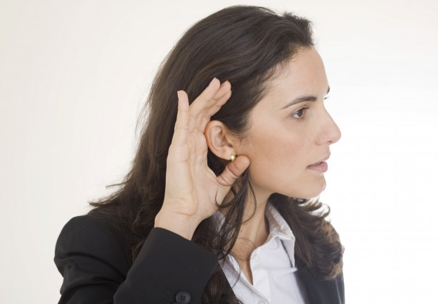
Non verbal literacy
Notes:
This presentation by @TeacherToolkit ( Ross Morrison McGill ) and is licensed under a Creative Commons Attribution-NonCommercial-NoDerivs 3.0 Unported License. Based on all work published at www.teachertoolkit.me
@TeacherToolkit Limited.

Slide 17
Non verbal literacy
Notes:
This presentation by @TeacherToolkit ( Ross Morrison McGill ) and is licensed under a Creative Commons Attribution-NonCommercial-NoDerivs 3.0 Unported License. Based on all work published at www.teachertoolkit.me
@TeacherToolkit Limited.

Slide 18
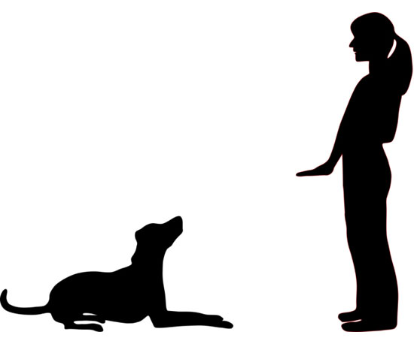
Non verbal literacy: Animals too!
Notes:
This presentation by @TeacherToolkit ( Ross Morrison McGill ) and is licensed under a Creative Commons Attribution-NonCommercial-NoDerivs 3.0 Unported License. Based on all work published at www.teachertoolkit.me
@TeacherToolkit Limited.

Slide 19
Non verbal literacy: Braille
Notes:
This presentation by @TeacherToolkit ( Ross Morrison McGill ) and is licensed under a Creative Commons Attribution-NonCommercial-NoDerivs 3.0 Unported License. Based on all work published at www.teachertoolkit.me
@TeacherToolkit Limited.

Slide 20
Semiotics?
Semiotics, also called semiotic studies is the study of signs and sign processes, analogy, metaphor, symbolism, and communication.
Notes:
This presentation by @TeacherToolkit ( Ross Morrison McGill ) and is licensed under a Creative Commons Attribution-NonCommercial-NoDerivs 3.0 Unported License. Based on all work published at www.teachertoolkit.me
@TeacherToolkit Limited.

Slide 21
The oldest semiotic language?
Hieroglyphics
Notes:
This presentation by @TeacherToolkit ( Ross Morrison McGill ) and is licensed under a Creative Commons Attribution-NonCommercial-NoDerivs 3.0 Unported License. Based on all work published at www.teachertoolkit.me
@TeacherToolkit Limited.

Slide 22
Semiotics today
At some point, you may need to know
what these signs mean…
Notes:
This presentation by @TeacherToolkit ( Ross Morrison McGill ) and is licensed under a Creative Commons Attribution-NonCommercial-NoDerivs 3.0 Unported License. Based on all work published at www.teachertoolkit.me
@TeacherToolkit Limited.

Slide 23
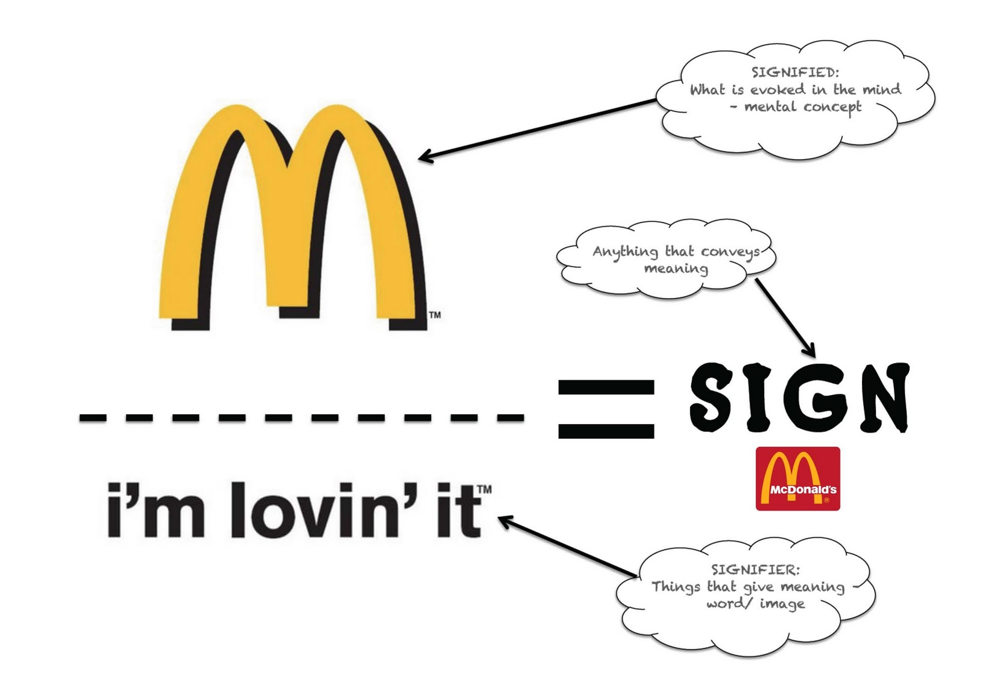
Semiotic meanings
Notes:
This presentation by @TeacherToolkit ( Ross Morrison McGill ) and is licensed under a Creative Commons Attribution-NonCommercial-NoDerivs 3.0 Unported License. Based on all work published at www.teachertoolkit.me
@TeacherToolkit Limited.

Slide 24
Some facts
Reading books is the only out-of-school activity for 16-year-olds demonstrably linked to securing managerial or professional jobs.
15.9% of all 16- to 24-year-olds in England are not in Education, employment or training
70% of pupils permanently excluded from school have difficulties in basic literacy skills.
Notes:
This presentation by @TeacherToolkit ( Ross Morrison McGill ) and is licensed under a Creative Commons Attribution-NonCommercial-NoDerivs 3.0 Unported License. Based on all work published at www.teachertoolkit.me
@TeacherToolkit Limited.

Slide 25
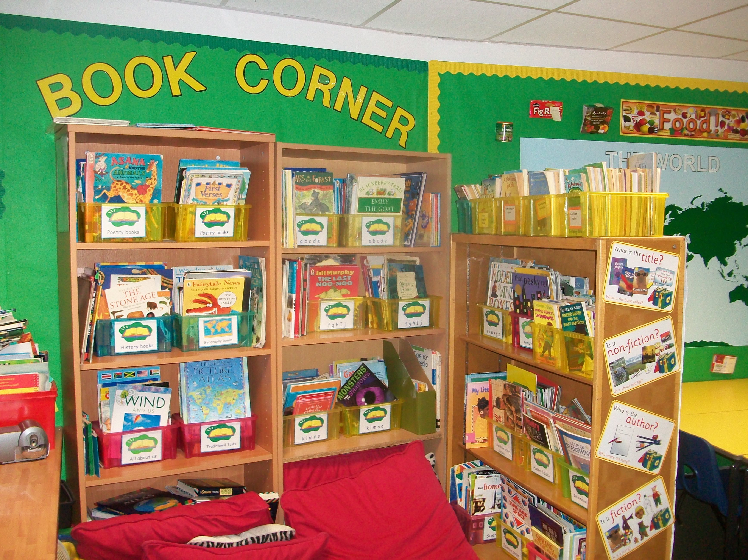
My own childhood at school
Notes:
This presentation by @TeacherToolkit ( Ross Morrison McGill ) and is licensed under a Creative Commons Attribution-NonCommercial-NoDerivs 3.0 Unported License. Based on all work published at www.teachertoolkit.me
@TeacherToolkit Limited.

Slide 26
My own childhood – visiting the library
Notes:
This presentation by @TeacherToolkit ( Ross Morrison McGill ) and is licensed under a Creative Commons Attribution-NonCommercial-NoDerivs 3.0 Unported License. Based on all work published at www.teachertoolkit.me
@TeacherToolkit Limited.

Slide 27
My favourite children’s story growing up
Notes:
This presentation by @TeacherToolkit ( Ross Morrison McGill ) and is licensed under a Creative Commons Attribution-NonCommercial-NoDerivs 3.0 Unported License. Based on all work published at www.teachertoolkit.me
@TeacherToolkit Limited.

Slide 28
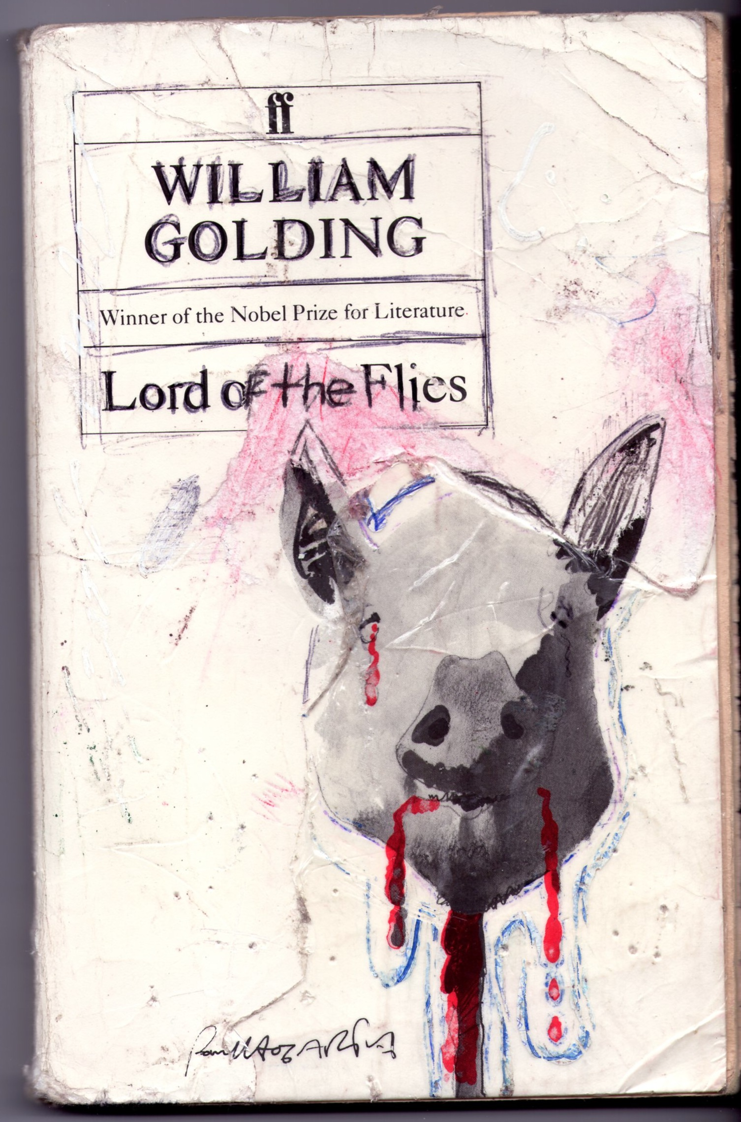
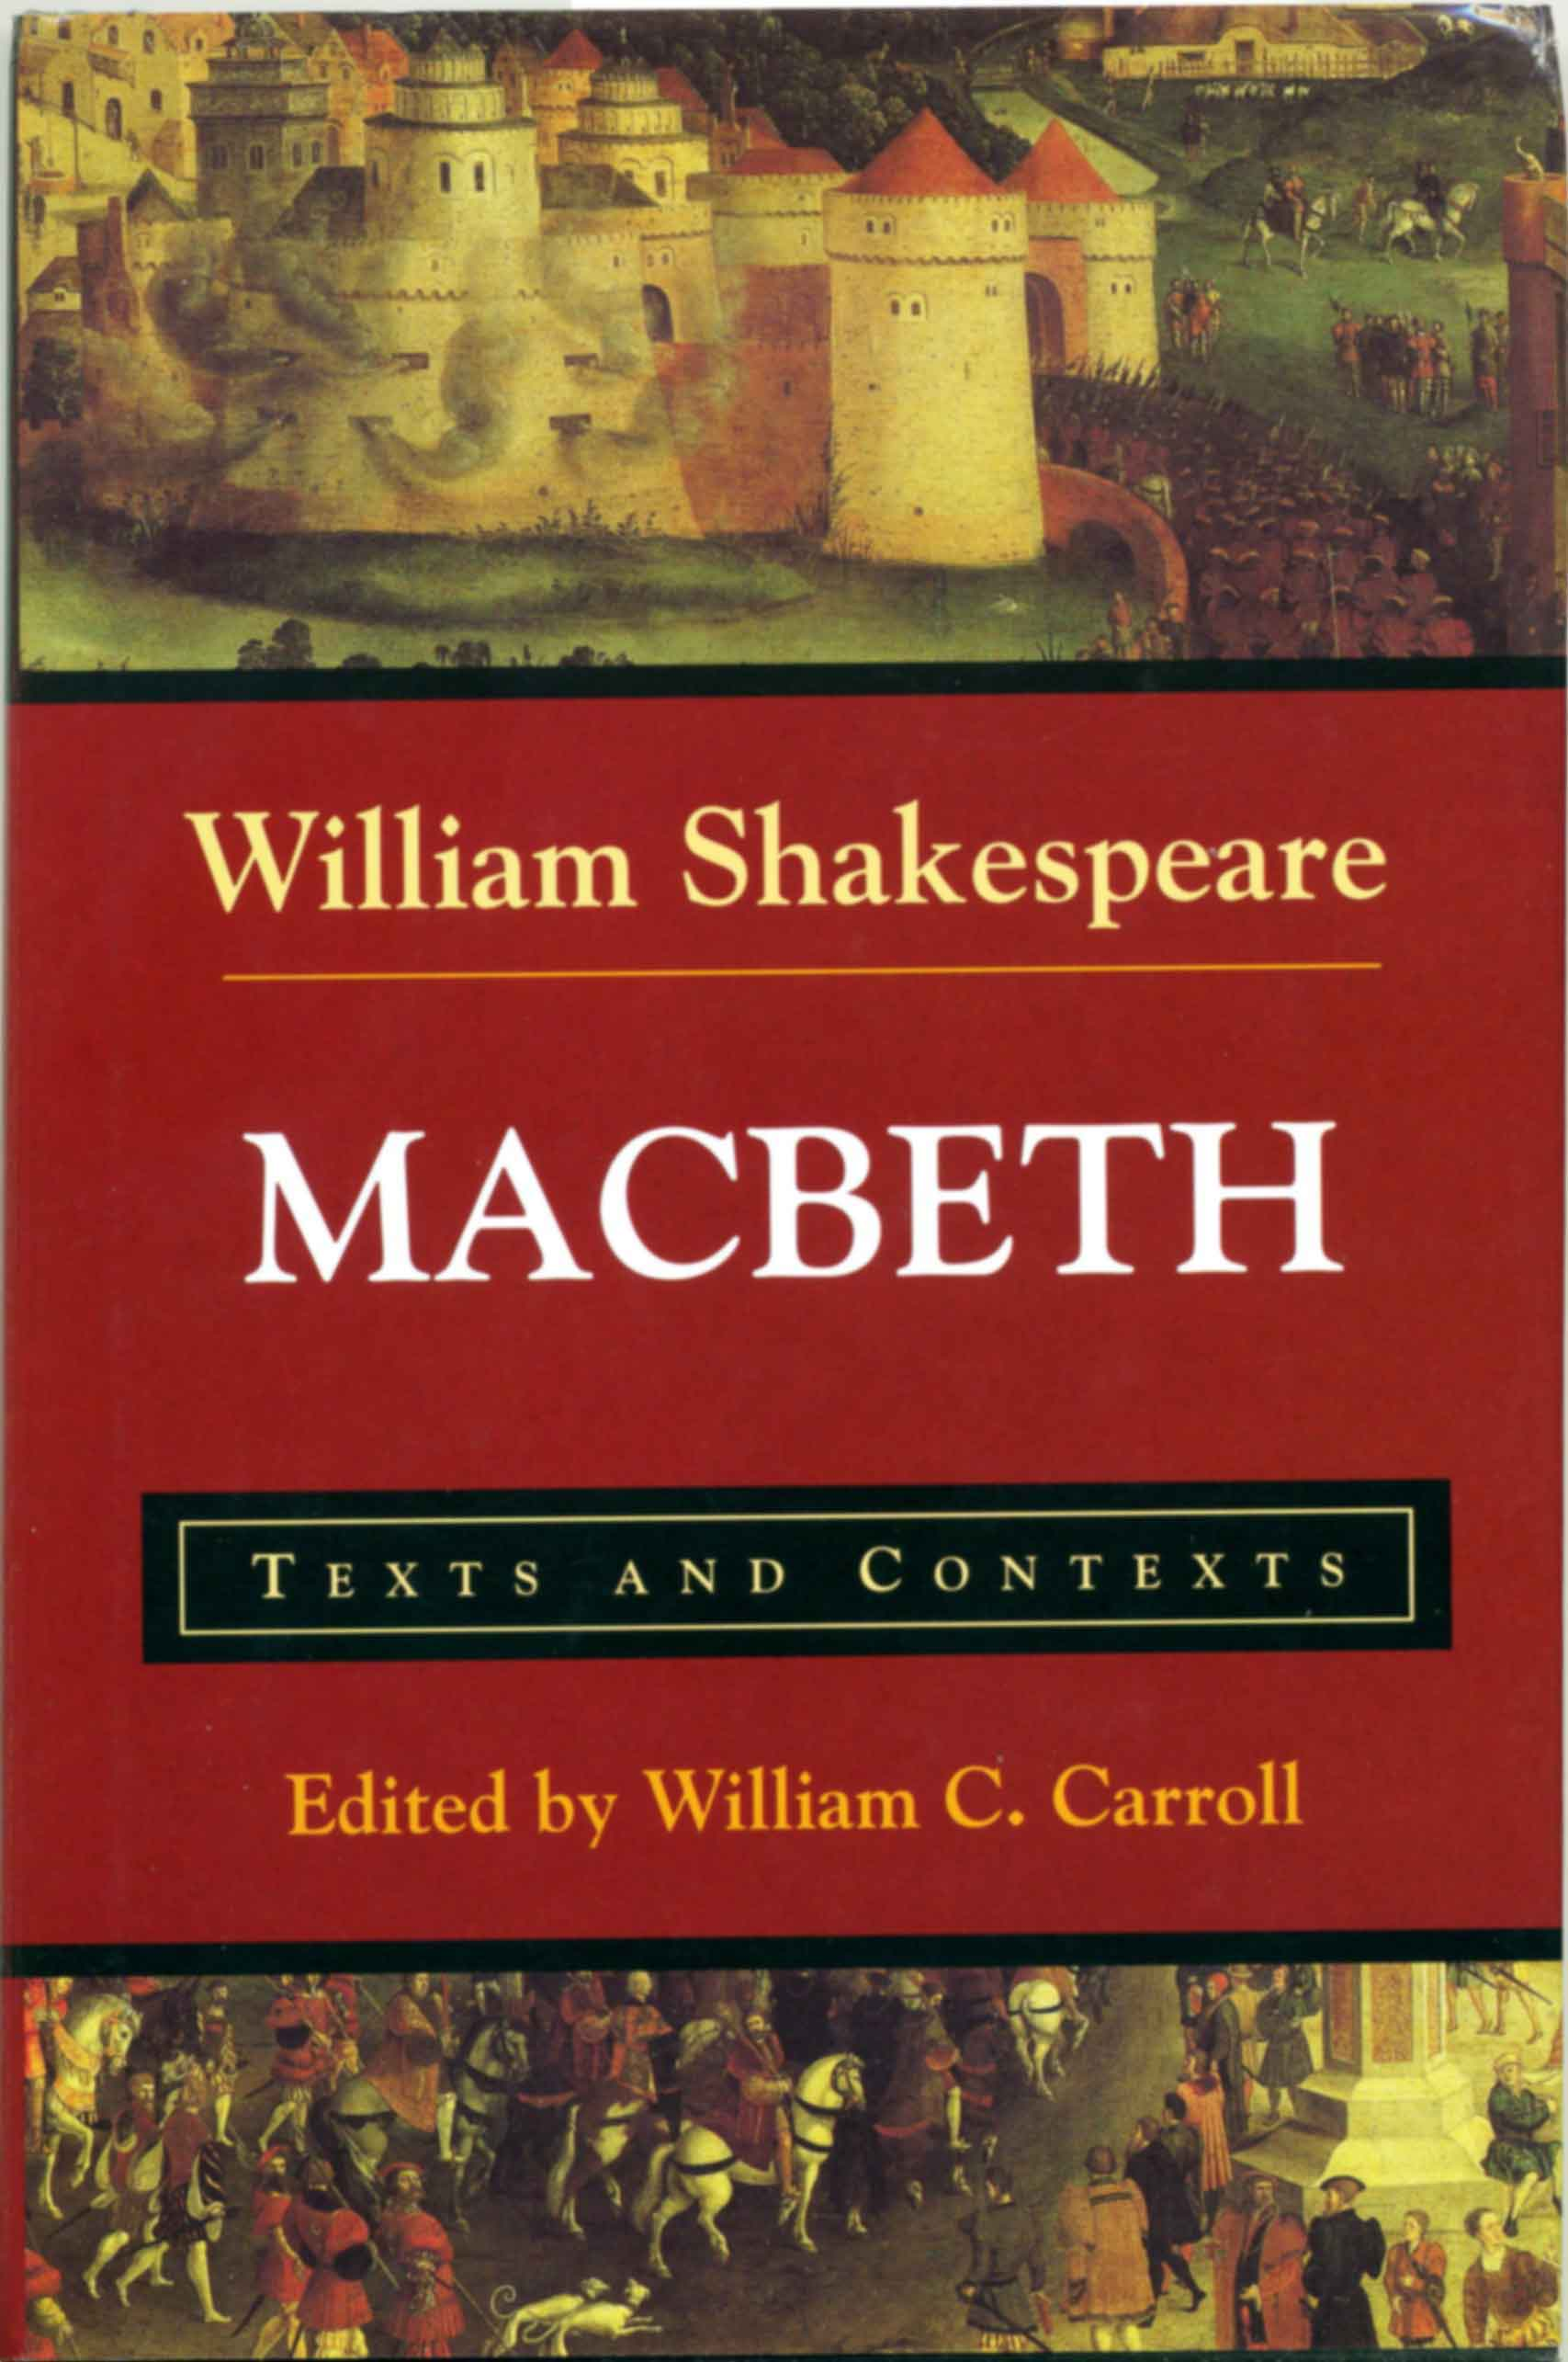
Reading at school
Notes:
This presentation by @TeacherToolkit ( Ross Morrison McGill ) and is licensed under a Creative Commons Attribution-NonCommercial-NoDerivs 3.0 Unported License. Based on all work published at www.teachertoolkit.me
@TeacherToolkit Limited.

Slide 29
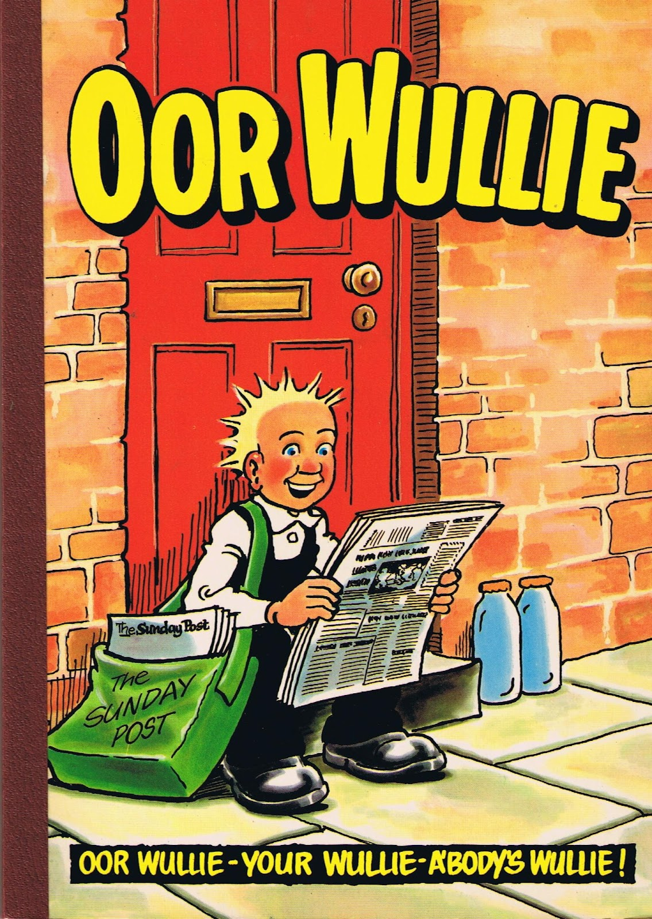
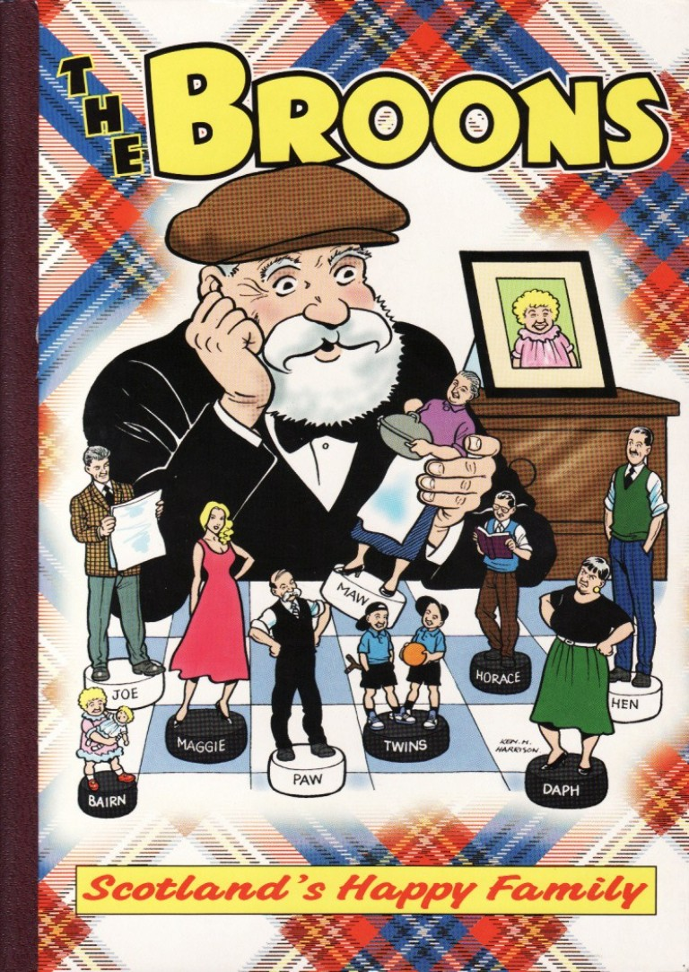
Reading outside of school
Notes:
This presentation by @TeacherToolkit ( Ross Morrison McGill ) and is licensed under a Creative Commons Attribution-NonCommercial-NoDerivs 3.0 Unported License. Based on all work published at www.teachertoolkit.me
@TeacherToolkit Limited.

Slide 30
Reading as a young adult… I probably did not read for pleasure between the ages of 17 – 21 years old
by
Notes:
This presentation by @TeacherToolkit ( Ross Morrison McGill ) and is licensed under a Creative Commons Attribution-NonCommercial-NoDerivs 3.0 Unported License. Based on all work published at www.teachertoolkit.me
@TeacherToolkit Limited.

Slide 31
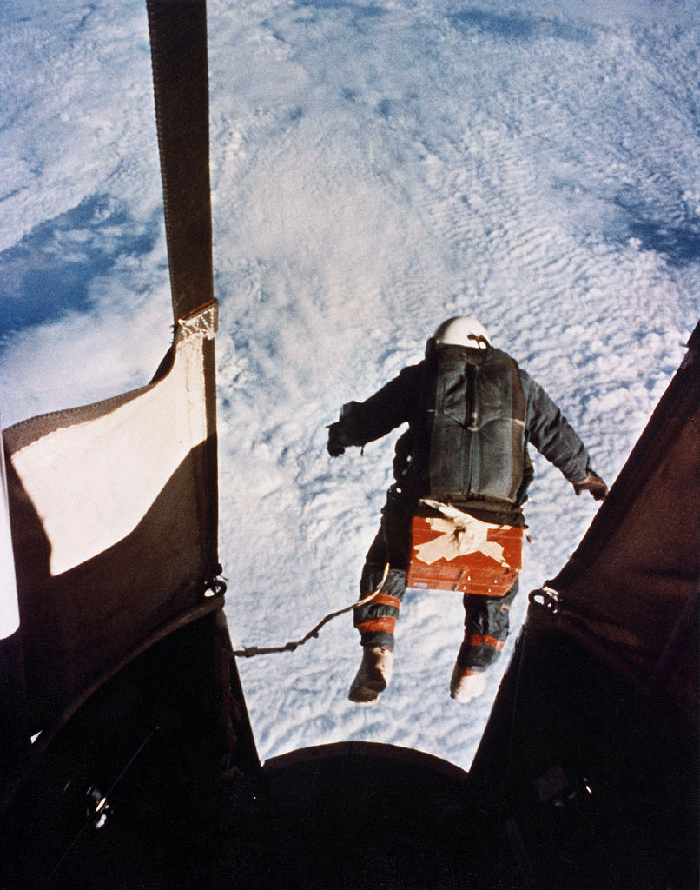
Reading as a young adult: 23Yrs+
Notes:
This presentation by @TeacherToolkit ( Ross Morrison McGill ) and is licensed under a Creative Commons Attribution-NonCommercial-NoDerivs 3.0 Unported License. Based on all work published at www.teachertoolkit.me
@TeacherToolkit Limited.

Slide 32
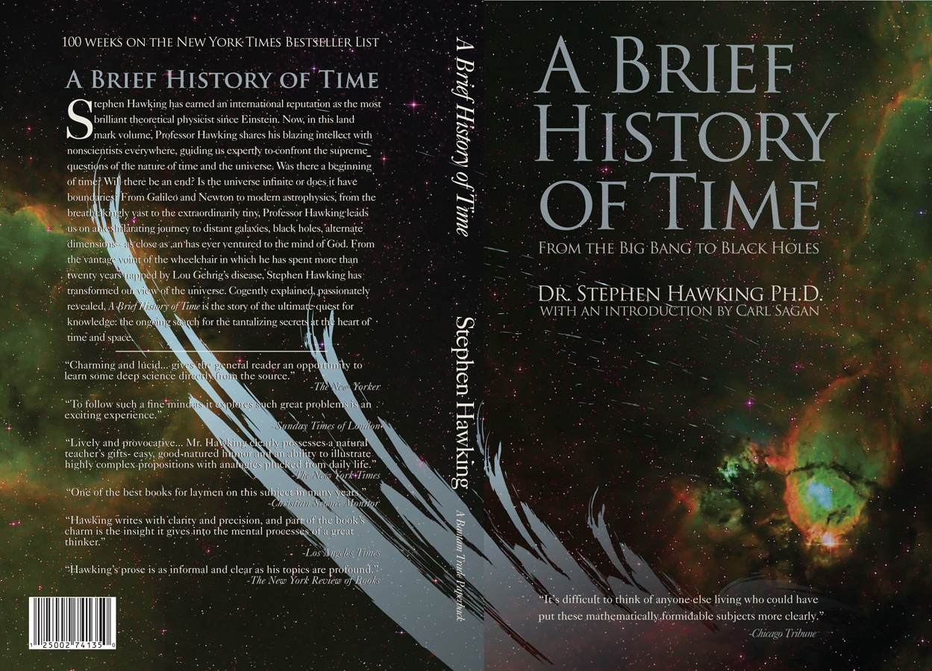
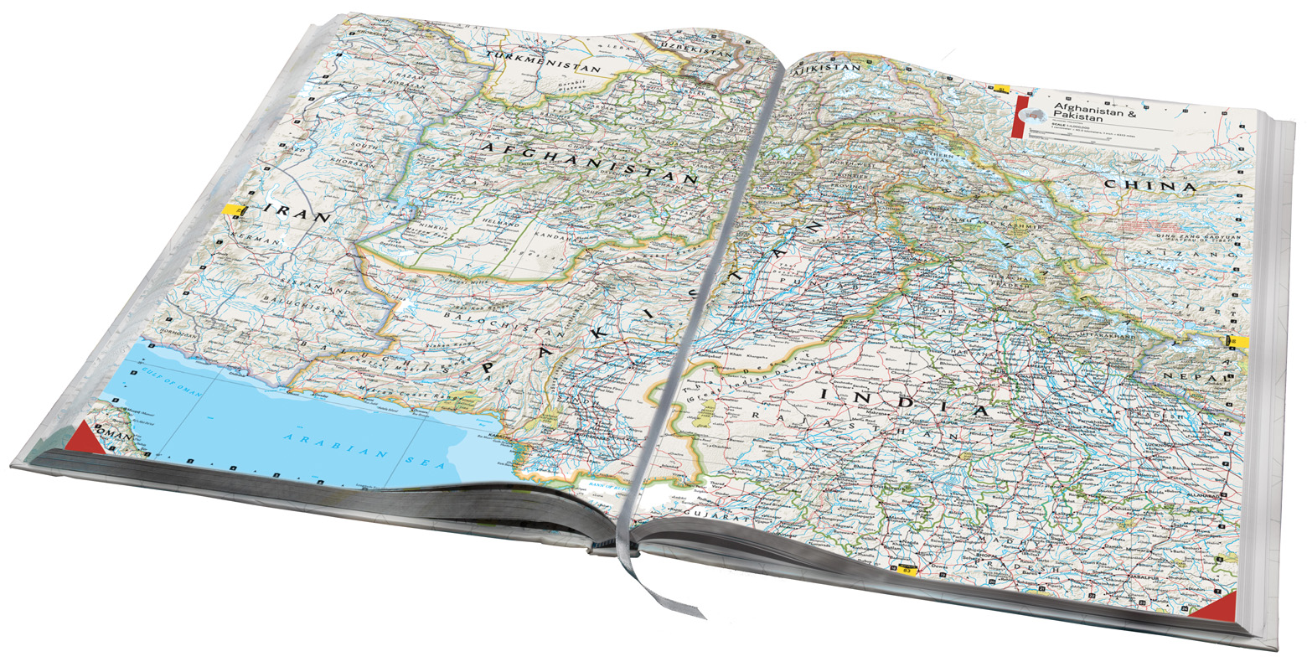
Reading as an adult
Notes:
This presentation by @TeacherToolkit ( Ross Morrison McGill ) and is licensed under a Creative Commons Attribution-NonCommercial-NoDerivs 3.0 Unported License. Based on all work published at www.teachertoolkit.me
@TeacherToolkit Limited.

Slide 33
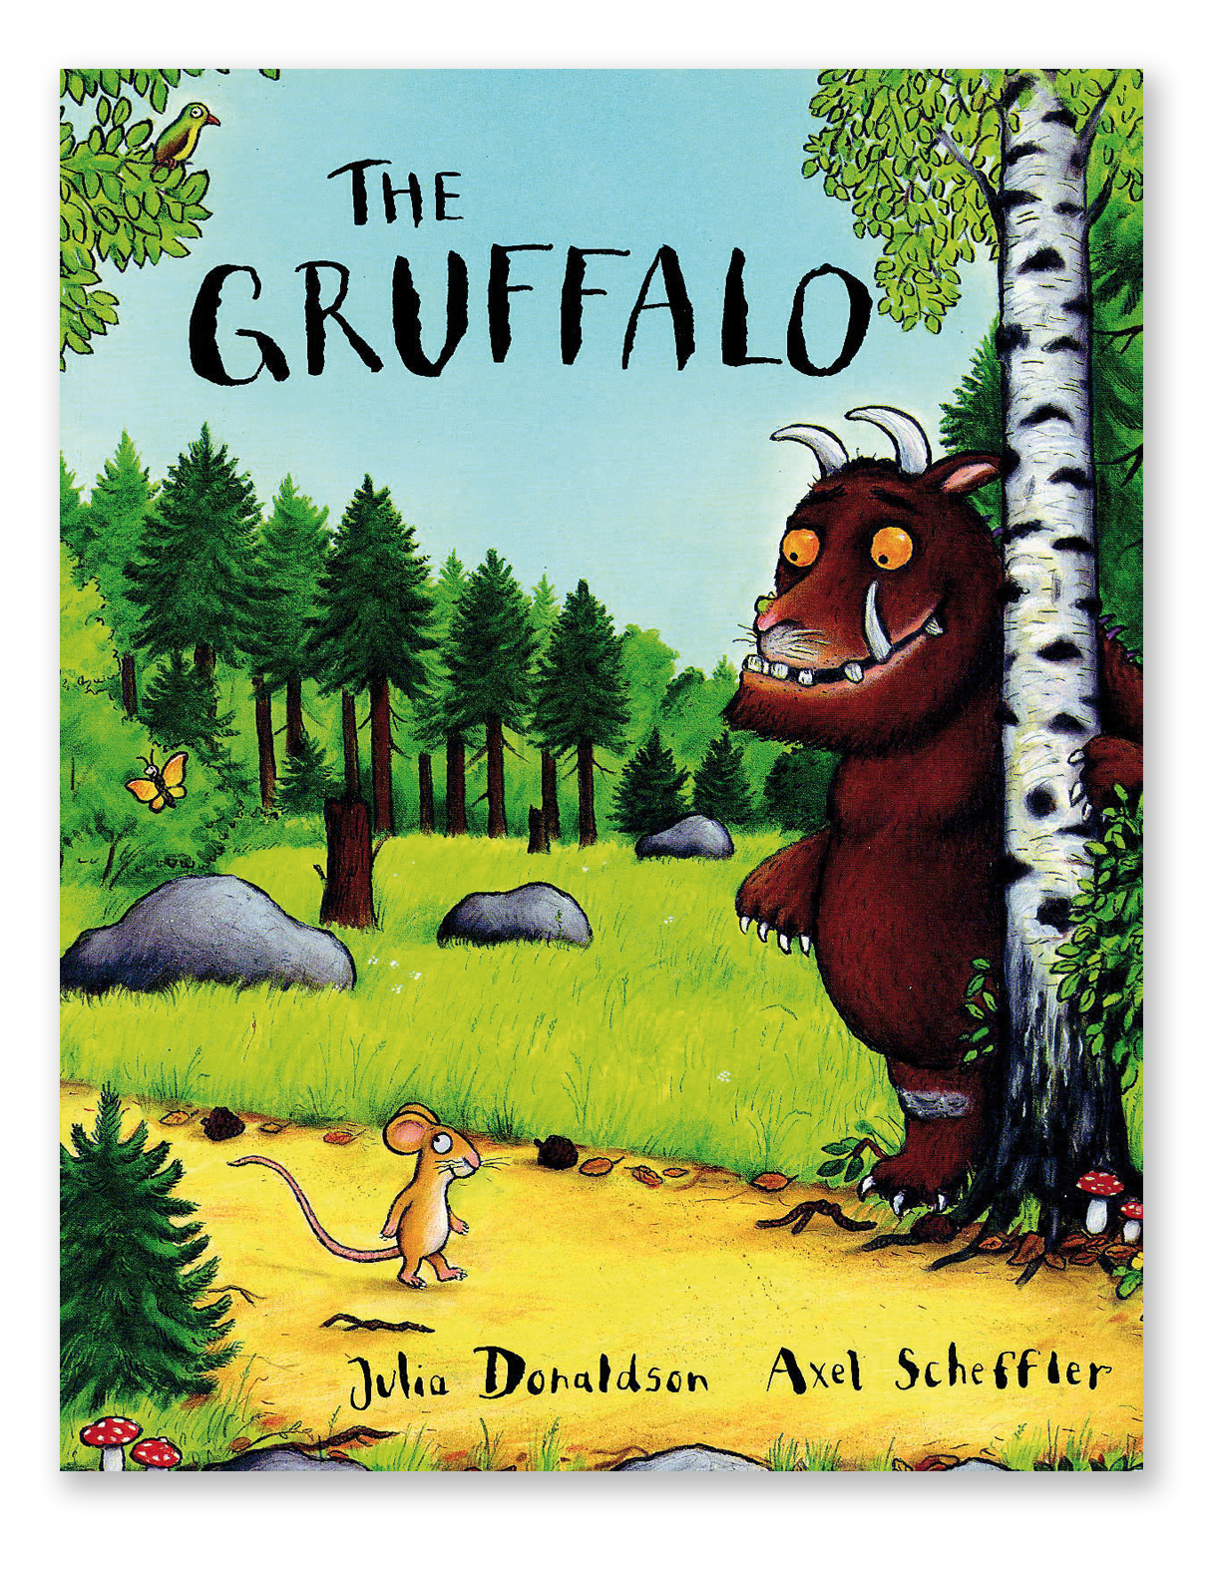
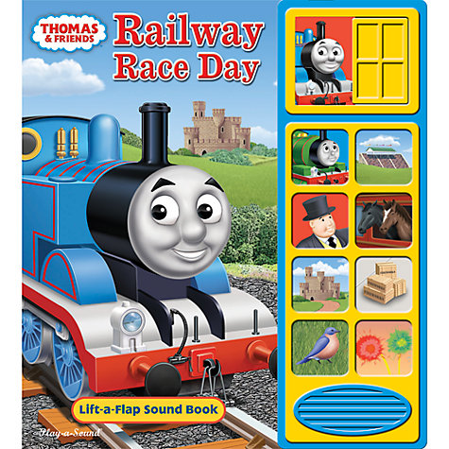
Reading as a parent
Notes:
This presentation by @TeacherToolkit ( Ross Morrison McGill ) and is licensed under a Creative Commons Attribution-NonCommercial-NoDerivs 3.0 Unported License. Based on all work published at www.teachertoolkit.me
@TeacherToolkit Limited.

Slide 34
At school
by
I loved spelling.
I needed reading intervention.
I disliked reading aloud in class.
I just scraped a (pass) grade C in English.
I studied English at A level and just passed!
Notes:
This presentation by @TeacherToolkit ( Ross Morrison McGill ) and is licensed under a Creative Commons Attribution-NonCommercial-NoDerivs 3.0 Unported License. Based on all work published at www.teachertoolkit.me
@TeacherToolkit Limited.

Slide 35
My own literacy skills
by
I would consider myself competent.
I would not consider myself confident.
So, I set myself targets – even today!
Notes:
This presentation by @TeacherToolkit ( Ross Morrison McGill ) and is licensed under a Creative Commons Attribution-NonCommercial-NoDerivs 3.0 Unported License. Based on all work published at www.teachertoolkit.me
@TeacherToolkit Limited.

Slide 36
Blogging = improves my literacy
Notes:
This presentation by @TeacherToolkit ( Ross Morrison McGill ) and is licensed under a Creative Commons Attribution-NonCommercial-NoDerivs 3.0 Unported License. Based on all work published at www.teachertoolkit.me
@TeacherToolkit Limited.

Slide 37
The Guardian
by
Notes:
This presentation by @TeacherToolkit ( Ross Morrison McGill ) and is licensed under a Creative Commons Attribution-NonCommercial-NoDerivs 3.0 Unported License. Based on all work published at www.teachertoolkit.me
@TeacherToolkit Limited.

Slide 38
Publication day.
by
My own book!
Notes:
This presentation by @TeacherToolkit ( Ross Morrison McGill ) and is licensed under a Creative Commons Attribution-NonCommercial-NoDerivs 3.0 Unported License. Based on all work published at www.teachertoolkit.me
@TeacherToolkit Limited.

Slide 39
What does this non-verbal image tell you?
by
Notes:
This presentation by @TeacherToolkit ( Ross Morrison McGill ) and is licensed under a Creative Commons Attribution-NonCommercial-NoDerivs 3.0 Unported License. Based on all work published at www.teachertoolkit.me
@TeacherToolkit Limited.

Slide 40
Reading to my own child
by
Notes:
This presentation by @TeacherToolkit ( Ross Morrison McGill ) and is licensed under a Creative Commons Attribution-NonCommercial-NoDerivs 3.0 Unported License. Based on all work published at www.teachertoolkit.me
@TeacherToolkit Limited.
Meet @FreddieWM

Slide 41
My favourite children’s story today
Notes:
This presentation by @TeacherToolkit ( Ross Morrison McGill ) and is licensed under a Creative Commons Attribution-NonCommercial-NoDerivs 3.0 Unported License. Based on all work published at www.teachertoolkit.me
@TeacherToolkit Limited.

Slide 42
Gruffalo is big and strong, but simple-minded and direct. He's not manipulative or evil – he's just very big and very hungry. And mice happen to be his favourite food.
Notes:
This presentation by @TeacherToolkit ( Ross Morrison McGill ) and is licensed under a Creative Commons Attribution-NonCommercial-NoDerivs 3.0 Unported License. Based on all work published at www.teachertoolkit.me
@TeacherToolkit Limited.

Slide 43
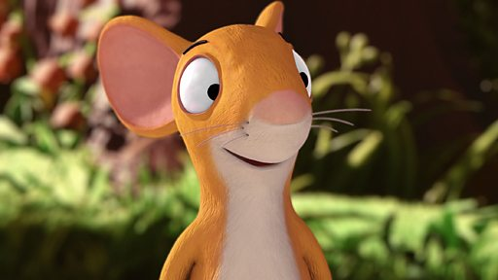
Mouse is clever, a fast learner and an optimist. He is cornered by 3 predators, Mouse invents the imaginary Gruffalo. The story gets him out of trouble.
Notes:
This presentation by @TeacherToolkit ( Ross Morrison McGill ) and is licensed under a Creative Commons Attribution-NonCommercial-NoDerivs 3.0 Unported License. Based on all work published at www.teachertoolkit.me
@TeacherToolkit Limited.

Slide 44
Fox thinks of himself as a charmer. He's not the brightest but is perfectly capable of seducing his prey and he's used to success.
Notes:
This presentation by @TeacherToolkit ( Ross Morrison McGill ) and is licensed under a Creative Commons Attribution-NonCommercial-NoDerivs 3.0 Unported License. Based on all work published at www.teachertoolkit.me
@TeacherToolkit Limited.

Slide 45
Snake is a cold-hearted eating machine. While one victim is in his mouth, his mind is already on his next prey.
Notes:
This presentation by @TeacherToolkit ( Ross Morrison McGill ) and is licensed under a Creative Commons Attribution-NonCommercial-NoDerivs 3.0 Unported License. Based on all work published at www.teachertoolkit.me
@TeacherToolkit Limited.

Slide 46
Owl is visibly past his prime, but he's in denial of that. Frail to look at, Owl is still murderous by nature.
Notes:
This presentation by @TeacherToolkit ( Ross Morrison McGill ) and is licensed under a Creative Commons Attribution-NonCommercial-NoDerivs 3.0 Unported License. Based on all work published at www.teachertoolkit.me
@TeacherToolkit Limited.

Slide 47
World Book Week
Notes:
This presentation by @TeacherToolkit ( Ross Morrison McGill ) and is licensed under a Creative Commons Attribution-NonCommercial-NoDerivs 3.0 Unported License. Based on all work published at www.teachertoolkit.me
@TeacherToolkit Limited.

Slide 48
Final reminder
by
10 to 16 year-olds
who read for pleasure do better at school.
Notes:
This presentation by @TeacherToolkit ( Ross Morrison McGill ) and is licensed under a Creative Commons Attribution-NonCommercial-NoDerivs 3.0 Unported License. Based on all work published at www.teachertoolkit.me
@TeacherToolkit Limited.

Slide 49
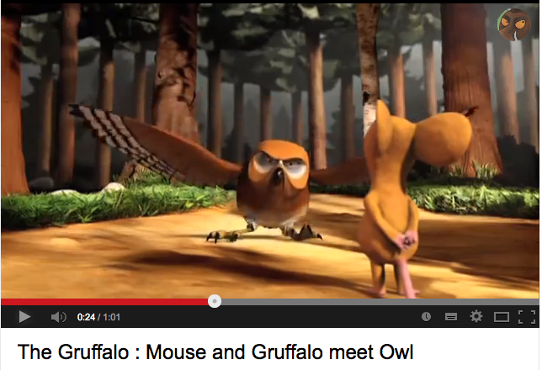
Watch
Owl scared: http://www.youtube.com/watch?v=SIqesEQtYAI
Notes:
Owl scared: http://www.youtube.com/watch?v=SIqesEQtYAI
This presentation by @TeacherToolkit ( Ross Morrison McGill ) and is licensed under a Creative Commons Attribution-NonCommercial-NoDerivs 3.0 Unported License. Based on all work published at www.teachertoolkit.me
@TeacherToolkit Limited.

Slide 50
End of presentation
by
Notes:
Blank slide

Slide 51
Video links
Owl scared: http://www.youtube.com/watch?v=SIqesEQtYAI
Mouse scared of snake (48 secs) http://www.youtube.com/watch?v=uVkuMsUYFw0
Elijah Wood; http://www.youtube.com/watch?v=eDzISc6o_Xs&index=7&list=PLbpi6ZahtOH6WqEc2d_xcPz0LXAbjfqUk
Year of Reading: http://www.youtube.com/watch?v=MSU1tgjcW8E
http://www.literacytrust.org.uk/about/faqs/filter/about%20literacy%20in%20the%20uk
Notes:
This presentation by @TeacherToolkit ( Ross Morrison McGill ) and is licensed under a Creative Commons Attribution-NonCommercial-NoDerivs 3.0 Unported License. Based on all work published at www.teachertoolkit.me
@TeacherToolkit Limited.

Slide 52
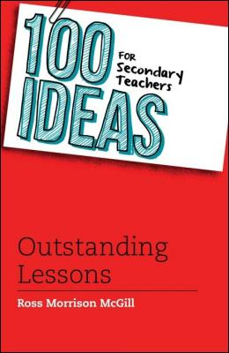
Thank you!
by
TeacherToolkit@me.com
@TeacherToolkit
www.TeacherToolkit.me
Notes:
This presentation by @TeacherToolkit ( Ross Morrison McGill ) and is licensed under a Creative Commons Attribution-NonCommercial-NoDerivs 3.0 Unported License. Based on all work published at www.teachertoolkit.me
@TeacherToolkit Limited.

