Slide 1
“A Few Ideas for Qualitative Research” Told through the medium of chocolate, sweets, crisps and selfies
“You mean qualitative research is valid too?!?”
Dr Carol Webb - @cazzwebbo
#SLTeachMeet @BELMASConf:
Research & Pedagogy
Stratford Upon Avon
Saturday 12th July 2014

Slide 2
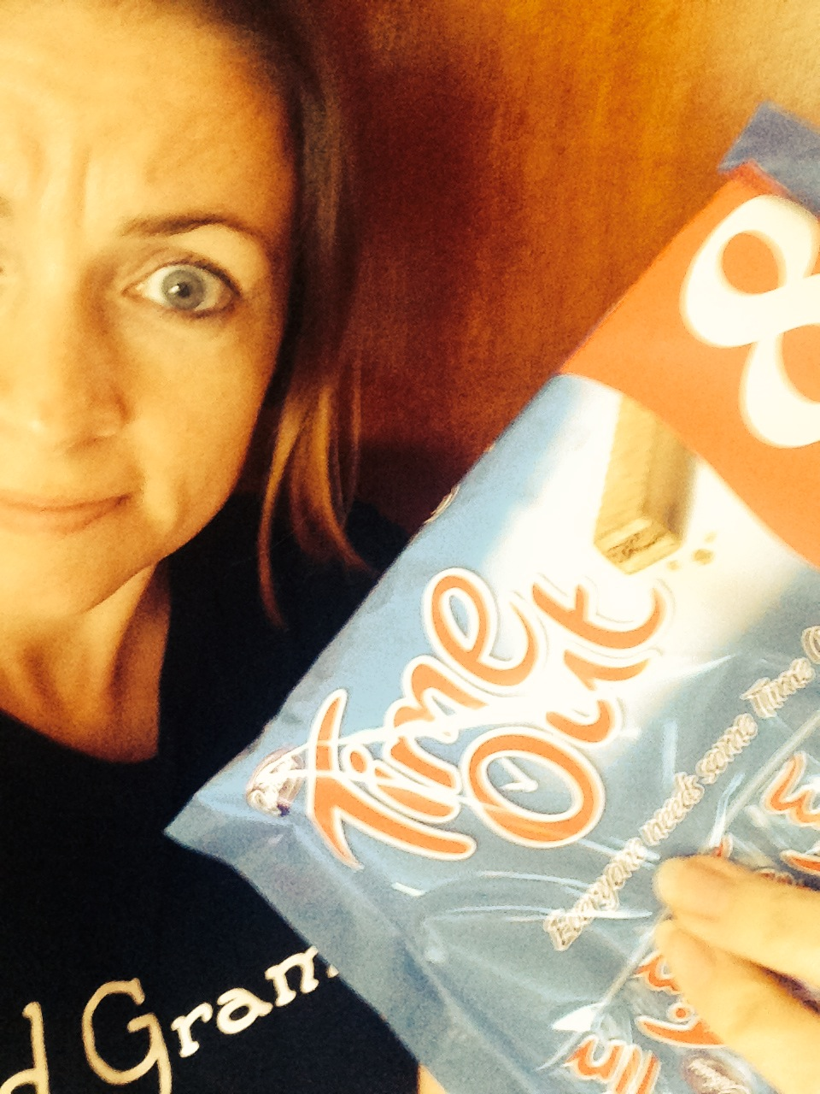
Research? As well as teaching??? You might need to take some…

Slide 3
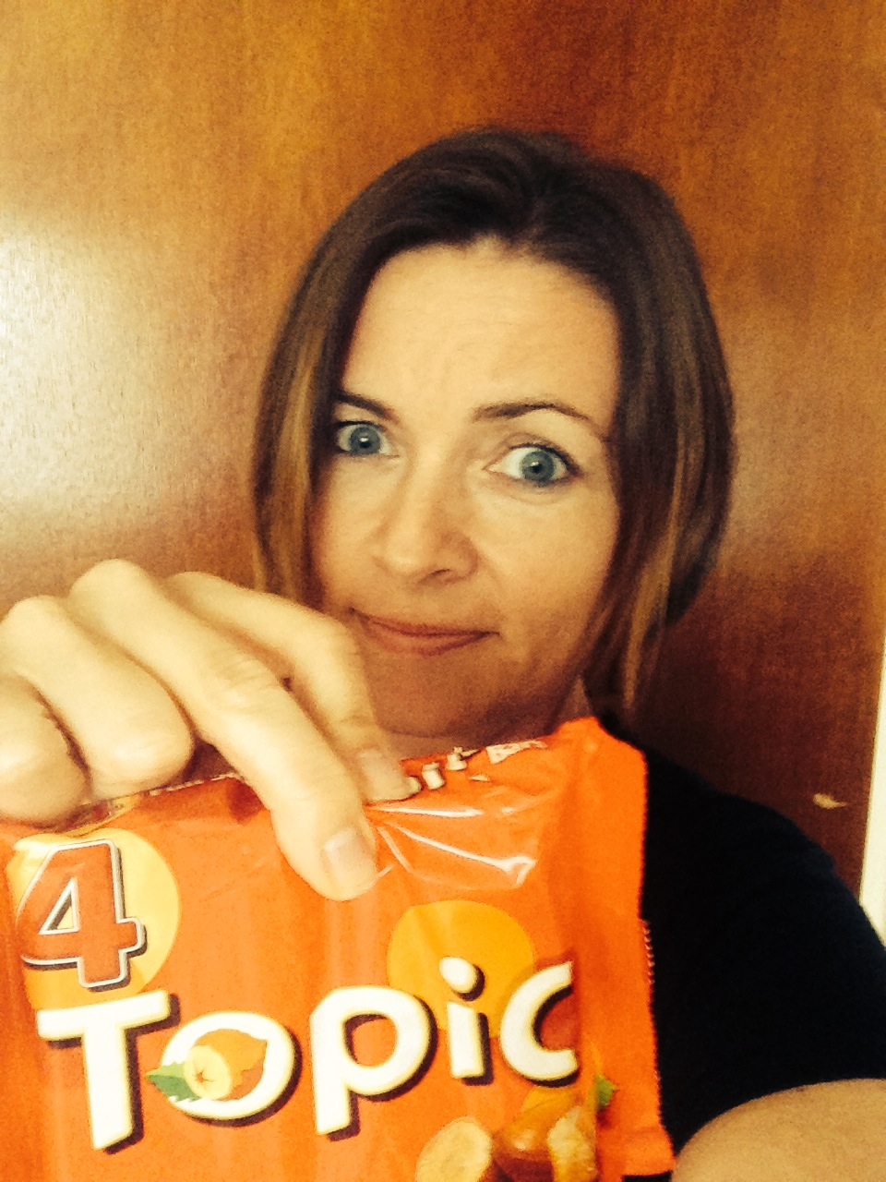
First things first… what’s your…

Slide 4
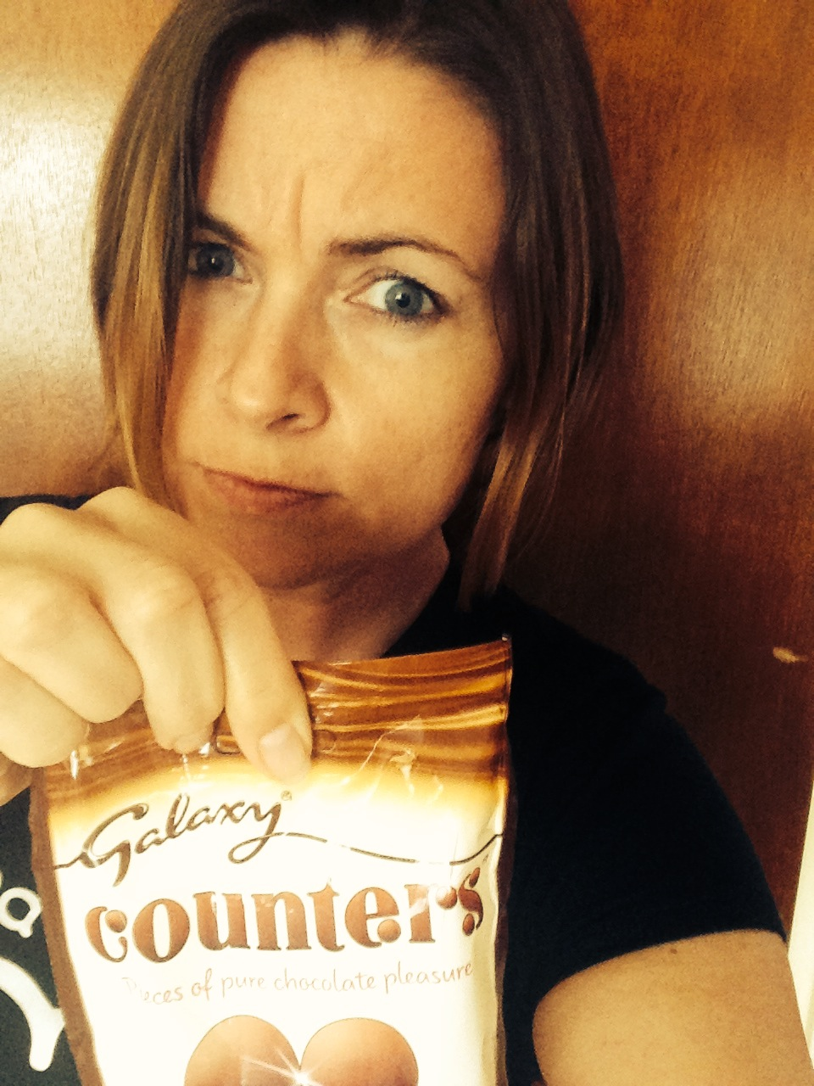
Your research question may well require quantitative research methods…

Slide 5
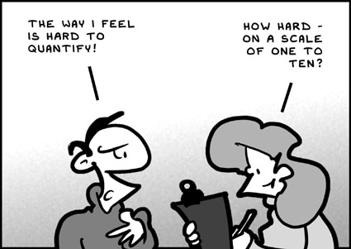
But equally, it may not!

Slide 6
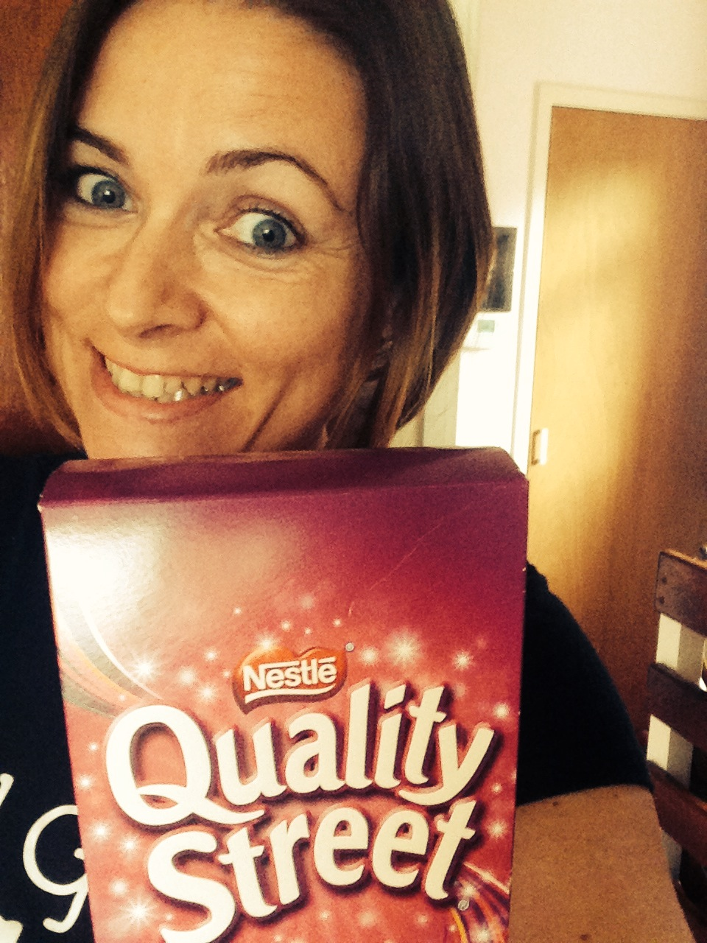
So maybe what you really need to do is use some qualitative research methods!!! Yey!!!

Slide 7
ALL research (qual or quant) has limitations, ads & disads

Slide 8
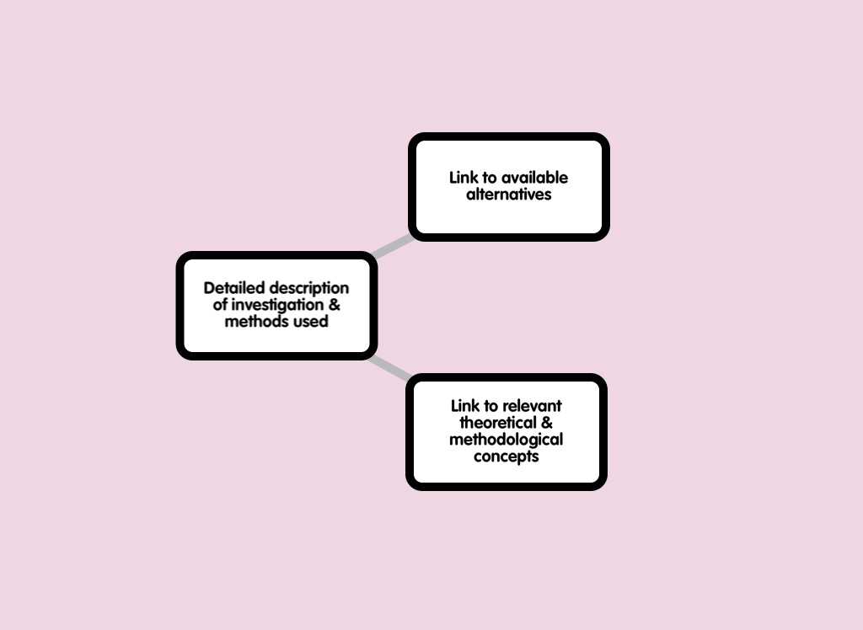

Slide 9
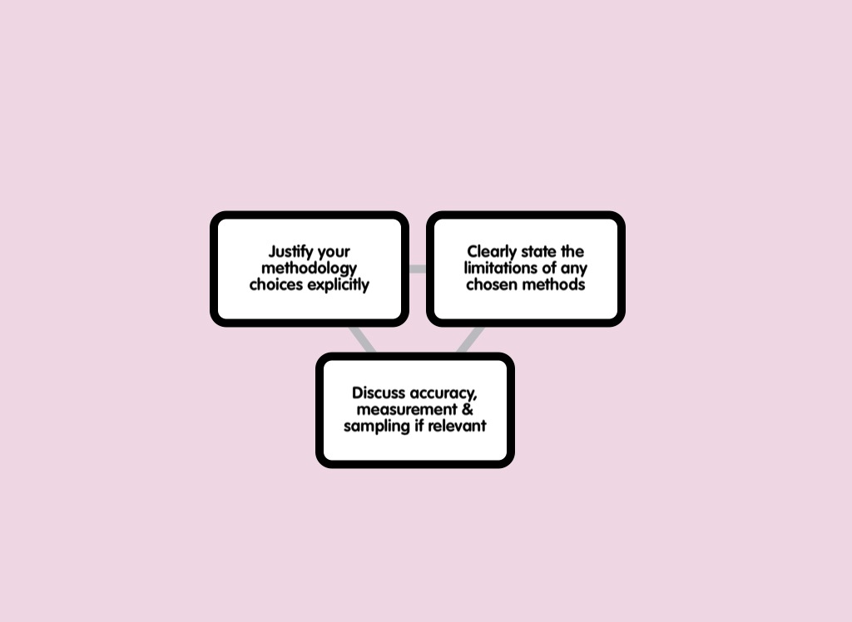

Slide 11
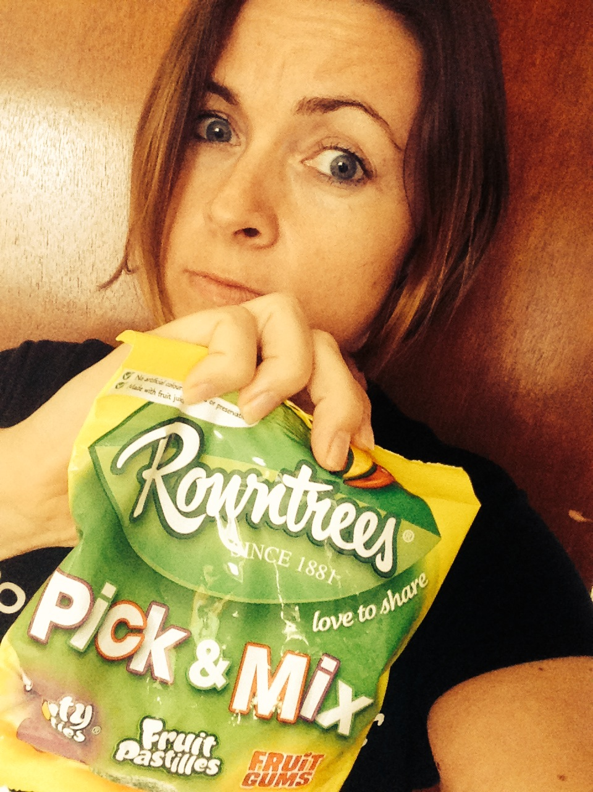
The more research methods you know about, the more you can…

Slide 12
If you work collaboratively in an interdisciplinary research team you could contribute to the…

Slide 13
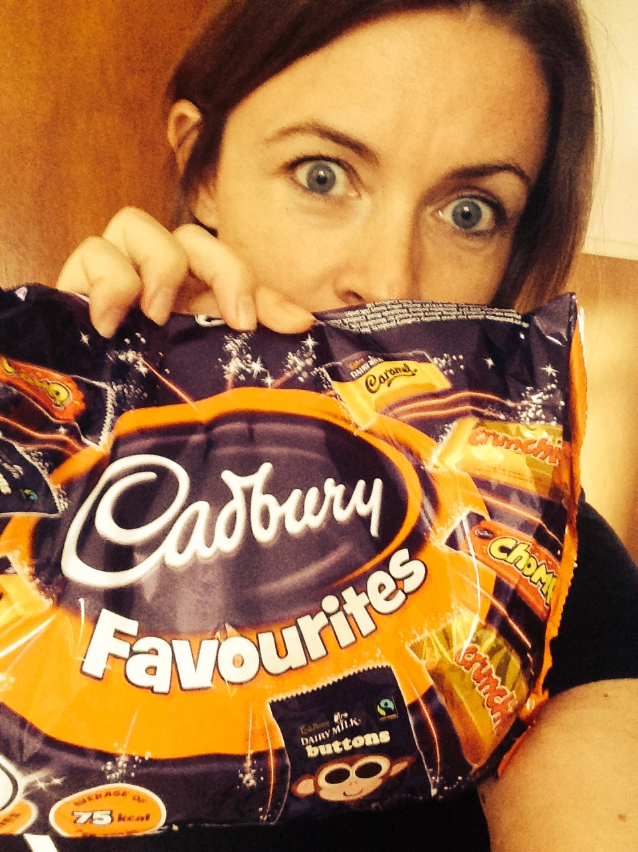
You can stick with your…

Slide 14
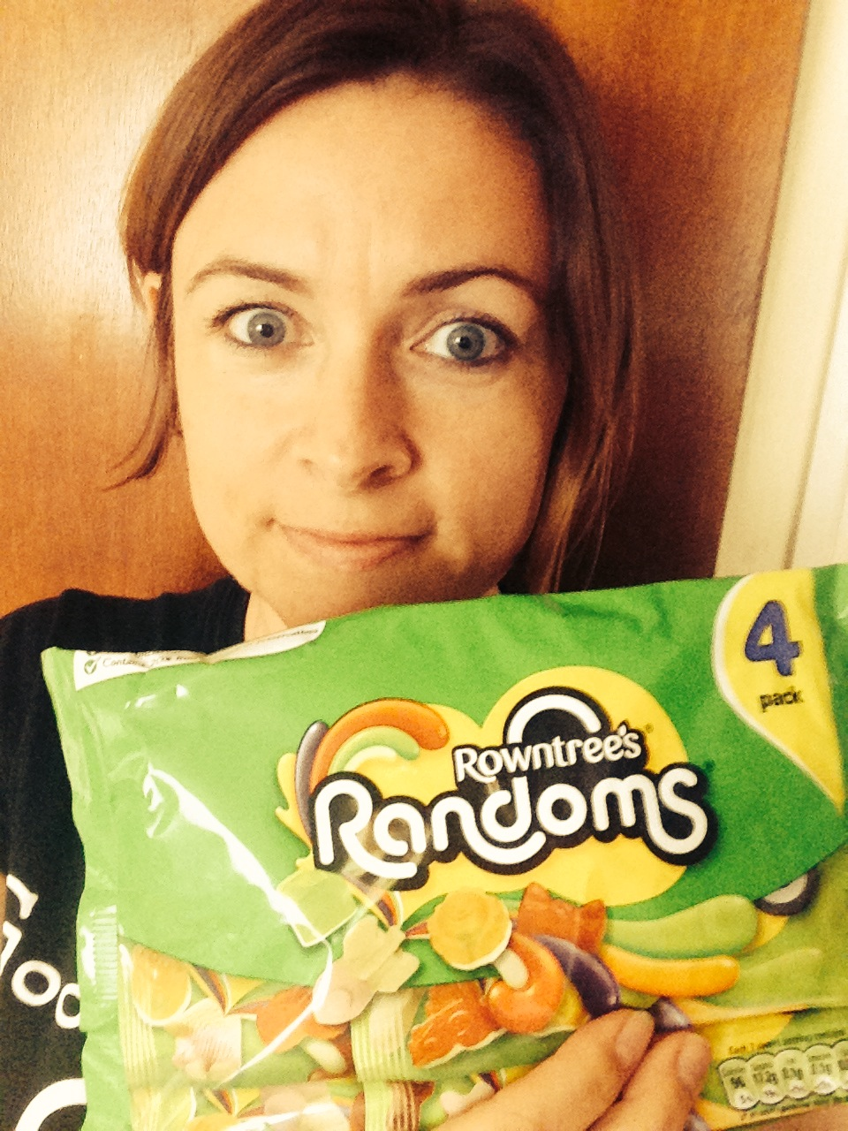
But you can introduce some…

Slide 15
Qualitative research can lead to …

Slide 16
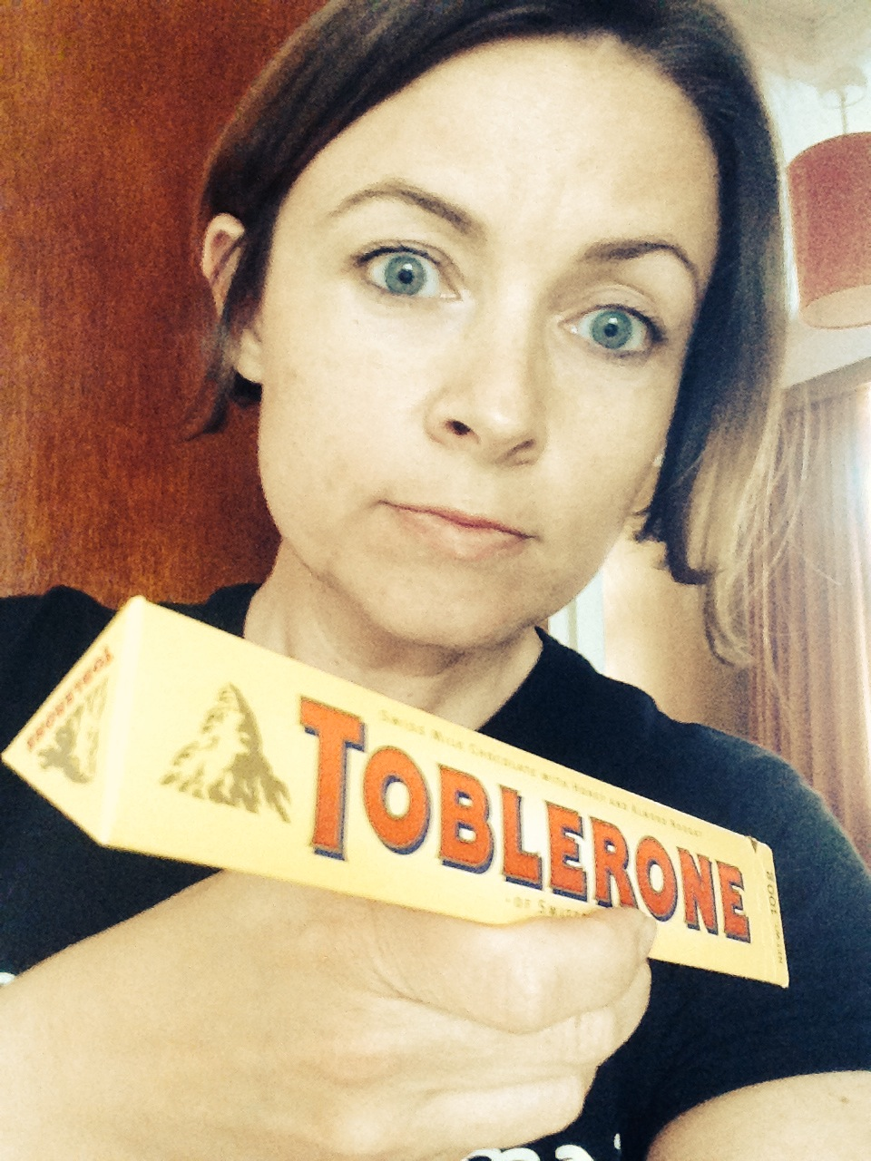
You’ll need to triangulate your findings to make sure they’re valid

Slide 17
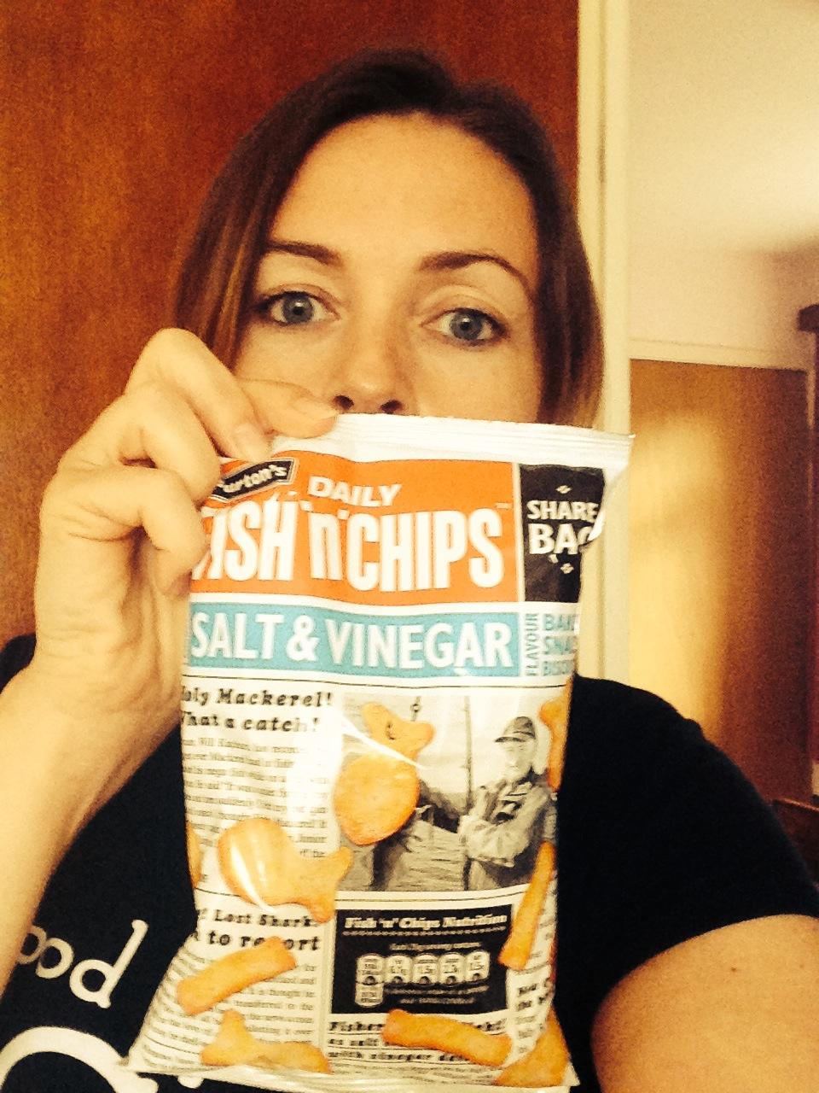
Don’t forget to disseminate your work and findings!

Slide 18
“A Few Ideas for Qualitative Research” Told through the medium of chocolate, sweets, crisps and selfies
“You mean qualitative research is valid too?!?”
Dr Carol Webb - @cazzwebbo
#SLTeachMeet @BELMASConf:
Research & Pedagogy
Stratford Upon Avon
Saturday 12th July 2014

