Slide 1
SLTeachmeet Teacher-led CPD
Jo Fairclough
Assistant Headteacher ~ Aldridge School
Affiliated to the EG Schools network
CreativeT&L@jkfairclough

Slide 2
Creating a research-rich climate – first steps
Encouraging staff at all levels to access educational research with a critical eye
To develop and support a range of form of research
Notes:
As a new and inexperienced member of SLT I have looked towards educational research to support me., I have read blogs, educational books, a few research papers. and started writing a blog too. It has opened up a real awareness to me role and the debate around educational research but ultimately it has provided a catalyst to many of the programmes we have developed at Aldridge School.
With the T&L team, I have been working this year to develop a research-aware climate. At present, our approach to research is still in the early stages and we see this year as our first steps. We are already a very good school whose motto is ‘Achieving Excellence’. The T&L team believe that creating a research-rich climate and providing increased opportunities to share best practice and research would be an important step. We are well-aware that this is a journey and this year we have made efforts to support staff to become ‘research-aware’. Therefore the two long-term goals we are working towards are as follows:
Encouraging staff at all levels to access educational research with a critical eye
To develop and support a range of forms of research

Slide 3
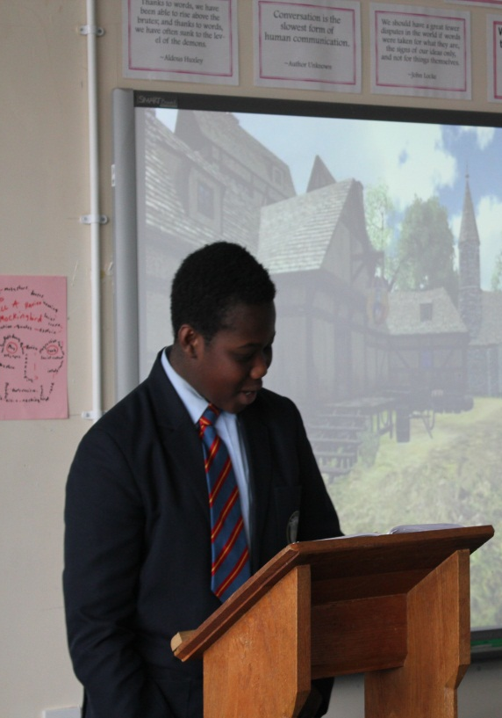
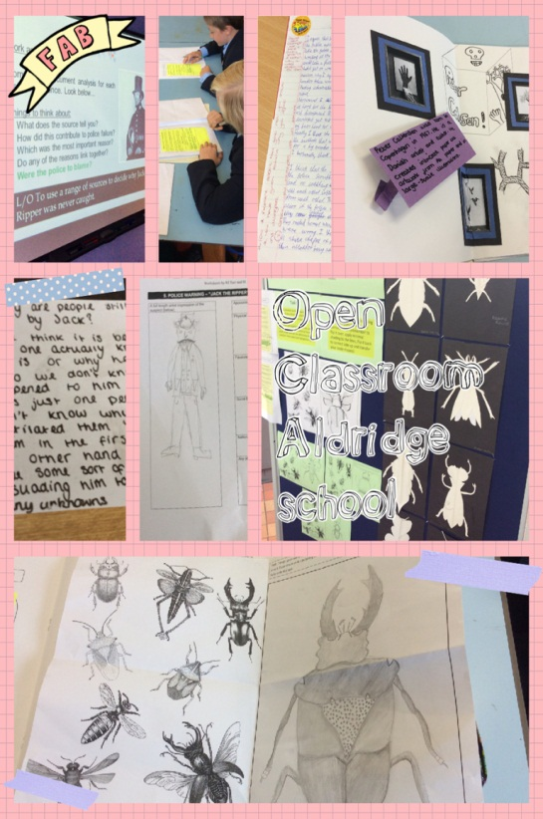
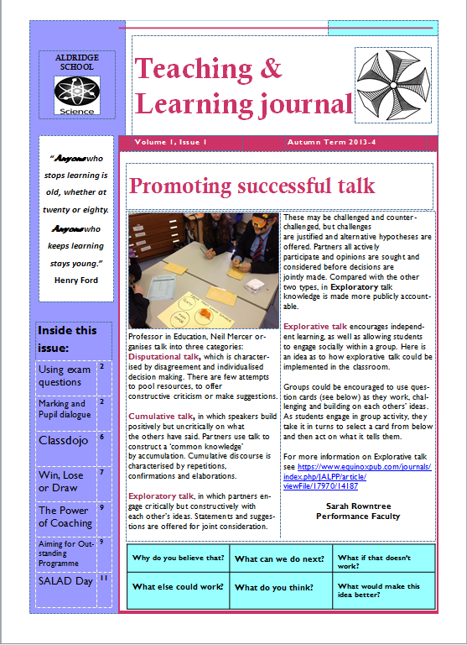
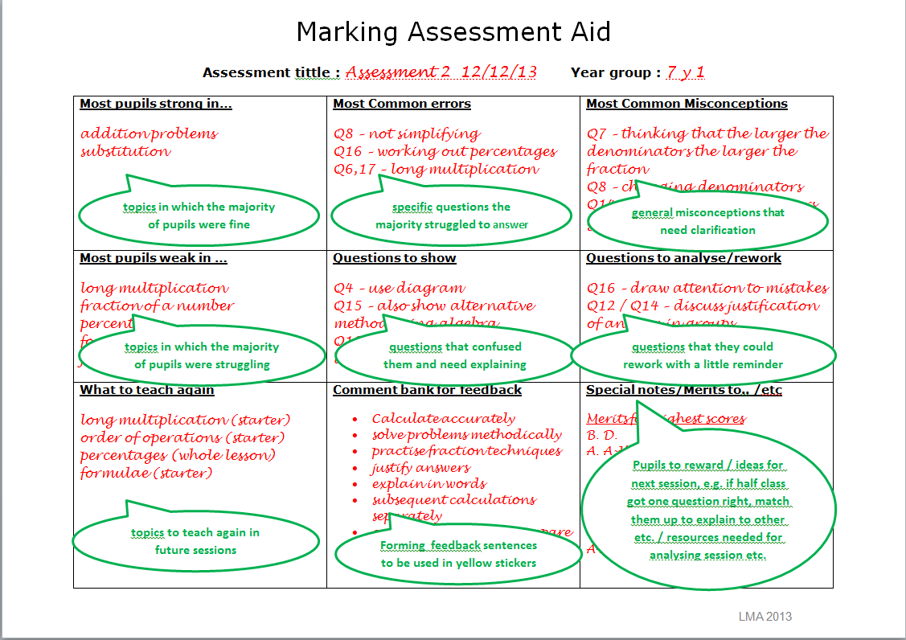
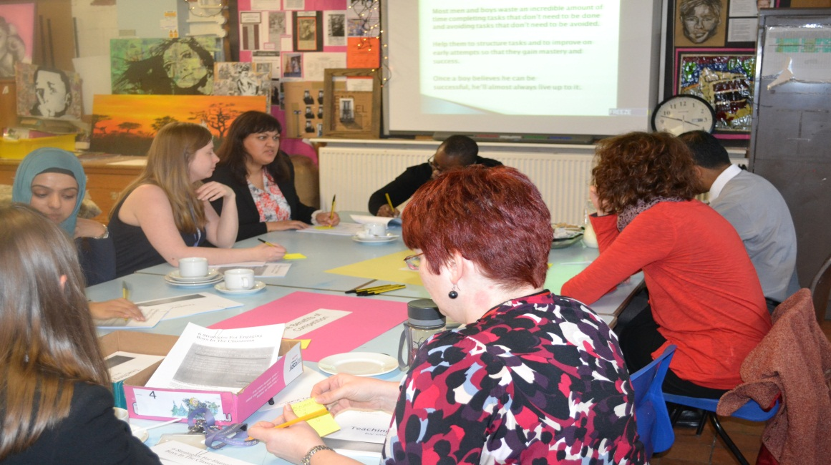
Notes:
Encouraging staff at all levels to access educational research with a critical eye
Introduced T&L journal to celebrate and share the learning of staff at Aldridge school. Although still in the early stages it provides an opportunity for staff to showcase reflective practice on areas such as reflections on the impact of our Speaking and Listening Active Development Days, Using student-led learning and improving student response to teacher feedback. Staff have also contributed references for further reading on key topics
To develop and support a range of form of research
All school leaders want to have good quality CPD that develops them as individuals. Clearly there are always a number of challenges associated with this, not least budgetary restrictions. Part of the programme I have led this year has focussed on developing opportunities for bespoke CPD so that through a variety of opportunities staff can select sessions that are relevant to their own needs. Short and long term impact statements are collated through Bluesky Education.
In 2013-4 staff could apply to be the Lead Learner for their faculty. Lead Learners have identified areas of development (or frustrations!) and used Faculty meetings as an opportunity to share key research and discuss the impact. Staff have also been approached and can volunteer to lead a Tea-time taster which are held every month based around their own projects. TTT are an opportunity again to share an overview of their work and its impact along with practical applications for the classroom.
This is a brief summary of the work of our Maths Lead Learner has focussed on developing strategies to ensure that marking informs planning. She developed this resource so while the Faculty are marking assessments notes can be made on common misconceptions and strengths. This way teacher notes are organised and ready to use. Students have been more clear on the individual progress they are making and it has increased the number of students reaching their target as student shave the opportunity to evaluate their work and rework some questions they couldn't answer before. From a teacher’s point of view the marking aid focusses any analysis or revision you are doing with a particular class as it addresses problems specific to this class. It is also handy to have for future planning where you might not remember very well exactly how each class did. The recommendation is that the marking aid is embedded into Faculty practice so it can be used to adapt SoL and assessment tasks.

Slide 5
Creating a research-rich climate – next steps
Development of OLC’s
Appointment of T&L Coaches
Use of DEAR
Notes:
Staff at Aldridge School have been able to apply for a one year role as a ‘T&L Coach’ which replaces the Faculty Lead Learner post. This whole-school role has been structured using a TLR 3 payment and, while it does include an aspect of supporting staff through coaching, a significant element of the role will focus on developing effective approaches to teaching and learning in a specific area. This will be done by leading an Outstanding Learning Community. OLC’s are part of our bespoke CPD which focusses on being targeted, collaborative and evidence-based. OLC’s are semi-autonomous learning bodies; each one focussed on a strand of T&L. Staff will select a strand of T&L to develop as part of these enquiry projects which will meet during Twilight time.

Slide 6
School based enquiry projects 2014-5
Jamie Lowe (Art) – Developing a growth mindset approach across the curriculum
Dave Wright (P.E.) – Developing the use of FROG throughout the school
Nichola Heeley (English) – Using questioning to measure student progress
Donna Edwards (IT) Using DIRT to close the gap
Notes:
The following projects will form part of our Outstanding Learning Communities in 2014-15
Findings will be shared through a T&L blog that will go live in September as well as through a specific Twitter account. Intend for our T&L journal to be available via iBooks.
We plan for the final Twilight of the year to be a Teammeet style whole-school event where staff and groups can share their journey,, their challenges, the impact and recommendations for further research and practice.
I’m looking forward to the ways my school can inspire our staff to become engaged with and in , research. I am no research expert myself and have a lot of summer reading to do. We are well aware that our programme will not be perfect the first time round but we are committed to what we want to achieve: a school where research evidence can highlight our successes, failures and move us towards our goal of excellence.

