Slide 1
Researchers and practitioners –
stronger together.
Vivienne Porritt
Director: School Partnerships
vivienne.porritt@ioe.ac.uk
www.ioe.ac.uk

Slide 2
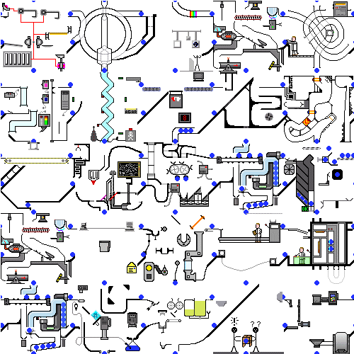

Slide 3
A ‘litany of barriers’ (Smedley, 2001)
‘A lot of academic research is disconnected from what is needed on the ground’ Christina Hinton, Harvard, 2014 | ‘The research projects and reports that schools value don’t help my career opportunities’ Researcher
‘We need flexibility, adaptability and a focus on school priorities’ School A, Headteacher | ‘We realised we talked a different language: we had to develop a shared understanding of our respective needs’ School A, Researcher

Slide 4

Conditions for success
All voices are heard, are equal and
respective strengths are valued
Identification of shared priorities and creation of shared (new) culture that enables creative ways of working.
Leaders shape partnerships that
overcome the cultural and practical
barriers
Agreed evaluative approaches to
evidence the impact of the partnership

Slide 5
Vision for practitioners
Rigorous, practice-focused research that transforms practice and professional and student learning
and supports professional career structures

Slide 6
Vision for researchers
Research that has a demonstrable impact for practitioners and students and that supports academic career structures

Slide 7
Stronger together
How do we make sure
that we are not here in
5/10 years’ time, asking
the same questions
again?

Slide 8

Stronger together

Slide 9
Excellent teachers….
...monitor impact on learning, adapting lessons as a result- rather than expecting pupils to keep up regardless of circumstances
...use evidence about what each pupil knows and understands to inform teaching interventions
...target assessment and teaching practices to maximise the information obtained about teaching and so optimise the chances of improving learning
...continuously evaluate the impact of their teaching, to inform next steps
Chris Husbands, Director. IOE

Slide 10
At the IOE…
‘No more ivory towers’: research project in partnership with four schools: launch Sep 2014
Synthesis of SUPI, RCUK
IOE R&D network: launch Sep 2014
Research newsletters and digests
Research Advisory Service
Masters module: Leadership of research
Shared school/IOE staffing models
EEF project for primary schools: Research
Learning Communities
IOE School Partnerships Awards: R&D
Specialist Partner

Slide 11

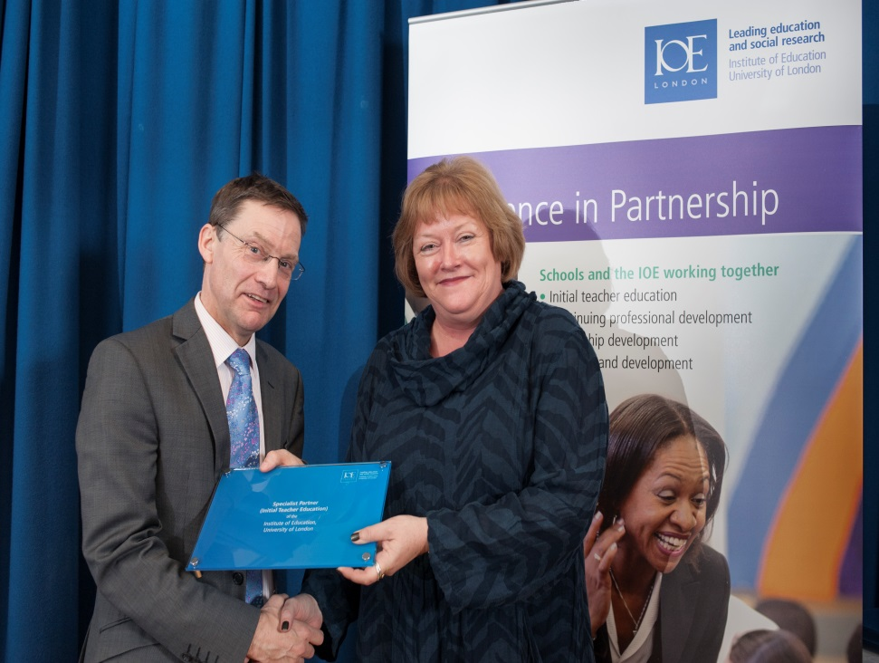
IOE School Partnerships Awards
Contact:
Chris Brown - c.brown@ioe.ac.uk
Contact:
Vivienne.porritt@ioe.ac.uk
www.ioe.ac.uk/school partnerships www.ioe.ac.uk/research

Slide 12
Stronger together: Knowledge creation
Tacit
Tacit
Classroom practice | External knowledge
Internalise and apply new knowledge | Combine and test practice and external knowledge
Tacit
Explicit
Tacit
Explicit
Explicit
Explicit
Adapted from Nonaka and Takeuchi (1995)

Slide 13
Stronger together: R&D network
Tacit
Tacit
Embed new classroom practice | External knowledge
Internalise and apply new knowledge | Combine and test practice and external knowledge
Tacit
Explicit
Research
Research impact of new knowledge
Tacit
Explicit
Explicit
Explicit
Adapted from Nonaka and Takeuchi (1995)

Slide 14
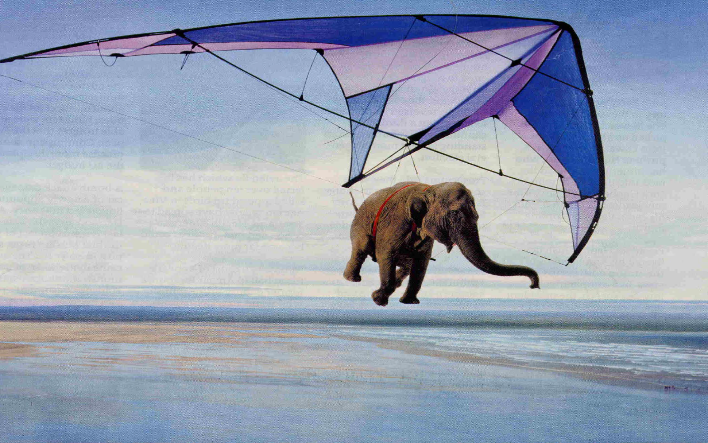
Stronger together: optimism

Slide 15
Researchers and practitioners –
stronger together.
Vivienne Porritt
Director: School Partnerships
vivienne.porritt@ioe.ac.uk
www.ioe.ac.uk

