Slide 1
Management with colours
Making progress visible
Presentation at #SLTeachMeet
12th July 2014
Kev Lister - @ListerKev
Blog http://bit.ly/ListerKev

Slide 2
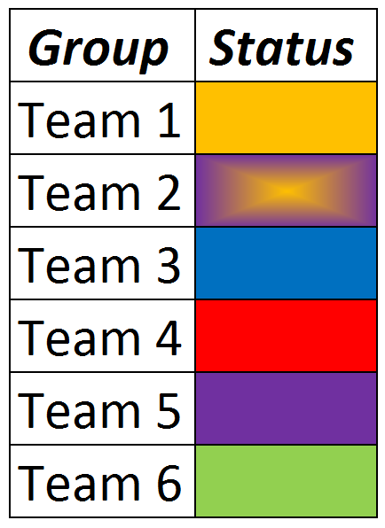
Which team would you be the most/least proud to be part of?
Colours are emotive
Even without a key we make judgements
No data to interpret
Loads of psychological theories about colour & impact on feelings
Make use of this to drive progress without confrontation
Experience shows it works both in industry and education

Slide 3
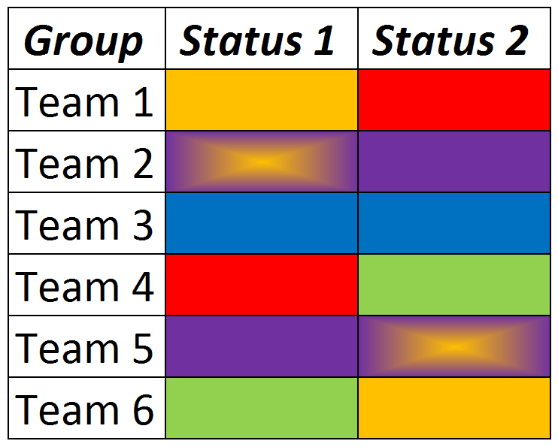
Who’s making progress?
Progress driven by natural competition
Minimal challenge required
Applications:
Report completion
Budgeting
Almost anything!

Slide 4
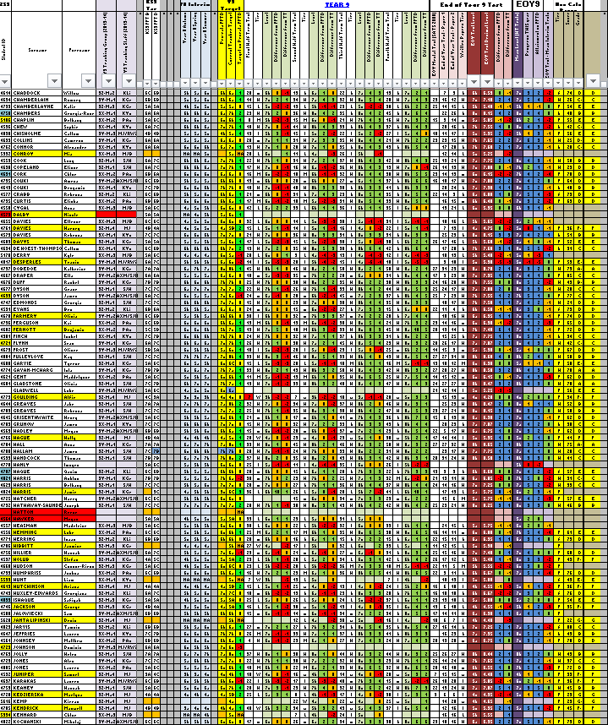
Colours in tracking documents
Highlights key points and makes comparisons quicker.
Encourages teachers to benchmark their performance with others
Makes patterns and trends easier to see

Slide 5
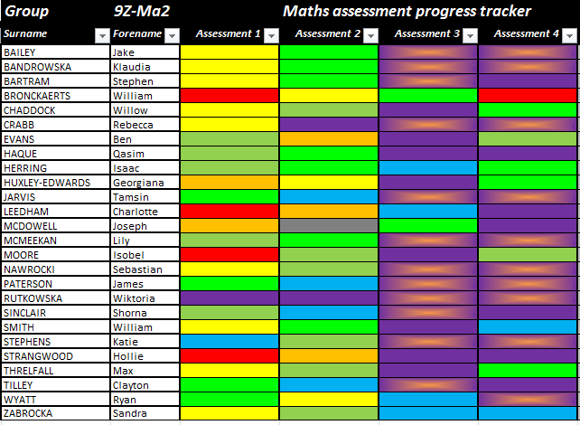
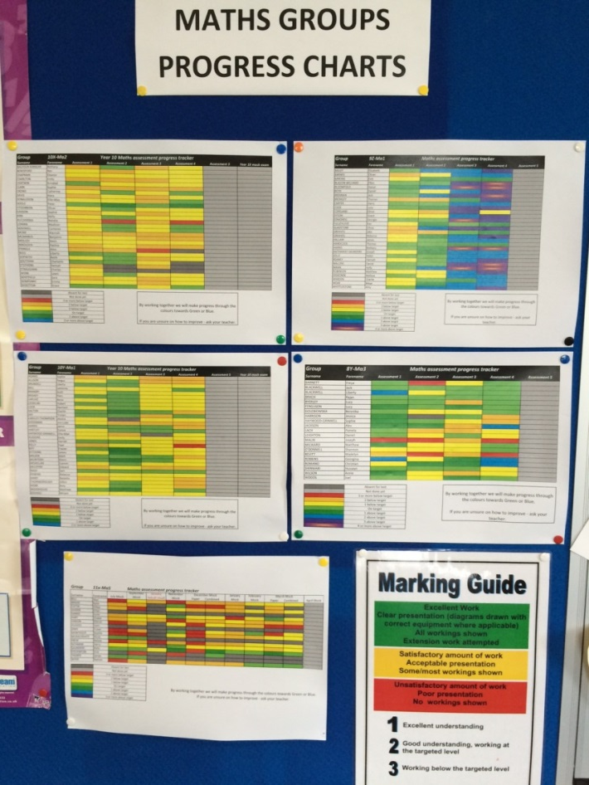
Colours in the classroom
All our maths classes have a progress wall

Slide 6
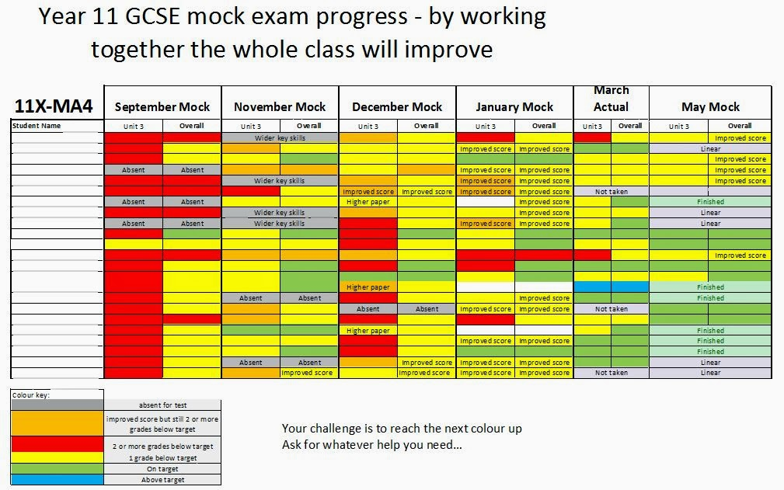
Colours in the classroom
Makes progress visible to students and teacher
Sometimes progress is non-linear
Provokes DIALOGUE and ACTION

Slide 7
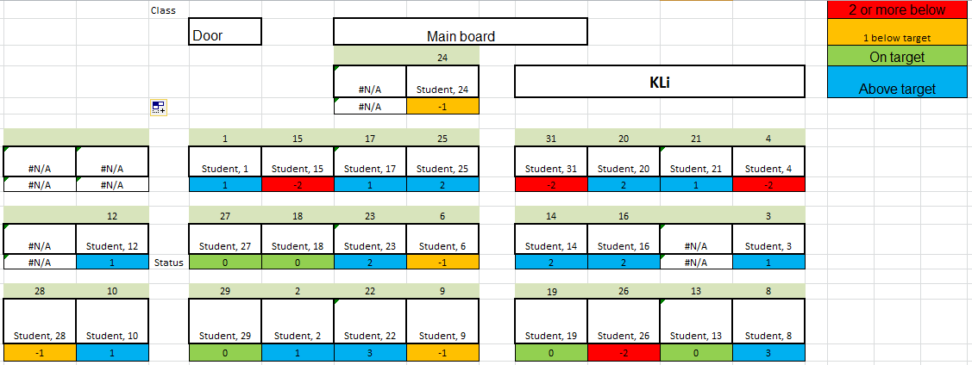
Colours in the classroom
Use colour to help with seating plans (both setting up and then reviewing)
Easy to see how stronger/weaker students are distributed
Template for plan available here: http://bit.ly/SeatingPlan

Slide 8
Colours in the classroom
#RAG123
WAY more than just traffic lights
Colours = Effort (under student control)
Numbers = Undertstanding (under teacher control)
Provokes discussion of student effort
82.5% of users report improved effort and/or attainment from their groups
More info on #RAG123 here http://bit.ly/RAG123blog

Slide 9
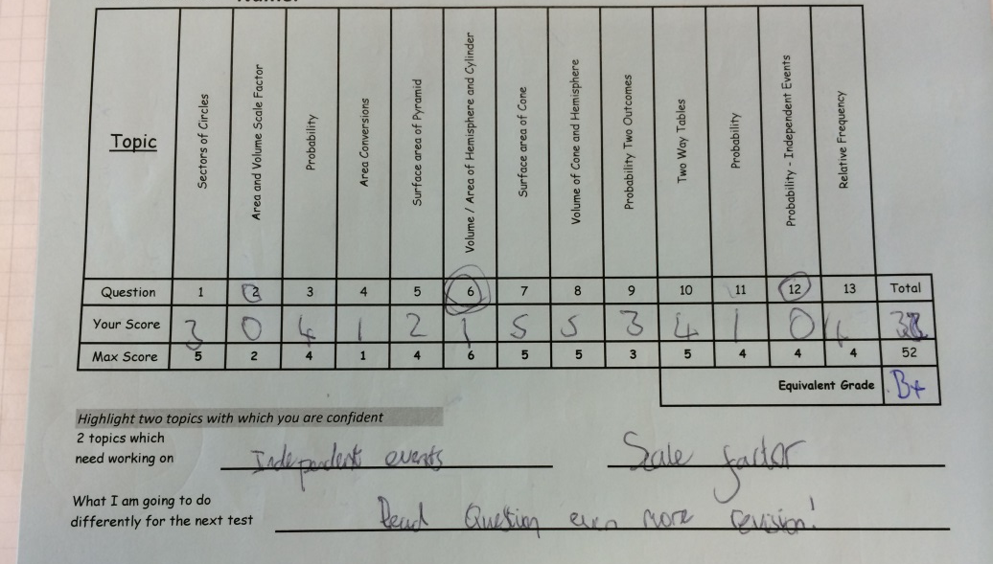
Colours in the classroom
Colour coding of information for students.
Green = feedback
Blue = self assessment
Yellow = information

Slide 10
Next steps
Investigate Psychological background – to inform and develop practice further
Develop progress charts, seating plans, RAG123 further
Other thoughts:
Studies suggest that exposure to a Sky blue colour improves cognition and perceived alertness… What colour are your slides?

Slide 11
Questions, thoughts, comments
Always welcome…
Tweet: @ListerKev
Blog: http://bit.ly/ListerKev

