Slide 1
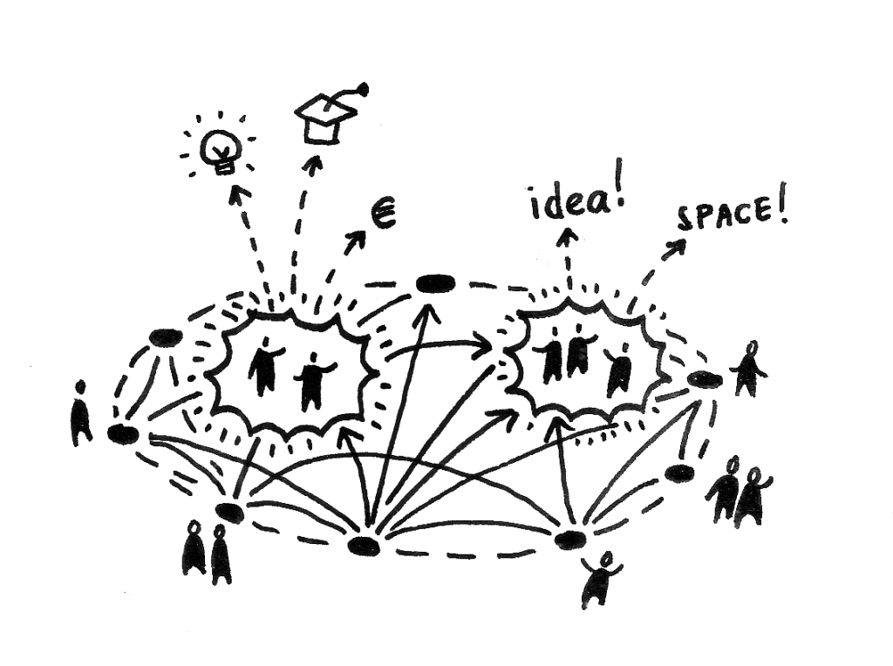
Lessons in Serendipity My EdD journey
Emma Kell
Assistant Principal , Francis Combe Academy, Watford
Supervisor: Professor Paul Gibbs, Middlesex University

Slide 2
Shifting Identities: A Mixed-Methods Study of the Experiences of Teachers who are also Parents
Key research question:
What is the influence of parenthood on teacher identity, effectiveness and well-being?
Subsidiary questions:
What are the factors, at micro, macro and meso level, that affect teacher-parent identity?
Which practices and policies are effective in promoting well-being and effectiveness of teacher-parents and how could policy be further developed in this area?

Slide 3
Writing my life!
Personal
Teacher-parent, family
Social network
Academic
BA, MA
Education
EdD Year 1
Professional
Teaching Management
Other ‘hats’
Nurturing role
Writing for impact
EdD
Questions
Learning Curves
Notes:
Personal – 5 years as a teacher-parent, writing as self-expression, desire to ‘make a difference’
Professional – learning curves, constant re-evaluation, relationships and contacts, adults and children – well-being and effectiveness
Academic – background in existentialism the nouveau roman, the Berlin Wall – philosophy meets practicality. Emphasise EdD Year 1 – Grounding for further study. Steep learning curve. Getting to grips with academic standards and principles (always someone to disagree / agree! Make your case strongly etc.)
EdD – change to bring it all together – blurrring boundaries and reducing polarities – theme of the research!

Slide 4
Teacher Identity, Teacher Wellbeing
Teachers have hearts and bodies, as well as heads and hands, though the deep and unruly nature of their hearts is governed by their heads, by the sense of moral responsibility for students and the integrity of their subject matter which are at the core of their professional identity. They cannot teach well if any part of them is disengaged for long. (Nias, 1996, p.305)

Slide 5
Theoretical model
INFLUENCES ON TEACHER-PARENT IDENTITY
Meso: school policy, procedures, networks
Personal identity and values
Micro: professional relationships and values
Macro: political, cultural, historical
Barriers, conflicts
Enablers, role-enrichment
Model based upon Bronfenbrenner’s Ecological Theory (1979) – my interpretation

Slide 6
Rethinking identity (and rethinking and rethinking)
Researcher as pragmatist
Ontological assumptions: Reality relative, fluid, constructed by social actors.
Both singular and multiple realities
Epistemological assumptions:
Validity and truth are subjective and multiple. Research findings are created through interaction. Practical impetus.
Rhetorical assumptions: ‘I’ as central to the research process; acknowledge bias, insider research
Axiological assumptions:
Values of researcher as teacher and educator. Impact on students as ultimate driving force. Desire to ‘make a difference’.
Notes:
Galt
Talk about Pragmatism – brings together experiences as academic and teacher
Acknowldge criticisms of pragmatism: Importance of relations theory / methods / data – advises retaining some elements of the dichotomy ‘to guard against a creeping pragamatism and an absence of theoretical perspective (Brannen p.33) – DANGER.

Slide 7
Methodologies and Methods

Slide 8
Emerging Findings… and Exciting Opportunities

Slide 9
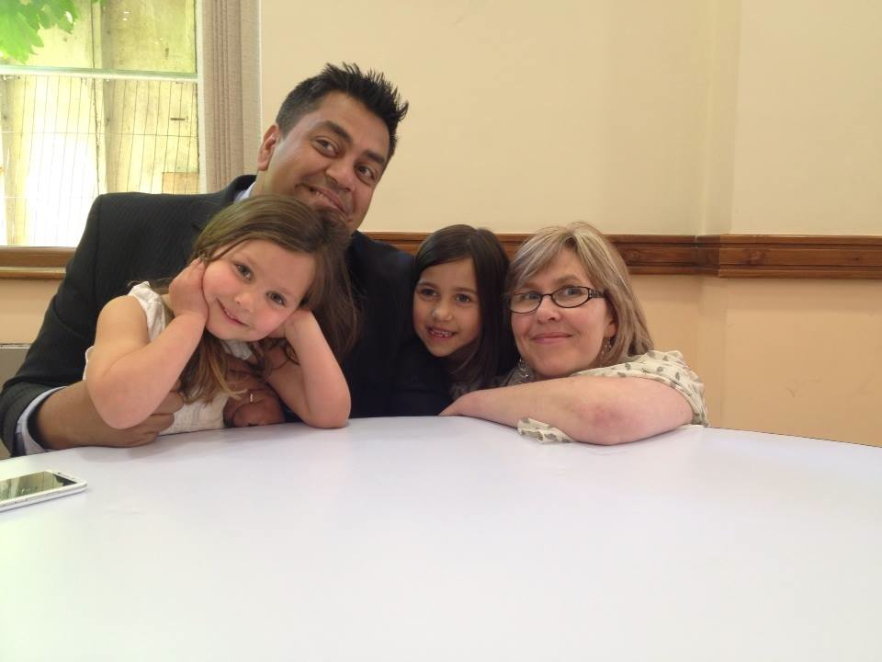
Impact?

Slide 10
Teacher Support Network
First publications….
Relational Schools
http://relationalschools.org/being-a-teacher-being-a-parent-is-being-good-enough-good-enough-part-1/
Teacher Support Network
http://www.teachersupport.info/blog/30-april-2014/balancing-teaching-and-parenthood#.U53fx5SwJXA
The Guardian (on my research)
http://www.theguardian.com/teacher-network/teacher-blog/2014/may/09/internet-addiction-young-people-exams-happiness
The TES
http://www.tes.co.uk/article.aspx?storyCode=6430086
The Guardian (by me!)
http://www.theguardian.com/teacher-network/teacher-blog/2014/jun/18/joining-new-senior-leadership-team-the-dos-and-donts

Slide 11
Bibliography
Kozinets, R.V. (2010). Netnography : Ethnographic research in the age of the internet. Thousand Oaks, CA: Sage.
Nias, J. (1996). Thinking About Feeling: The Emotions in Teaching. Cambridge Journal of Education 26(3), 293–306.

Slide 12
Contact info
Follow me @thosethatcan
Or email: emmakell@me.com

