Slide 1
Powerful Professional learning
NTEN
Helping young people to succeed, and helping us to thrive
National Teacher Enquiry Network

Slide 2
School professionals are amazing…
Awareness of effective ideas, techniques and approaches
Ability to recognise/ diagnose suitability of approaches, and when they are not working
Ability to adapt, vary, combine and refine approaches
Understanding of underlying theory - solid conceptual understanding
Fluency - instinctive recall and use of appropriate techniques
Systematic and sustained use of approaches
Ability to reflect on (and assess) own learning progress
Recognition of student behaviours and patterns of likely future behaviour
Increasing emotional self-regulation
Notes:
There are a number of things we need to consider about effective professional learning.

Slide 3
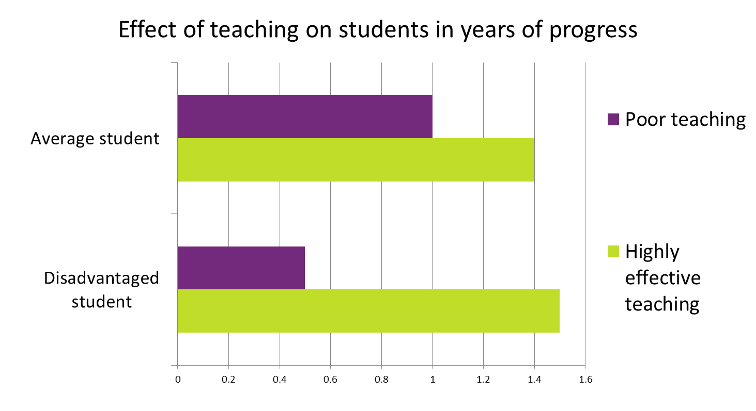
Why does professional learning matter?
Source: Sutton Trust (2011)
Notes:
Why should we improve the quality of teaching? This research from the Sutton Trust shows us that the more disadvantaged the learner, the more they stand to lose, or gain from varying teaching quality. This speaks to our mission as teachers – to help the most vulnerable we need to improve our practice.

Slide 4
What can great Professional learning do…
… for teachers?
… for students?
Confidence
Self - Efficacy
Enjoyment
Change - maker
Change enthusiasm
Outcomes
Engagement
Confidence
Fluency
Gap - closing

Slide 5
Questions
How many of you have spent time trying to improve your teaching?
How many of you have been on courses to improve your teaching?
How many of you have read printed advice/books to improve your teaching?

Slide 6
The culture we all work in
“Teachers described CPD activities […] primarily delivered through lectures, presentations and discussion. Teachers reported little active learning.”
(Opfer et. al. for TDA, 2008)
Notes:
In a large-scale survey of practice within schools, the most common practices were those that were the least effective.

Slide 7
Questions
How many people have ever watched a TV programme about diet/eating?
Keep your hands up if the programme made you aware of some new information
Keep your hands up if that TV programme (not something else) caused you to change your eating habits sustainably and successfully

Slide 8
Changing habits is hard
Not sufficient
One-off courses
Lectures
Printed guidance
Discussion

Slide 9
Learning happens
When we are motivated to pay attention
When we are motivated to remain resilient and put in the time and effort to reflect, practice, seek new knowledge
When we have the opportunity to connect new learning, skill and theory to existing experience

Slide 10
Powerful professional learning is…
Collaborative
Focused on valued outcomes for pupils
Practical and theoretical
Sustained (30-50 hrs)
Draws on external expertise
Evaluated and monitored
Challenging
Notes:
Powerful professional learning has these characteristics. Teachers must work together to support and challenge, to enquire together. They must focus their work on student learning, identify issues/areas for development and work on these valued student outcomes. This must be relevant to the needs of students in their own classes, and sustained for many hours of thinking, planning, reflecting, discussing, reading, etc.
Professional learning must cycle between understanding the why and the how, developing the theory and the practical wisdom. It requires ongoing monitoring and evaluation, particularly of its effect on the valued pupils outcomes that drive it. Finally, it must not sit within our comfort zone – we all learned the most in our first year of teaching (although many of us cried at the sheer challenge of it).

Slide 11
Great leadership includes…
Source: Robinson (2009)
Notes:
Vivane Robinson’s research shows school leaders what it is that they can do to most effectively raise attainment in their school. By far and away the most effective action they can take is to empower teachers to become learners, actively improving their own teaching rather than simply complying with rules about how to teach.

Slide 12
Reflection
What professional learning did you do over the last 3 years that had the most beneficial impact on you and your students?
How did you know?

Slide 13
NTEN
National Teacher Enquiry Network
CPD Quality Peer Audit
NTEN Lesson Study
Peer-to-peer support
National & Local Events
Support for R&D + closing the gap
A powerful voice
Notes:
Our National Teacher Enquiry Network can support teacher learning in your school. We have a large range of schools across the country who are working hard to incorporate evidence and improve professional learning. This network works at national scale to do the things that would not be possible for your own CPD leader – e.g. buying in access to a huge range of journals, visiting and sharing ideas from hundreds of schools, and commissioning advice from leading experts.
This is an annual membership network which includes a huge number of features to empower your school in transforming professional development, at far less cost than you could get them individually by yourself.

Slide 14
NTEN Lesson Study
Teacher-led, evidence-informed professional development
Strong collaborative and supportive focus on observing pupil learning
Absolutely not: performance-management style observations and Ofsted judgements.
Notes:
Lesson Study has been shown to be one of the best ways of doing this.
First, is that this is very non-judgemental development. It should be given sufficient time and should not be part of performance management or accountability.

Slide 15
Lesson Study
1. Plan
Plan a lesson together.
Address each activity to your Learning Goal and predict how pupils will react and how you will assess this.
Pick 2 or 3 case pupils.
2. Observe
Teach the lesson with your colleagues observing.
Pay particular attention to the case pupils
Conduct any assessments and/or interviews during & after.
3. Reflect & Plan
As soon after the lesson as possible, reflect how each activity elicited the sought-after change. Were your predictions correct? Why?

Slide 16
Supporting teachers to become reflective practitioners, who evaluate their practice with a pupil focus.
Helping teachers to embed and contextualise new research and best practice into their schools and classrooms.
Notes:
It has been shown that Lesson Study has improved student outcomes and teacher morale. It has two key purposes:
They key thing about Lesson Study is that it allows you to uncover what is happening in your classroom. Practitioners really learn to consider not just what ‘feels better’ or ‘Ofsted says is better’ but – how do my pupils react? How do my pupils learn? It is often a real surprise.
Similarly, we are in the age of social media, research is increasingly accessible. Especially now that you’re members of NTEN, you have free access to research, but actually TOO much information, and not all relevant. Always needs embedding and contextualising, and Lesson Study is a really effective way of embedding that new practice and ensuring that YOUR pupils are REALLY benefitting.

Slide 17
Lesson Study…
“My colleagues understand this is nothing to do with observation grades. It's taken the pressure off everyone planning by themselves. It's a really supportive way to work together and develop our practice”
“A girl who’d almost never existed for me in my PE lesson is now loving her lessons – she’s even started coming to athletics club after school”

Slide 18
What have other teachers said about it?
“It is no exaggeration to say that, for me, it is one of the most interesting CPD activities I’ve ever done. I can see this becoming a popular, teacher-driven activity that is highly cost-effective.”
“There is much less pressure on the teacher whose students are being observed and it’s all about the learning. They have welcomed the chance to talk about challenges in teaching and learning, alongside looking at recent research and development”
“The benefit of lesson study is not restricted to the outcome, it’s in the process that you have gone through as a reflective practitioner to how that is going to enhance your teaching in the future.”

Slide 19
Teachers of the same (or similar) class, different subjects
Teachers of the same subject, same year group
Teachers of the same subject, different year groups
Cross-curricular, same year (incl. pastoral)
Cross-curricular, different year

Slide 20
NTEN
National Teacher Enquiry Network
Diagnosis stage
- Observing/ interviewing pupils
- Really analyse the ‘issue’
- Take a baseline
Research an intervention
- Find an evidence-informed intervention to try out and develop in your classroom
Embed and refine the intervention in your class
- Plan intervention
- Measure impact
- Refine process
- Take post-test
Notes:
Three main stages to Lesson Study. We will be looking at an overview of all of them and particularly planning the first stage.

Slide 21
Research & Evaluation
What can we find out about how our students are learning?
What can we find out about the most suitable strategies?
How might we best evaluate the progress they are making?

Slide 22
Use and understand the evidence
Read and share research widely – e.g. Hattie – Visible Learning, EEF T&L Toolkit, Muijs & Reynolds – Effective Teaching
Be critical consumers, learn the detail, seek criticism
Look for high value, efficient approaches
Revisit theory constantly – deepen, debate, discuss → culture shift

Slide 23
Teacher Development Trust
The national charity for effective professional development in schools and colleges
Powerful professional development helps children succeed and teachers thrive
@informed_edu @TeacherDevTrust @NTENetwork
@GoodCPDGuide
David.Weston@TDTrust.org
http://www.TDTrust.org/ http://www.GoodCPDGuide.com/
020 7250 8276
Notes:
As a teacher I founded the charity, the Teacher Development Trust, to try and help drive improvement through every school so that everyone can experience the types of powerful professional development that help children succeed and teachers thrive. Please do get in touch.

