Slide 1
What?
Use the following slides to guide you through this self-directed CPD session.
A step-by-step Self Review …

Slide 2
Reviewing Progress against the National Teaching Standards Wednesday 19th November 3pm – 4.30pm Please use this time to work in faculty areas – in teams or individually – as directed by your Head of Faculty.

Slide 3
The presentation guides you through the process for completing a self-review.
This is a reflection of your professional development / progress / needs.
Please use this step-by-step guide to navigate through Blue Sky.
The activity should take no longer than 30-45 minutes to complete.
https://v2.blueskyeducation.co.uk/login

Slide 4
Why?
Completing a self-review allows an individual to reflect on their professional practice.
Using Blue Sky allows your appraiser to see this information (by default), so please review yourself carefully. Next term, we will activate the Mentor section on Blue Sky so that you can choose a ‘critical friend’. Your Mentor will be able to offer you an impartial 360-review of your self-review (analysis).

Slide 5
Example
On the next slide I have offered an example of my own self-review of the national leadership standards (and not the Teaching Standards).
I started this in 2008 and have since reviewed each year.
The most recent image is my review from August 2014.

Slide 6
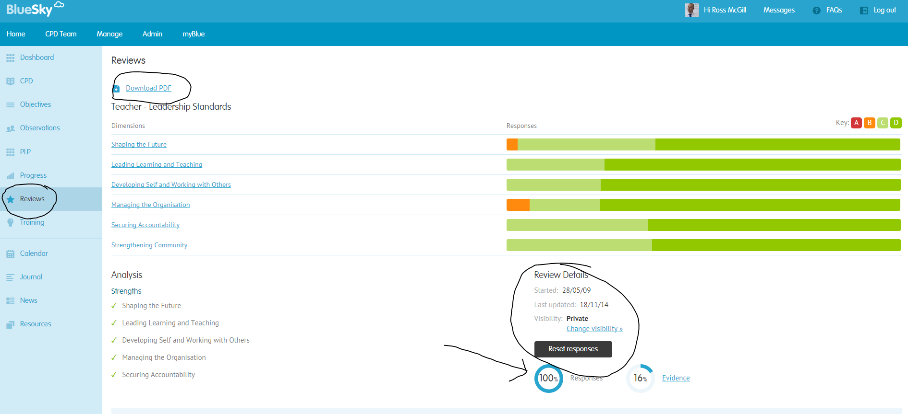
Completing a Self-Review generates a Needs Analysis
The image below shows an Overview of RMC’s “needs analysis” set against the Leadership Standards (NPQH)
You can click here or here for more details

Slide 7
Completing a Self-Review generates a Needs Analysis
The outcome should inform performance management targets and CPD needs.
Once complete, please use the remainder of your time to meet with appraisers / appraisee to set Performance Management targets in the Objective Tab

Slide 8
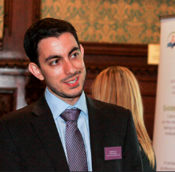
A reminder from David Weston
“Powerful professional development helps children succeed and teachers thrive.”

Slide 9
How?
Use the following slides to guide you through the process step-by-step.

Slide 10
Click the ‘Home’ tab.

Slide 11
Click the ‘Reviews’ tab which will show ‘your current level.’
Click on the standards hyperlink.

Slide 12
The ‘standards’ will be displayed …

Slide 13
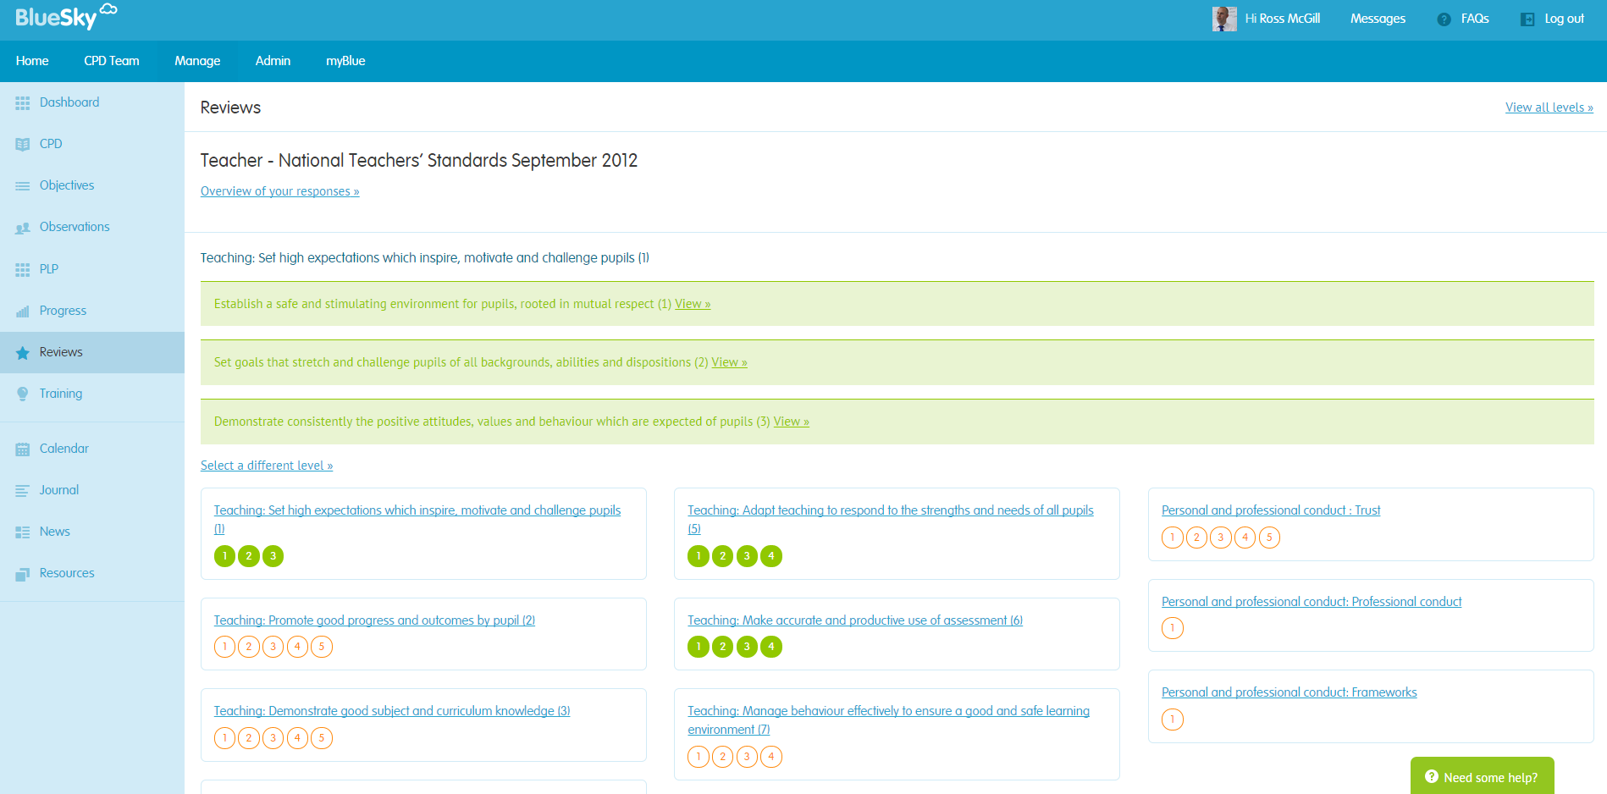
Click on each Teaching Standard and review
Each standard is here and broken down into sections

Slide 14
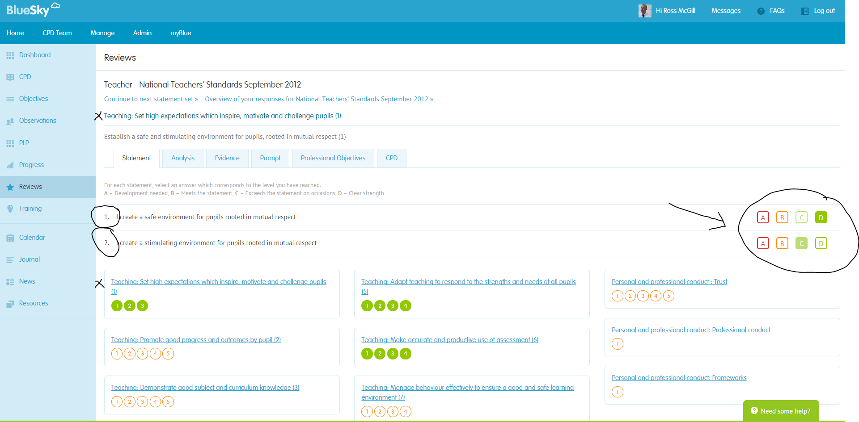
Click the number to review each standard.
Click the number to be able to self-review each statement (A-D)

Slide 15
At any moment you can do any 3 of the following …
Look at the Overview of your Self-Review
Flag up a potential training need linked to your Self-Review …
Create a Performance Management target linked directly to an area you wish to develop

Slide 16
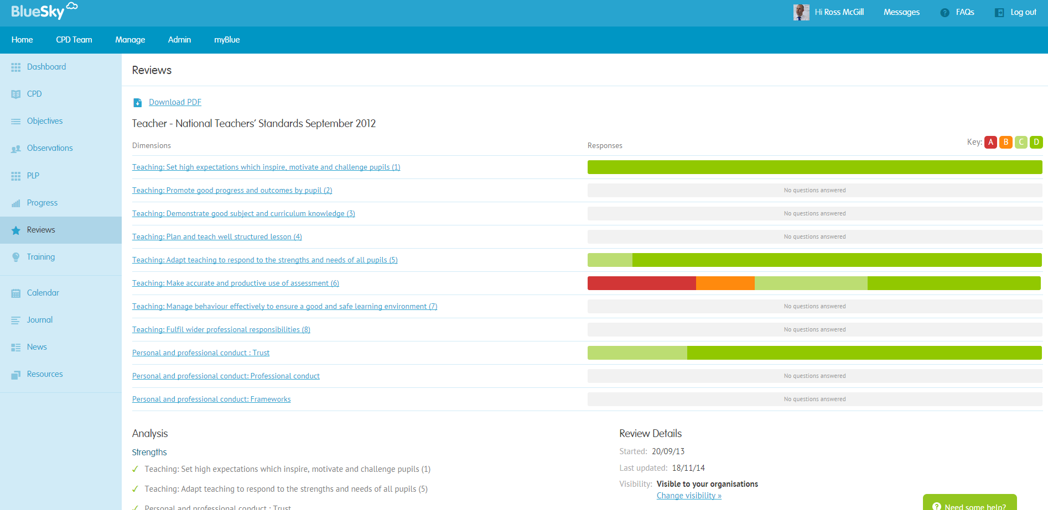
An Overview of your responses …
Download as PDF for evidence file
Look at the Overview of your Self-Review
Strengths are highlighted

Slide 17
At any point, you can click the ‘Progress Tab.’
Make sure you back date the drop-down field to 1st September 2014
This will generate a report of all the information (about YOU) stored on Blue Sky, including your latest Self-Review.

Slide 18
This is a close-up example of a Progress Summary

Slide 19
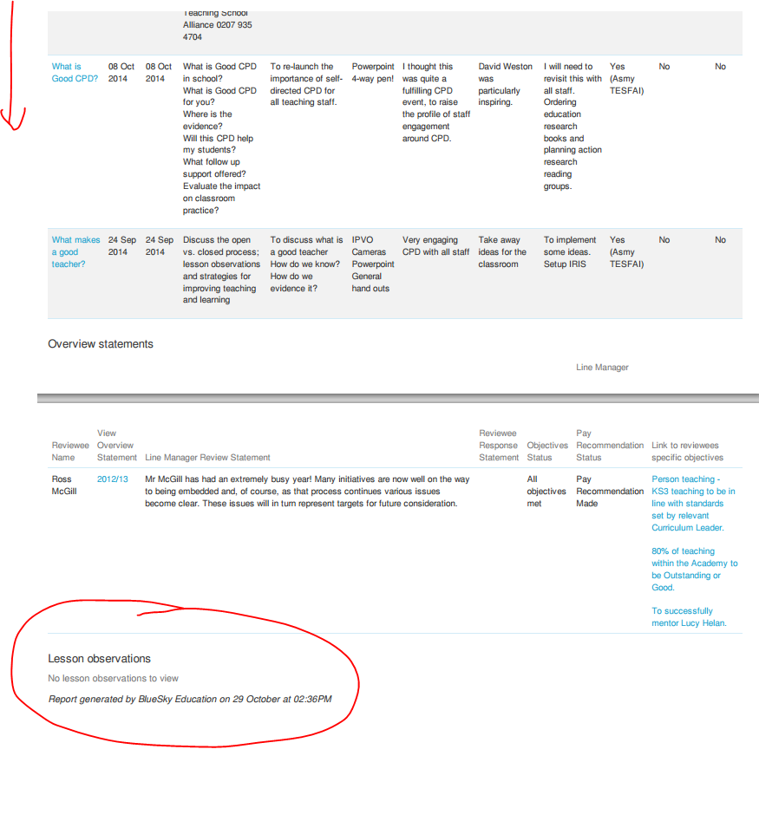
This is an example of a Progress Summary Report

Slide 20
What if?
… you completed a Self-Review every term?
… you completed a Self-Review once a year with your Apprasier?
… you invited a Mentor to complete a 360-Review of your analysis?

