Slide 1
is setting up…
by
Notes:
Videos needed:
Taylor Mali – What teachers make? = https://www.youtube.com/watch?v=RxsOVK4syxU
Lamont Carey – I can’t read = http://youtu.be/lByDfPOG0LA?t=22s
The 5 Minute Lesson Plan = http://bit.ly/5MinVideo
IRIS myself: https://teachertoolkitdotme.files.wordpress.com/2014/01/year-9-iris-export-for-teachertoolkit-blog.m4v
Resources:
Keywords for literateness?
IPEVO camera?
Latest reading book?
This presentation by @TeacherToolkit ( Ross Morrison McGill ) and is licensed under a Creative Commons Attribution-NonCommercial-NoDerivs 3.0 Unported License.
Based on all work published at www.teachertoolkit.me
@TeacherToolkit Limited.

Slide 2
Fingertips ready?
by
#GrowEX
Notes:
This presentation by @TeacherToolkit ( Ross Morrison McGill ) and is licensed under a Creative Commons Attribution-NonCommercial-NoDerivs 3.0 Unported License.
Based on all work published at www.teachertoolkit.me
@TeacherToolkit Limited.

Slide 3
Start thinking …
by
If you could observe someone teach,
who would it be and why?
Notes:
This presentation by @TeacherToolkit ( Ross Morrison McGill ) and is licensed under a Creative Commons Attribution-NonCommercial-NoDerivs 3.0 Unported License.
Based on all work published at www.teachertoolkit.me
@TeacherToolkit Limited.

Slide 4
by

Slide 5
A Valid Landscape for Teaching and Learning by Ross McGill Deputy Headteacher Quintin Kynaston @TeacherToolkit
by

Slide 6
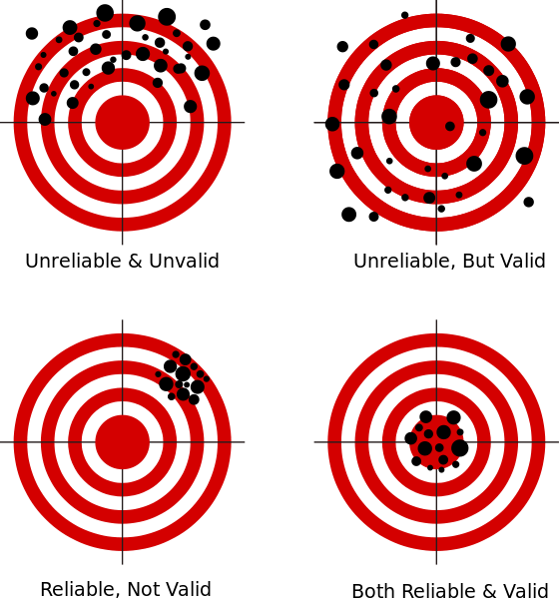
by

Slide 7
What do you see?
by

Slide 8
Looking at OR Looking for?
by

Slide 9
by
Straw poll …
Photo credit: www.memphisflyer.com
Notes:
This presentation by @TeacherToolkit ( Ross Morrison McGill ) and is licensed under a Creative Commons Attribution-NonCommercial-NoDerivs 3.0 Unported License.
Based on all work published at www.teachertoolkit.me
@TeacherToolkit Limited.
Who tweets?
Who uses Twitter professionally?
TeachMeets?
Who reads blogs?
Who writes a blog?
Who lesson grades?
Who doesn’t lesson grade?

Slide 10
by
Warm up!
Photo credit: www.mediabistro.com
Notes:
This presentation by @TeacherToolkit ( Ross Morrison McGill ) and is licensed under a Creative Commons Attribution-NonCommercial-NoDerivs 3.0 Unported License.
Based on all work published at www.teachertoolkit.me
@TeacherToolkit Limited.
Idea 11 in my 100 ideas book.
Sitting down all day – So, in a moment it will be time to stand up/move about.
FUN PART STARTS here. Rest is boring!
Promotes literacy

Slide 11
Grab!
by
A pen
Scrap A4 paper
Photo credit: www.sk-eternalsapience.blogspot.com
Notes:
This presentation by @TeacherToolkit ( Ross Morrison McGill ) and is licensed under a Creative Commons Attribution-NonCommercial-NoDerivs 3.0 Unported License.
Based on all work published at www.teachertoolkit.me
@TeacherToolkit Limited.
Idea 11 in my 100 ideas book.

Slide 12
by
Draw a circle
Photo credit: www.clker.com
Notes:
This presentation by @TeacherToolkit ( Ross Morrison McGill ) and is licensed under a Creative Commons Attribution-NonCommercial-NoDerivs 3.0 Unported License.
Based on all work published at www.teachertoolkit.me
@TeacherToolkit Limited.
Idea 11 in my 100 ideas book.

Slide 13
by
Divide into 6 pizza slices
Photo credit: www.clker.com
Notes:
This presentation by @TeacherToolkit ( Ross Morrison McGill ) and is licensed under a Creative Commons Attribution-NonCommercial-NoDerivs 3.0 Unported License.
Based on all work published at www.teachertoolkit.me
@TeacherToolkit Limited.
Idea 11 in my 100 ideas book.

Slide 14
by
1
2
6
3
5
4
Number the pizza slices
Photo credit: www.clker.com
Notes:
This presentation by @TeacherToolkit ( Ross Morrison McGill ) and is licensed under a Creative Commons Attribution-NonCommercial-NoDerivs 3.0 Unported License.
Based on all work published at www.teachertoolkit.me
@TeacherToolkit Limited.
Idea 11 in my 100 ideas book.

Slide 15
Spell these words!
by
Photo credit: www.psychologies.co.uk
Notes:
This presentation by @TeacherToolkit ( Ross Morrison McGill ) and is licensed under a Creative Commons Attribution-NonCommercial-NoDerivs 3.0 Unported License.
Based on all work published at www.teachertoolkit.me
@TeacherToolkit Limited.
Idea 11 in my 100 ideas book.
life skills
2. complex
3. commercial
SWAP
4. analysis
5. vocational
6. specialist
SWAP
7. rigour
8. progression
9. colloids
10. caramelise
Food technology in secondary schools
This report evaluates the effectiveness of provision in secondary schools for food technology within the National Curriculum subject design and technology. It examines strengths and weaknesses in pupils' achievement and the tension between the teaching of food to develop life skills and using food as a means to teach design and technology.

Slide 16
Now swap papers!
by
Photo credit: www.kstfamily.com
Notes:
This presentation by @TeacherToolkit ( Ross Morrison McGill ) and is licensed under a Creative Commons Attribution-NonCommercial-NoDerivs 3.0 Unported License.
Based on all work published at www.teachertoolkit.me
@TeacherToolkit Limited.
Idea 11 in my 100 ideas book.

Slide 17
Spell these words!
by
Spellcheck!
Photo credit: www.mommynoire.com
Notes:
This presentation by @TeacherToolkit ( Ross Morrison McGill ) and is licensed under a Creative Commons Attribution-NonCommercial-NoDerivs 3.0 Unported License.
Based on all work published at www.teachertoolkit.me
@TeacherToolkit Limited.

Slide 18
Now swap papers!
by
Photo credit: www.thebabyshopaholic.com
Notes:
This presentation by @TeacherToolkit ( Ross Morrison McGill ) and is licensed under a Creative Commons Attribution-NonCommercial-NoDerivs 3.0 Unported License.
Based on all work published at www.teachertoolkit.me
@TeacherToolkit Limited.

Slide 19
Spell these words!
Spellcheck!
by
Photo credit: www.theguardian.com
Notes:
This presentation by @TeacherToolkit ( Ross Morrison McGill ) and is licensed under a Creative Commons Attribution-NonCommercial-NoDerivs 3.0 Unported License.
Based on all work published at www.teachertoolkit.me
@TeacherToolkit Limited.

Slide 20
Why?
by

Slide 21
The current landscape for teaching and learning is divided
by
Notes:
www.personal.psu.edu700 × 485Search by image

Slide 22
Ofsted have freed us from the burden of lesson gradings, and more specifically judging individual lessons and teachers …
by

Slide 23
However, many schools (or at least individual teachers) are reporting no changes.
by

Slide 24
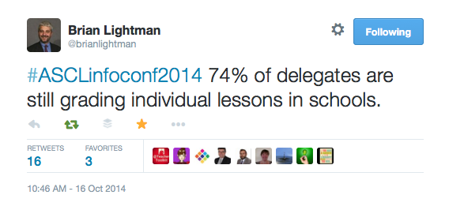
by
ASCL are reporting that 2/3rds of schools are still using summative assessments on individual lessons & teachers.
Notes:
https://twitter.com/brianlightman/status/522685002904256512

Slide 25
by
Notes:
https://twitter.com/TeacherToolkit/status/533910519468802048

Slide 26
Mission: A move away from one-off classroom performance towards a more sophisticated model of gathering reliable and valid sources of evidence (without a grade) over time …
by

Slide 27
Running thought …
by
If you could observe someone, who would it be and why?
Image: www.everydayfeminism.com
Notes:
This presentation by @TeacherToolkit ( Ross Morrison McGill ) and is licensed under a Creative Commons Attribution-NonCommercial-NoDerivs 3.0 Unported License.
Based on all work published at www.teachertoolkit.me
@TeacherToolkit Limited.

Slide 28
Bravery Award!
by

Slide 29
by
What we may be used to?
Notes:
This presentation by @TeacherToolkit ( Ross Morrison McGill ) and is licensed under a Creative Commons Attribution-NonCommercial-NoDerivs 3.0 Unported License.
Based on all work published at www.teachertoolkit.me
@TeacherToolkit Limited.

Slide 30
by
The full time classroom teacher
Teaches on average 20 hours per week.
Teaches for 38 weeks per year.
This equates to 760 hours per year!
So why do we judge
Teachers on just 3 hours ?!
Notes:
This presentation by @TeacherToolkit ( Ross Morrison McGill ) and is licensed under a Creative Commons Attribution-NonCommercial-NoDerivs 3.0 Unported License.
Based on all work published at www.teachertoolkit.me
@TeacherToolkit Limited.

Slide 31
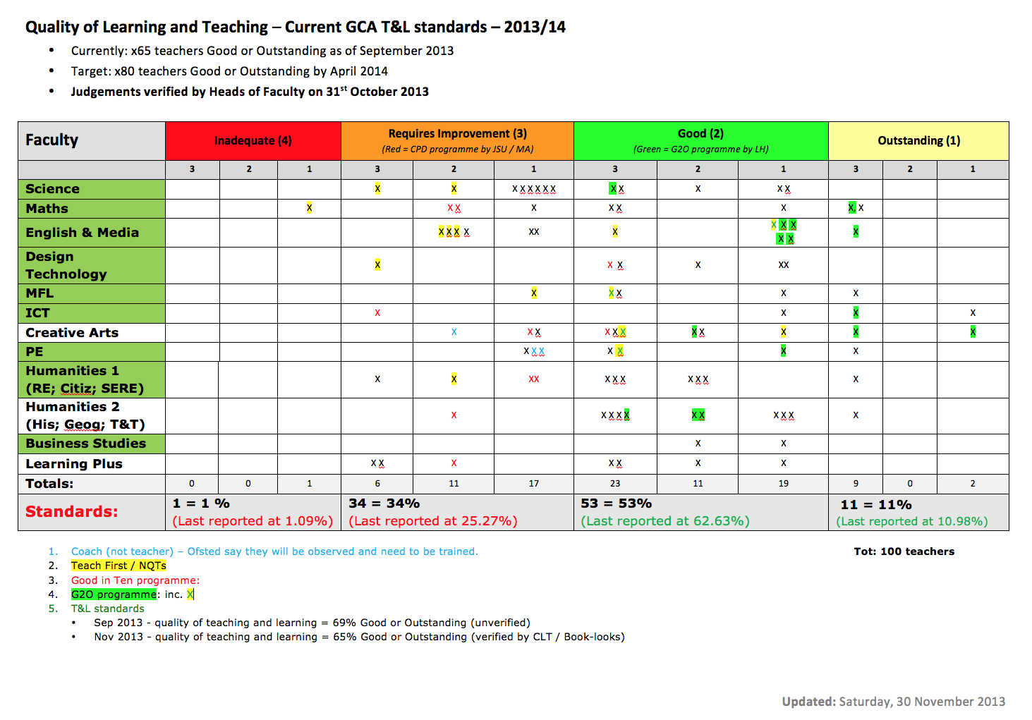
by
We are then placed in a box!
and this is/was shared with Ofsted!
Notes:
This presentation by @TeacherToolkit ( Ross Morrison McGill ) and is licensed under a Creative Commons Attribution-NonCommercial-NoDerivs 3.0 Unported License.
Based on all work published at www.teachertoolkit.me
@TeacherToolkit Limited.

Slide 32
by
Maybe we should focus on?
Notes:
This presentation by @TeacherToolkit ( Ross Morrison McGill ) and is licensed under a Creative Commons Attribution-NonCommercial-NoDerivs 3.0 Unported License.
Based on all work published at www.teachertoolkit.me
@TeacherToolkit Limited.

Slide 33
Mike Cladingbowl National Ofsted Director for Schools
by

Slide 34
No more grades!
by

Slide 35
… that formative observations will become the predominant factor for assessing the overall quality of teaching and learning in most schools.
by
Prediction

Slide 36
What works for my school may not work for your school
by
Remember!

Slide 37
Open vs. Closed
by

Slide 38
What is a Good teacher?

Slide 39
1. What is a Good teacher? 2. How do you know?

Slide 40
Open vs. Closed
by
Open = formative
Closed = summative

Slide 41
Open vs. Closed
by
Open = formative
To develop
To inform
To improve

Slide 42
Open vs. Closed
by
Closed = summative
To measure
To report
To support students?

Slide 43
How do you evidence Good teaching?
Image: www.invessence.com
Notes:
This presentation by @TeacherToolkit ( Ross Morrison McGill ) and is licensed under a Creative Commons Attribution-NonCommercial-NoDerivs 3.0 Unported License.
Based on all work published at www.teachertoolkit.me
@TeacherToolkit Limited.

Slide 44
1. What is a Good teacher? 2. How do you know? 3. How do you evidence this?
by
Discuss

Slide 45
Time to think!
by
Notes:
This presentation by @TeacherToolkit ( Ross Morrison McGill ) and is licensed under a Creative Commons Attribution-NonCommercial-NoDerivs 3.0 Unported License.
Based on all work published at www.teachertoolkit.me
@TeacherToolkit Limited.

Slide 46
by
Don’t forget …
If you could observe someone, who would it be and why?
Image: www.huffingtonpost.com
Notes:
This presentation by @TeacherToolkit ( Ross Morrison McGill ) and is licensed under a Creative Commons Attribution-NonCommercial-NoDerivs 3.0 Unported License.
Based on all work published at www.teachertoolkit.me
@TeacherToolkit Limited.

Slide 48
Progress Over Time
by

Slide 49
A suggestion . . .
by
Image: galleryhip.com
Notes:
This presentation by @TeacherToolkit ( Ross Morrison McGill ) and is licensed under a Creative Commons Attribution-NonCommercial-NoDerivs 3.0 Unported License. Based on all work published at www.teachertoolkit.me
@TeacherToolkit Limited.

Slide 51
The boring bit . . .
by
Notes:
This presentation by @TeacherToolkit ( Ross Morrison McGill ) and is licensed under a Creative Commons Attribution-NonCommercial-NoDerivs 3.0 Unported License.
Based on all work published at www.teachertoolkit.me
@TeacherToolkit Limited.
Latest guidance
Let me give you an oxymoron to consider…
NO LESSON PLANS
NO JUDGEMENTS EVER
PROGRESS OVER TIME

Slide 52
What it is not!
by
Expecting (rapid) progress to be evident in 20 minute snapshots; one-off lessons judgements based on what you see in the classroom; forming an opinion, based solely on what you see in a one-off lesson.

Slide 53
Quote:
by
“There is no progress within lessons. There is only learning.”
“The Ofsted framework talks about ‘gains in their knowledge, skills and understanding’ in lessons. They are things that inspectors will be looking to see from the students.
Where progress is mentioned, it is not something that inspectors will be looking to see from the students, because it is about the effectiveness of monitoring that they will be looking to see from the teacher.”
@KevBartle – Canons Park Headteacher
Notes:
This presentation by @TeacherToolkit ( Ross Morrison McGill ) and is licensed under a Creative Commons Attribution-NonCommercial-NoDerivs 3.0 Unported License.
Based on all work published at www.teachertoolkit.me
@TeacherToolkit Limited.

Slide 54
This means that no matter if we do judge (or not judge) teaching or individual lessons, or even lessons over time, schools will always be held to account on their overall performance. This doesn’t mean that teachers shouldn’t be judged too, but that we should move towards a more reliable and fairer method for doing this. I believe we are moving in the right direction.
by

Slide 55
September 18th 2014
by

Slide 56
by

Slide 57
Observing the Observers Impact on achievement versus Teaching and Learning
by

Slide 58
It is very significant that Ofsted liked what they saw in our classrooms. However, our headline results determined our overall teaching and learning grade. If our results had been higher, then our grade for teaching and learning would have too.
by

Slide 59
Therefore, if outcomes require improvement, then teaching and learning over time cannot be better … … which makes one wonder what significance no grading of lesson observations actually has on the outcome of an inspection.
by

Slide 60
Qualitative or Quantative?
by

Slide 61
“I once attended a conference session where a senior leader told us that, in his school, 85.26% of lessons were good or outstanding. How delusional that this seems and how toxic; a symptom of how far we’d fallen into the accountability abyss, losing sight of our professionalism.” @headguruteacher Headteacher Highbury Grove School

Slide 62
On observing 97 lessons this term … “The lessons are more normal. You see regular lessons. People tell me so; they fret less about putting on a show and I’m more confident that what I see is what the students get on a normal day. There may be some tidying up but it’s not a performance.” @headguruteacher Headteacher Highbury Grove School

Slide 63
Brian Lightman
by

Slide 64
“The question asked whether leaders were still grading lessons .... This issue needs a great deal of caution for the following reasons: Ofsted clarification makes it very clear that it lists what they do not require and not what heads may or may not do. That should be their professional judgement and a decision that needs to be made at school level. The greatest problem with Ofsted grading lessons (apart from the variability of teams) was that they were drawing invalid conclusions after a very short period in the classroom. We have had big concerns about this for a long time and are pleased that Ofsted has recognised the problem. Schools may or may not use Ofsted grades and may be helpful to teachers. What we do know of course is that the perceived or sometimes genuine requirements of Ofsted in the past have led schools to adopt practices which are not necessarily in the interests of students or create unnecessary teacher workload.
by

Slide 65
Nuts and bolts …
by

Slide 66
… as we move towards a landscape of teaching and learning without lesson gradings in individual lessons and over time … a challenge …
by

Slide 67
Term 1 = Typicality and Support. Term 2 = Book Looks and non-graded Observations. Term 3 = Data and formalised Student Conversations. Term 4 = Paired formative-Observations Term 5 = Typicality, IRIS and Student Conversations Term 6 = Data, Book Looks and Paired formative-Observations. *Lesson Study *IRIS Connect *Triads
by

Slide 68
All evidence gathered will be uploaded onto Blue Sky.
by

Slide 69
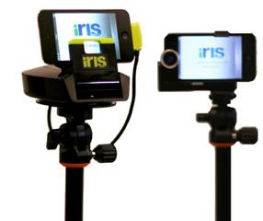
One user-licence for every teacher
by

Slide 70
Running thought …
by
?
If you could observe someone, who would it be and why?
Notes:
This presentation by @TeacherToolkit ( Ross Morrison McGill ) and is licensed under a Creative Commons Attribution-NonCommercial-NoDerivs 3.0 Unported License.
Based on all work published at www.teachertoolkit.me
@TeacherToolkit Limited.
This slideshow forms part of a formal presentation to be given in person.
Essentially, there are 5 ideas within this slideshow for any classroom teacher.
All the other slides are used for conversation at a CPD event.

Slide 71
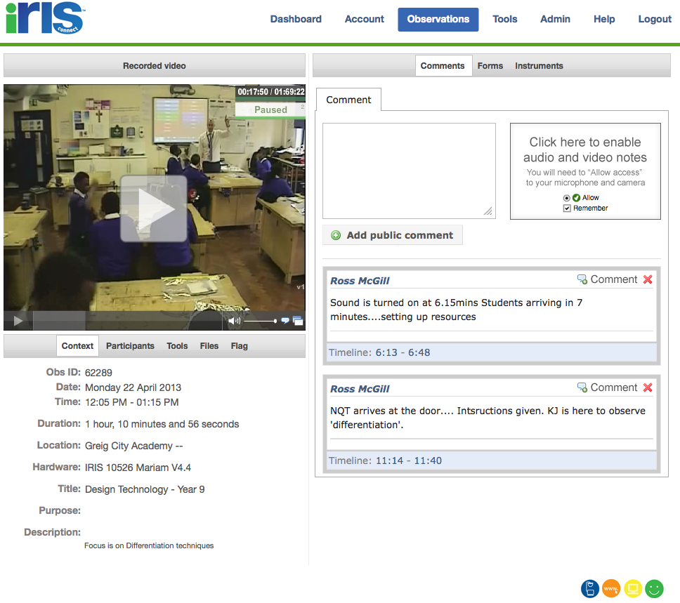
Film yourself!
by
https://teachertoolkitdotme.files.wordpress.com/2014/01/year-9-iris-export-for-teachertoolkit-blog.m4v
Notes:
https://teachertoolkitdotme.files.wordpress.com/2014/01/year-9-iris-export-for-teachertoolkit-blog.m4v
https://eu.irisconnect.com/observations/62289 – from 22mins 38
Year 8 - https://eu.irisconnect.com/observations/62241 - 32 minutes - NOT SURE!

Slide 73
Priorities
by

Slide 74
Training observers to: 1. ‘look at’ rather than ‘look for.’ 2. develop high-level observational skills. 3. offer sophisticated feedback over time. The challenge of: 1. setting up groups of observational-triads, matched to needs. 2. encouraging all teachers to use Iris Connect licence. 3. lesson grading fear and one-off performance.
by

Slide 75
A Valid Model for Teaching and Learning
by
without summative assessments but with formative assessment (over time).

Slide 76
by
The marking frenzy?

Slide 77
Questions?
by
Image: http://4.bp.blogspot.com
Notes:
This presentation by @TeacherToolkit ( Ross Morrison McGill ) and is licensed under a Creative Commons Attribution-NonCommercial-NoDerivs 3.0 Unported License. Based on all work published at www.teachertoolkit.me
@TeacherToolkit Limited.

Slide 78
Thank you!
by
TeacherToolkit@me.com
@TeacherToolkit
www.TeacherToolkit.me
Notes:
This presentation by @TeacherToolkit ( Ross Morrison McGill ) and is licensed under a Creative Commons Attribution-NonCommercial-NoDerivs 3.0 Unported License.
Based on all work published at www.teachertoolkit.me
@TeacherToolkit Limited.

Slide 79
The new vogue!

Slide 80
As a result, I have also suggested that moving away from gradings under the current guise as ‘progress over time’ has now triggered …
by

Slide 81
The Marking Frenzy!
by

Slide 82
A few days ago I posted this tweet. You can see from the evidence, that the response speaks for itself!
by

Slide 83
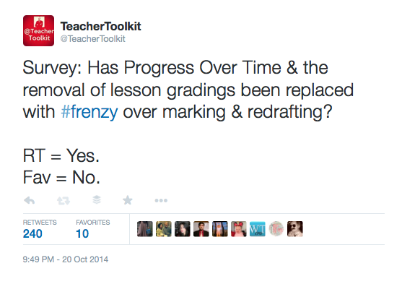
Notes:
https://twitter.com/teachertoolkit/status/524301471861334017?refsrc=email

Slide 84
Has marking replaced ‘progress in one-off’ lessons as the latest pressure point for teachers? Perhaps a new myth and unachievable workload for every teacher?
by

Slide 85
Marking is broken!
by
Credit: @MrLockyer (concept) / Photo credit http://bushtherapy.com
Notes:
This presentation by @TeacherToolkit (Ross Morrison McGill) & @LeadingLearner (Stephen Tierney)
and is licensed under a Creative Commons Attribution-NonCommercial-NoDerivs 3.0 Unported License.
Based on all work published at www.teachertoolkit.me & www.leadinglearner.me
@TeacherToolkit Limited & @LeadingLearner Limited
See here: http://headguruteacher.files.wordpress.com/2012/11/reduce-workload.jpg
Parents – they LOVE marking – it shows their child has been taught and that the teacher has spent time working with them.
SLT – They also LOVE marking – in a time-poor environment, looking at marking is a quick snapshot system of identifying work output from staff and pupils.
Inspectors – They LOVE marking – making a value judgement once every three years is hard enough, and marking is some of thee only tangible evidence that there has been some teaching in the previous three years.
This leaves two stakeholders left:
Teachers – No teacher LOVES marking. When I asked the workshop attendees, none from the 90 who attended said that they liked marking. None – and this was at the start of their career!
Pupils – they don’t get the value of marking either. Very often they seek a reward, and rarely read the the comments.
This leaves us with a huge problem - the two most key stakeholders in marking – the producer (teacher) and consumer (pupil) – get the least from it. How could we change this?

Slide 86
5 key stakeholders
by
Notes:
This presentation by @TeacherToolkit (Ross Morrison McGill) & @LeadingLearner (Stephen Tierney)
and is licensed under a Creative Commons Attribution-NonCommercial-NoDerivs 3.0 Unported License.
Based on all work published at www.teachertoolkit.me & www.leadinglearner.me
@TeacherToolkit Limited & @LeadingLearner Limited
See here: http://headguruteacher.files.wordpress.com/2012/11/reduce-workload.jpg
Parents – they LOVE marking – it shows their child has been taught and that the teacher has spent time working with them.
SLT – They also LOVE marking – in a time-poor environment, looking at marking is a quick snapshot system of identifying work output from staff and pupils.
Inspectors – They LOVE marking – making a value judgement once every three years is hard enough, and marking is some of thee only tangible evidence that there has been some teaching in the previous three years.
This leaves two stakeholders left:
Teachers – No teacher LOVES marking. When I asked the workshop attendees, none from the 90 who attended said that they liked marking. None – and this was at the start of their career!
Pupils – they don’t get the value of marking either. Very often they seek a reward, and rarely read the the comments.
This leaves us with a huge problem - the two most key stakeholders in marking – the producer (teacher) and consumer (pupil) – get the least from it. How could we change this?

Slide 87
Parents
by
Senior Leadership
Child
Inspectors
Teachers
Notes:
This presentation by @TeacherToolkit (Ross Morrison McGill) & @LeadingLearner (Stephen Tierney)
and is licensed under a Creative Commons Attribution-NonCommercial-NoDerivs 3.0 Unported License.
Based on all work published at www.teachertoolkit.me & www.leadinglearner.me
@TeacherToolkit Limited & @LeadingLearner Limited
See here: http://headguruteacher.files.wordpress.com/2012/11/reduce-workload.jpg
Parents – they LOVE marking – it shows their child has been taught and that the teacher has spent time working with them.
SLT – They also LOVE marking – in a time-poor environment, looking at marking is a quick snapshot system of identifying work output from staff and pupils.
Inspectors – They LOVE marking – making a value judgement once every three years is hard enough, and marking is some of thee only tangible evidence that there has been some teaching in the previous three years.
This leaves two stakeholders left:
Teachers – No teacher LOVES marking. Anyone?
Pupils – they don’t get the value of marking either. Very often they seek a reward, and rarely read the the comments.
This leaves us with a huge problem - the two most key stakeholders in marking – the producer (teacher) and consumer (pupil) – get the least from it. How could we change this?

Slide 88
by
Plan → Teach → Mark
Mark → Plan → Teach
Notes:
This presentation by @TeacherToolkit (Ross Morrison McGill) & @LeadingLearner (Stephen Tierney)
and is licensed under a Creative Commons Attribution-NonCommercial-NoDerivs 3.0 Unported License.
Based on all work published at www.teachertoolkit.me & www.leadinglearner.me
@TeacherToolkit Limited & @LeadingLearner Limited
In the old system, the routine appears to be PLAN > TEACH > MARK
However, in the new system, which is simply a change of mindset, the order is: MARK > PLAN > TEACH
This is not going to upset your SLT, will improve your teaching and planning (and marking of course). I have found this to be most effective if you do the marking AT THE SAME TIME as your planning, alongside each other.
Quote: @MrLockyer & @LearningSpy
As well as my own headteacher. Simple profesional standards.

Slide 89
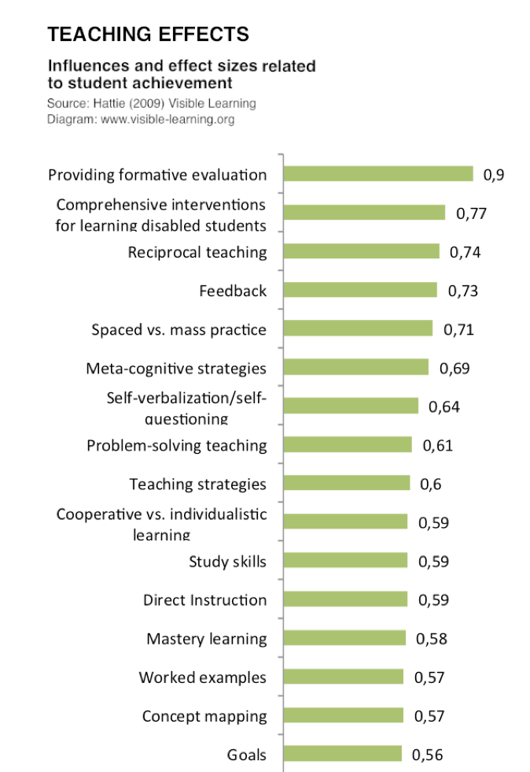
Feedback!
Professor John Hattie
by
Hattie effect size list that contains 138 influences and effect sizes across all areas related to student achievement.
0.4+ represents ½ (value added) grade in progress.
Notes:
This presentation by @TeacherToolkit (Ross Morrison McGill) & @LeadingLearner (Stephen Tierney) and is licensed under a
Creative Commons Attribution-NonCommercial-NoDerivs 3.0 Unported License.
Based on all work published at www.teachertoolkit.me & www.leadinglearner.me
@TeacherToolkit Limited & @LeadingLearner Limited

Slide 90
Is a Marking Frenzy brewing?
by

Slide 91
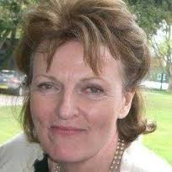
“In the third mention of marking in the [School Inspection] handbook is in the outstanding section for the quality of teaching. It says ‘consistently high quality marking and constructive feedback from teachers ensure that pupils make significant and sustained gains in their learning.’ High quality, not truck-loads of ticks. Fewer things, done really well.” @MaryMyatt - HMI

Slide 92
Most Commons Areas for Improvement in over 200 inspection reports! “They are a cross section judged to be outstanding, good or requiring improvement. These are the themes mentioned most frequently: feedback to students and what happens to that feedback … The quality of feedback has been high on the list of areas for improvement for some years. The commentary now appears to extend to what is done with the feedback.”
@MaryMyatt - HMI

Slide 94
by
Should I be marking
every piece of work?

Slide 95
by
NO!

Slide 96
by
How often should
I expect to see feedback?

Slide 97
by
When
needed!

Slide 98
by
A solution?

Slide 99
by
You know your students better than me.
You know what works best in your school and
what will aid student progress and what won’t.
You also know the needs of your teaching
staff and their current workload…
… matched alongside your school priorities and the
quality of teaching and learning in your school.

Slide 100
by
Common Sense
‘Little and often.’
‘Quality not quantity.’
‘What not to mark?’

Slide 101
by
Progress Over Time ensures that teachers are
judged more fairly and accurately.
The Marking Frenzy should also be treated fairly and
taken into account when making this judgement
on student progress against teacher workload.

Slide 102
by
Last slide …

Slide 103
Questions?
by
Image: http://4.bp.blogspot.com
Notes:
This presentation by @TeacherToolkit ( Ross Morrison McGill ) and is licensed under a Creative Commons Attribution-NonCommercial-NoDerivs 3.0 Unported License. Based on all work published at www.teachertoolkit.me
@TeacherToolkit Limited.

Slide 104
Thank you!
by
TeacherToolkit@me.com
@TeacherToolkit
www.TeacherToolkit.me
Notes:
This presentation by @TeacherToolkit ( Ross Morrison McGill ) and is licensed under a Creative Commons Attribution-NonCommercial-NoDerivs 3.0 Unported License.
Based on all work published at www.teachertoolkit.me
@TeacherToolkit Limited.

