Slide 1
is setting up…
by
Notes:
Videos needed:
Taylor Mali – What teachers make? = https://www.youtube.com/watch?v=RxsOVK4syxU
Lamont Carey – I can’t read = http://youtu.be/lByDfPOG0LA?t=22s
The 5 Minute Lesson Plan = http://bit.ly/5MinVideo
IRIS myself: https://teachertoolkitdotme.files.wordpress.com/2014/01/year-9-iris-export-for-teachertoolkit-blog.m4v
Resources:
Keywords for literateness?
IPEVO camera?
Latest reading book?
This presentation by @TeacherToolkit ( Ross Morrison McGill ) and is licensed under a Creative Commons Attribution-NonCommercial-NoDerivs 3.0 Unported License.
Based on all work published at www.teachertoolkit.me
@TeacherToolkit Limited.

Slide 2
Fingertips ready?
by
#LCiiMcGill
Notes:
This presentation by @TeacherToolkit ( Ross Morrison McGill ) and is licensed under a Creative Commons Attribution-NonCommercial-NoDerivs 3.0 Unported License.
Based on all work published at www.teachertoolkit.me
@TeacherToolkit Limited.

Slide 3
Pens – You will need one! Paper – Scribble thoughts. Conversation – Yes please!

Slide 4
What is a Good Teacher? by Ross M. McGill Deputy Headteacher Quintin Kynaston @TeacherToolkit www.TeacherToolkit.me
by

Slide 5
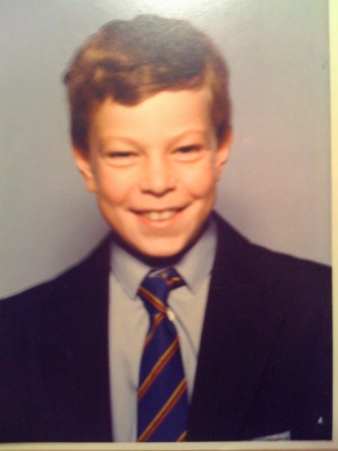
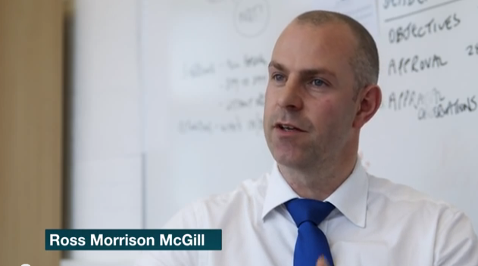
Who am I?
by
Aged 11 - 1985 Aged 40 - 2013
Notes:
This presentation by @TeacherToolkit ( Ross Morrison McGill ) and is licensed under a Creative Commons Attribution-NonCommercial-NoDerivs 3.0 Unported License.
Based on all work published at www.teachertoolkit.me
@TeacherToolkit Limited.

Slide 6
Education snapshot
by
2025 – EdD? NPQH?
2004-06 = 1st Masters degree.
1993-97 = BAEd Hons (QTS) Goldsmiths College
1991-93 = x4 A-levels. Dropped one; failed another; passed two!
1991 = I repeated my GCSE year = x13 GCSEs
Passed English Literature = grade C
Failed English Language = grade D
Failed GCSE Maths = grade D.
Left school = x3 grade C+
GCSEs in 1990 = 2 years after 1988 Education Act
x3 secondary schools = Newcastle; S. Wales; Blackpool
x4 primary schools = nr. Glasgow; Dundee; London; Newcastle
Notes:
This presentation by @TeacherToolkit ( Ross Morrison McGill ) and is licensed under a Creative Commons Attribution-NonCommercial-NoDerivs 3.0 Unported License.
Based on all work published at www.teachertoolkit.me
@TeacherToolkit Limited.

Slide 7
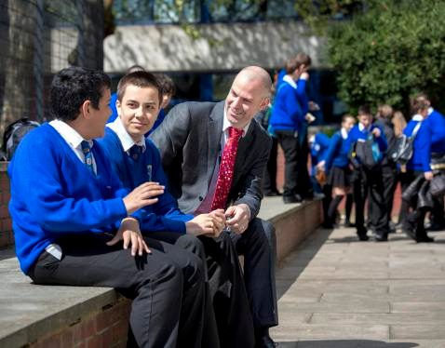
Career snapshot
by
2015 = Debretts – 500 Most Influential People in Britain
2014 = Appointed Deputy Headteacher, Quintin Kynaston
2013 = Blog openly about job-hunting via social-media.
2013 = @SLTchat recognised by DfE. (trending across UK)
2011 = Assistant Vice Principal, Greig City Academy
2011 = Made redundant! Become a father.
2010 = Joined Twitter professionally. (personally in 2008)
2008 – Assistant Principal, John Kelly Girls Technology College / Crest Girls Academy
2007 = Head of Design Technology and ICT, Alexandra Park School.
2004 = Teacher of the Year award in Secondary School in London
2000 = Head of Design Technology. Alexandra Park School
1998 = Full time Technology teacher.
1997 = Supply teaching in South and North London
1997 = VSO: Nigeria as NQT / Head of Department
Notes:
This presentation by @TeacherToolkit ( Ross Morrison McGill ) and is licensed under a Creative Commons Attribution-NonCommercial-NoDerivs 3.0 Unported License.
Based on all work published at www.teachertoolkit.me
@TeacherToolkit Limited.

Slide 8
Subject snapshot
by
1993 – 2008:
Graphics
Resistant Materials
Art
2000+ :
Food Technology
Textiles
Electronics
Systems and Control
2007+ :
ICT
2011+ :
Food Technology; Art; History; ICT
2013+ :
Media Studies; Psychology; Textiles
Cover lessons!
Maths; English; PE; Drama; Music; Business; MFL!
Image: www.joejuggler.com
Notes:
This presentation by @TeacherToolkit ( Ross Morrison McGill ) and is licensed under a Creative Commons Attribution-NonCommercial-NoDerivs 3.0 Unported License.
Based on all work published at www.teachertoolkit.me
@TeacherToolkit Limited.

Slide 9
by
Straw poll …
Photo credit: www.memphisflyer.com
Notes:
This presentation by @TeacherToolkit ( Ross Morrison McGill ) and is licensed under a Creative Commons Attribution-NonCommercial-NoDerivs 3.0 Unported License.
Based on all work published at www.teachertoolkit.me
@TeacherToolkit Limited.
Who tweets?
Who uses Twitter professionally?
TeachMeets?
Who reads blogs?
Who writes a blog?
Who lesson grades?
Who doesn’t lesson grade?

Slide 10
Running thought …
by
Notes:
This presentation by @TeacherToolkit ( Ross Morrison McGill ) and is licensed under a Creative Commons Attribution-NonCommercial-NoDerivs 3.0 Unported License. Based on all work published at www.teachertoolkit.me
@TeacherToolkit Limited.
This slideshow forms part of a formal presentation to be given in person.
Essentially, there are 5 ideas within this slideshow for any classroom teacher.
All the other slides are used for conversation at a CPD event.

Slide 11
Just ideas and suggestions …

Slide 12
Part one Part two Part three Part four
Notes:
This presentation by @TeacherToolkit ( Ross Morrison McGill ) and is licensed under a Creative Commons Attribution-NonCommercial-NoDerivs 3.0 Unported License. Based on all work published at www.teachertoolkit.me
@TeacherToolkit Limited.

Slide 13
Starter
Photo credit: www.mediabistro.com
Notes:
This presentation by @TeacherToolkit ( Ross Morrison McGill ) and is licensed under a Creative Commons Attribution-NonCommercial-NoDerivs 3.0 Unported License.
Based on all work published at www.teachertoolkit.me
@TeacherToolkit Limited.
Idea 11 in my 100 ideas book.
Sitting down all day – So, in a moment it will be time to stand up/move about.
FUN PART STARTS here. Rest is boring!
Promotes literacy

Slide 14
Grab …
A pen
Scrap A4 paper
Photo credit: www.sk-eternalsapience.blogspot.com
Notes:
This presentation by @TeacherToolkit ( Ross Morrison McGill ) and is licensed under a Creative Commons Attribution-NonCommercial-NoDerivs 3.0 Unported License.
Based on all work published at www.teachertoolkit.me
@TeacherToolkit Limited.
Idea 11 in my 100 ideas book.

Slide 15
Draw a circle
Photo credit: www.clker.com
Notes:
This presentation by @TeacherToolkit ( Ross Morrison McGill ) and is licensed under a Creative Commons Attribution-NonCommercial-NoDerivs 3.0 Unported License.
Based on all work published at www.teachertoolkit.me
@TeacherToolkit Limited.
Idea 11 in my 100 ideas book.

Slide 16
Divide into 6 pizza slices
Photo credit: www.clker.com
Notes:
This presentation by @TeacherToolkit ( Ross Morrison McGill ) and is licensed under a Creative Commons Attribution-NonCommercial-NoDerivs 3.0 Unported License.
Based on all work published at www.teachertoolkit.me
@TeacherToolkit Limited.
Idea 11 in my 100 ideas book.

Slide 17
1
2
6
3
5
4
Number the pizza slices
Photo credit: www.clker.com
Notes:
This presentation by @TeacherToolkit ( Ross Morrison McGill ) and is licensed under a Creative Commons Attribution-NonCommercial-NoDerivs 3.0 Unported License.
Based on all work published at www.teachertoolkit.me
@TeacherToolkit Limited.
Idea 11 in my 100 ideas book.

Slide 18
Spell these words!
Photo credit: www.psychologies.co.uk
Notes:
This presentation by @TeacherToolkit ( Ross Morrison McGill ) and is licensed under a Creative Commons Attribution-NonCommercial-NoDerivs 3.0 Unported License.
Based on all work published at www.teachertoolkit.me
@TeacherToolkit Limited.
Idea 11 in my 100 ideas book.
life skills
2. complex
3. commercial
SWAP
4. analysis
5. vocational
6. specialist
SWAP
7. rigour
8. progression
9. colloids
10. caramelise
Food technology in secondary schools
This report evaluates the effectiveness of provision in secondary schools for food technology within the National Curriculum subject design and technology. It examines strengths and weaknesses in pupils' achievement and the tension between the teaching of food to develop life skills and using food as a means to teach design and technology.

Slide 19
Now swap papers!
Photo credit: www.kstfamily.com
Notes:
This presentation by @TeacherToolkit ( Ross Morrison McGill ) and is licensed under a Creative Commons Attribution-NonCommercial-NoDerivs 3.0 Unported License.
Based on all work published at www.teachertoolkit.me
@TeacherToolkit Limited.
Idea 11 in my 100 ideas book.

Slide 20
Spell these words!
Spellcheck!
Photo credit: www.mommynoire.com
Notes:
This presentation by @TeacherToolkit ( Ross Morrison McGill ) and is licensed under a Creative Commons Attribution-NonCommercial-NoDerivs 3.0 Unported License.
Based on all work published at www.teachertoolkit.me
@TeacherToolkit Limited.

Slide 21
Now swap papers!
Photo credit: www.thebabyshopaholic.com
Notes:
This presentation by @TeacherToolkit ( Ross Morrison McGill ) and is licensed under a Creative Commons Attribution-NonCommercial-NoDerivs 3.0 Unported License.
Based on all work published at www.teachertoolkit.me
@TeacherToolkit Limited.

Slide 22
Spell these words!
Spellcheck!
Photo credit: www.theguardian.com
Notes:
This presentation by @TeacherToolkit ( Ross Morrison McGill ) and is licensed under a Creative Commons Attribution-NonCommercial-NoDerivs 3.0 Unported License.
Based on all work published at www.teachertoolkit.me
@TeacherToolkit Limited.

Slide 23
What’s the point ?
Photo credit: www.thefeedingdoctor.com
Notes:
This presentation by @TeacherToolkit ( Ross Morrison McGill ) and is licensed under a Creative Commons Attribution-NonCommercial-NoDerivs 3.0 Unported License.
Based on all work published at www.teachertoolkit.me
@TeacherToolkit Limited.

Slide 24
1. Improves literacy 2. Improves subject knowledge 3. Great starter / plenary 4. Intentional fun with purpose 5. Active learning
Photo credit: www.lindseymcdivitt.com
Notes:
This presentation by @TeacherToolkit ( Ross Morrison McGill ) and is licensed under a Creative Commons Attribution-NonCommercial-NoDerivs 3.0 Unported License.
Based on all work published at www.teachertoolkit.me
@TeacherToolkit Limited.
5 reasons for using Snowball Literacy

Slide 25
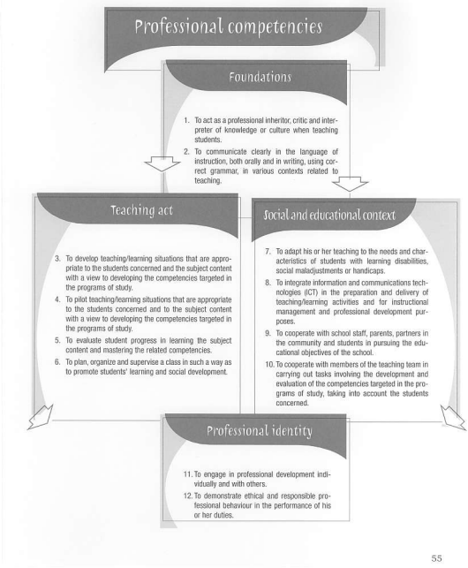
Taken from the Teacher Standards (Canada)
Notes:
This presentation by @TeacherToolkit ( Ross Morrison McGill ) and is licensed under a Creative Commons Attribution-NonCommercial-NoDerivs 3.0 Unported License. Based on all work published at www.teachertoolkit.me
@TeacherToolkit Limited.
http://www.mcgill.ca/edu-e3ftoption/files/edu-e3ftoption/ProCompetencies.PDF

Slide 26
Running thought …
by
Notes:
This presentation by @TeacherToolkit ( Ross Morrison McGill ) and is licensed under a Creative Commons Attribution-NonCommercial-NoDerivs 3.0 Unported License. Based on all work published at www.teachertoolkit.me
@TeacherToolkit Limited.
This slideshow forms part of a formal presentation to be given in person.
Essentially, there are 5 ideas within this slideshow for any classroom teacher.
All the other slides are used for conversation at a CPD event.

Slide 27
Part one Part two Part three Part four
Notes:
This presentation by @TeacherToolkit ( Ross Morrison McGill ) and is licensed under a Creative Commons Attribution-NonCommercial-NoDerivs 3.0 Unported License. Based on all work published at www.teachertoolkit.me
@TeacherToolkit Limited.

Slide 28
What is a Good teacher?

Slide 29
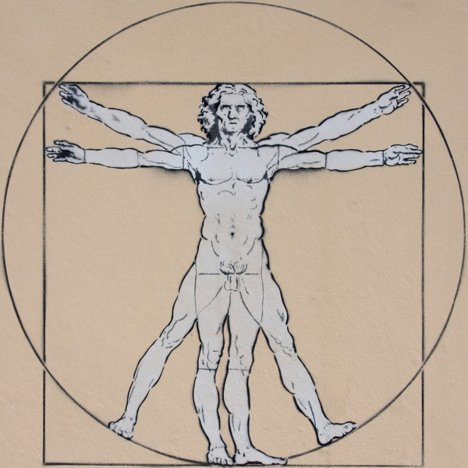
Da Vinci ‘Vitruvian Man’ which “is a drawing is based on the correlations of ideal human proportions.”
“….there ought to be the greatest harmony in the symmetrical relations of the different parts to the general magnitude of the whole…”
(Source: Vitruvius’ De architectura 3.1.2-3)
Marcus Vitruvius Pollio
Roman architect
Born c. 80-15 BC

Slide 30
The perfect teacher?
Image: http://vampireexplored.wordpress.com
Notes:
This presentation by @TeacherToolkit ( Ross Morrison McGill ) and is licensed under a Creative Commons Attribution-NonCommercial-NoDerivs 3.0 Unported License.
Based on all work published at www.teachertoolkit.me
@TeacherToolkit Limited.

Slide 31
If perfection is a myth, can goodness be achieved?
What is a Good teacher?
You will know this teacher at QK.
It may be you or someone next door to you?

Slide 32
Post It Notes

Slide 33
Discuss in your group. 5 minutes. Try to identify 5-10 keywords
What is a Good teacher?

Slide 34
A thought …
“Sometimes the simplest questions in life are the hardest to answer.”

Slide 35
“Young people appreciate great teachers as much as they ever did, but are more intolerant of mediocre ones.” (Geoff Barton – Headteacher)
A thought …

Slide 36
Post It Notes

Slide 37
Engaging? Organised? Reflective? Subject expert? Maverick? Makes mistakes? Takes risks? Breaks down barriers? Professional? Says no?
Suggestions …

Slide 38
The visual anatomy of a GREAT teacher.
Engaging
Visionary
Audacious
Organised
Reflective
Dexterous
Supportive
Subject-expert
High expectations
Reciprocal-feedback
Breaks down barriers
Communicates
The above captures the article here.
by @TeacherToolkit
http://wp.me/p2HFBD-27z
Web: www.teachertoolkit.me
Image credit: BLT Photo
http://bltphoto.wordpress.com/about/
Notes:
Credit: http://bltphoto.wordpress.com/category/silhouettes/
If you do want to adapt this image to suit your own school; please credit the original photographer; as well as myself by including @TeacherToolkit and BLTPhotos.
@TeacherToolkit by Ross Morrison McGill is licensed under a Creative Commons Attribution-NonCommercial-NoDerivs 3.0 Unported License. Based on all work published at www.teachertoolkit.me.
Web: www.teachertoolkit.me
Twitter: @TeacherToolkit
Email: TeacherToolkit@me.com

Slide 39
Do we agree?
“No two teachers are the same, nor should they be … All good teachers share the same goal: to give children and young people the best chance in life. However, the way in which they reach that goal will depend on what works for them and their pupils.”
Who?

Slide 40
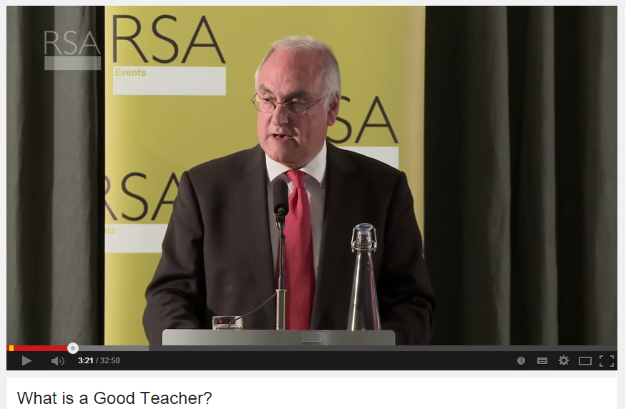
Wilshaw
http://youtu.be/is31rrXubQ0?t=58s – to 7m38s
Notes:
http://youtu.be/is31rrXubQ0?t=58s
Play from 0.58 seconds up until 7m 37 secs

Slide 41
Self -evaluate yourself. 10 minutes.
Teacher Standards

Slide 42
Self-evaluate yourself. 10 minutes.
Teacher Standards

Slide 43
1. Self Review Your Practice

Slide 44
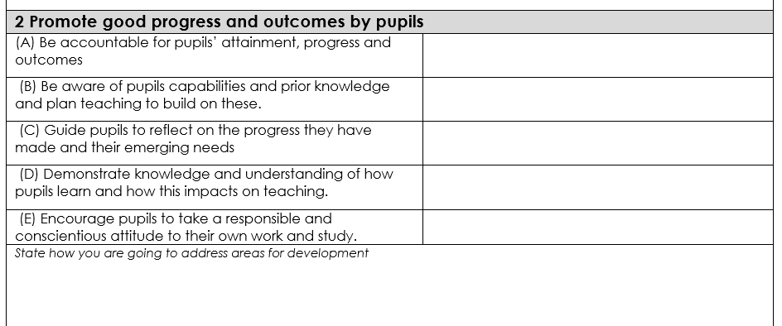
2. Self Review Your Practice

Slide 45
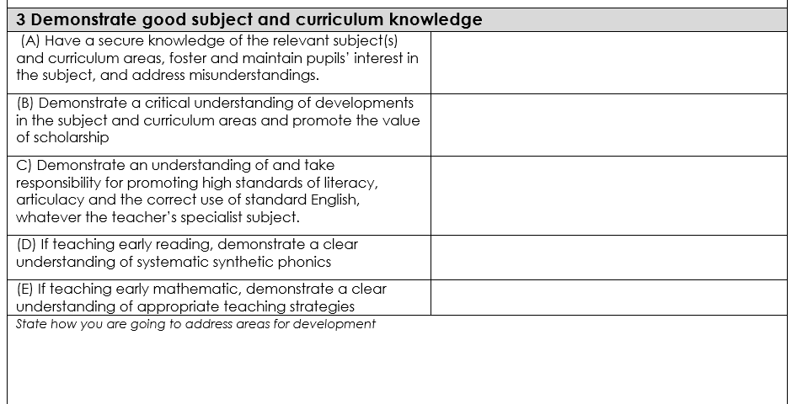
3. Self Review Your Practice

Slide 46
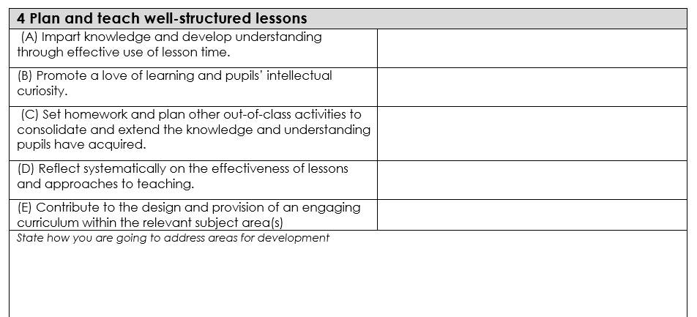
4. Self Review Your Practice

Slide 47
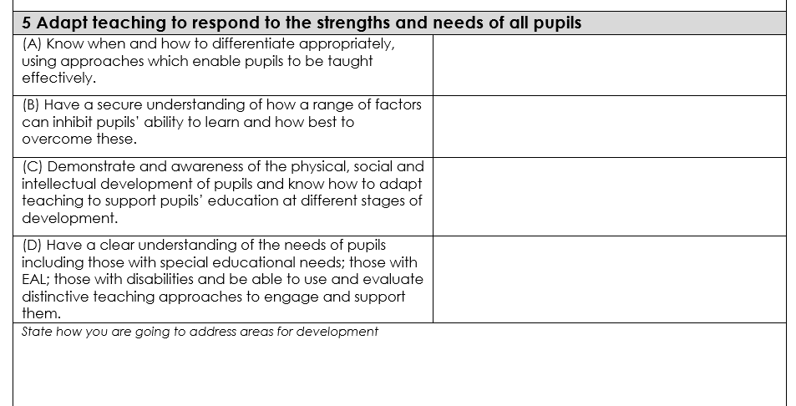
5. Self Review Your Practice

Slide 48
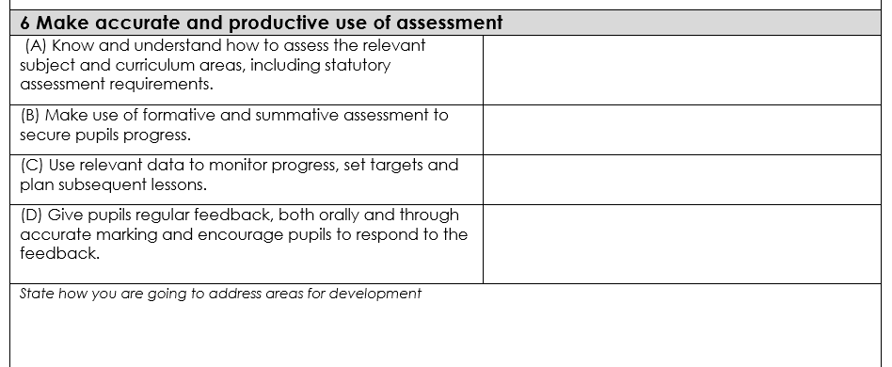
6. Self Review Your Practice

Slide 49
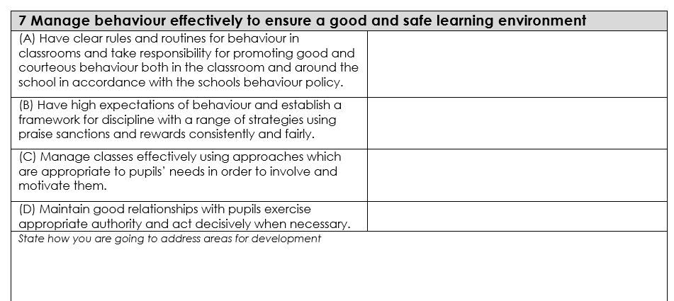
7. Self Review Your Practice

Slide 50
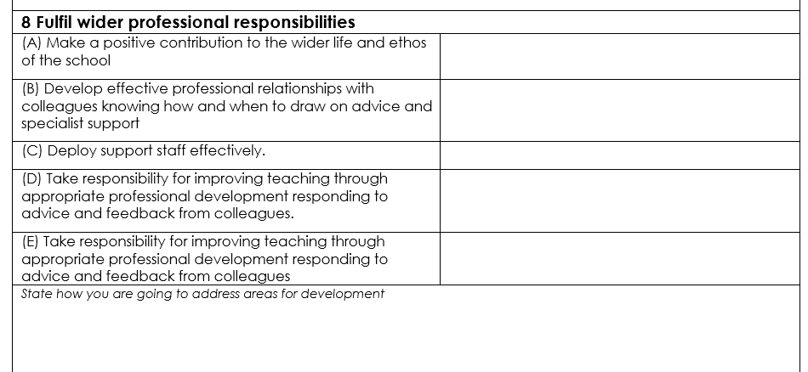
8. Self Review Your Practice

Slide 51
Questions?
Image: http://4.bp.blogspot.com
Notes:
This presentation by @TeacherToolkit ( Ross Morrison McGill ) and is licensed under a Creative Commons Attribution-NonCommercial-NoDerivs 3.0 Unported License. Based on all work published at www.teachertoolkit.me
@TeacherToolkit Limited.

Slide 52
Don’t forget
by
Notes:
This presentation by @TeacherToolkit ( Ross Morrison McGill ) and is licensed under a Creative Commons Attribution-NonCommercial-NoDerivs 3.0 Unported License. Based on all work published at www.teachertoolkit.me
@TeacherToolkit Limited.
This slideshow forms part of a formal presentation to be given in person.
Essentially, there are 5 ideas within this slideshow for any classroom teacher.
All the other slides are used for conversation at a CPD event.

Slide 53
Part one Part two Part three Part four
Notes:
This presentation by @TeacherToolkit ( Ross Morrison McGill ) and is licensed under a Creative Commons Attribution-NonCommercial-NoDerivs 3.0 Unported License. Based on all work published at www.teachertoolkit.me
@TeacherToolkit Limited.

Slide 54
What is a Good teacher?

Slide 55
1. What is a Good teacher? 2. How do you know?

Slide 56
Open vs. Closed
by

Slide 57
Open vs. Closed
by
Open = formative
Closed = summative

Slide 58
Open vs. Closed
by
Open = formative
To develop
To inform
To improve

Slide 59
Open vs. Closed
by
Closed = summative
To measure
To report
To support students?

Slide 60
Time to think!
by
Notes:
This presentation by @TeacherToolkit ( Ross Morrison McGill ) and is licensed under a Creative Commons Attribution-NonCommercial-NoDerivs 3.0 Unported License.
Based on all work published at www.teachertoolkit.me
@TeacherToolkit Limited.

Slide 61
Discuss in your group. 5 minutes. Try to identify 5-10 keywords
How do you know a Good teacher?

Slide 62
Post It Notes

Slide 63
Part one Part two Part three Part four
Notes:
This presentation by @TeacherToolkit ( Ross Morrison McGill ) and is licensed under a Creative Commons Attribution-NonCommercial-NoDerivs 3.0 Unported License. Based on all work published at www.teachertoolkit.me
@TeacherToolkit Limited.

Slide 64
1. What is a Good teacher? 2. How do you know? 3. How do you evidence this?
by
Discuss

Slide 65
Discuss in your group. 5 minutes. Try to identify 5-10 keywords
How do you evidence a Good teacher?

Slide 66
Post It Notes

Slide 67
How do you evidence Good teaching?
Image: www.invessence.com
Notes:
This presentation by @TeacherToolkit ( Ross Morrison McGill ) and is licensed under a Creative Commons Attribution-NonCommercial-NoDerivs 3.0 Unported License.
Based on all work published at www.teachertoolkit.me
@TeacherToolkit Limited.

Slide 69
Running thought …
by
Notes:
This presentation by @TeacherToolkit ( Ross Morrison McGill ) and is licensed under a Creative Commons Attribution-NonCommercial-NoDerivs 3.0 Unported License. Based on all work published at www.teachertoolkit.me
@TeacherToolkit Limited.
This slideshow forms part of a formal presentation to be given in person.
Essentially, there are 5 ideas within this slideshow for any classroom teacher.
All the other slides are used for conversation at a CPD event.

Slide 70
Part one Part two Part three Part four
Notes:
This presentation by @TeacherToolkit ( Ross Morrison McGill ) and is licensed under a Creative Commons Attribution-NonCommercial-NoDerivs 3.0 Unported License. Based on all work published at www.teachertoolkit.me
@TeacherToolkit Limited.

Slide 71
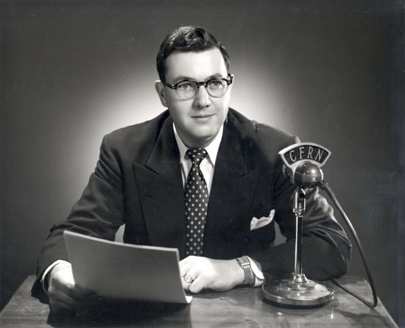
And the latest by Ofsted is …

Slide 72
Mike Cladingbowl National Ofsted Director for Schools

Slide 73
Ofsted: February 2014
This is the outcome of the meeting.
That inspectors must always visit classrooms.
That we can give a different grade for teaching than we do for overall achievement.
No aggregated grades. No more grades recorded on EFs.
Instead, inspectors will record what is going well, and what is going less well, and use this to feed back to teachers.
Looking across a range of children’s work (in books), establishing how well children acquire knowledge (student conversations), understanding the teachers’ own views, observing direct practice, and checking on the views of children and parents.
That individual lesson check-lists are not helpful.
Notes:
This presentation by @TeacherToolkit ( Ross Morrison McGill ) and is licensed under a Creative Commons Attribution-NonCommercial-NoDerivs 3.0 Unported License. Based on all work published at www.teachertoolkit.me
@TeacherToolkit Limited.

Slide 74
No more grades!

Slide 75
A common framework?
This framework may exist in your mind …
Across the whole school, whether you be an observer, a coach, a mentee or the observed, we will all need to have a criteria in order to be able to understand what “is” a good teacher?

Slide 76
Questions?
Image: lbsolutions.no
Notes:
This presentation by @TeacherToolkit ( Ross Morrison McGill ) and is licensed under a Creative Commons Attribution-NonCommercial-NoDerivs 3.0 Unported License. Based on all work published at www.teachertoolkit.me
@TeacherToolkit Limited.

Slide 77
Context
For most teachers, their first experience of lesson observation usually occurs on an Initial Teacher Training (ITT) course when they are observed on teaching placement, with feedback typically given on their ‘strengths’ and ‘weaknesses’ and how to improve their practice in the future.
The often considers endless paperwork and a grade.
From this point onwards, whether it is for appraisal, inspection, CPD or research purposes, observation becomes a constant in teachers’ professional lives.

Slide 78
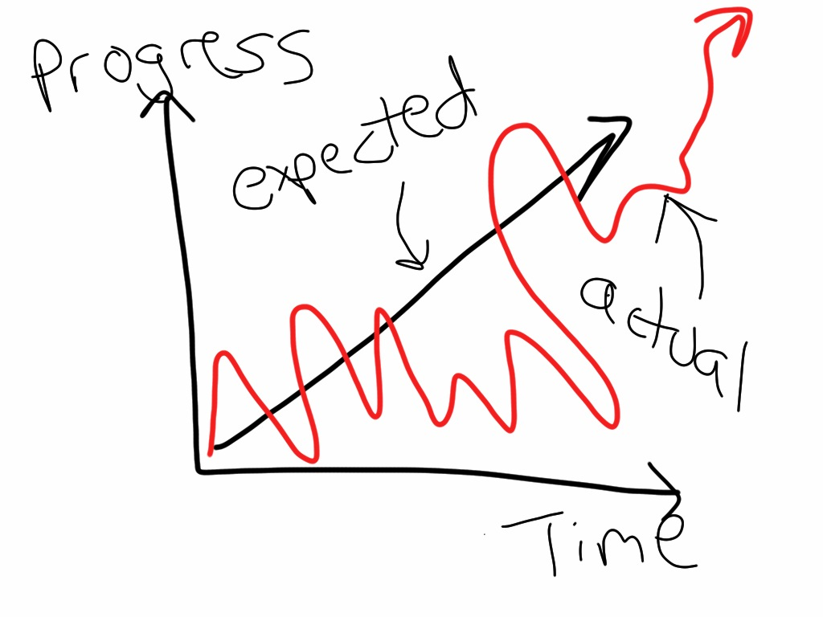
So, what is progress over time?
Notes:
This presentation by @TeacherToolkit ( Ross Morrison McGill ) and is licensed under a Creative Commons Attribution-NonCommercial-NoDerivs 3.0 Unported License. Based on all work published at www.teachertoolkit.me
@TeacherToolkit Limited.

Slide 79
Something to unpick …
What is progress over time?
Why is it important?
How do you evidence it?

Slide 80
Mission: A move away from one-off classroom performance towards a more sophisticated model of gathering reliable and valid sources of evidence (without a grade) over time …
by

Slide 81
by
What we may be used to?
Notes:
This presentation by @TeacherToolkit ( Ross Morrison McGill ) and is licensed under a Creative Commons Attribution-NonCommercial-NoDerivs 3.0 Unported License.
Based on all work published at www.teachertoolkit.me
@TeacherToolkit Limited.

Slide 82
by
The full time classroom teacher
Teaches on average 20 hours per week.
Teaches for 38 weeks per year.
This equates to 760 hours per year!
So why do we judge
Teachers on just 3 hours ?!
Notes:
This presentation by @TeacherToolkit ( Ross Morrison McGill ) and is licensed under a Creative Commons Attribution-NonCommercial-NoDerivs 3.0 Unported License.
Based on all work published at www.teachertoolkit.me
@TeacherToolkit Limited.

Slide 83
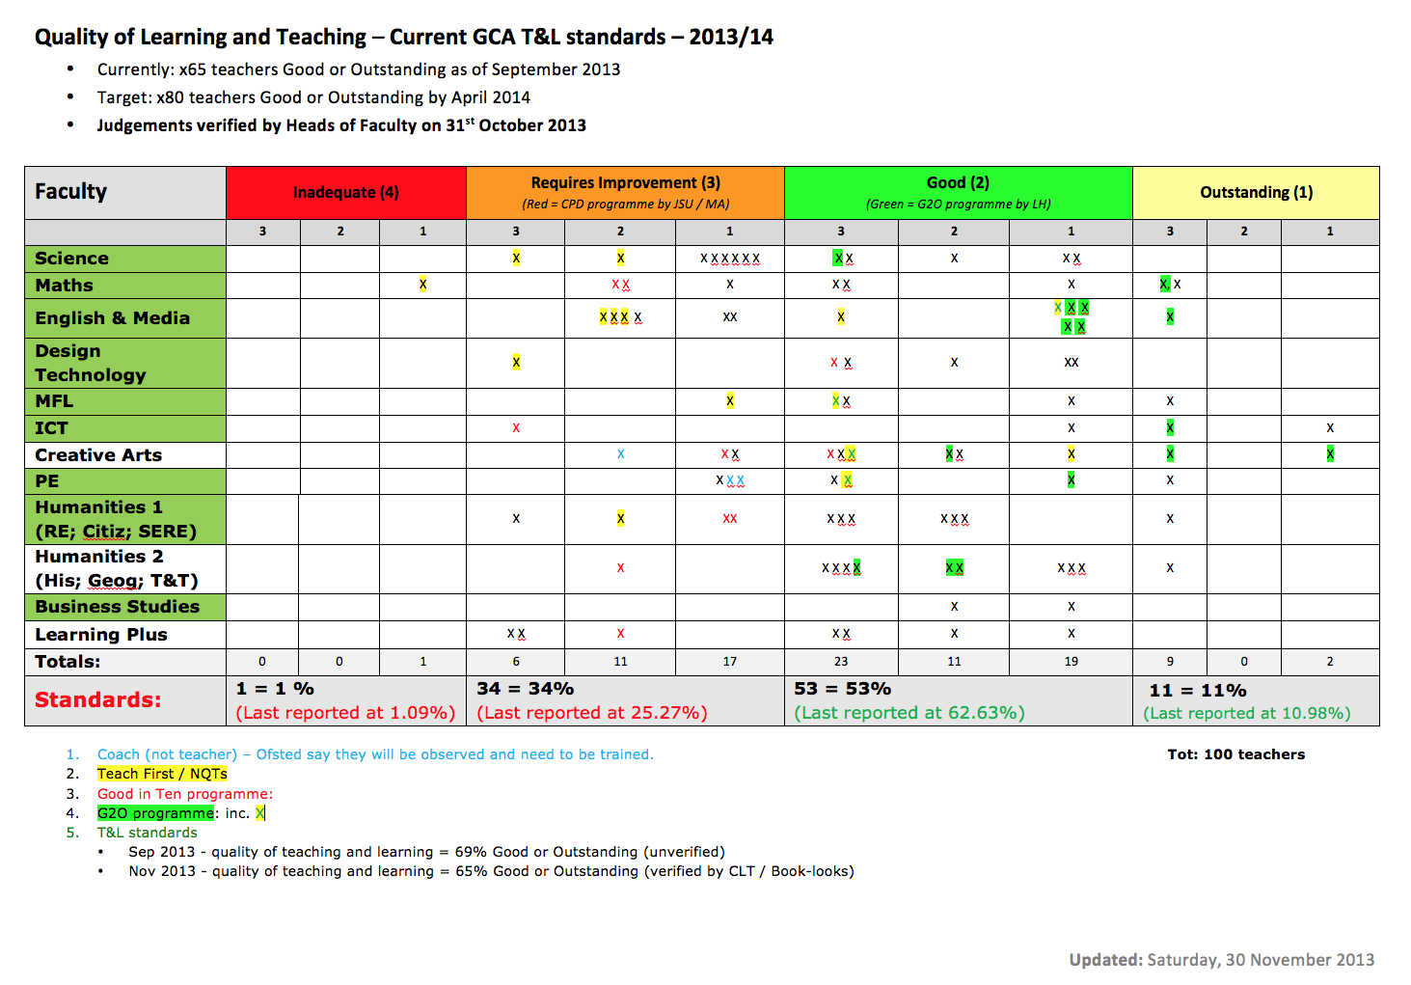
by
We are then placed in a box!
and this is/was shared with Ofsted!
Notes:
This presentation by @TeacherToolkit ( Ross Morrison McGill ) and is licensed under a Creative Commons Attribution-NonCommercial-NoDerivs 3.0 Unported License.
Based on all work published at www.teachertoolkit.me
@TeacherToolkit Limited.

Slide 84
by
Maybe we should focus on?
Notes:
This presentation by @TeacherToolkit ( Ross Morrison McGill ) and is licensed under a Creative Commons Attribution-NonCommercial-NoDerivs 3.0 Unported License.
Based on all work published at www.teachertoolkit.me
@TeacherToolkit Limited.

Slide 85
Ofsted: September 2014
Please read …
Evaluating learning over time.
Direct observation must be supplemented by a range of other evidence to enable inspectors to evaluate what teaching is like typically and the impact that teaching has had on pupils’ learning over time.

Slide 86
Let’s remove all the dialogue … and keep this in mind.

Slide 88
Progress Over Time
Intended outcome this year …
To clarify how standards of teaching and learning will be gathered?
2. To decide how all teachers will be observed across the school?
3. To offer a solution for monitoring and evaluating the quality of teaching and learning.

Slide 89
Discuss in your group. 5 minutes. Try to identify 5-10 keywords
What is progress over time?

Slide 90
Questions to consider:
Should we continue to judge one-off lessons?
2. Should we remove lesson judgements altogether?
3. If judgements remain, should we judge lessons based on progress over time?
4. What training opportunities are needed?

Slide 91
Unpick reminders … 1 minute
What is progress over time?
Why is it important?
How do you evidence it?

Slide 92
Post It Notes

Slide 93
A last reminder …
by
Notes:
This presentation by @TeacherToolkit ( Ross Morrison McGill ) and is licensed under a Creative Commons Attribution-NonCommercial-NoDerivs 3.0 Unported License. Based on all work published at www.teachertoolkit.me
@TeacherToolkit Limited.
This slideshow forms part of a formal presentation to be given in person.
Essentially, there are 5 ideas within this slideshow for any classroom teacher.
All the other slides are used for conversation at a CPD event.

Slide 94
A suggestion . . .
Image: galleryhip.com
Notes:
This presentation by @TeacherToolkit ( Ross Morrison McGill ) and is licensed under a Creative Commons Attribution-NonCommercial-NoDerivs 3.0 Unported License. Based on all work published at www.teachertoolkit.me
@TeacherToolkit Limited.

Slide 95
A definition?
‘Progress over time’
Students making sustained progress throughout a topic / term / year / key-stage; with demonstrable evidence such as data; students’ books; routines and the quality of teaching (not the teacher).

Slide 96
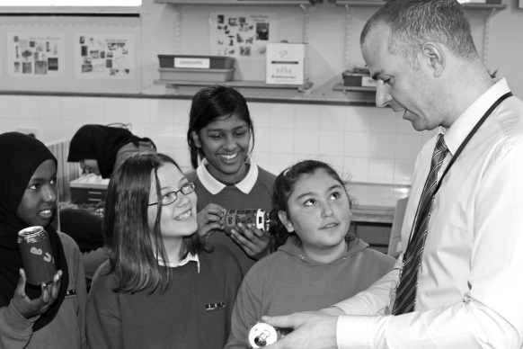
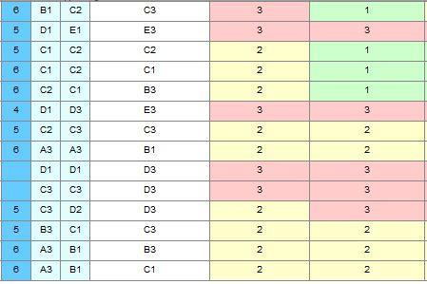
Sources of
Images: http://www.studyblue.com & melisaandryun.com
Notes:
This presentation by @TeacherToolkit ( Ross Morrison McGill ) and is licensed under a Creative Commons Attribution-NonCommercial-NoDerivs 3.0 Unported License.
Based on all work published at www.teachertoolkit.me
@TeacherToolkit Limited.

Slide 98
What it is not!
Progress Over Time: Expecting (rapid) progress to be evident in 20 minute snapshots; one-off lessons judgements based on what you see in the classroom; forming an opinion, based solely on what you see in a lesson.

Slide 99
Quote:
by
“There is no progress within lessons. There is only learning.”
“The Ofsted framework talks about ‘gains in their knowledge, skills and understanding’ in lessons. They are things that inspectors will be looking to see from the students.
Where progress is mentioned, it is not something that inspectors will be looking to see from the students, because it is about the effectiveness of monitoring that they will be looking to see from the teacher.”
Headteacher, @KevBartle – Canons Park, London.
Notes:
This presentation by @TeacherToolkit ( Ross Morrison McGill ) and is licensed under a Creative Commons Attribution-NonCommercial-NoDerivs 3.0 Unported License.
Based on all work published at www.teachertoolkit.me
@TeacherToolkit Limited.

Slide 100
This means that no matter if we do judge (or not judge) teaching or individual lessons, or even lessons over time, schools will always be held to account on their overall performance. This doesn’t mean that teachers shouldn’t be judged too, but that we should move towards a more reliable and fairer method for doing this. I believe we are moving in the right direction.
by

Slide 101
Why is it important?
Appraisal decisions and overall quality of teaching across the school; to inform CPD.
A fairer system for observing what is typical; makes observational feedback relevant to every lesson, rather than a particular activity; more reflective of what students receive day to day = getting a good deal.
A more rounded view of the teacher. Impressions (typicality and support) are not based on a one-off performance; but rather what is typical.

Slide 102
Questions?
Image: theblackedition.hubpages.com
Notes:
This presentation by @TeacherToolkit ( Ross Morrison McGill ) and is licensed under a Creative Commons Attribution-NonCommercial-NoDerivs 3.0 Unported License. Based on all work published at www.teachertoolkit.me
@TeacherToolkit Limited.

Slide 103
Think – pair - share…
by
Notes:
This presentation by @TeacherToolkit ( Ross Morrison McGill ) and is licensed under a Creative Commons Attribution-NonCommercial-NoDerivs 3.0 Unported License. Based on all work published at www.teachertoolkit.me
@TeacherToolkit Limited.

Slide 104
Are you consistently, the sort of teacher you would want your own children to have?
Photo credit: www.thefeedingdoctor.com
Notes:
The 5 Minute Lesson Plan is by @TeacherToolkit ( Ross Morrison McGill ) and is licensed under a Creative Commons Attribution-NonCommercial-NoDerivs 3.0 Unported License. Based on all work published at www.teachertoolkit.me
@TeacherToolkit Limited.
Saving time?
Outstanding?
IT DOESN’T MATTER – just be the best you can.
Read all
Great appraisal conversation – great question to ask yourself/
Now re-read the RED parts only
By removing (own) insinuates the reader (as a teacher) – are they doing the best for their own kids in their own classroom

Slide 105
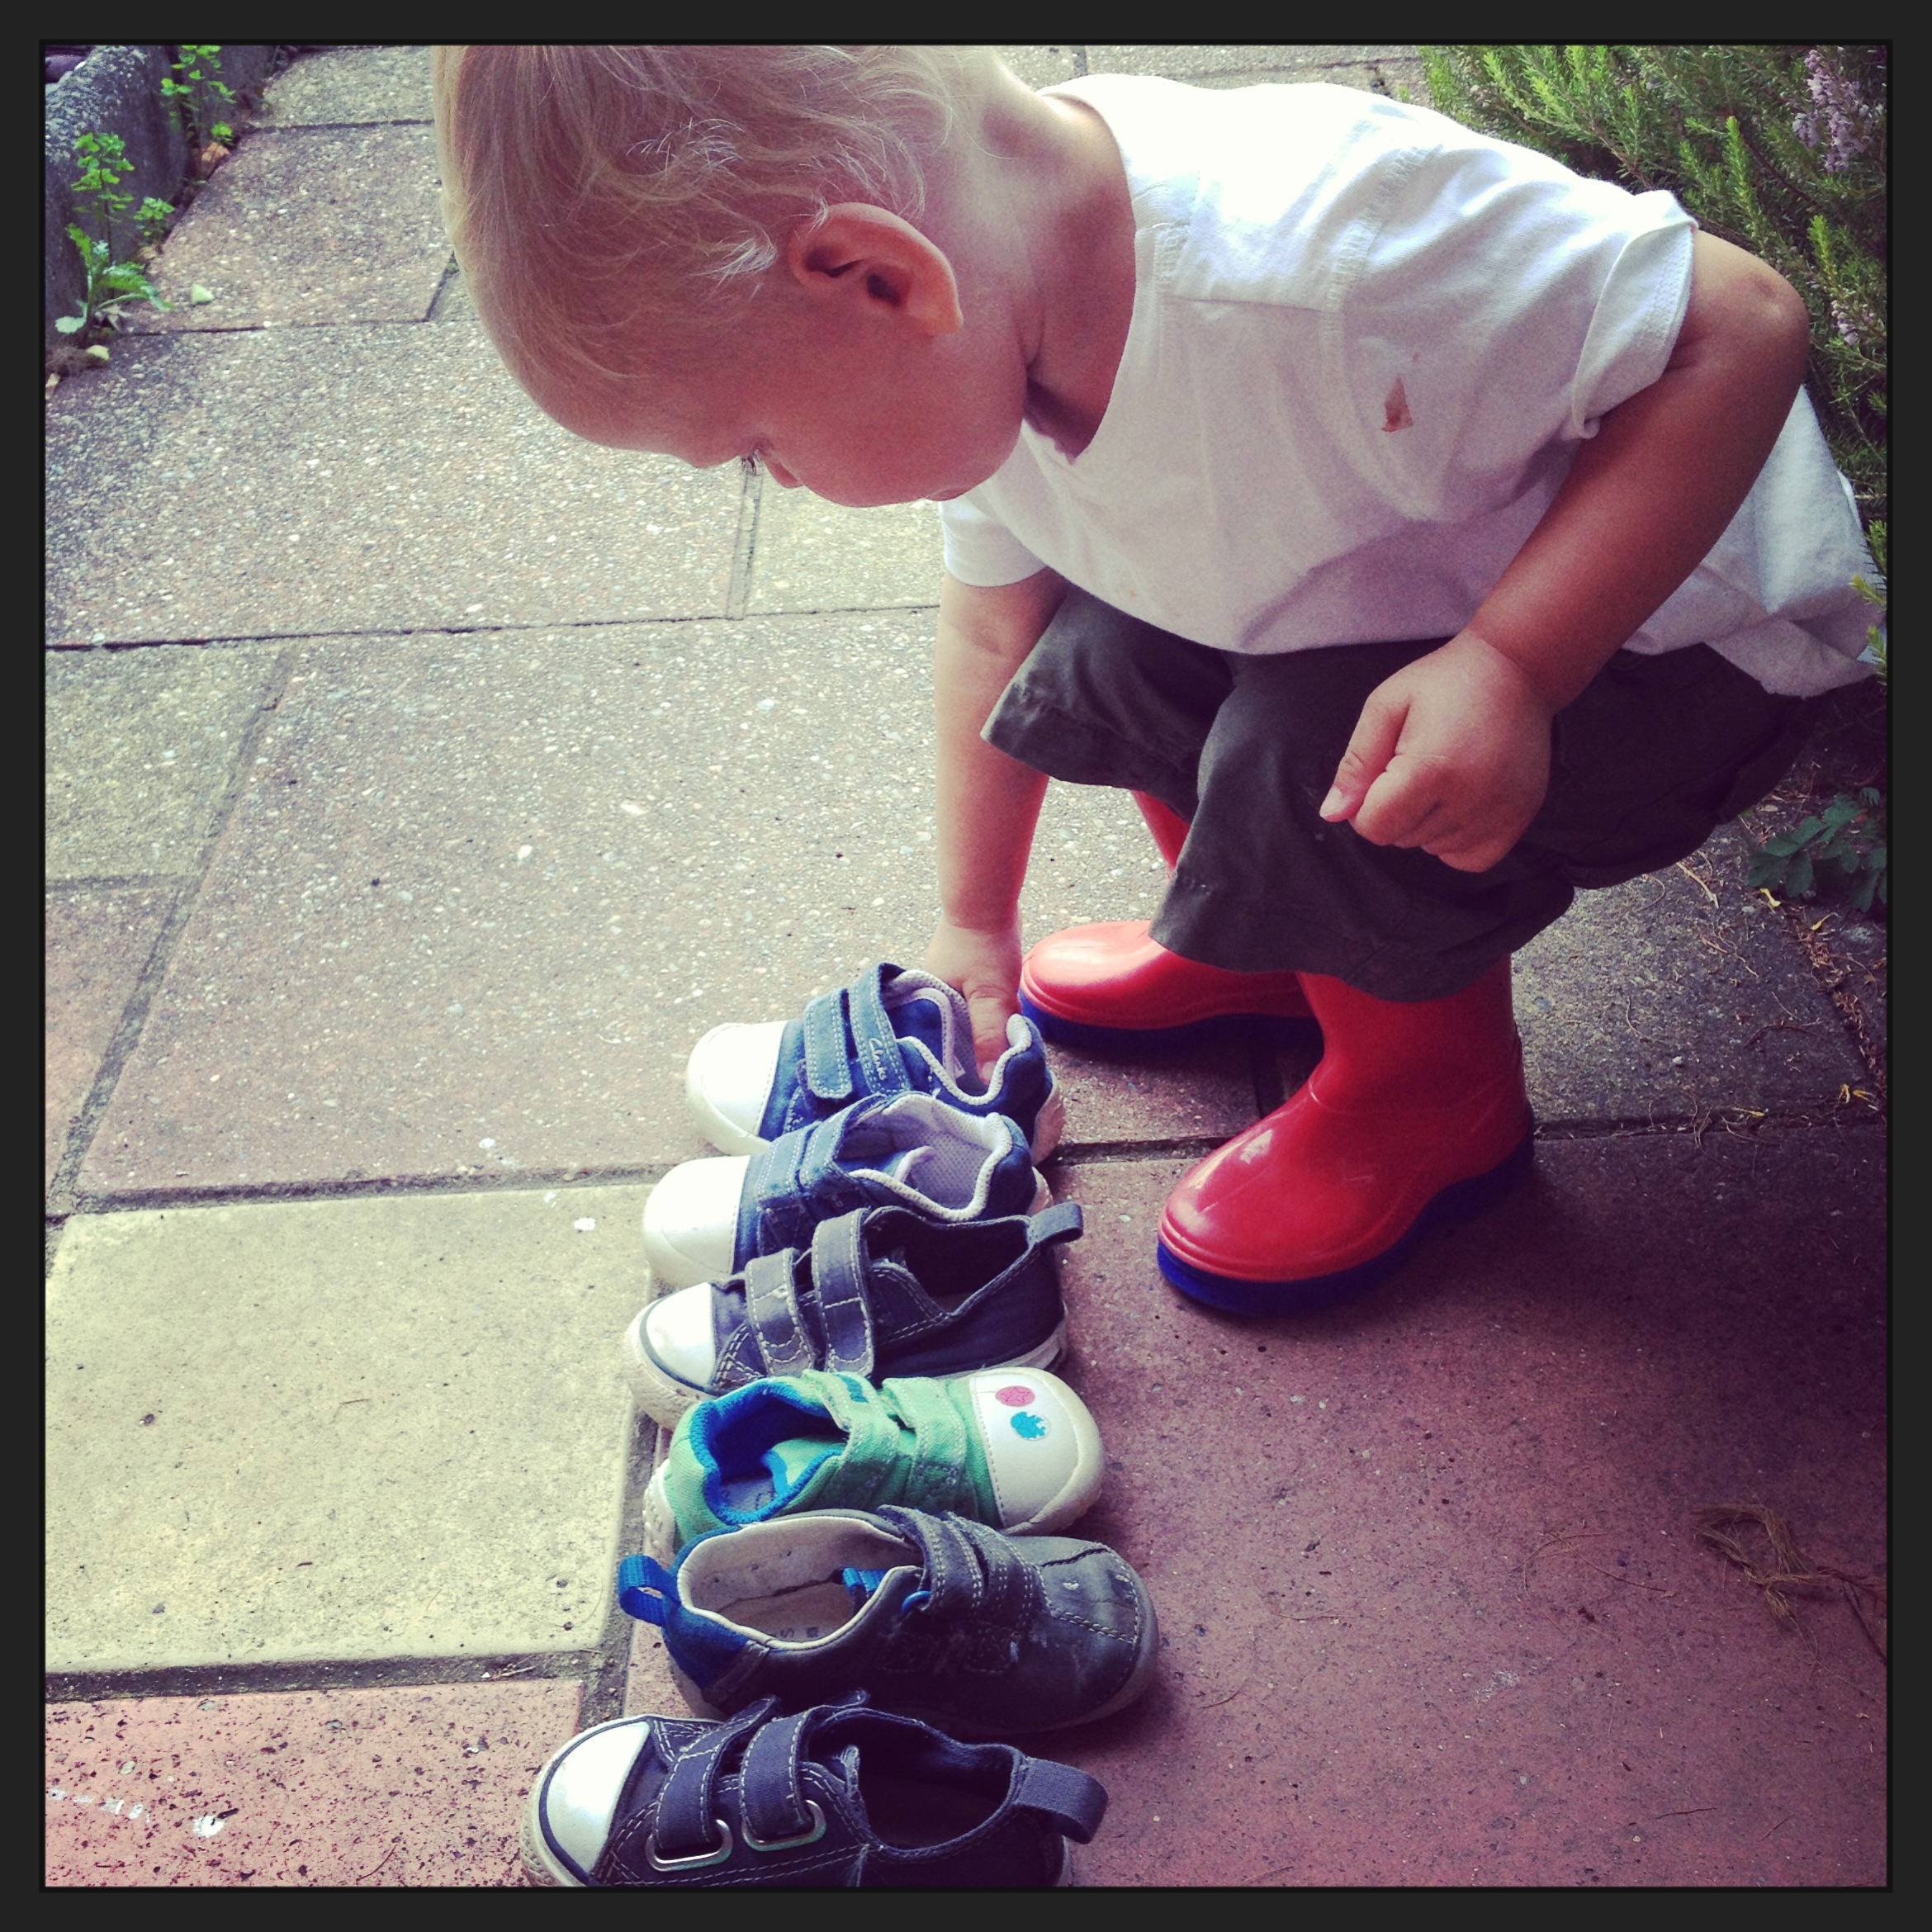
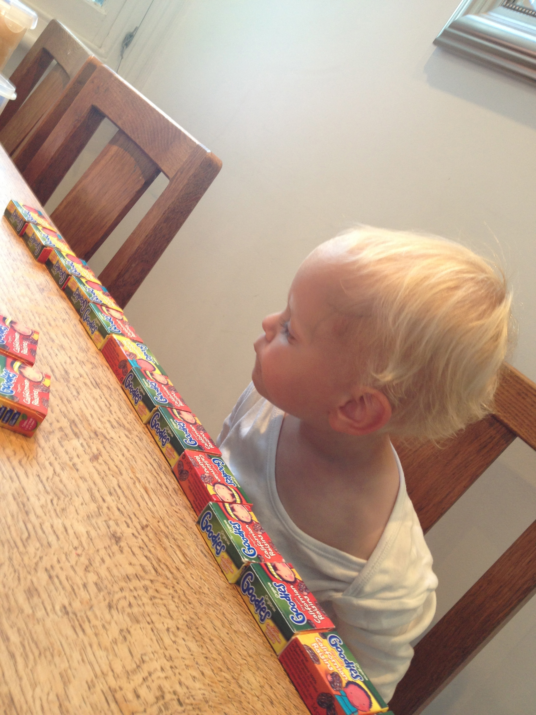
My answer.
What’s yours?
Notes:
This presentation by @TeacherToolkit ( Ross Morrison McGill ) and is licensed under a Creative Commons Attribution-NonCommercial-NoDerivs 3.0 Unported License. Based on all work published at www.teachertoolkit.me
@TeacherToolkit Limited.
Photos of @FreddieWM
Learing outside and at home.
How can this be brought back into the classroom.

Slide 106
Notes:
This presentation by @TeacherToolkit ( Ross Morrison McGill ) and is licensed under a Creative Commons Attribution-NonCommercial-NoDerivs 3.0 Unported License. Based on all work published at www.teachertoolkit.me
@TeacherToolkit Limited.

Slide 107
What teachers make? Taylor Mali
https://www.youtube.com/watch?v=RxsOVK4syxU
Notes:
Video here;
https://www.youtube.com/watch?v=RxsOVK4syxU

Slide 108
Thank you!
by
TeacherToolkit@me.com
@TeacherToolkit
www.TeacherToolkit.me
Notes:
This presentation by @TeacherToolkit ( Ross Morrison McGill ) and is licensed under a Creative Commons Attribution-NonCommercial-NoDerivs 3.0 Unported License.
Based on all work published at www.teachertoolkit.me
@TeacherToolkit Limited.

Slide 109
by
Last slide …

