Slide 1
is setting up…
by
Notes:
Videos needed:
Taylor Mali – What teachers make? = https://www.youtube.com/watch?v=RxsOVK4syxU
Lamont Carey – I can’t read = http://youtu.be/lByDfPOG0LA?t=22s
The 5 Minute Lesson Plan = http://bit.ly/5MinVideo
IRIS myself: https://teachertoolkitdotme.files.wordpress.com/2014/01/year-9-iris-export-for-teachertoolkit-blog.m4v
Resources:
Keywords for literateness?
IPEVO camera?
Latest reading book?
This presentation by @TeacherToolkit ( Ross Morrison McGill ) and is licensed under a Creative Commons Attribution-NonCommercial-NoDerivs 3.0 Unported License.
Based on all work published at www.teachertoolkit.me
@TeacherToolkit Limited.

Slide 2
Fingertips ready?
by
#LCiiMcGill
Notes:
This presentation by @TeacherToolkit ( Ross Morrison McGill ) and is licensed under a Creative Commons Attribution-NonCommercial-NoDerivs 3.0 Unported License.
Based on all work published at www.teachertoolkit.me
@TeacherToolkit Limited.

Slide 3
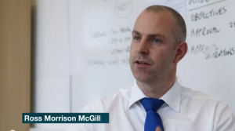
A Valid Landscape for Teaching and Learning. by Ross M. McGill Deputy Headteacher Quintin Kynaston @TeacherToolkit www.TeacherToolkit.me
by

Slide 4
Start thinking …
by
If you could observe someone teach,
who would it be and why?
Notes:
This presentation by @TeacherToolkit ( Ross Morrison McGill ) and is licensed under a Creative Commons Attribution-NonCommercial-NoDerivs 3.0 Unported License.
Based on all work published at www.teachertoolkit.me
@TeacherToolkit Limited.

Slide 5
by

Slide 6
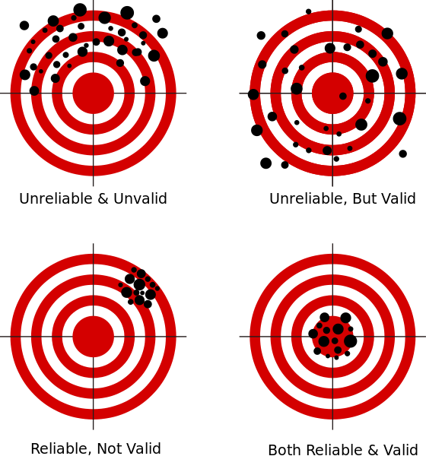
by

Slide 7
What do you see?
by

Slide 8
Looking at OR Looking for?
by

Slide 9
by
Warm up!
Photo credit: www.mediabistro.com
Notes:
This presentation by @TeacherToolkit ( Ross Morrison McGill ) and is licensed under a Creative Commons Attribution-NonCommercial-NoDerivs 3.0 Unported License.
Based on all work published at www.teachertoolkit.me
@TeacherToolkit Limited.
Idea 11 in my 100 ideas book.
Sitting down all day – So, in a moment it will be time to stand up/move about.
FUN PART STARTS here. Rest is boring!
Promotes literacy

Slide 10
Grab!
by
A pen
Scrap A4 paper
Photo credit: www.sk-eternalsapience.blogspot.com
Notes:
This presentation by @TeacherToolkit ( Ross Morrison McGill ) and is licensed under a Creative Commons Attribution-NonCommercial-NoDerivs 3.0 Unported License.
Based on all work published at www.teachertoolkit.me
@TeacherToolkit Limited.
Idea 11 in my 100 ideas book.

Slide 11
by
Draw a circle
Photo credit: www.clker.com
Notes:
This presentation by @TeacherToolkit ( Ross Morrison McGill ) and is licensed under a Creative Commons Attribution-NonCommercial-NoDerivs 3.0 Unported License.
Based on all work published at www.teachertoolkit.me
@TeacherToolkit Limited.
Idea 11 in my 100 ideas book.

Slide 12
by
Divide into 6 pizza slices
Photo credit: www.clker.com
Notes:
This presentation by @TeacherToolkit ( Ross Morrison McGill ) and is licensed under a Creative Commons Attribution-NonCommercial-NoDerivs 3.0 Unported License.
Based on all work published at www.teachertoolkit.me
@TeacherToolkit Limited.
Idea 11 in my 100 ideas book.

Slide 13
by
1
2
6
3
5
4
Number the pizza slices
Photo credit: www.clker.com
Notes:
This presentation by @TeacherToolkit ( Ross Morrison McGill ) and is licensed under a Creative Commons Attribution-NonCommercial-NoDerivs 3.0 Unported License.
Based on all work published at www.teachertoolkit.me
@TeacherToolkit Limited.
Idea 11 in my 100 ideas book.

Slide 14
Spell these words!
by
Photo credit: www.psychologies.co.uk
Notes:
This presentation by @TeacherToolkit ( Ross Morrison McGill ) and is licensed under a Creative Commons Attribution-NonCommercial-NoDerivs 3.0 Unported License.
Based on all work published at www.teachertoolkit.me
@TeacherToolkit Limited.
Idea 11 in my 100 ideas book.
life skills
2. complex
3. commercial
SWAP
4. analysis
5. vocational
6. specialist
SWAP
7. rigour
8. progression
9. colloids
10. caramelise
Food technology in secondary schools
This report evaluates the effectiveness of provision in secondary schools for food technology within the National Curriculum subject design and technology. It examines strengths and weaknesses in pupils' achievement and the tension between the teaching of food to develop life skills and using food as a means to teach design and technology.

Slide 15
Now swap papers!
by
Photo credit: www.kstfamily.com
Notes:
This presentation by @TeacherToolkit ( Ross Morrison McGill ) and is licensed under a Creative Commons Attribution-NonCommercial-NoDerivs 3.0 Unported License.
Based on all work published at www.teachertoolkit.me
@TeacherToolkit Limited.
Idea 11 in my 100 ideas book.

Slide 16
Spell these words!
by
Spellcheck!
Photo credit: www.mommynoire.com
Notes:
This presentation by @TeacherToolkit ( Ross Morrison McGill ) and is licensed under a Creative Commons Attribution-NonCommercial-NoDerivs 3.0 Unported License.
Based on all work published at www.teachertoolkit.me
@TeacherToolkit Limited.

Slide 17
Now swap papers!
by
Photo credit: www.thebabyshopaholic.com
Notes:
This presentation by @TeacherToolkit ( Ross Morrison McGill ) and is licensed under a Creative Commons Attribution-NonCommercial-NoDerivs 3.0 Unported License.
Based on all work published at www.teachertoolkit.me
@TeacherToolkit Limited.

Slide 18
Spell these words!
Spellcheck!
by
Photo credit: www.theguardian.com
Notes:
This presentation by @TeacherToolkit ( Ross Morrison McGill ) and is licensed under a Creative Commons Attribution-NonCommercial-NoDerivs 3.0 Unported License.
Based on all work published at www.teachertoolkit.me
@TeacherToolkit Limited.

Slide 19
Why?
by

Slide 20
The current landscape for teaching and learning is divided
by
Notes:
www.personal.psu.edu700 × 485Search by image

Slide 21
Ofsted have freed us from the burden of lesson gradings, and more specifically judging individual lessons and teachers …
by

Slide 22
However, many schools (or at least individual teachers) are reporting no changes.
by

Slide 23
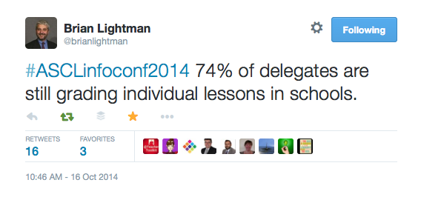
by
ASCL are reporting that 2/3rds of schools are still using summative assessments on individual lessons & teachers.
Notes:
https://twitter.com/brianlightman/status/522685002904256512

Slide 24
by
Notes:
https://twitter.com/TeacherToolkit/status/533910519468802048

Slide 25
Mission: A move away from one-off classroom performance towards a more sophisticated model of gathering reliable and valid sources of evidence (without a grade) over time …
by

Slide 26
Running thought …
by
If you could observe someone, who would it be and why?
Image: www.everydayfeminism.com
Notes:
This presentation by @TeacherToolkit ( Ross Morrison McGill ) and is licensed under a Creative Commons Attribution-NonCommercial-NoDerivs 3.0 Unported License.
Based on all work published at www.teachertoolkit.me
@TeacherToolkit Limited.

Slide 27
Bravery Award!
by

Slide 28
by
What we may be used to?
Notes:
This presentation by @TeacherToolkit ( Ross Morrison McGill ) and is licensed under a Creative Commons Attribution-NonCommercial-NoDerivs 3.0 Unported License.
Based on all work published at www.teachertoolkit.me
@TeacherToolkit Limited.

Slide 29
by
Maybe we should focus on?
Notes:
This presentation by @TeacherToolkit ( Ross Morrison McGill ) and is licensed under a Creative Commons Attribution-NonCommercial-NoDerivs 3.0 Unported License.
Based on all work published at www.teachertoolkit.me
@TeacherToolkit Limited.

Slide 30
No more grades!
by

Slide 31
… that formative observations will become the predominant factor for assessing the overall quality of teaching and learning in most schools.
by
Prediction

Slide 32
What works for my school may not work for your school
by
Remember!

Slide 33
Open vs. Closed
by

Slide 34
Open vs. Closed
by
Open = formative
Closed = summative

Slide 35
by
Don’t forget …
If you could observe someone, who would it be and why?
Image: www.huffingtonpost.com
Notes:
This presentation by @TeacherToolkit ( Ross Morrison McGill ) and is licensed under a Creative Commons Attribution-NonCommercial-NoDerivs 3.0 Unported License.
Based on all work published at www.teachertoolkit.me
@TeacherToolkit Limited.

Slide 37
September 18th 2014
by

Slide 38
by

Slide 39
Observing the Observers Impact on achievement versus Teaching and Learning
by

Slide 40
It is very significant that Ofsted liked what they saw in our classrooms. However, our headline results determined our overall teaching and learning grade. If our results had been higher, then our grade for teaching and learning would have too.
by

Slide 41
Therefore, if outcomes require improvement, then teaching and learning over time cannot be better … … which makes one wonder what significance no grading of lesson observations actually has on the outcome of an inspection.
by

Slide 42
Qualitative or Quantative?
by

Slide 43
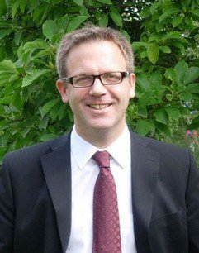
“I once attended a conference session where a senior leader told us that, in his school, 85.26% of lessons were good or outstanding. How delusional that this seems and how toxic; a symptom of how far we’d fallen into the accountability abyss, losing sight of our professionalism.” @headguruteacher Headteacher Highbury Grove School

Slide 44
On observing 97 lessons this term … “The lessons are more normal. You see regular lessons. People tell me so; they fret less about putting on a show and I’m more confident that what I see is what the students get on a normal day. There may be some tidying up but it’s not a performance.” @headguruteacher Headteacher Highbury Grove School

Slide 45
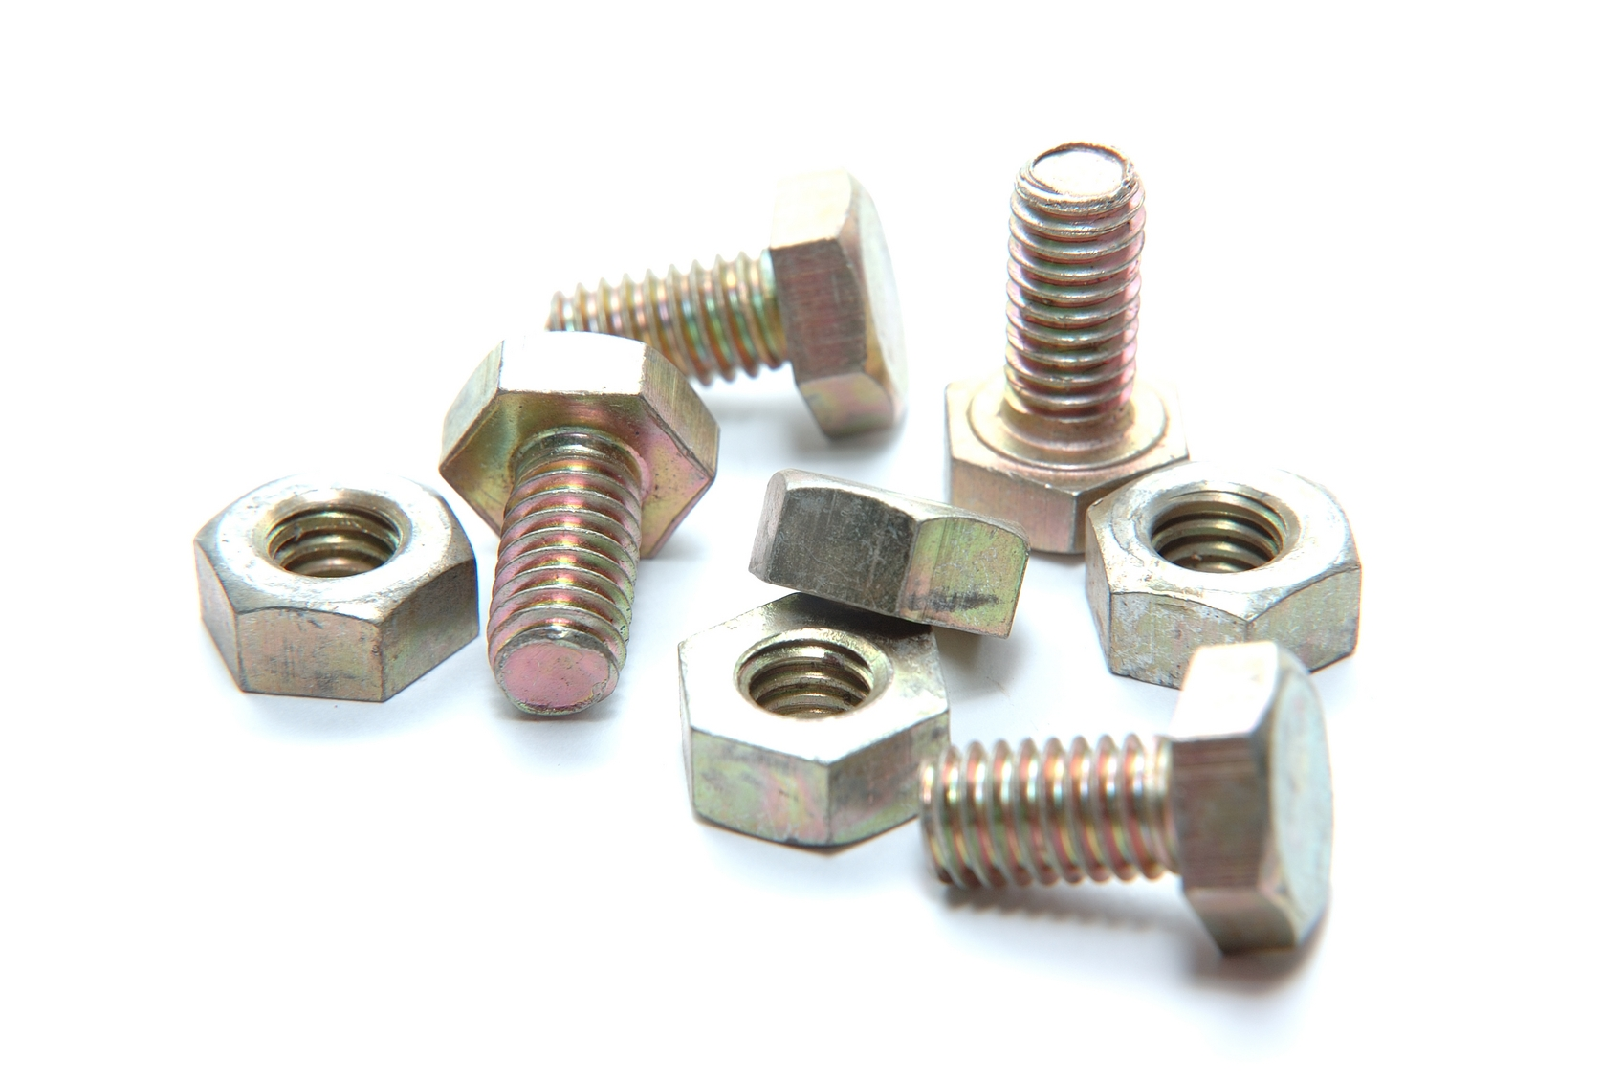
Nuts and bolts …
by

Slide 46
… as we move towards a landscape of teaching and learning without lesson gradings in individual lessons and over time … a challenge …
by

Slide 47
Term 1 = Typicality and Support. Term 2 = Book Looks and non-graded Observations. Term 3 = Data and formalised Student Conversations. Term 4 = Paired formative-Observations Term 5 = Typicality, IRIS and Student Conversations Term 6 = Data, Book Looks and Paired formative-Observations. *Lesson Study *IRIS Connect *Triads
by

Slide 48
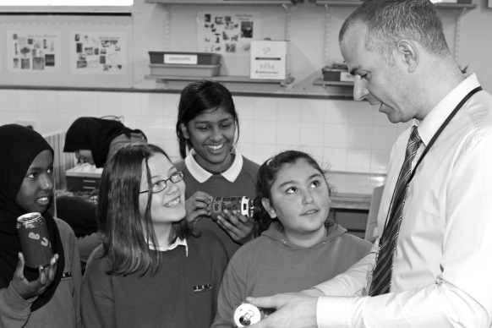
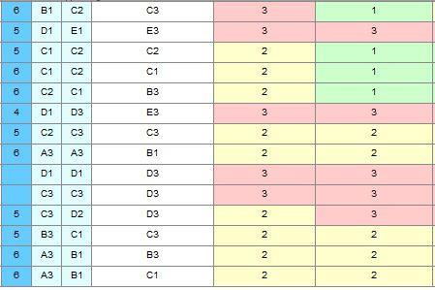
Sources of
Images: http://www.studyblue.com & melisaandryun.com
Notes:
This presentation by @TeacherToolkit ( Ross Morrison McGill ) and is licensed under a Creative Commons Attribution-NonCommercial-NoDerivs 3.0 Unported License.
Based on all work published at www.teachertoolkit.me
@TeacherToolkit Limited.

Slide 49
All evidence gathered will be uploaded onto Blue Sky.
by

Slide 50
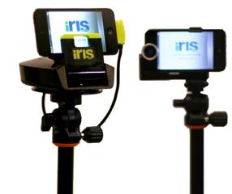
One user-licence for every teacher
by

Slide 51
Running thought …
by
?
If you could observe someone, who would it be and why?
Notes:
This presentation by @TeacherToolkit ( Ross Morrison McGill ) and is licensed under a Creative Commons Attribution-NonCommercial-NoDerivs 3.0 Unported License.
Based on all work published at www.teachertoolkit.me
@TeacherToolkit Limited.
This slideshow forms part of a formal presentation to be given in person.
Essentially, there are 5 ideas within this slideshow for any classroom teacher.
All the other slides are used for conversation at a CPD event.

Slide 52
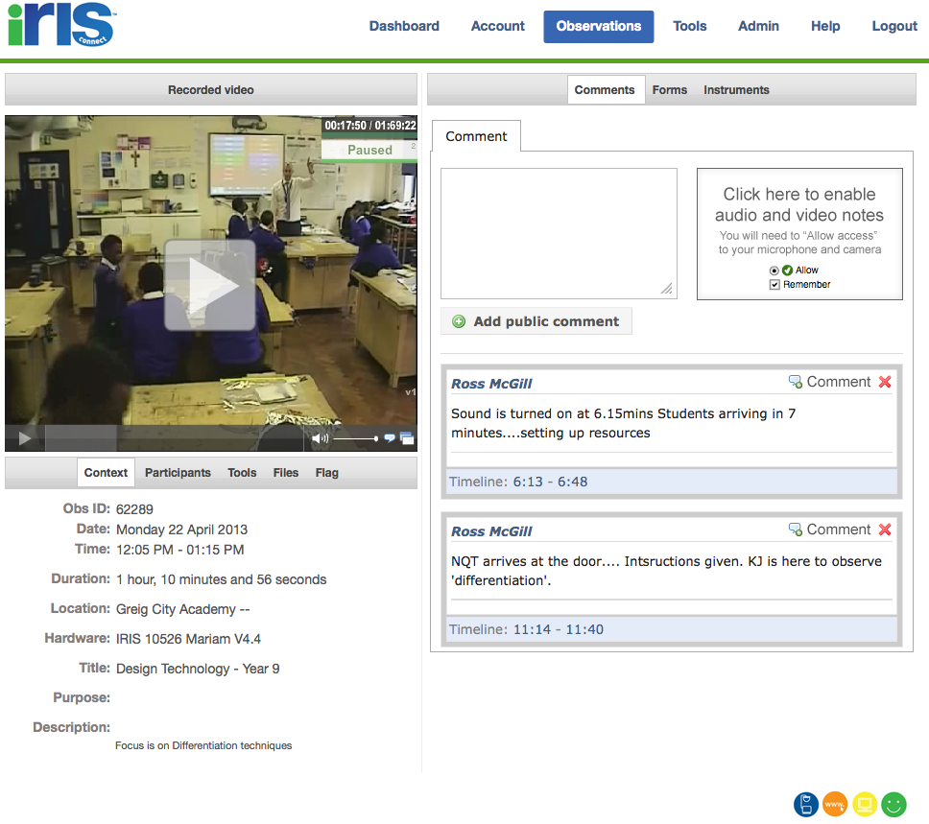
Film yourself!
by
https://teachertoolkitdotme.files.wordpress.com/2014/01/year-9-iris-export-for-teachertoolkit-blog.m4v
Notes:
https://teachertoolkitdotme.files.wordpress.com/2014/01/year-9-iris-export-for-teachertoolkit-blog.m4v
https://eu.irisconnect.com/observations/62289 – from 22mins 38
Year 8 - https://eu.irisconnect.com/observations/62241 - 32 minutes - NOT SURE!

Slide 53
Priorities
by

Slide 54
Training observers to: 1. ‘look at’ rather than ‘look for.’ 2. develop high-level observational skills. 3. offer sophisticated feedback over time. The challenge of: 1. setting up groups of observational-triads, matched to needs. 2. encouraging all teachers to use Iris Connect licence. 3. lesson grading fear and one-off performance.
by

Slide 55
A Valid Model for Teaching and Learning
by
without summative assessments but with formative assessment (over time).

Slide 56
Questions?
by
Image: http://4.bp.blogspot.com
Notes:
This presentation by @TeacherToolkit ( Ross Morrison McGill ) and is licensed under a Creative Commons Attribution-NonCommercial-NoDerivs 3.0 Unported License. Based on all work published at www.teachertoolkit.me
@TeacherToolkit Limited.

Slide 57
Notes:
This presentation by @TeacherToolkit ( Ross Morrison McGill ) and is licensed under a Creative Commons Attribution-NonCommercial-NoDerivs 3.0 Unported License. Based on all work published at www.teachertoolkit.me
@TeacherToolkit Limited.

Slide 58
What teachers make? Taylor Mali
https://www.youtube.com/watch?v=RxsOVK4syxU
Notes:
Video here;
https://www.youtube.com/watch?v=RxsOVK4syxU

Slide 59
Thank you!
by
TeacherToolkit@me.com
@TeacherToolkit
www.TeacherToolkit.me
Notes:
This presentation by @TeacherToolkit ( Ross Morrison McGill ) and is licensed under a Creative Commons Attribution-NonCommercial-NoDerivs 3.0 Unported License.
Based on all work published at www.teachertoolkit.me
@TeacherToolkit Limited.

Slide 60
by
Last slide …

