Slide 1
is setting up…
by
Notes:
Videos needed:
Taylor Mali – What teachers make? = https://www.youtube.com/watch?v=RxsOVK4syxU
Lamont Carey – I can’t read = http://youtu.be/lByDfPOG0LA?t=22s
The 5 Minute Lesson Plan = http://bit.ly/5MinVideo
IRIS myself: https://teachertoolkitdotme.files.wordpress.com/2014/01/year-9-iris-export-for-teachertoolkit-blog.m4v
Resources:
Keywords for literateness?
IPEVO camera?
Latest reading book?
This presentation by @TeacherToolkit ( Ross Morrison McGill ) and is licensed under a Creative Commons Attribution-NonCommercial-NoDerivs 3.0 Unported License.
Based on all work published at www.teachertoolkit.me
@TeacherToolkit Limited.

Slide 2
The 5 Minute Lesson Plan. by Ross M. McGill Deputy Headteacher Quintin Kynaston @TeacherToolkit www.TeacherToolkit.me
by

Slide 3
Start slide See notes
Notes:
Kick off after this slide.
All slides previously, rotate with clicker by hand as staff come and sign in ….

Slide 4
Blank copy of lesson plan?
Notes:
This presentation by @TeacherToolkit ( Ross Morrison McGill ) and is licensed under a Creative Commons Attribution-NonCommercial-NoDerivs 3.0 Unported License. Based on all work published at www.teachertoolkit.me
@TeacherToolkit Limited.

Slide 5
Guide to outstanding!
Notes:
This presentation by @TeacherToolkit ( Ross Morrison McGill ) and is licensed under a Creative Commons Attribution-NonCommercial-NoDerivs 3.0 Unported License. Based on all work published at www.teachertoolkit.me
@TeacherToolkit Limited.

Slide 6
NO!
Photo credit: www.parentspartner.com
Notes:
This presentation by @TeacherToolkit ( Ross Morrison McGill ) and is licensed under a Creative Commons Attribution-NonCommercial-NoDerivs 3.0 Unported License. Based on all work published at www.teachertoolkit.me
@TeacherToolkit Limited.
Blog reading link: http://teachertoolkit.me//?s=observations
Tell you some key facts.
Outstanding teaching – or at least one-off – outstanding teaching is a myth.
Dare I say it does not exist.
Good and possible great teaching DOES exist – over time; books; routines; student conversations; data…
BUT NOT something that can be observed in ANY lessons – never mind a Food Technology lesson
Photo credit: www.parentspartner.com

Slide 7
Saving teachers time!
Photo credit: www.education.scholastic.co.uk
Notes:
This presentation by @TeacherToolkit ( Ross Morrison McGill ) and is licensed under a Creative Commons Attribution-NonCommercial-NoDerivs 3.0 Unported License. Based on all work published at www.teachertoolkit.me
@TeacherToolkit Limited.
Saving time may help you get better. If you want to call this ‘outstanding’; then fine!

Slide 8
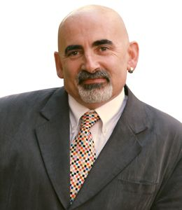
“Every teacher needs to improve, not because they are not good enough, but because they can be even better.” Dylan Wiliam
Notes:
This presentation by @TeacherToolkit ( Ross Morrison McGill ) and is licensed under a Creative Commons Attribution-NonCommercial-NoDerivs 3.0 Unported License. Based on all work published at www.teachertoolkit.me
@TeacherToolkit Limited.

Slide 9
Cognitive Thinking
Photo credit: vip.startrankingnow.com
Notes:
This presentation by @TeacherToolkit ( Ross Morrison McGill ) and is licensed under a Creative Commons Attribution-NonCommercial-NoDerivs 3.0 Unported License. Based on all work published at www.teachertoolkit.me
@TeacherToolkit Limited.
Book reading as of 2.3.14
Cognitive thinking
Cognitive psychology is the study of mental processes such as "attention, language use, memory, perception, problem solving, creativity and thinking.

Slide 10
Pocketstrain Brainstrain
Photo credit: vip.startrankingnow.com
Notes:
This presentation by @TeacherToolkit ( Ross Morrison McGill ) and is licensed under a Creative Commons Attribution-NonCommercial-NoDerivs 3.0 Unported License. Based on all work published at www.teachertoolkit.me
@TeacherToolkit Limited.
Pocketstrain = saving money
Brainstrain = saving thinking time
Read the book. It also discusses the opposite. Things that cost/take time, equally gain more value.
This resource took me 30 hours to produce and tweak.
For students; teachers and headteacher = saving money; saving time (win-win)
Busy people; not much time to think; working on limited budgets

Slide 11
The plan.
Notes:
This presentation by @TeacherToolkit ( Ross Morrison McGill ) and is licensed under a Creative Commons Attribution-NonCommercial-NoDerivs 3.0 Unported License. Based on all work published at www.teachertoolkit.me
@TeacherToolkit Limited.

Slide 12
The facts:
Recognised by Ofsted and individual inspectors.
Used by a mainstream examination boards.
Used by PGCEs, NQTs, Tutors, Mentors, Senior Teachers, Headteachers and schools.
Countless variations online for subject specific content: English; Maths; PE; Science; EYFS; Primary; Higher Education.
Notes:
This presentation by @TeacherToolkit ( Ross Morrison McGill ) and is licensed under a Creative Commons Attribution-NonCommercial-NoDerivs 3.0 Unported License. Based on all work published at www.teachertoolkit.me
@TeacherToolkit Limited.

Slide 13
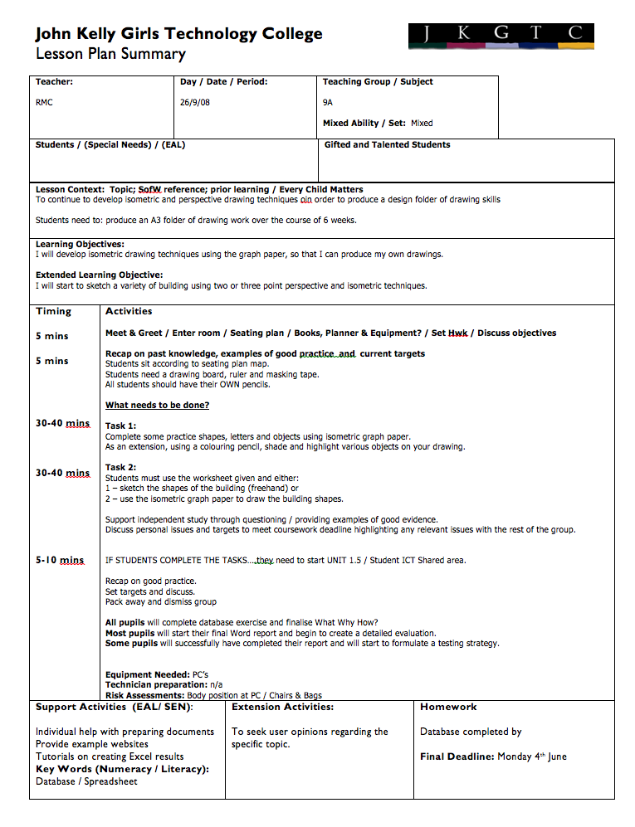
3 types of lesson planning
Notes:
In true 5 Minute Plan form; Stickability – What are our aims?

Slide 14
Rewind
Notes:
This presentation by @TeacherToolkit ( Ross Morrison McGill ) and is licensed under a Creative Commons Attribution-NonCommercial-NoDerivs 3.0 Unported License. Based on all work published at www.teachertoolkit.me
@TeacherToolkit Limited.
A typical lesson plan.
Nothing wrong with it – but potentially laborious / not aesthetically pleasing

Slide 15
The plan
Notes:
Visual learners
Levels
Keywords
Scribble NOT type

Slide 16
The importance of lesson planning
Notes:
This presentation by @TeacherToolkit ( Ross Morrison McGill ) and is licensed under a Creative Commons Attribution-NonCommercial-NoDerivs 3.0 Unported License. Based on all work published at www.teachertoolkit.me
@TeacherToolkit Limited.

Slide 17
Lesson Planning and sucking eggs?
Notes:
This presentation by @TeacherToolkit ( Ross Morrison McGill ) and is licensed under a Creative Commons Attribution-NonCommercial-NoDerivs 3.0 Unported License. Based on all work published at www.teachertoolkit.me
@TeacherToolkit Limited.

Slide 18
Why lesson plan?
by
Planning is imagining the lesson before it happens.
This involves prediction, anticipation, sequencing & simplifying.
When planning a lesson, you make different types of decisions: the aims; the content to be taught.
Planning is a vital component of the teaching-learning process.
Provides a coherent framework for efficient teaching.
A sense of direction.
Helps the teacher to be more confident.
Notes:
This presentation by @TeacherToolkit ( Ross Morrison McGill ) and is licensed under a Creative Commons Attribution-NonCommercial-NoDerivs 3.0 Unported License. Based on all work published at www.teachertoolkit.me
@TeacherToolkit Limited.

Slide 19
Teacher Standards (England)
Notes:
This presentation by @TeacherToolkit ( Ross Morrison McGill ) and is licensed under a Creative Commons Attribution-NonCommercial-NoDerivs 3.0 Unported License. Based on all work published at www.teachertoolkit.me
@TeacherToolkit Limited.

Slide 20
A walk through
Notes:
This presentation by @TeacherToolkit ( Ross Morrison McGill ) and is licensed under a Creative Commons Attribution-NonCommercial-NoDerivs 3.0 Unported License. Based on all work published at www.teachertoolkit.me
@TeacherToolkit Limited.

Slide 21
In video:
Notes:
DO NOT PLAY – it will crash during live presentation.
Watch via You Tube
http://www.youtube.com/watch?v=HPPkwfLbzkM&list=PLKHMsF9J8O635e0wrnnNL6He4GekMG8yT
This presentation by @TeacherToolkit ( Ross Morrison McGill ) and is licensed under a Creative Commons Attribution-NonCommercial-NoDerivs 3.0 Unported License. Based on all work published at www.teachertoolkit.me
@TeacherToolkit Limited.

Slide 22
Step by step.
The big picture
How does the lesson fit into your scheme of work / topic
What knowledge are pupils coming to the lesson with already?
What links have you made / can you make?
Describe the lesson in 30 seconds!
Notes:
Bryan’s advice
Walk through the plan and ask delegates to complete
30 seconds PER SLIDE
Queries:
Tell a story – how it started
Lorna Cork
Jokes!
Keep it informal
If I had my way – I would dictate how every school uses this lesson plan!
Stickability to make the plan work
Loose lesson plan; tight learning gains
This presentation by @TeacherToolkit ( Ross Morrison McGill ) and is licensed under a Creative Commons Attribution-NonCommercial-NoDerivs 3.0 Unported License. Based on all work published at www.teachertoolkit.me
@TeacherToolkit Limited.

Slide 23
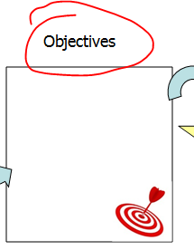
Step by step.
Objectives:
Your objectives for the current lesson and that your lesson is building on what’s gone before.
How to incorporate at least 2 different leveled objectives – perhaps allowing students to choose their own.
Notes:
Keep it informal
If I had my way – I would dictate how every school uses this lesson plan!
Stickability to make the plan work
Loose lesson plan; tight learning gains
This presentation by @TeacherToolkit ( Ross Morrison McGill ) and is licensed under a Creative Commons Attribution-NonCommercial-NoDerivs 3.0 Unported License. Based on all work published at www.teachertoolkit.me
@TeacherToolkit Limited.

Slide 24
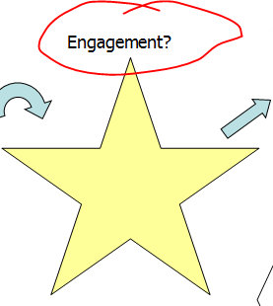
Step by step.
Engagement:
What’s the hook? How will you gain student attention at the start?
And throughout the lesson that is exciting and meaningful (without you working to hard!)
It’s not needed every lesson… but a good story often is enough!
Notes:
This presentation by @TeacherToolkit ( Ross Morrison McGill ) and is licensed under a Creative Commons Attribution-NonCommercial-NoDerivs 3.0 Unported License. Based on all work published at www.teachertoolkit.me
@TeacherToolkit Limited.

Slide 25
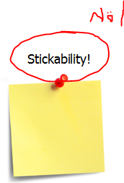
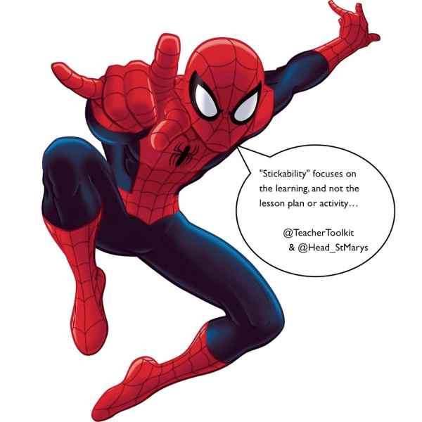
Step by step.
‘Stickability’:
What will stick in pupils’ minds as they leave your lesson?
What key point(s) do you want them to remember and bring back to the next lesson? Read more here.
Notes:
This presentation by @TeacherToolkit ( Ross Morrison McGill ) and is licensed under a Creative Commons Attribution-NonCommercial-NoDerivs 3.0 Unported License. Based on all work published at www.teachertoolkit.me
@TeacherToolkit Limited.

Slide 26
Stickability: continued
Credit: Stephen Tierney (@LeadingLearner)
Notes:
Keep the plan loose and learning tight!
THIS IS WHAT STICKABILITY IS.
This presentation by @TeacherToolkit ( Ross Morrison McGill ) and is licensed under a Creative Commons Attribution-NonCommercial-NoDerivs 3.0 Unported License. Based on all work published at www.teachertoolkit.me
@TeacherToolkit Limited.

Slide 27
Questions?
Coming up: A walk though
Notes:
This presentation by @TeacherToolkit ( Ross Morrison McGill ) and is licensed under a Creative Commons Attribution-NonCommercial-NoDerivs 3.0 Unported License. Based on all work published at www.teachertoolkit.me
@TeacherToolkit Limited.

Slide 28
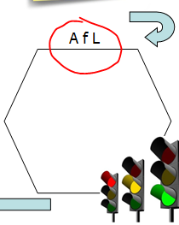
Step by step.
AfL
How will you assess where your learners are?
During various points in the lesson?
What AfL strategies are you going to use?
What key questions will help you to lure pupils into learning?
Try Pose, Pause, Pounce, Bounce?
Planning for various (AfL) Assessment for Learning strategies to allow students to see progress. Using a Targeted-Question grid to help frame higher-order questions.
Check out the new 5MinAfLPlan?
Notes:
This presentation by @TeacherToolkit ( Ross Morrison McGill ) and is licensed under a Creative Commons Attribution-NonCommercial-NoDerivs 3.0 Unported License. Based on all work published at www.teachertoolkit.me
@TeacherToolkit Limited.

Slide 29
Step by step.
Key words:
Literacy has never had such a high-profile as it has at the moment.
Encourage students to read lesson objectives out.
Picking out keywords and extrapolating their meanings.
Use techniques to break down the phonics of each word and encourage visual recognition to reinforce.
Plan what keywords you want students to learn. This promotes high levels of literacy which is an Ofsted focus.
What about numeracy? Every lesson should involve some mathematical reference of link.
Notes:
This presentation by @TeacherToolkit ( Ross Morrison McGill ) and is licensed under a Creative Commons Attribution-NonCommercial-NoDerivs 3.0 Unported License. Based on all work published at www.teachertoolkit.me
@TeacherToolkit Limited.

Slide 30
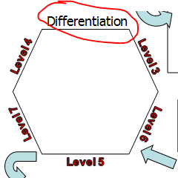
Step by step.
Differentiation / Groupings:
Plan – at a glance – what activities you will provide for gifted and talented students?
Students with SEN/D and EAL?
What sort of groupings are needed?
What are they doing and when?
Do you have this mapped to a seating plan with current levels of progress?
Notes:
This presentation by @TeacherToolkit ( Ross Morrison McGill ) and is licensed under a Creative Commons Attribution-NonCommercial-NoDerivs 3.0 Unported License. Based on all work published at www.teachertoolkit.me
@TeacherToolkit Limited.

Slide 31
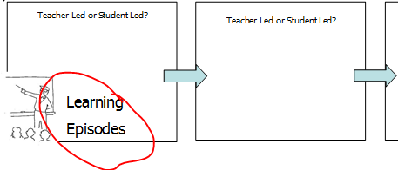
Step by step.
Learning episodes:
Student-led or teacher-led?
What is going to happen in the lesson from start to finish?
Identify as many opportunities for pupil-led learning as possible.
The four boxes do NOT denote a four-part lesson. Just fill them up with what needs to happen.
Notes:
This presentation by @TeacherToolkit ( Ross Morrison McGill ) and is licensed under a Creative Commons Attribution-NonCommercial-NoDerivs 3.0 Unported License. Based on all work published at www.teachertoolkit.me
@TeacherToolkit Limited.

Slide 32
End of step by step
Notes:
This presentation by @TeacherToolkit ( Ross Morrison McGill ) and is licensed under a Creative Commons Attribution-NonCommercial-NoDerivs 3.0 Unported License. Based on all work published at www.teachertoolkit.me
@TeacherToolkit Limited.

Slide 33
Questions?
Coming up: The boring bit.
Notes:
This presentation by @TeacherToolkit ( Ross Morrison McGill ) and is licensed under a Creative Commons Attribution-NonCommercial-NoDerivs 3.0 Unported License. Based on all work published at www.teachertoolkit.me
@TeacherToolkit Limited.

Slide 34
Useful reminders for every teacher
PLAN AND TEACH WELL STRUCTURED LESSONS
Notes:
This presentation by @TeacherToolkit ( Ross Morrison McGill ) and is licensed under a Creative Commons Attribution-NonCommercial-NoDerivs 3.0 Unported License. Based on all work published at www.teachertoolkit.me
@TeacherToolkit Limited.

Slide 35
Reflection Questions:
Subject knowledge :
Is understanding checked systematically and effectively in order to anticipate interventions?
Do you ask key questions in order to assess understanding and deepen learning?
Notes:
This presentation by @TeacherToolkit ( Ross Morrison McGill ) and is licensed under a Creative Commons Attribution-NonCommercial-NoDerivs 3.0 Unported License. Based on all work published at www.teachertoolkit.me
@TeacherToolkit Limited.
Hattie effect sizes and influences on student achievement

Slide 36
Useful reminders for every teacher
Promote a love of learning and children’s intellectual curiosity.
Notes:
This presentation by @TeacherToolkit ( Ross Morrison McGill ) and is licensed under a Creative Commons Attribution-NonCommercial-NoDerivs 3.0 Unported License. Based on all work published at www.teachertoolkit.me
@TeacherToolkit Limited.

Slide 37
Reflection Questions:
Attitudes to learning:
Do students demonstrate high levels of engagement, courtesy, collaboration and cooperation?
Is praise genuine and purposeful?
Notes:
This presentation by @TeacherToolkit ( Ross Morrison McGill ) and is licensed under a Creative Commons Attribution-NonCommercial-NoDerivs 3.0 Unported License. Based on all work published at www.teachertoolkit.me
@TeacherToolkit Limited.

Slide 38
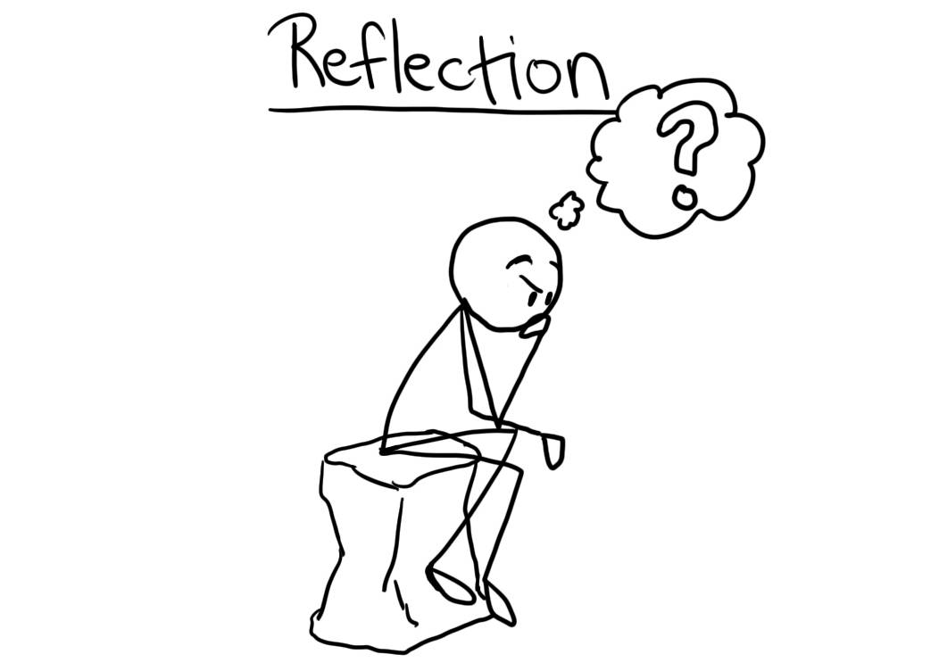
Useful reminders for every teacher
Reflect systematically on the effectiveness of lessons and approaches to teaching.
Notes:
This presentation by @TeacherToolkit ( Ross Morrison McGill ) and is licensed under a Creative Commons Attribution-NonCommercial-NoDerivs 3.0 Unported License. Based on all work published at www.teachertoolkit.me
@TeacherToolkit Limited.

Slide 39
Reflection Questions:
Teaching:
Do the students work harder than you?
Can students explain how what they are?
Notes:
This presentation by @TeacherToolkit ( Ross Morrison McGill ) and is licensed under a Creative Commons Attribution-NonCommercial-NoDerivs 3.0 Unported License. Based on all work published at www.teachertoolkit.me
@TeacherToolkit Limited.

Slide 40
Useful reminders for every teacher
Contribute to the design and provision of an engaging curriculum within the relevant subject area(s).
Notes:
This presentation by @TeacherToolkit ( Ross Morrison McGill ) and is licensed under a Creative Commons Attribution-NonCommercial-NoDerivs 3.0 Unported License. Based on all work published at www.teachertoolkit.me
@TeacherToolkit Limited.

Slide 41
Reflection Questions:
Progress:
Do you build resilience, confidence and engagement?
Do you plan for the needs to different groups of learners?
Notes:
This presentation by @TeacherToolkit ( Ross Morrison McGill ) and is licensed under a Creative Commons Attribution-NonCommercial-NoDerivs 3.0 Unported License. Based on all work published at www.teachertoolkit.me
@TeacherToolkit Limited.
Hattie effect sizes and influences on student achievement

Slide 42
The boring bit . . .
Notes:
This presentation by @TeacherToolkit ( Ross Morrison McGill ) and is licensed under a Creative Commons Attribution-NonCommercial-NoDerivs 3.0 Unported License. Based on all work published at www.teachertoolkit.me
@TeacherToolkit Limited.
Latest guidance
Let me give you an oxymoron to consider…
NO LESSON PLANS
NO JUDGEMENTS EVER
PROGRESS OVER TIME

Slide 43
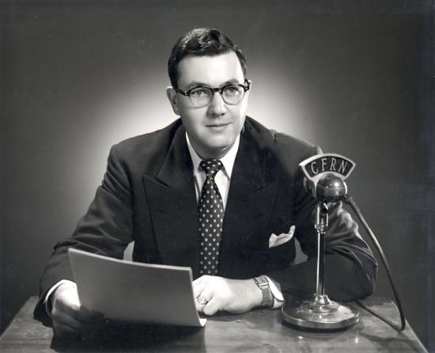
And the latest by Ofsted is …

Slide 44
What do Ofsted say?
“Ofsted do not require a lesson plan;
but evidence of a planned lesson!”
Ofsted Handbook: September 2012 and then again in 2013 and 2014
Notes:
Oxymoron
Evidence found in schemes of work; routines; prior knowledge; curriculum plans

Slide 45
What do Ofsted say?
“Inspectors will not expect teachers to prepare lesson plans for the inspection. However, they will use the evidence gathered from lesson observations to help judge the overall quality of the school’s curriculum planning.“
Notes:
This presentation by @TeacherToolkit ( Ross Morrison McGill ) and is licensed under a Creative Commons Attribution-NonCommercial-NoDerivs 3.0 Unported License.
Based on all work published at www.teachertoolkit.me
@TeacherToolkit Limited.

Slide 46
What do Ofsted say?
“Inspectors must not advocate a particular method of teaching or show preference towards a specific lesson structure.”
Notes:
This presentation by @TeacherToolkit ( Ross Morrison McGill ) and is licensed under a Creative Commons Attribution-NonCommercial-NoDerivs 3.0 Unported License.
Based on all work published at www.teachertoolkit.me
@TeacherToolkit Limited.

Slide 47
The importance evidence and impact
Notes:
This presentation by @TeacherToolkit ( Ross Morrison McGill ) and is licensed under a Creative Commons Attribution-NonCommercial-NoDerivs 3.0 Unported License. Based on all work published at www.teachertoolkit.me
@TeacherToolkit Limited.

Slide 48
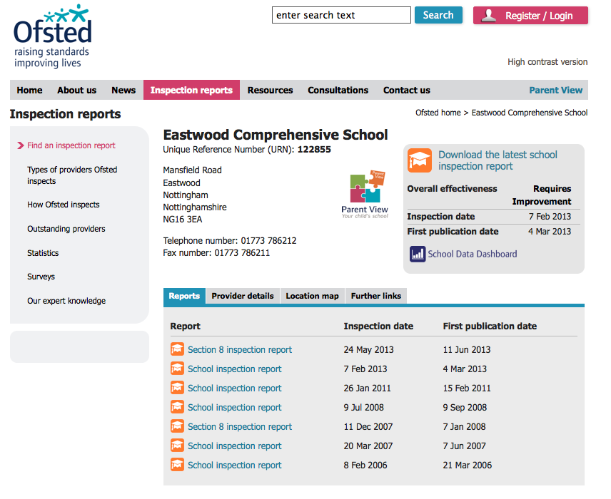
Notes:
This presentation by @TeacherToolkit ( Ross Morrison McGill ) and is licensed under a Creative Commons Attribution-NonCommercial-NoDerivs 3.0 Unported License. Based on all work published at www.teachertoolkit.me
@TeacherToolkit Limited.
Ofsted http://www.ofsted.gov.uk/inspection-reports/find-inspection-report/provider/ELS/122855
February 2013 version

Slide 49
Ofsted affirmation:
Notes:
This presentation by @TeacherToolkit ( Ross Morrison McGill ) and is licensed under a Creative Commons Attribution-NonCommercial-NoDerivs 3.0 Unported License. Based on all work published at www.teachertoolkit.me
@TeacherToolkit Limited.
Ofsted http://www.ofsted.gov.uk/inspection-reports/find-inspection-report/provider/ELS/122855
February 2013 version

Slide 50
Evidence:
One-off or over time?
https://twitter.com/Jobaker9/statuses/380666404523237376
Notes:
This presentation by @TeacherToolkit ( Ross Morrison McGill ) and is licensed under a Creative Commons Attribution-NonCommercial-NoDerivs 3.0 Unported License. Based on all work published at www.teachertoolkit.me
@TeacherToolkit Limited.
I used to show messages like this to my staff; blog readers and Twitter followers. I NOW NO longer do this.
Explain!

Slide 51
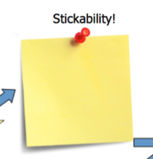
Stickability!
by
What will stick as students leave your lesson?
What key points do you want them to remember?
What do you want to bring back to the next lesson?
Notes:
This presentation by @TeacherToolkit ( Ross Morrison McGill ) and is licensed under a Creative Commons Attribution-NonCommercial-NoDerivs 3.0 Unported License.
Based on all work published at www.teachertoolkit.me
@TeacherToolkit Limited.

Slide 52
Stickability: continued
by
Credit: Stephen Tierney (@LeadingLearner)
Notes:
This presentation by @TeacherToolkit ( Ross Morrison McGill ) and is licensed under a Creative Commons Attribution-NonCommercial-NoDerivs 3.0 Unported License.
Based on all work published at www.teachertoolkit.me
@TeacherToolkit Limited.
Keep the plan loose and learning tight!
THIS IS WHAT STICKABILITY IS.

Slide 53
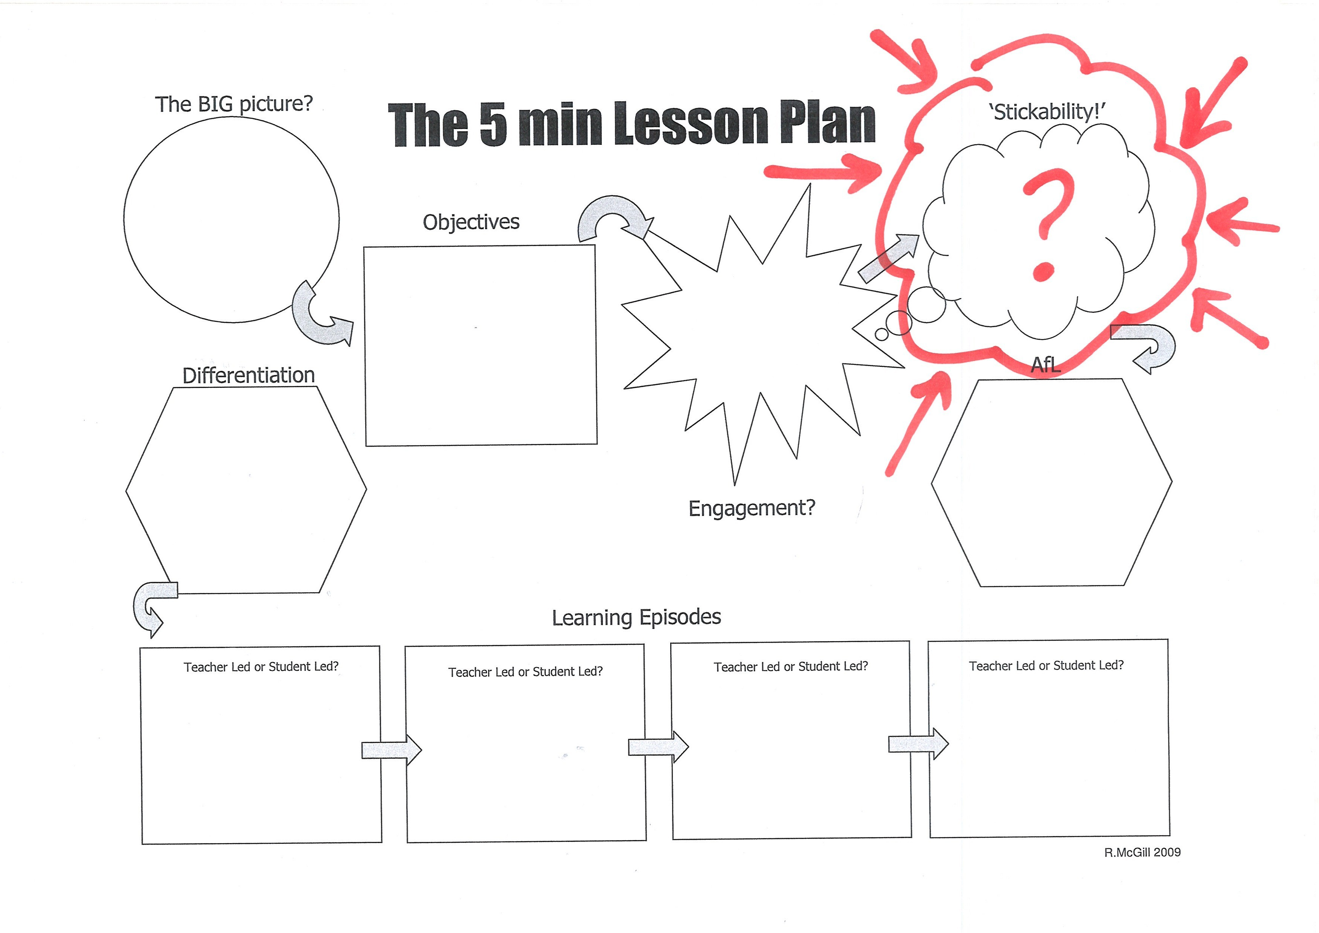
The original plan
by
Notes:
This presentation by @TeacherToolkit ( Ross Morrison McGill ) and is licensed under a Creative Commons Attribution-NonCommercial-NoDerivs 3.0 Unported License.
Based on all work published at www.teachertoolkit.me
@TeacherToolkit Limited.

Slide 54
Stickability?
by
Notes:
This presentation by @TeacherToolkit ( Ross Morrison McGill ) and is licensed under a Creative Commons Attribution-NonCommercial-NoDerivs 3.0 Unported License.
Based on all work published at www.teachertoolkit.me
@TeacherToolkit Limited.

Slide 55
Meta-cognitive planning:
by
Meta = meaning "after" or "beyond"
Take you beyond planning thought!
Notes:
This presentation by @TeacherToolkit ( Ross Morrison McGill ) and is licensed under a Creative Commons Attribution-NonCommercial-NoDerivs 3.0 Unported License.
Based on all work published at www.teachertoolkit.me
@TeacherToolkit Limited.

Slide 56
Make it stick!
by
A reminder …
Your Stickability focus is NOT the activity.
Focus on what students are:
LEARNING
LEARNING
LEARNING!
Notes:
This presentation by @TeacherToolkit ( Ross Morrison McGill ) and is licensed under a Creative Commons Attribution-NonCommercial-NoDerivs 3.0 Unported License.
Based on all work published at www.teachertoolkit.me
@TeacherToolkit Limited.

Slide 57
Stage 1: The day ahead…
by
Lesson 1: Stickability!
Lesson 2: Stickability!
Lesson 3: Stickability!
Lesson 4: Stickability!
Lesson 5: Stickability!
Notes:
This presentation by @TeacherToolkit ( Ross Morrison McGill ) and is licensed under a Creative Commons Attribution-NonCommercial-NoDerivs 3.0 Unported License.
Based on all work published at www.teachertoolkit.me
@TeacherToolkit Limited.
Look / Think for one minute about your day ahead. 5 lessons ahead. Summarise all the lessons into one sentence!
NOT AN ACTIVITY – LEARNING! LEARNING LEARNING!

Slide 58
Questions?
Coming up: The evidence
Notes:
This presentation by @TeacherToolkit ( Ross Morrison McGill ) and is licensed under a Creative Commons Attribution-NonCommercial-NoDerivs 3.0 Unported License. Based on all work published at www.teachertoolkit.me
@TeacherToolkit Limited.

Slide 59
Evidence-based research
Photo credit: vip.startrankingnow.com
Notes:
This presentation by @TeacherToolkit ( Ross Morrison McGill ) and is licensed under a Creative Commons Attribution-NonCommercial-NoDerivs 3.0 Unported License. Based on all work published at www.teachertoolkit.me
@TeacherToolkit Limited.
Book reading as of 2.3.14
Cognitive thinking
Cognitive psychology is the study of mental processes such as "attention, language use, memory, perception, problem solving, creativity and thinking.

Slide 60
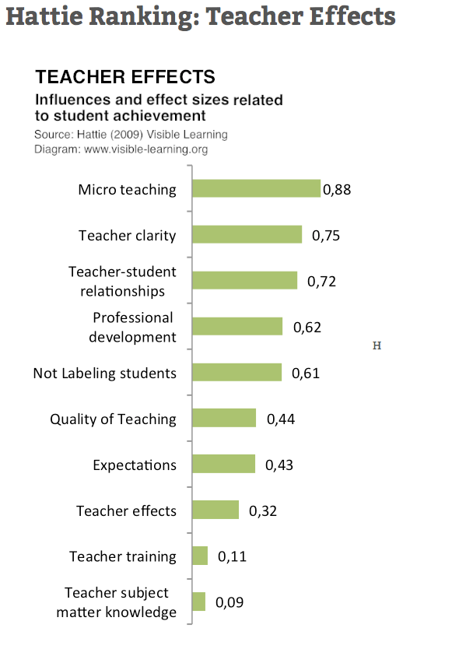
The Teacher
by
• An effect size of 0.5 is equivalent to a one grade leap at GCSE
• An effect size of 1.0 is equivalent to a two grade leap at GCSE
Notes:
This presentation by @TeacherToolkit ( Ross Morrison McGill ) and is licensed under a Creative Commons Attribution-NonCommercial-NoDerivs 3.0 Unported License.
Based on all work published at www.teachertoolkit.me
@TeacherToolkit Limited.
Hattie effect sizes and influences on student achievement

Slide 61
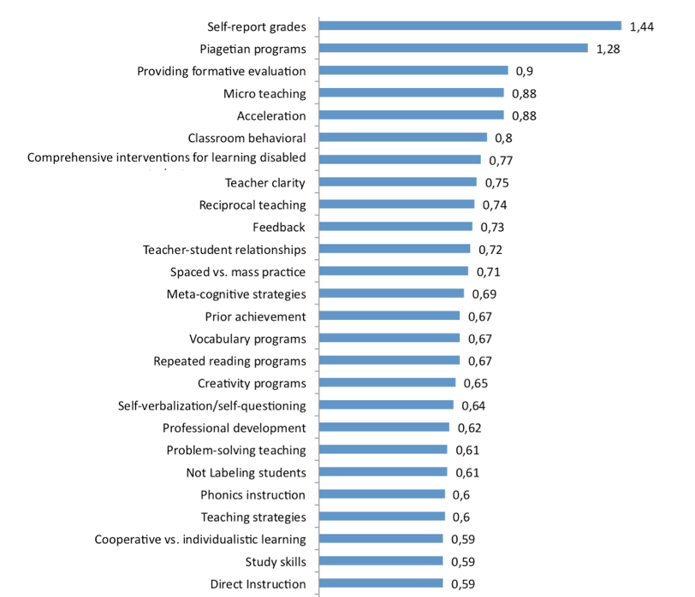
Effect sizes:
by
• An effect size of 0.5 is equivalent to a one grade leap at GCSE
• An effect size of 1.0 is equivalent to a two grade leap at GCSE
Stickability!
(THE TEACHING)
www.bit.ly/5MLPHattie
Notes:
This presentation by @TeacherToolkit ( Ross Morrison McGill ) and is licensed under a Creative Commons Attribution-NonCommercial-NoDerivs 3.0 Unported License.
Based on all work published at www.teachertoolkit.me
@TeacherToolkit Limited.
Link: www.bit.ly/5MLPHattie

Slide 62
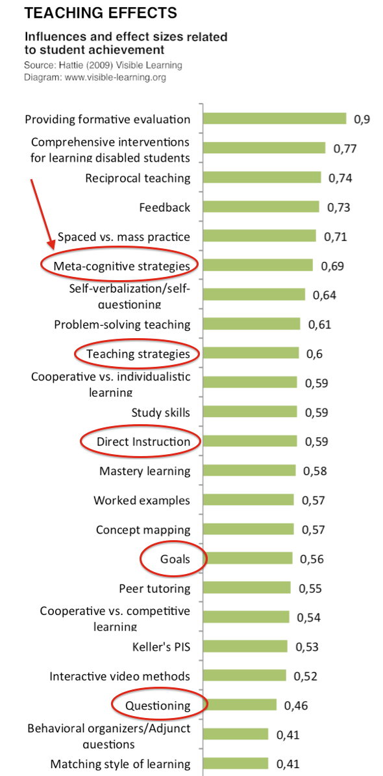
Teacher:
Effect-size and influence above questioning and
setting goals.
Notes:
This presentation by @TeacherToolkit ( Ross Morrison McGill ) and is licensed under a Creative Commons Attribution-NonCommercial-NoDerivs 3.0 Unported License. Based on all work published at www.teachertoolkit.me
@TeacherToolkit Limited.
Hattie effect sizes and influences on student achievement

Slide 63
Metacognition is defined as:
"cognition about cognition",
or "knowing about knowing".
It comes from the root word meta, meaning beyond. It can take many forms; it includes knowledge about when and how to use particular strategies for learning or for problem solving.
Notes:
This presentation by @TeacherToolkit ( Ross Morrison McGill ) and is licensed under a Creative Commons Attribution-NonCommercial-NoDerivs 3.0 Unported License. Based on all work published at www.teachertoolkit.me
@TeacherToolkit Limited.
Hattie effect sizes and influences on student achievement

Slide 64
Real-time Tweets:
https://twitter.com/search?q=%235minplan&src=savs&f=realtime
Notes:
Real time search
https://twitter.com/search?q=%235minplan&src=savs&f=realtime
This presentation by @TeacherToolkit ( Ross Morrison McGill ) and is licensed under a Creative Commons Attribution-NonCommercial-NoDerivs 3.0 Unported License. Based on all work published at www.teachertoolkit.me
@TeacherToolkit Limited.

Slide 65
Real-time photos:
https://twitter.com/search?q=%235minplan&src=savs&mode=photos
Notes:
Real time search
https://twitter.com/search?q=%235minplan&src=savs&mode=photos
This presentation by @TeacherToolkit ( Ross Morrison McGill ) and is licensed under a Creative Commons Attribution-NonCommercial-NoDerivs 3.0 Unported License. Based on all work published at www.teachertoolkit.me
@TeacherToolkit Limited.

Slide 66
Variations to support lesson reflection
Notes:
This presentation by @TeacherToolkit ( Ross Morrison McGill ) and is licensed under a Creative Commons Attribution-NonCommercial-NoDerivs 3.0 Unported License. Based on all work published at www.teachertoolkit.me
@TeacherToolkit Limited.

Slide 67
Example:
Notes:
This presentation by @TeacherToolkit ( Ross Morrison McGill ) and is licensed under a Creative Commons Attribution-NonCommercial-NoDerivs 3.0 Unported License. Based on all work published at www.teachertoolkit.me
@TeacherToolkit Limited.

Slide 68
Example:
Notes:
This presentation by @TeacherToolkit ( Ross Morrison McGill ) and is licensed under a Creative Commons Attribution-NonCommercial-NoDerivs 3.0 Unported License. Based on all work published at www.teachertoolkit.me
@TeacherToolkit Limited.

Slide 69
Open doors …

Slide 70
Introducing

Slide 71
Automatic seating plans!

Slide 72
Click and drag manually …

Slide 73
Display / Hide data

Slide 74
Target grade, Current grade, KS2 average score, Pupil Premium and SEN

Slide 75
Questions?
by
Coming up: The end . . .
Notes:
This presentation by @TeacherToolkit ( Ross Morrison McGill ) and is licensed under a Creative Commons Attribution-NonCommercial-NoDerivs 3.0 Unported License. Based on all work published at www.teachertoolkit.me
@TeacherToolkit Limited.

Slide 76
Find out more . . .
Notes:
This presentation by @TeacherToolkit ( Ross Morrison McGill ) and is licensed under a Creative Commons Attribution-NonCommercial-NoDerivs 3.0 Unported License. Based on all work published at www.teachertoolkit.me
@TeacherToolkit Limited.

Slide 77
5 Minute Series
Notes:
This presentation by @TeacherToolkit ( Ross Morrison McGill ) and is licensed under a Creative Commons Attribution-NonCommercial-NoDerivs 3.0 Unported License. Based on all work published at www.teachertoolkit.me
@TeacherToolkit Limited.

Slide 78
The series:
TeacherToolkit.me/5minplan-series
Notes:
This presentation by @TeacherToolkit ( Ross Morrison McGill ) and is licensed under a Creative Commons Attribution-NonCommercial-NoDerivs 3.0 Unported License. Based on all work published at www.teachertoolkit.me
@TeacherToolkit Limited.

Slide 79
Notes:
This presentation by @TeacherToolkit ( Ross Morrison McGill ) and is licensed under a Creative Commons Attribution-NonCommercial-NoDerivs 3.0 Unported License. Based on all work published at www.teachertoolkit.me
@TeacherToolkit Limited.

Slide 80
Thank you!
by
TeacherToolkit@me.com
@TeacherToolkit
www.TeacherToolkit.me
Notes:
This presentation by @TeacherToolkit ( Ross Morrison McGill ) and is licensed under a Creative Commons Attribution-NonCommercial-NoDerivs 3.0 Unported License.
Based on all work published at www.teachertoolkit.me
@TeacherToolkit Limited.

Slide 81
by
Last slide …

