Slide 1
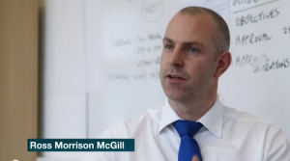
is setting up…
by
Notes:
Videos needed:
Taylor Mali – What teachers make? = https://www.youtube.com/watch?v=RxsOVK4syxU
Lamont Carey – I can’t read = http://youtu.be/lByDfPOG0LA?t=22s
The 5 Minute Lesson Plan = http://bit.ly/5MinVideo
IRIS myself: https://teachertoolkitdotme.files.wordpress.com/2014/01/year-9-iris-export-for-teachertoolkit-blog.m4v
Resources:
Keywords for literateness?
IPEVO camera?
Latest reading book?
This presentation by @TeacherToolkit ( Ross Morrison McGill ) and is licensed under a Creative Commons Attribution-NonCommercial-NoDerivs 3.0 Unported License.
Based on all work published at www.teachertoolkit.me
@TeacherToolkit Limited.

Slide 2
Start slide See notes
Notes:
Kick off after this slide.
All slides previously, rotate with clicker by hand as staff come and sign in ….

Slide 3
The Importance of Teaching and CPD. by Ross M. McGill Deputy Headteacher Quintin Kynaston @TeacherToolkit www.TeacherToolkit.me
by

Slide 4
Something to hear Something for free Something to do …

Slide 5
CPD agenda

Slide 6
Reflection Questions …
What professional learning did you do over the last 3 years?
Did it have impact on you?
Your students?
How did you know?

Slide 7
CPD agenda

Slide 8
CPD agenda Good CPD in school?
Fad or genuine school priority?

Slide 9
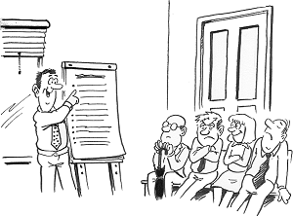
CPD agenda Good CPD in school? Good CPD for you?
More than going on a course?

Slide 10
CPD agenda Good CPD in school? Good CPD for you? Evidence to suggest impact on students?

Slide 11
CPD agenda Good CPD in school? Good CPD for you? Where is the evidence? Will this CPD help my students?

Slide 12
CPD agenda Good CPD in school? Good CPD for you? Where is the evidence? Will this CPD help my students? What follow up support is offered?

Slide 13
CPD agenda Good CPD in school? Good CPD for you? Where is the evidence? Will this CPD help my students? What follow up support is offered? Evaluate the impact on classroom practice?

Slide 14
CPD agenda Good CPD in school? Good CPD for you? Where is the evidence? Will this CPD help my students? What follow up support is offered? Evaluate the impact on classroom practice?

Slide 15
CPD agenda Good CPD in school? Good CPD for you? Where is the evidence? Will this CPD help my students? What follow up support is offered? Evaluate the impact on classroom practice?

Slide 16
CPD agenda Good CPD in school? Good CPD for you? Where is the evidence? Will this CPD help my students? What follow up support is offered? Evaluate the impact on classroom practice?

Slide 17
CPD agenda Good CPD in school? Good CPD for you? Where is the evidence? Will this CPD help my students? What follow up support is offered? Evaluate the impact on classroom practice?

Slide 18
CPD agenda Good CPD in school? Good CPD for you? Where is the evidence? Will this CPD help my students? What follow up support is offered? Evaluate the impact on classroom practice?

Slide 19
CPD agenda Good CPD in school? Good CPD for you? Where is the evidence? Will this CPD help my students? What follow up support is offered? Evaluate the impact on classroom practice?

Slide 20
CPD agenda Good CPD in school? Good CPD for you? Where is the evidence? Will this CPD help my students? What follow up support is offered? Evaluate the impact on classroom practice?

Slide 21
CPD agenda Good CPD in school? Good CPD for you? Where is the evidence? Will this CPD help my students? What follow up support is offered? Evaluate the impact on classroom practice?

Slide 22
Effective CPD! 1. Shared responsibility (CPD/T&L) 2. On-going process 3. Everyone evaluates the impact on students 4. Support / Observing each other 5. Research, innovation, evidence.

Slide 23
Something to hear Something for free Something to do …

Slide 24
A professional portfolio

Slide 25
Something to hear

Slide 26
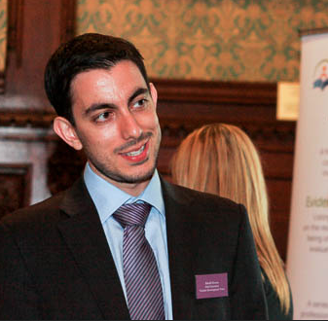
Introducing
David Weston,
Chief Executive of The Teacher Development Trust
@Informed_Edu
A non-profit organisation promoting world-leading approaches to teacher learning and effective teacher development.

Slide 27
Teachers are amazing…
Awareness of effective ideas, techniques and approaches
Ability to recognise/ diagnose suitability of approaches, and when they are not working
Ability to adapt, vary, combine and refine approaches
Understanding of underlying theory - solid conceptual understanding
Fluency - instinctive recall and use of appropriate techniques
Systematic and sustained use of approaches
Ability to reflect on (and assess) own learning progress
Recognition of student behaviours and patterns of likely future behaviour
Increasing emotional self-regulation
Notes:
There are a number of things we need to consider about effective professional learning.

Slide 28
Why does professional learning matter?
Source: Sutton Trust (2011)
Notes:
Why should we improve the quality of teaching? This research from the Sutton Trust shows us that the more disadvantaged the learner, the more they stand to lose, or gain from varying teaching quality. This speaks to our mission as teachers – to help the most vulnerable we need to improve our practice.

Slide 29
What can great professional learning do?
… for teachers?
… for students?
Confidence
Self - Efficacy
Enjoyment
Change - maker
Change enthusiasm
Outcomes
Engagement
Confidence
Fluency
Gap - closing

Slide 30
Reflection Questions …
How many of you have spent time trying to improve your teaching?
How many of you have been on courses to improve your teaching?
How many of you have read printed advice/books to improve your teaching?

Slide 31
Changing habits is hard
Not sufficient
One-off courses
Lectures
Printed guidance
Discussion

Slide 32
Learning happens …
When we are motivated to pay attention.
When we are motivated to remain resilient and put in the time and effort to reflect, practice, seek new knowledge.
When we have the opportunity to connect new learning, skill and theory to existing experience.

Slide 33
Powerful professional learning is…
Collaborative
Focused on valued outcomes for pupils
Practical and theoretical
Sustained (30-50 hrs)
Draws on external expertise
Evaluated and monitored
Challenging
Notes:
Powerful professional learning has these characteristics. Teachers must work together to support and challenge, to enquire together. They must focus their work on student learning, identify issues/areas for development and work on these valued student outcomes. This must be relevant to the needs of students in their own classes, and sustained for many hours of thinking, planning, reflecting, discussing, reading, etc.
Professional learning must cycle between understanding the why and the how, developing the theory and the practical wisdom. It requires ongoing monitoring and evaluation, particularly of its effect on the valued pupils outcomes that drive it. Finally, it must not sit within our comfort zone – we all learned the most in our first year of teaching (although many of us cried at the sheer challenge of it).

Slide 34
Great leadership includes…
Source: Robinson (2009)
Notes:
Vivane Robinson’s research shows school leaders what it is that they can do to most effectively raise attainment in their school. By far and away the most effective action they can take is to empower teachers to become learners, actively improving their own teaching rather than simply complying with rules about how to teach.

Slide 35
. Something for free .

Slide 36
Introducing Edu-Book Club

Slide 37
What?
As part of our Action Research CPD,
we disseminated 15 educational books.

Slide 38
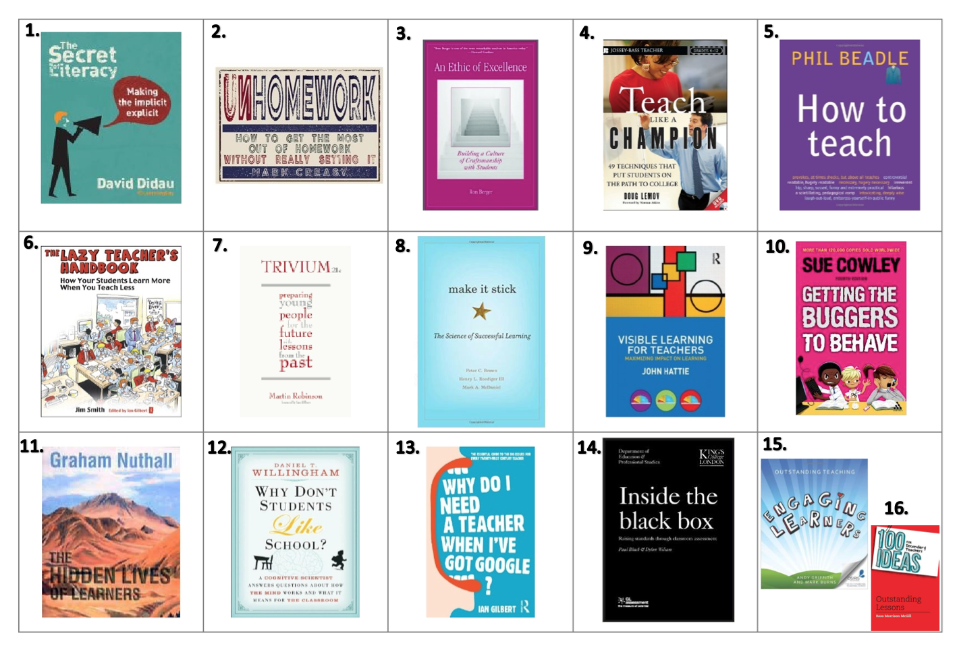
Edu-Book club

Slide 39
Why
We think it will make a difference to teacher practice at school.

Slide 40
Why?
To discuss the content and
how it has made an impact on classroom practice.

Slide 41
How?
1. The idea is simple …
2. Every teacher will select a book to read.

Slide 42
Make 1st and 2nd choice …

Slide 43
How?
We purchase a copy for every member of staff.
During INSET CPD sessions, we’ll meet and give time to discuss.

Slide 44
Something to do …

Slide 45
Lesson Study
1. Plan
Plan a lesson together.
Address each activity to your Learning Goal and predict how pupils will react and how you will assess this.
Pick 2 or 3 case pupils.
2. Observe
Teach the lesson with your colleagues observing.
Pay particular attention to the case pupils
Conduct any assessments and/or interviews during & after.
3. Reflect & Plan
As soon after the lesson as possible, reflect how each activity elicited the sought-after change. Were your predictions correct? Why?

Slide 46
Teachers of the same (or similar) class, different subjects
Teachers of the same subject, same year group
Teachers of the same subject, different year groups
Cross-curricular, same year (incl. pastoral)
Cross-curricular, different year

Slide 47
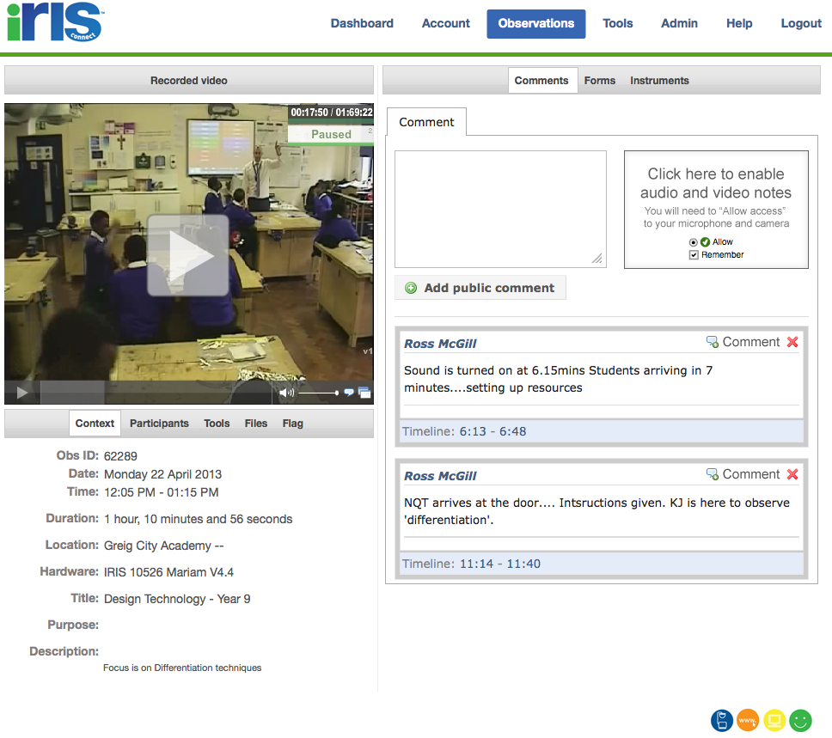
Film yourself!
by
https://teachertoolkitdotme.files.wordpress.com/2014/01/year-9-iris-export-for-teachertoolkit-blog.m4v
Notes:
https://teachertoolkitdotme.files.wordpress.com/2014/01/year-9-iris-export-for-teachertoolkit-blog.m4v
https://eu.irisconnect.com/observations/62289 – from 22mins 38
Year 8 - https://eu.irisconnect.com/observations/62241 - 32 minutes - NOT SURE!

Slide 48
Notes:
This presentation by @TeacherToolkit ( Ross Morrison McGill ) and is licensed under a Creative Commons Attribution-NonCommercial-NoDerivs 3.0 Unported License. Based on all work published at www.teachertoolkit.me
@TeacherToolkit Limited.

Slide 49
Thank you!
by
TeacherToolkit@me.com
@TeacherToolkit
www.TeacherToolkit.me
Notes:
This presentation by @TeacherToolkit ( Ross Morrison McGill ) and is licensed under a Creative Commons Attribution-NonCommercial-NoDerivs 3.0 Unported License.
Based on all work published at www.teachertoolkit.me
@TeacherToolkit Limited.

Slide 50
by
Last slide …

