Slide 1
is setting up…
by
Notes:
Videos needed:
Taylor Mali – What teachers make? = https://www.youtube.com/watch?v=RxsOVK4syxU
Lamont Carey – I can’t read = http://youtu.be/lByDfPOG0LA?t=22s
The 5 Minute Lesson Plan = http://bit.ly/5MinVideo
IRIS myself: https://teachertoolkitdotme.files.wordpress.com/2014/01/year-9-iris-export-for-teachertoolkit-blog.m4v
Resources:
Keywords for literateness?
IPEVO camera?
Latest reading book?
This presentation by @TeacherToolkit ( Ross Morrison McGill ) and is licensed under a Creative Commons Attribution-NonCommercial-NoDerivs 3.0 Unported License.
Based on all work published at www.teachertoolkit.me
@TeacherToolkit Limited.

Slide 2
Start slide See notes
Notes:
Kick off after this slide.
All slides previously, rotate with clicker by hand as staff come and sign in ….

Slide 3
Homework. by Ross M. McGill Deputy Headteacher Quintin Kynaston @TeacherToolkit www.TeacherToolkit.me
by

Slide 4
The need for homework will never go away!
Notes:
This presentation by @TeacherToolkit ( Ross Morrison McGill ) and is licensed under a Creative Commons Attribution-NonCommercial-NoDerivs 3.0 Unported License. Based on all work published at www.teachertoolkit.me
@TeacherToolkit Limited.

Slide 5
Humph!
#TakeAwayHmk will not solve whole-school homework issues overnight.
Photo credit: instituteforattachment.org
Notes:
This presentation by @TeacherToolkit ( Ross Morrison McGill ) and is licensed under a Creative Commons Attribution-NonCommercial-NoDerivs 3.0 Unported License. Based on all work published at www.teachertoolkit.me
@TeacherToolkit Limited.
Even though students may NOT want homework – parents, headteachers and great teachers do!
So, how can we add value to homework to those that it is most important to.
The STUDENT
THE TEACHER

Slide 6
Great teachers set great homework!
Image credit: www.toonvectors.com
Notes:
This presentation by @TeacherToolkit ( Ross Morrison McGill ) and is licensed under a Creative Commons Attribution-NonCommercial-NoDerivs 3.0 Unported License. Based on all work published at www.teachertoolkit.me
@TeacherToolkit Limited.
Empower ALL teachers to be GREAT teachers who set GREAT homework.
Saving time may help you get better. If you want to call this ‘outstanding’; then fine!
TakeAwayHmk is a WINNER

Slide 7
#TakeAwayHmk
Notes:
This presentation by @TeacherToolkit ( Ross Morrison McGill ) and is licensed under a Creative Commons Attribution-NonCommercial-NoDerivs 3.0 Unported License. Based on all work published at www.teachertoolkit.me
@TeacherToolkit Limited.

Slide 8
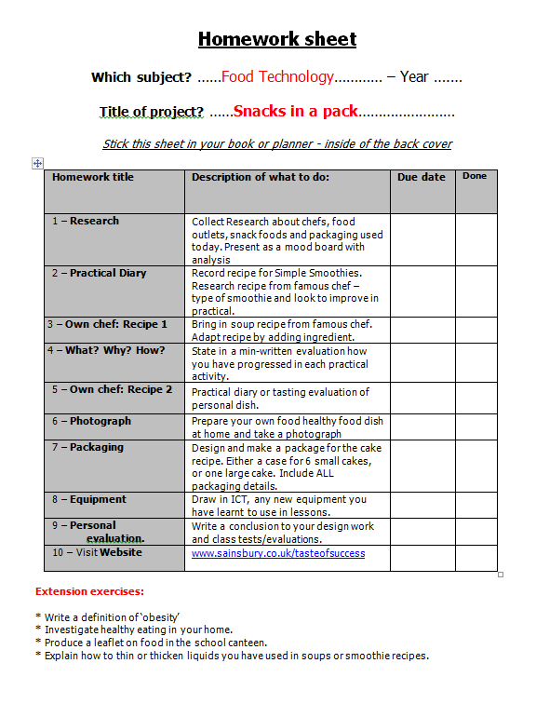
Think of ONE homework task you have set.
Notes:
This presentation by @TeacherToolkit ( Ross Morrison McGill ) and is licensed under a Creative Commons Attribution-NonCommercial-NoDerivs 3.0 Unported License. Based on all work published at www.teachertoolkit.me
@TeacherToolkit Limited.

Slide 9
Research how homework is set is likely to be very important.
http://bit.ly/PrimaryHmk and http://bit.ly/SecondaryHmk
Notes:
This presentation by @TeacherToolkit ( Ross Morrison McGill ) and is licensed under a Creative Commons Attribution-NonCommercial-NoDerivs 3.0 Unported License. Based on all work published at www.teachertoolkit.me
@TeacherToolkit Limited.
How effective is it?
On average, the impact of homework on learning is consistently positive (leading to on average five months additional progress). However, beneath this average there is a wide variation in potential impact, suggesting that how homework is set is likely to be very important.

Slide 10
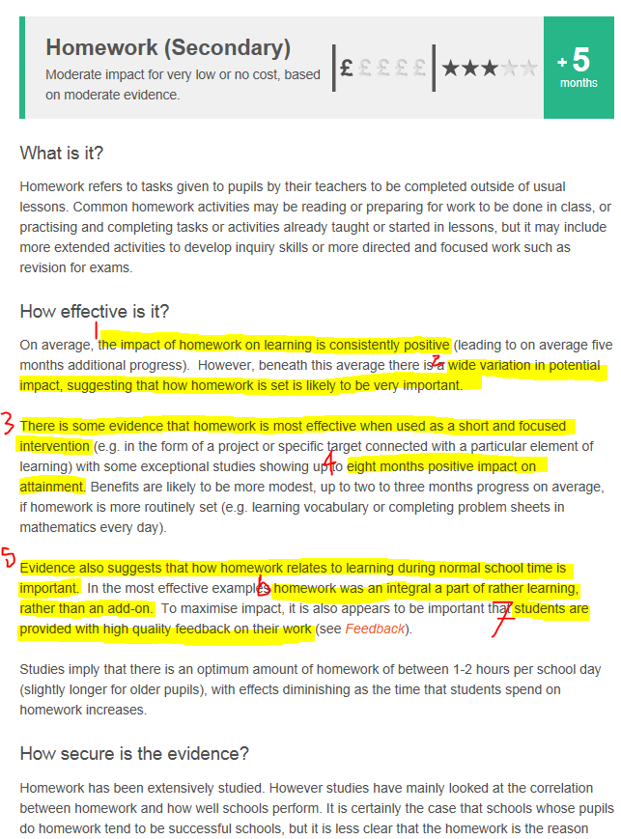
Notes:
This presentation by @TeacherToolkit ( Ross Morrison McGill ) and is licensed under a Creative Commons Attribution-NonCommercial-NoDerivs 3.0 Unported License. Based on all work published at www.teachertoolkit.me
@TeacherToolkit Limited.
How effective is it?
On average, the impact of homework on learning is consistently positive (leading to on average five months additional progress). However, beneath this average there is a wide variation in potential impact, suggesting that how homework is set is likely to be very important.
DISCUSS 2 6 & 7

Slide 11
Cognitive Non-cognitive
Image credit: www.thenorthblog.com
Notes:
This presentation by @TeacherToolkit ( Ross Morrison McGill ) and is licensed under a Creative Commons Attribution-NonCommercial-NoDerivs 3.0 Unported License. Based on all work published at www.teachertoolkit.me
@TeacherToolkit Limited.

Slide 12
The concept.
Notes:
This presentation by @TeacherToolkit ( Ross Morrison McGill ) and is licensed under a Creative Commons Attribution-NonCommercial-NoDerivs 3.0 Unported License. Based on all work published at www.teachertoolkit.me
@TeacherToolkit Limited.

Slide 13
Useful reminders for every teacher
PLAN AND TEACH WELL STRUCTURED LESSONS
Set homework and plan other out-of-class activities to consolidate and extend the knowledge and understanding pupils have acquired.
Image credit: blogs.gartner.com
Notes:
This presentation by @TeacherToolkit ( Ross Morrison McGill ) and is licensed under a Creative Commons Attribution-NonCommercial-NoDerivs 3.0 Unported License. Based on all work published at www.teachertoolkit.me
@TeacherToolkit Limited.

Slide 14
The original
Notes:
Visual learners
Levels
Keywords
Scribble NOT type

Slide 15
Context:
For the past 2 years, I have set homework as a professional goal to improve in my own classroom practice.
The reason for this focus, is that I’ve been teaching in over 4-6 classrooms, in each academic year …
… and have been teaching in 2-3 subject-areas (each year) to help support students in under-allocated faculties.
This is challenging enough; even without the demands of setting/collecting meaningful homework that contributes to learning and progress!
Notes:
This presentation by @TeacherToolkit ( Ross Morrison McGill ) and is licensed under a Creative Commons Attribution-NonCommercial-NoDerivs 3.0 Unported License. Based on all work published at www.teachertoolkit.me
@TeacherToolkit Limited.

Slide 16
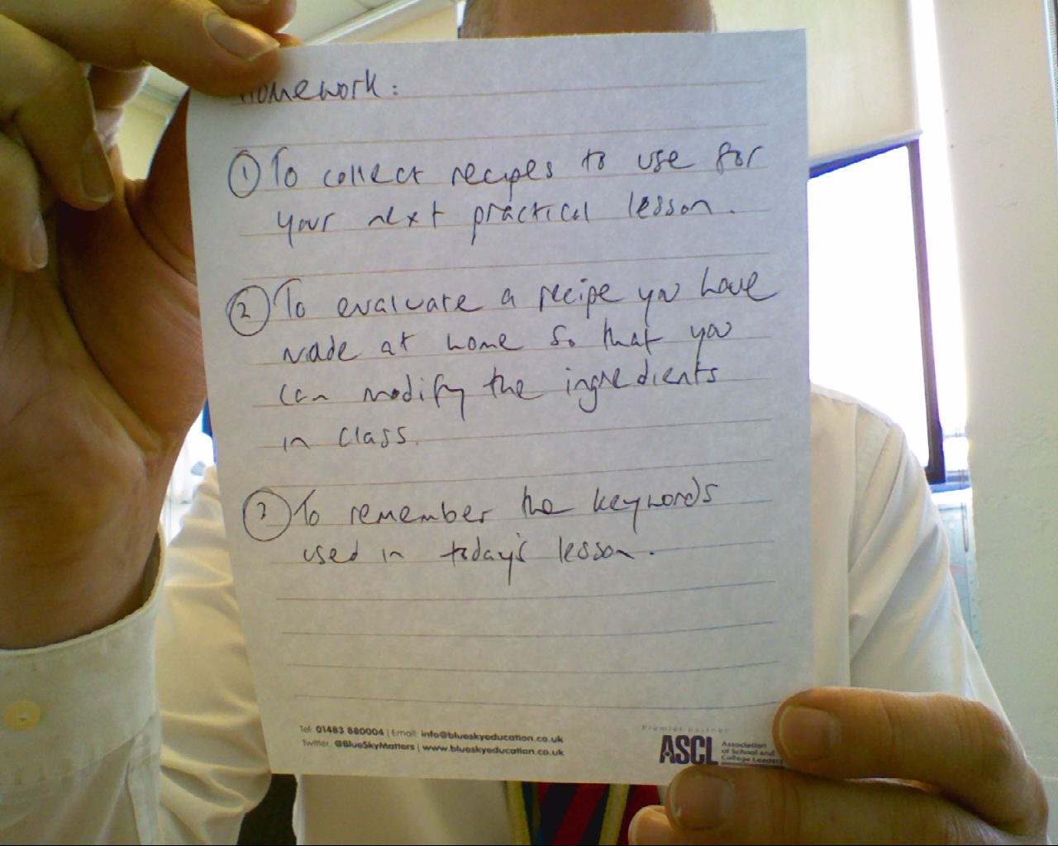
Quick Test!
Activity or Learning?
Notes:
This presentation by @TeacherToolkit ( Ross Morrison McGill ) and is licensed under a Creative Commons Attribution-NonCommercial-NoDerivs 3.0 Unported License. Based on all work published at www.teachertoolkit.me
@TeacherToolkit Limited.

Slide 17
Context:
The challenge of setting homework is ultimately about raising standards.
The result of this professional journey was #TakeAwayHmk – an alternative model for setting homework in the classroom.
It is about developing a quality framework and overview of homework, linked to schemes of work; then leading into the actual process of setting homework.
This process (in the classroom) can be quick, but stooped in classroom rigour, teacher-clarity and inspiration.
The outcome is a portable homework solution for teachers, teaching multiple subjects; age-groups and in a large number of classrooms.
#TakeAwayHmk was born! Differentiated; personalised; self-selecting; inspiring; rewarding and medium-term learning.
Notes:
This presentation by @TeacherToolkit ( Ross Morrison McGill ) and is licensed under a Creative Commons Attribution-NonCommercial-NoDerivs 3.0 Unported License. Based on all work published at www.teachertoolkit.me
@TeacherToolkit Limited.

Slide 18
Updated version
Notes:
This presentation by @TeacherToolkit ( Ross Morrison McGill ) and is licensed under a Creative Commons Attribution-NonCommercial-NoDerivs 3.0 Unported License. Based on all work published at www.teachertoolkit.me
@TeacherToolkit Limited.

Slide 19
Notes:
This presentation by @TeacherToolkit ( Ross Morrison McGill ) and is licensed under a Creative Commons Attribution-NonCommercial-NoDerivs 3.0 Unported License. Based on all work published at www.teachertoolkit.me
@TeacherToolkit Limited.

Slide 20
Context:
I re-discovered how homework makes a significant difference to the learning process and the bridge between teacher-led and student-led learning for:
extending learning time
creating opportunities for creativity and choice
developing the skills required for independent learning
reducing the diverging effect of home support
equal opportunities
and, not least, communicating the values of the school and the teacher.
I firmly believe, that differentiated; targeted and independent homework, followed with targeted feedback, leads to student ownership and improved levels of progress.
Notes:
This presentation by @TeacherToolkit ( Ross Morrison McGill ) and is licensed under a Creative Commons Attribution-NonCommercial-NoDerivs 3.0 Unported License. Based on all work published at www.teachertoolkit.me
@TeacherToolkit Limited.

Slide 21
Homework is served!
Starter:
What homework?
Main:
What homework?
Dessert:
What homework?
Notes:
This presentation by @TeacherToolkit ( Ross Morrison McGill ) and is licensed under a Creative Commons Attribution-NonCommercial-NoDerivs 3.0 Unported License. Based on all work published at www.teachertoolkit.me
@TeacherToolkit Limited.
Move webcam to RIGHT HAND SCREEN so that it is captured in the video

Slide 22
Reflection Questions:
Homework:
Homework which is planned is more beneficial than routine homework and not linked with what is being learned in class.
It should not be used as a punishment or penalty for poor performance.
A variety of tasks with different levels of challenge is likely to be beneficial.
The quality of homework is more important than the quantity. Pupils should receive feedback on homework which is specific and timely.
Have you made the purpose of homework clear to children? e.g. to increase a specific area of knowledge, or fluency in a particular area. An assessment criteria?
Source: EEF - http://bit.ly/PrimaryHmk and http://bit.ly/SecondaryHmk
Notes:
This presentation by @TeacherToolkit ( Ross Morrison McGill ) and is licensed under a Creative Commons Attribution-NonCommercial-NoDerivs 3.0 Unported License. Based on all work published at www.teachertoolkit.me
@TeacherToolkit Limited.

Slide 23
Questions?
Coming up: A walk-through
Notes:
This presentation by @TeacherToolkit ( Ross Morrison McGill ) and is licensed under a Creative Commons Attribution-NonCommercial-NoDerivs 3.0 Unported License. Based on all work published at www.teachertoolkit.me
@TeacherToolkit Limited.

Slide 24
A walk through
Image credit: www.vectorstock.com
Notes:
This presentation by @TeacherToolkit ( Ross Morrison McGill ) and is licensed under a Creative Commons Attribution-NonCommercial-NoDerivs 3.0 Unported License. Based on all work published at www.teachertoolkit.me
@TeacherToolkit Limited.

Slide 25
Step by step.
Planning stage:
Locate an existing scheme of work.
What homework is set and why?
Where can homework be improved?
Notes:
This presentation by @TeacherToolkit ( Ross Morrison McGill ) and is licensed under a Creative Commons Attribution-NonCommercial-NoDerivs 3.0 Unported License. Based on all work published at www.teachertoolkit.me
@TeacherToolkit Limited.

Slide 26
Step by step.
Providing choice:
List 20-30 homework that focus on learning (not an activity).
Why have you identified this as a suitable homework option?
How will students be expected to report back?
Image credit: www.naturalandfab.com
Notes:
This presentation by @TeacherToolkit ( Ross Morrison McGill ) and is licensed under a Creative Commons Attribution-NonCommercial-NoDerivs 3.0 Unported License. Based on all work published at www.teachertoolkit.me
@TeacherToolkit Limited.

Slide 27
Step by step.
Subliminal assessment:
What tasks can be sorted into top, middle and bottom?
Why does that homework vary in difficulty?
How will students receive feedback? And in what format?
Image credit: www.speareducation.com
Notes:
This presentation by @TeacherToolkit ( Ross Morrison McGill ) and is licensed under a Creative Commons Attribution-NonCommercial-NoDerivs 3.0 Unported License. Based on all work published at www.teachertoolkit.me
@TeacherToolkit Limited.

Slide 28
Step by step.
Differentiation:
What homework can be increased in difficulty?
Why would a student want to opt for this harder homework?
Add a chili or a vegetarian icon to add difficulty / differentiation.
Notes:
This presentation by @TeacherToolkit ( Ross Morrison McGill ) and is licensed under a Creative Commons Attribution-NonCommercial-NoDerivs 3.0 Unported License. Based on all work published at www.teachertoolkit.me
@TeacherToolkit Limited.

Slide 29
Step by step.
Context for each homework:
What is the homework?
Why will this homework add value to (student) learning?
How do you provide a snapshot?
For example:
Include a statement for each homework. A simple sentence will do.
Director’s Ideas *
Annotate a piece of script from the play you have been exploring, so that you can consider decisions for stage directions, actions & sound effects.
Notes:
This presentation by @TeacherToolkit ( Ross Morrison McGill ) and is licensed under a Creative Commons Attribution-NonCommercial-NoDerivs 3.0 Unported License. Based on all work published at www.teachertoolkit.me
@TeacherToolkit Limited.

Slide 30
Step by step.
Success criteria:
What is the success criteria for each homework?
Why? Does that assessment and completing that homework add value to the learning / progress?
A second crib-sheet with success-criteria may need to be considered.
I will discuss how to assess #TakeAwayHmk later …
Image credit: haynet.info
Notes:
Bryan’s advice
Walk through the plan and ask delegates to complete
30 seconds PER SLIDE
Queries:
Tell a story – how it started
Lorna Cork
Jokes!
Keep it informal
If I had my way – I would dictate how every school uses this lesson plan!
Stickability to make the plan work
Loose lesson plan; tight learning gains
This presentation by @TeacherToolkit ( Ross Morrison McGill ) and is licensed under a Creative Commons Attribution-NonCommercial-NoDerivs 3.0 Unported License. Based on all work published at www.teachertoolkit.me
@TeacherToolkit Limited.

Slide 31
Step by step.
Take-Away means Take it Away!
Remember how the concept came about. Meaningful homework that is: differentiated; personalised;
Why? So that it is self-selecting and inspiring.
How? By adding value to the learning, supported by medium-term planning/deadlines. Give extended deadlines.
This will add consolidation space between lessons…
Image credit: link2power.org
Notes:
This presentation by @TeacherToolkit ( Ross Morrison McGill ) and is licensed under a Creative Commons Attribution-NonCommercial-NoDerivs 3.0 Unported License. Based on all work published at www.teachertoolkit.me
@TeacherToolkit Limited.

Slide 32
Reflection Questions:
Progress:
Is your homework rigorous?
Does each homework challenge students at all levels?
How will the homework be assessed?
If 25 students handed in 25 different formats / pieces of homework, how would you go about assessment?
What feedback can students expect from you? What improvements would you insist?
Notes:
This presentation by @TeacherToolkit ( Ross Morrison McGill ) and is licensed under a Creative Commons Attribution-NonCommercial-NoDerivs 3.0 Unported License. Based on all work published at www.teachertoolkit.me
@TeacherToolkit Limited.

Slide 33
End of step by step
Image: www.kaushik.net
Notes:
This presentation by @TeacherToolkit ( Ross Morrison McGill ) and is licensed under a Creative Commons Attribution-NonCommercial-NoDerivs 3.0 Unported License. Based on all work published at www.teachertoolkit.me
@TeacherToolkit Limited.

Slide 34
Questions?
Coming up: The importance of homework
Notes:
This presentation by @TeacherToolkit ( Ross Morrison McGill ) and is licensed under a Creative Commons Attribution-NonCommercial-NoDerivs 3.0 Unported License. Based on all work published at www.teachertoolkit.me
@TeacherToolkit Limited.

Slide 35
by
Notes:
This presentation by @TeacherToolkit ( Ross Morrison McGill ) and is licensed under a Creative Commons Attribution-NonCommercial-NoDerivs 3.0 Unported License. Based on all work published at www.teachertoolkit.me
@TeacherToolkit Limited.

Slide 36
The importance of setting homework
Notes:
This presentation by @TeacherToolkit ( Ross Morrison McGill ) and is licensed under a Creative Commons Attribution-NonCommercial-NoDerivs 3.0 Unported License. Based on all work published at www.teachertoolkit.me
@TeacherToolkit Limited.

Slide 37
Time to think!
Photo credit: www.sitelogicmarketing.com
Notes:
This presentation by @TeacherToolkit ( Ross Morrison McGill ) and is licensed under a Creative Commons Attribution-NonCommercial-NoDerivs 3.0 Unported License. Based on all work published at www.teachertoolkit.me
@TeacherToolkit Limited.

Slide 38
Reminder!
Homework should always be planned.
Homework should be differentiated.
Students should expect feedback from you!
Photo credit: www.arinanikitina.com
Notes:
In true 5 Minute Plan form; Stickability – What are our aims?
1. individual teachers / schools who wish to use The 5 Minute Lesson Plan at a deeper level.
2. this is only for existing users who wish to fully develop how The 5 Minute Lesson Plan is deployed within their teaching and learning settings.
3. this process requires cognitive consideration and risk.
This presentation by @TeacherToolkit ( Ross Morrison McGill ) and is licensed under a Creative Commons Attribution-NonCommercial-NoDerivs 3.0 Unported License. Based on all work published at www.teachertoolkit.me
@TeacherToolkit Limited.
This webinar will help you focus on:
What is the fundamental aspect of the lesson, you need students to learn?
What should students leave your classroom knowing/understanding?
What should students return to class knowing/understanding?

Slide 39
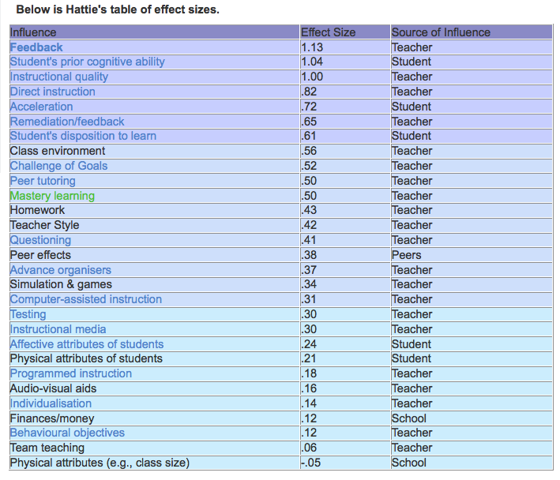
Academic Research: Effect sizes
• An effect size of 0.5 is equivalent to a one grade leap at GCSE
• An effect size of 1.0 is equivalent to a two grade leap at GCSE
Notes:
This presentation by @TeacherToolkit ( Ross Morrison McGill ) and is licensed under a Creative Commons Attribution-NonCommercial-NoDerivs 3.0 Unported License. Based on all work published at www.teachertoolkit.me
@TeacherToolkit Limited.

Slide 40
Questions to ask students (in observations)
about homework:
Does your teacher set challenging homework?
Describe a typical homework to me…
Is the homework at a suitable (challenging) level for you to learn?
Can you tell me which homework has helped you learn? Why? How?
How often is your homework marked?
Do you receive feedback on your homework? Give me an example…
Are you allowed time to improve (re-draft) your homework?
Is it okay to make mistakes?
Do you enjoy completing homework in the subject? Why?
Does your teacher links what you are learning in homework, to what you have learnt in class? All of the time?
Notes:
This presentation by @TeacherToolkit ( Ross Morrison McGill ) and is licensed under a Creative Commons Attribution-NonCommercial-NoDerivs 3.0 Unported License. Based on all work published at www.teachertoolkit.me
@TeacherToolkit Limited.

Slide 41
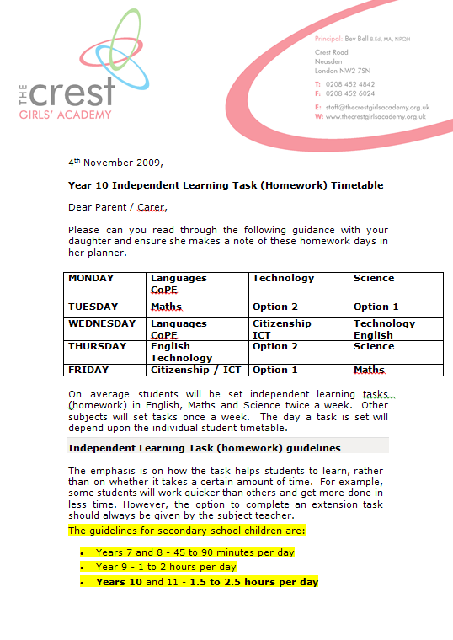
Cognitive homework planning?
Going whole-school?
The guidelines for secondary school children are:
Years 7 and 8 - 45 to 90 minutes per day
Year 9 - 1 to 2 hours per day
Years 10 and 11 - 1.5 to 2.5 hours per day
Notes:
This presentation by @TeacherToolkit ( Ross Morrison McGill ) and is licensed under a Creative Commons Attribution-NonCommercial-NoDerivs 3.0 Unported License. Based on all work published at www.teachertoolkit.me
@TeacherToolkit Limited.

Slide 42
Questions about whole-school?
What does homework do for your students?
Why don’t all students complete homework?
What are the rewards and sanctions?
What makes the most difference to homework completion / quality?
Why do we set homework? For what purpose?
Notes:
This presentation by @TeacherToolkit ( Ross Morrison McGill ) and is licensed under a Creative Commons Attribution-NonCommercial-NoDerivs 3.0 Unported License. Based on all work published at www.teachertoolkit.me
@TeacherToolkit Limited.
Q2 = Are parents willing to help?
-Does the student have to work to help out family?
-Is their an appropriate place for the student to work?
-Is the student involved in extracurricular activities

Slide 43
Homework: DO NOT SET
homework if you will not mark it!
homework if you do not expect students to invest the time.
homework if you will not give feedback.
homework if students are not aware of the assessment.
homework on a whim. Last minute lesson-filler.
Notes:
This presentation by @TeacherToolkit ( Ross Morrison McGill ) and is licensed under a Creative Commons Attribution-NonCommercial-NoDerivs 3.0 Unported License. Based on all work published at www.teachertoolkit.me
@TeacherToolkit Limited.
Q2 = Are parents willing to help?
-Does the student have to work to help out family?
-Is their an appropriate place for the student to work?
-Is the student involved in extracurricular activities

Slide 44
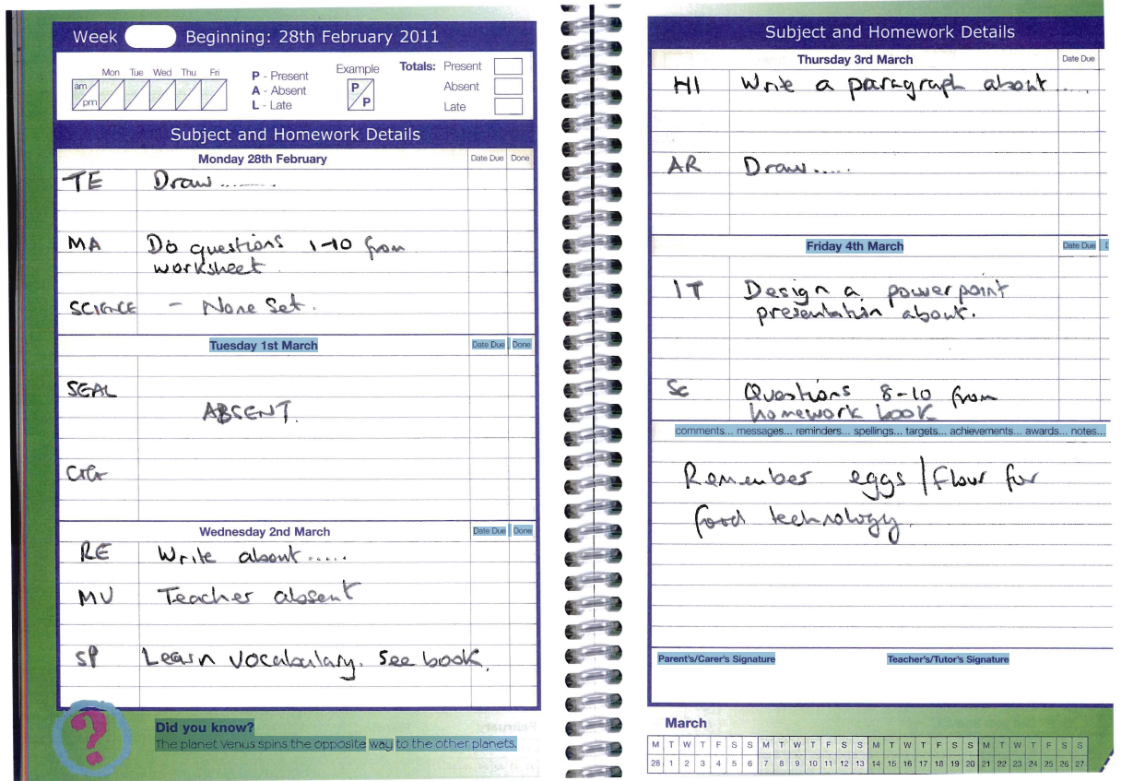
Student planner:
Notes:
This presentation by @TeacherToolkit ( Ross Morrison McGill ) and is licensed under a Creative Commons Attribution-NonCommercial-NoDerivs 3.0 Unported License. Based on all work published at www.teachertoolkit.me
@TeacherToolkit Limited.
Good or bad homework example?

Slide 45
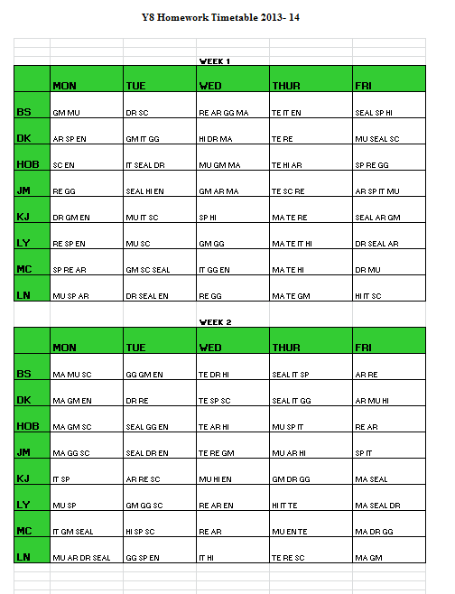
Timetable:
Notes:
This presentation by @TeacherToolkit ( Ross Morrison McGill ) and is licensed under a Creative Commons Attribution-NonCommercial-NoDerivs 3.0 Unported License. Based on all work published at www.teachertoolkit.me
@TeacherToolkit Limited.
Good or bad homework example?

Slide 46
Questions?
Coming up: The boring bit…
Notes:
This presentation by @TeacherToolkit ( Ross Morrison McGill ) and is licensed under a Creative Commons Attribution-NonCommercial-NoDerivs 3.0 Unported License. Based on all work published at www.teachertoolkit.me
@TeacherToolkit Limited.

Slide 47
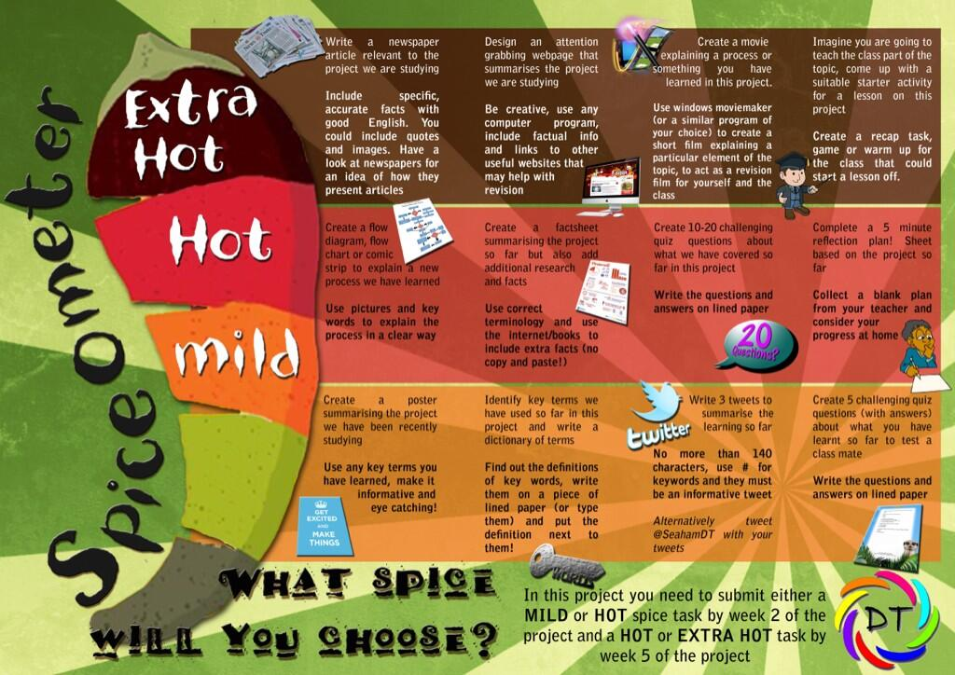
by
Notes:
This presentation by @TeacherToolkit ( Ross Morrison McGill ) and is licensed under a Creative Commons Attribution-NonCommercial-NoDerivs 3.0 Unported License. Based on all work published at www.teachertoolkit.me
@TeacherToolkit Limited.

Slide 48
The boring bit . . .
Notes:
This presentation by @TeacherToolkit ( Ross Morrison McGill ) and is licensed under a Creative Commons Attribution-NonCommercial-NoDerivs 3.0 Unported License. Based on all work published at www.teachertoolkit.me
@TeacherToolkit Limited.
Latest guidance
Let me give you an oxymoron to consider…
NO LESSON PLANS
NO JUDGEMENTS EVER
PROGRESS OVER TIME
What about homework?

Slide 49
“Teachers use well-judged and often imaginative teaching strategies, including setting appropriate homework that, together with clearly directed and timely support and intervention, match individual needs accurately. Consequently, pupils learn exceptionally well across the curriculum.”
Photo credit: www.techyville.com
Notes:
This presentation by @TeacherToolkit ( Ross Morrison McGill ) and is licensed under a Creative Commons Attribution-NonCommercial-NoDerivs 3.0 Unported License. Based on all work published at www.teachertoolkit.me
@TeacherToolkit Limited.

Slide 50
Interestingly the word “regular” was removed in iterations after January 2012.
Photo credit: www.techyville.com
Notes:
This presentation by @TeacherToolkit ( Ross Morrison McGill ) and is licensed under a Creative Commons Attribution-NonCommercial-NoDerivs 3.0 Unported License. Based on all work published at www.teachertoolkit.me
@TeacherToolkit Limited.

Slide 51
Homework …
Doh!
Son, if your teacher needs to set homework, the clearly cannot teach you everything they need to in that lesson … Stupid!
Notes:
This presentation by @TeacherToolkit ( Ross Morrison McGill ) and is licensed under a Creative Commons Attribution-NonCommercial-NoDerivs 3.0 Unported License. Based on all work published at www.teachertoolkit.me
@TeacherToolkit Limited.

Slide 52
The importance evidence and impact
Notes:
This presentation by @TeacherToolkit ( Ross Morrison McGill ) and is licensed under a Creative Commons Attribution-NonCommercial-NoDerivs 3.0 Unported License. Based on all work published at www.teachertoolkit.me
@TeacherToolkit Limited.

Slide 53
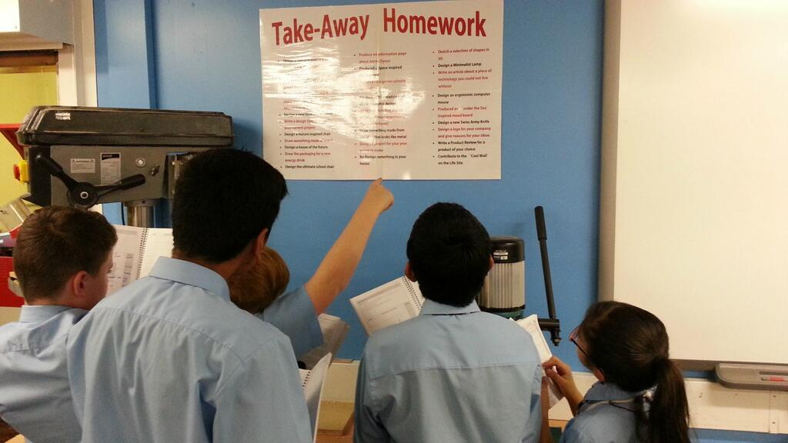
#TakeAwayHmk
by
Notes:
This presentation by @TeacherToolkit ( Ross Morrison McGill ) and is licensed under a Creative Commons Attribution-NonCommercial-NoDerivs 3.0 Unported License. Based on all work published at www.teachertoolkit.me
@TeacherToolkit Limited.
Let the image speak fro itself

Slide 54
Evidence-based research
Photo credit: vip.startrankingnow.com
Notes:
This presentation by @TeacherToolkit ( Ross Morrison McGill ) and is licensed under a Creative Commons Attribution-NonCommercial-NoDerivs 3.0 Unported License. Based on all work published at www.teachertoolkit.me
@TeacherToolkit Limited.
Book reading as of 2.3.14
Cognitive thinking
Cognitive psychology is the study of mental processes such as "attention, language use, memory, perception, problem solving, creativity and thinking.

Slide 55
As ever, data is only one side of the story. We need a context for each point of reference. For example; despite me in the classroom, setting meaningful homework; providing astonishing feedback; and providing students with quality reflection time in class; this could all be lost if students do not have a suitable home environment in which to work. Many of my students do (not have a suitable home environment for completing homework)! Just take a look at the influences of Home Effects on student achievement. These are the conditions that could tip the balance for meaningful (set) homework being completed!
Putting research into context:
Notes:
This presentation by @TeacherToolkit ( Ross Morrison McGill ) and is licensed under a Creative Commons Attribution-NonCommercial-NoDerivs 3.0 Unported License. Based on all work published at www.teachertoolkit.me
@TeacherToolkit Limited.

Slide 56
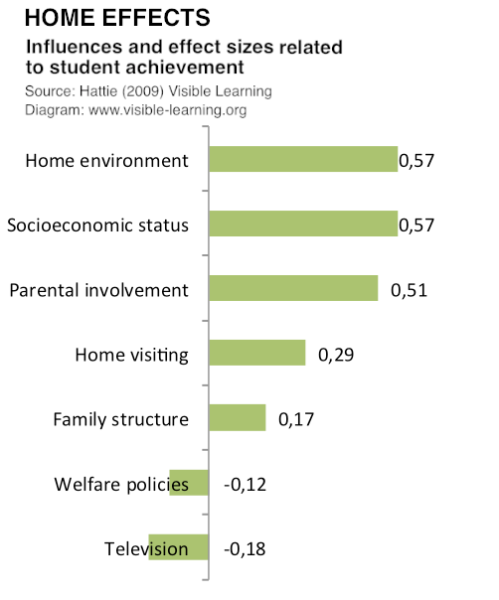
The Teacher
by
• An effect size of 0.5 is equivalent to a one grade leap at GCSE
• An effect size of 1.0 is equivalent to a two grade leap at GCSE
Notes:
This presentation by @TeacherToolkit ( Ross Morrison McGill ) and is licensed under a Creative Commons Attribution-NonCommercial-NoDerivs 3.0 Unported License. Based on all work published at www.teachertoolkit.me
@TeacherToolkit Limited.
Hattie effect sizes and influences on student achievement

Slide 57
Regarding Hattie’s 138 influences scale. Here is an overview of the Hattie effect size list that contains 138 influences and effect sizes across all areas related to student achievement. Can homework be a contributing factor to student achievement? I think so! I have circled aspects that I believe are some of the instrumental factors that can make a difference beyond home environment..
Putting research into context:
Image credit: www.businessnewsdaily.com
Notes:
This presentation by @TeacherToolkit ( Ross Morrison McGill ) and is licensed under a Creative Commons Attribution-NonCommercial-NoDerivs 3.0 Unported License. Based on all work published at www.teachertoolkit.me
@TeacherToolkit Limited.

Slide 58
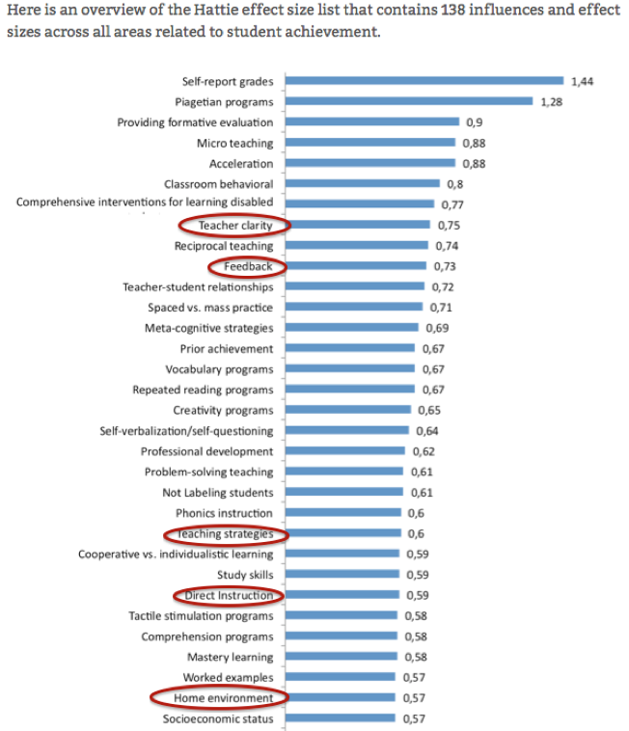
by
Teacher:
Effect-size and influence above home environment.
• An effect size of 0.5 is equivalent to a one grade leap at GCSE
• An effect size of 1.0 is equivalent to a two grade leap at GCSE
Notes:
This presentation by @TeacherToolkit ( Ross Morrison McGill ) and is licensed under a Creative Commons Attribution-NonCommercial-NoDerivs 3.0 Unported License. Based on all work published at www.teachertoolkit.me
@TeacherToolkit Limited.
Hattie effect sizes and influences on student achievement

Slide 59
Questions?
Coming up: The end . . .
Notes:
This presentation by @TeacherToolkit ( Ross Morrison McGill ) and is licensed under a Creative Commons Attribution-NonCommercial-NoDerivs 3.0 Unported License. Based on all work published at www.teachertoolkit.me
@TeacherToolkit Limited.

Slide 60
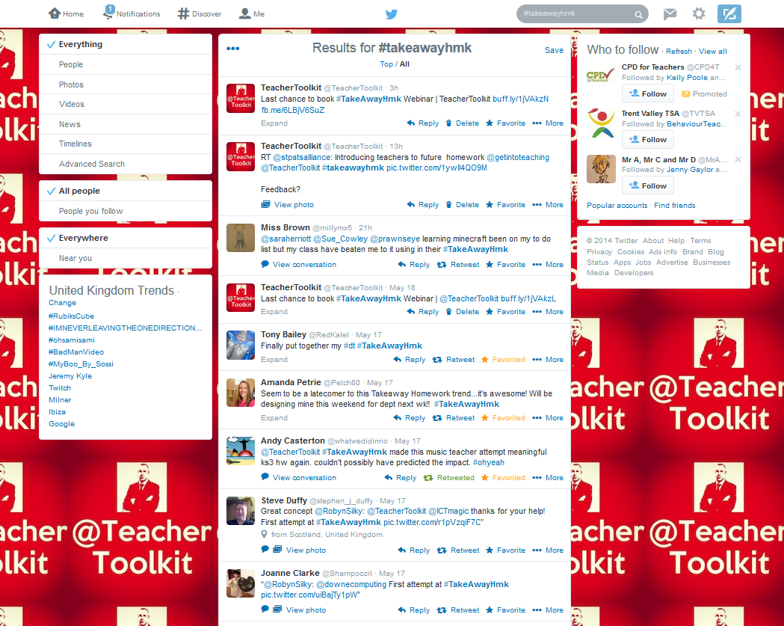
Real-time Tweets:
https://twitter.com/search?f=realtime&q=%23takeawayhmk&src=tyah
Notes:
Real time search
https://twitter.com/search?f=realtime&q=%23takeawayhmk&src=tyah
This presentation by @TeacherToolkit ( Ross Morrison McGill ) and is licensed under a Creative Commons Attribution-NonCommercial-NoDerivs 3.0 Unported License. Based on all work published at www.teachertoolkit.me
@TeacherToolkit Limited.

Slide 61
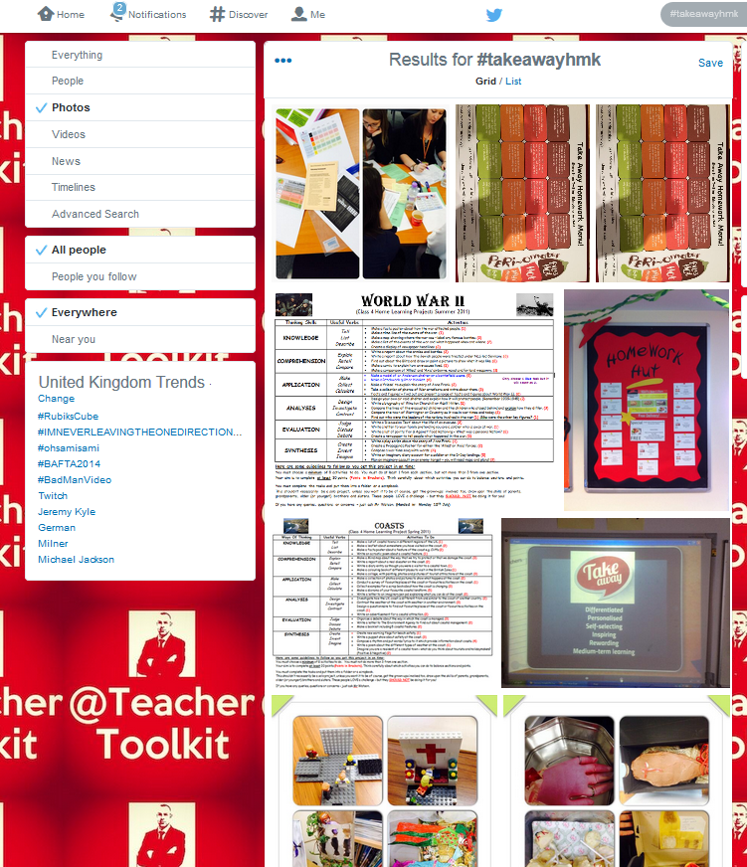
Real-time photos:
https://twitter.com/search?q=%23takeawayhmk&src=tyah&mode=photos
Notes:
Real time search
https://twitter.com/search?q=%235minplan&src=savs&mode=photos
This presentation by @TeacherToolkit ( Ross Morrison McGill ) and is licensed under a Creative Commons Attribution-NonCommercial-NoDerivs 3.0 Unported License. Based on all work published at www.teachertoolkit.me
@TeacherToolkit Limited.

Slide 62
Find out more . . .
Notes:
This presentation by @TeacherToolkit ( Ross Morrison McGill ) and is licensed under a Creative Commons Attribution-NonCommercial-NoDerivs 3.0 Unported License. Based on all work published at www.teachertoolkit.me
@TeacherToolkit Limited.

Slide 63
#TakeAwayHmk
Notes:
This presentation by @TeacherToolkit ( Ross Morrison McGill ) and is licensed under a Creative Commons Attribution-NonCommercial-NoDerivs 3.0 Unported License. Based on all work published at www.teachertoolkit.me
@TeacherToolkit Limited.

Slide 64
Further reading:
http://teachertoolkit.me/2014/01/28/takeawayhmk-is-unhomework/
Notes:
This presentation by @TeacherToolkit ( Ross Morrison McGill ) and is licensed under a Creative Commons Attribution-NonCommercial-NoDerivs 3.0 Unported License. Based on all work published at www.teachertoolkit.me
@TeacherToolkit Limited.
http://teachertoolkit.me/2014/01/28/takeawayhmk-is-unhomework/

Slide 65
Tom Sherrington
Put time and energy into setting great homeworks,
Add in routine consolidation tasks.
Don’t get overly bogged down in setting detentions.
The greatest sanction of all is learning…
As soon as homework is associated directly with punitive sanctions, the battle has been lost – and you get a canteen full of students copying out last minute bits of work just to have something to hand in!
My most well-worn teacher-cliche, as I refuse to accept the scrappy, half-hearted, last-ditched effort: “you are not doing it for me, you are doing it for yourself!”
Homework Matters: Great teachers set great homework:
http://headguruteacher.com
Notes:
This presentation by @TeacherToolkit ( Ross Morrison McGill ) and is licensed under a Creative Commons Attribution-NonCommercial-NoDerivs 3.0 Unported License. Based on all work published at www.teachertoolkit.me
@TeacherToolkit Limited.

Slide 66
Notes:
This presentation by @TeacherToolkit ( Ross Morrison McGill ) and is licensed under a Creative Commons Attribution-NonCommercial-NoDerivs 3.0 Unported License. Based on all work published at www.teachertoolkit.me
@TeacherToolkit Limited.

Slide 67
Thank you!
by
TeacherToolkit@me.com
@TeacherToolkit
www.TeacherToolkit.me
Notes:
This presentation by @TeacherToolkit ( Ross Morrison McGill ) and is licensed under a Creative Commons Attribution-NonCommercial-NoDerivs 3.0 Unported License.
Based on all work published at www.teachertoolkit.me
@TeacherToolkit Limited.

Slide 68
by
Last slide …

