Slide 1
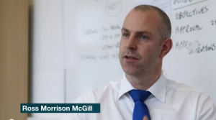
is setting up…
by
Notes:
Videos needed:
Taylor Mali – What teachers make? = https://www.youtube.com/watch?v=RxsOVK4syxU
Lamont Carey – I can’t read = http://youtu.be/lByDfPOG0LA?t=22s
The 5 Minute Lesson Plan = http://bit.ly/5MinVideo
IRIS myself: https://teachertoolkitdotme.files.wordpress.com/2014/01/year-9-iris-export-for-teachertoolkit-blog.m4v
Resources:
Keywords for literateness?
IPEVO camera?
Latest reading book?
This presentation by @TeacherToolkit ( Ross Morrison McGill ) and is licensed under a Creative Commons Attribution-NonCommercial-NoDerivs 3.0 Unported License.
Based on all work published at www.teachertoolkit.me
@TeacherToolkit Limited.

Slide 2
Start slide See notes
Notes:
Kick off after this slide.
All slides previously, rotate with clicker by hand as staff come and sign in ….

Slide 3
Behaviour. by Ross M. McGill Deputy Headteacher Quintin Kynaston @TeacherToolkit www.TeacherToolkit.me
by

Slide 4
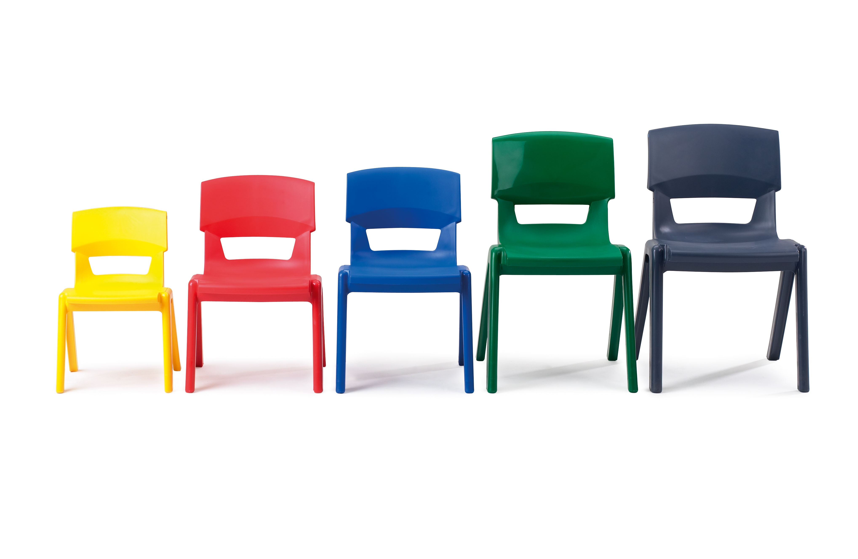
You will need
* a pen
* some creative energy!
Sit anywhere

Slide 5
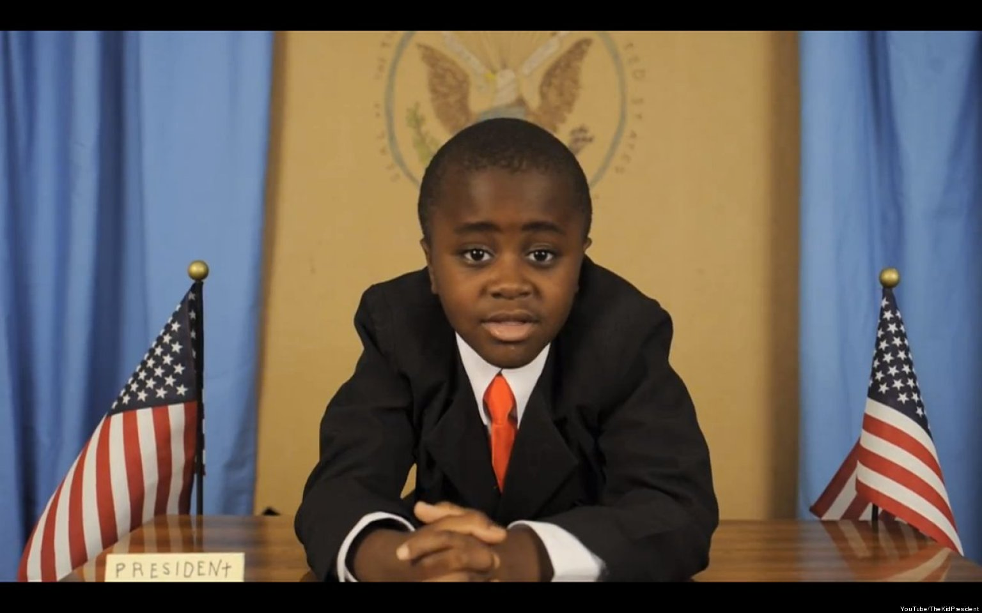
Notes:
Video https://www.youtube.com/watch?v=RwlhUcSGqgs

Slide 6
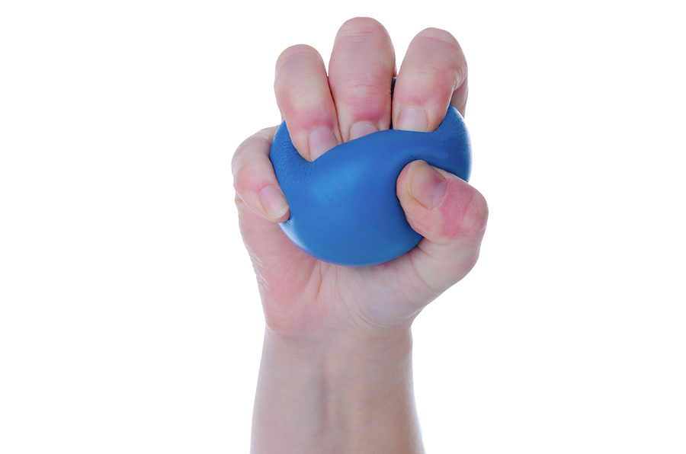
Questioning
Facilitating
Stress

Slide 7
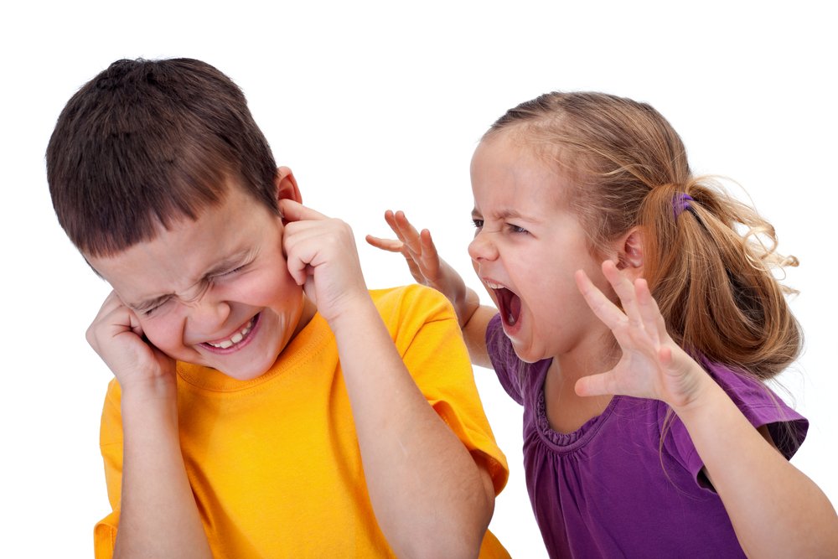
Consolidating Behaviour

Slide 8
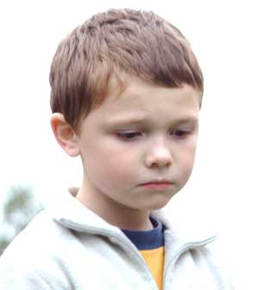
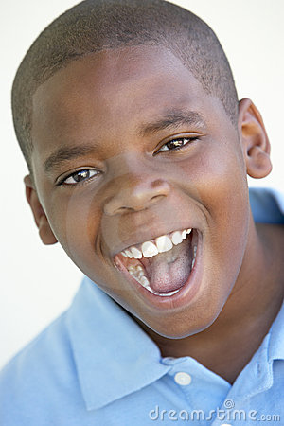
Barriers and Interventions

Slide 9
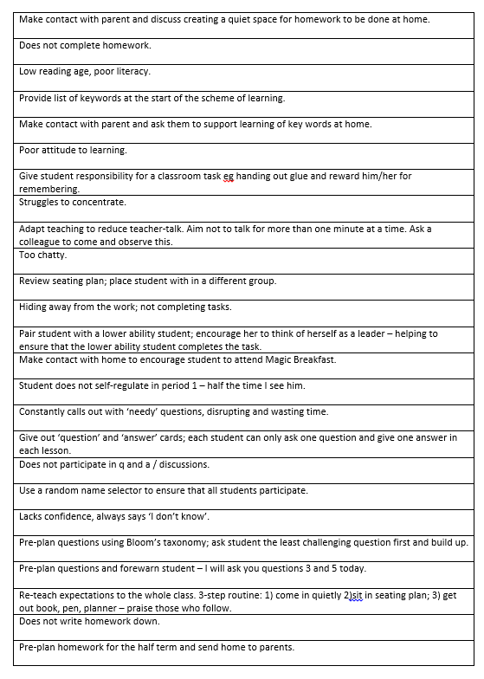
Barriers
and
Interventions

Slide 10
Rewind
Notes:
This presentation by @TeacherToolkit ( Ross Morrison McGill ) and is licensed under a Creative Commons Attribution-NonCommercial-NoDerivs 3.0 Unported License.
Based on all work published at www.teachertoolkit.me
@TeacherToolkit Limited.
Idea 11 in my 100 ideas book.
Sitting down all day – So, in a moment it will be time to stand up/move about.
FUN PART STARTS here. Rest is boring!
Promotes literacy

Slide 11
Snowball

Slide 12
Divide page into 6

Slide 13
1
2
3
4
5
6
Number each area

Slide 14
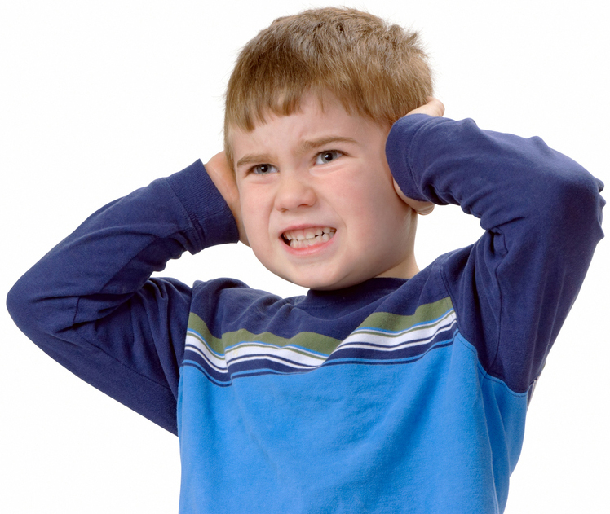
Spell these words!

Slide 15
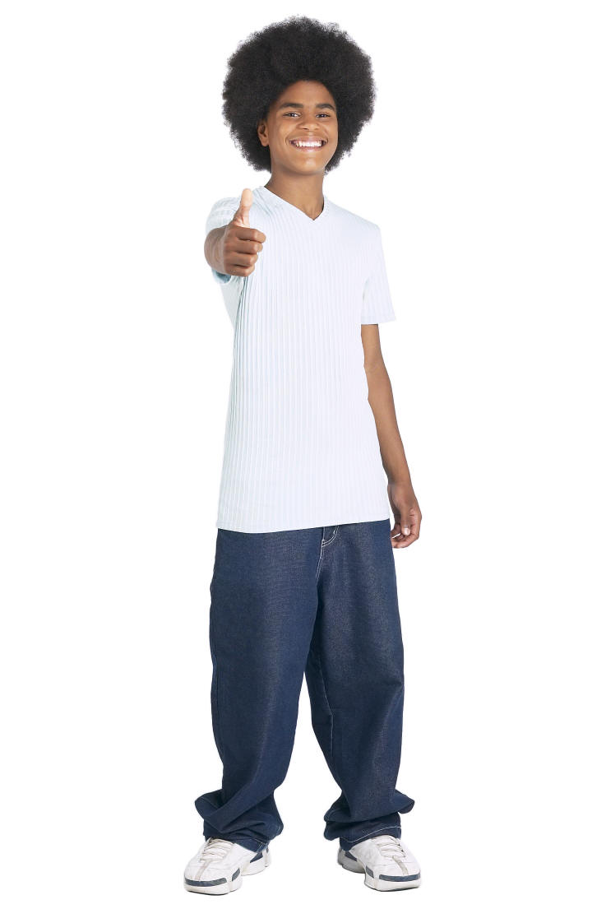
Now swap papers!

Slide 16
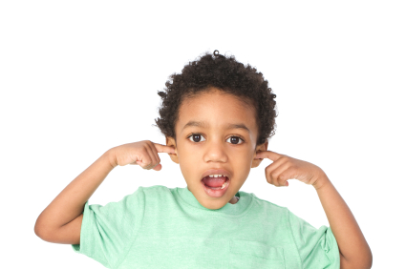
Spell these words!
Quiet Please!
Spellcheck!

Slide 17
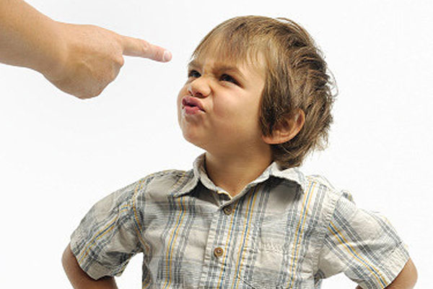
Now swap papers!

Slide 18
Spell these words!
Spellcheck!
Notes:
This presentation by @TeacherToolkit ( Ross Morrison McGill ) and is licensed under a Creative Commons Attribution-NonCommercial-NoDerivs 3.0 Unported License.
Based on all work published at www.teachertoolkit.me
@TeacherToolkit Limited.

Slide 19
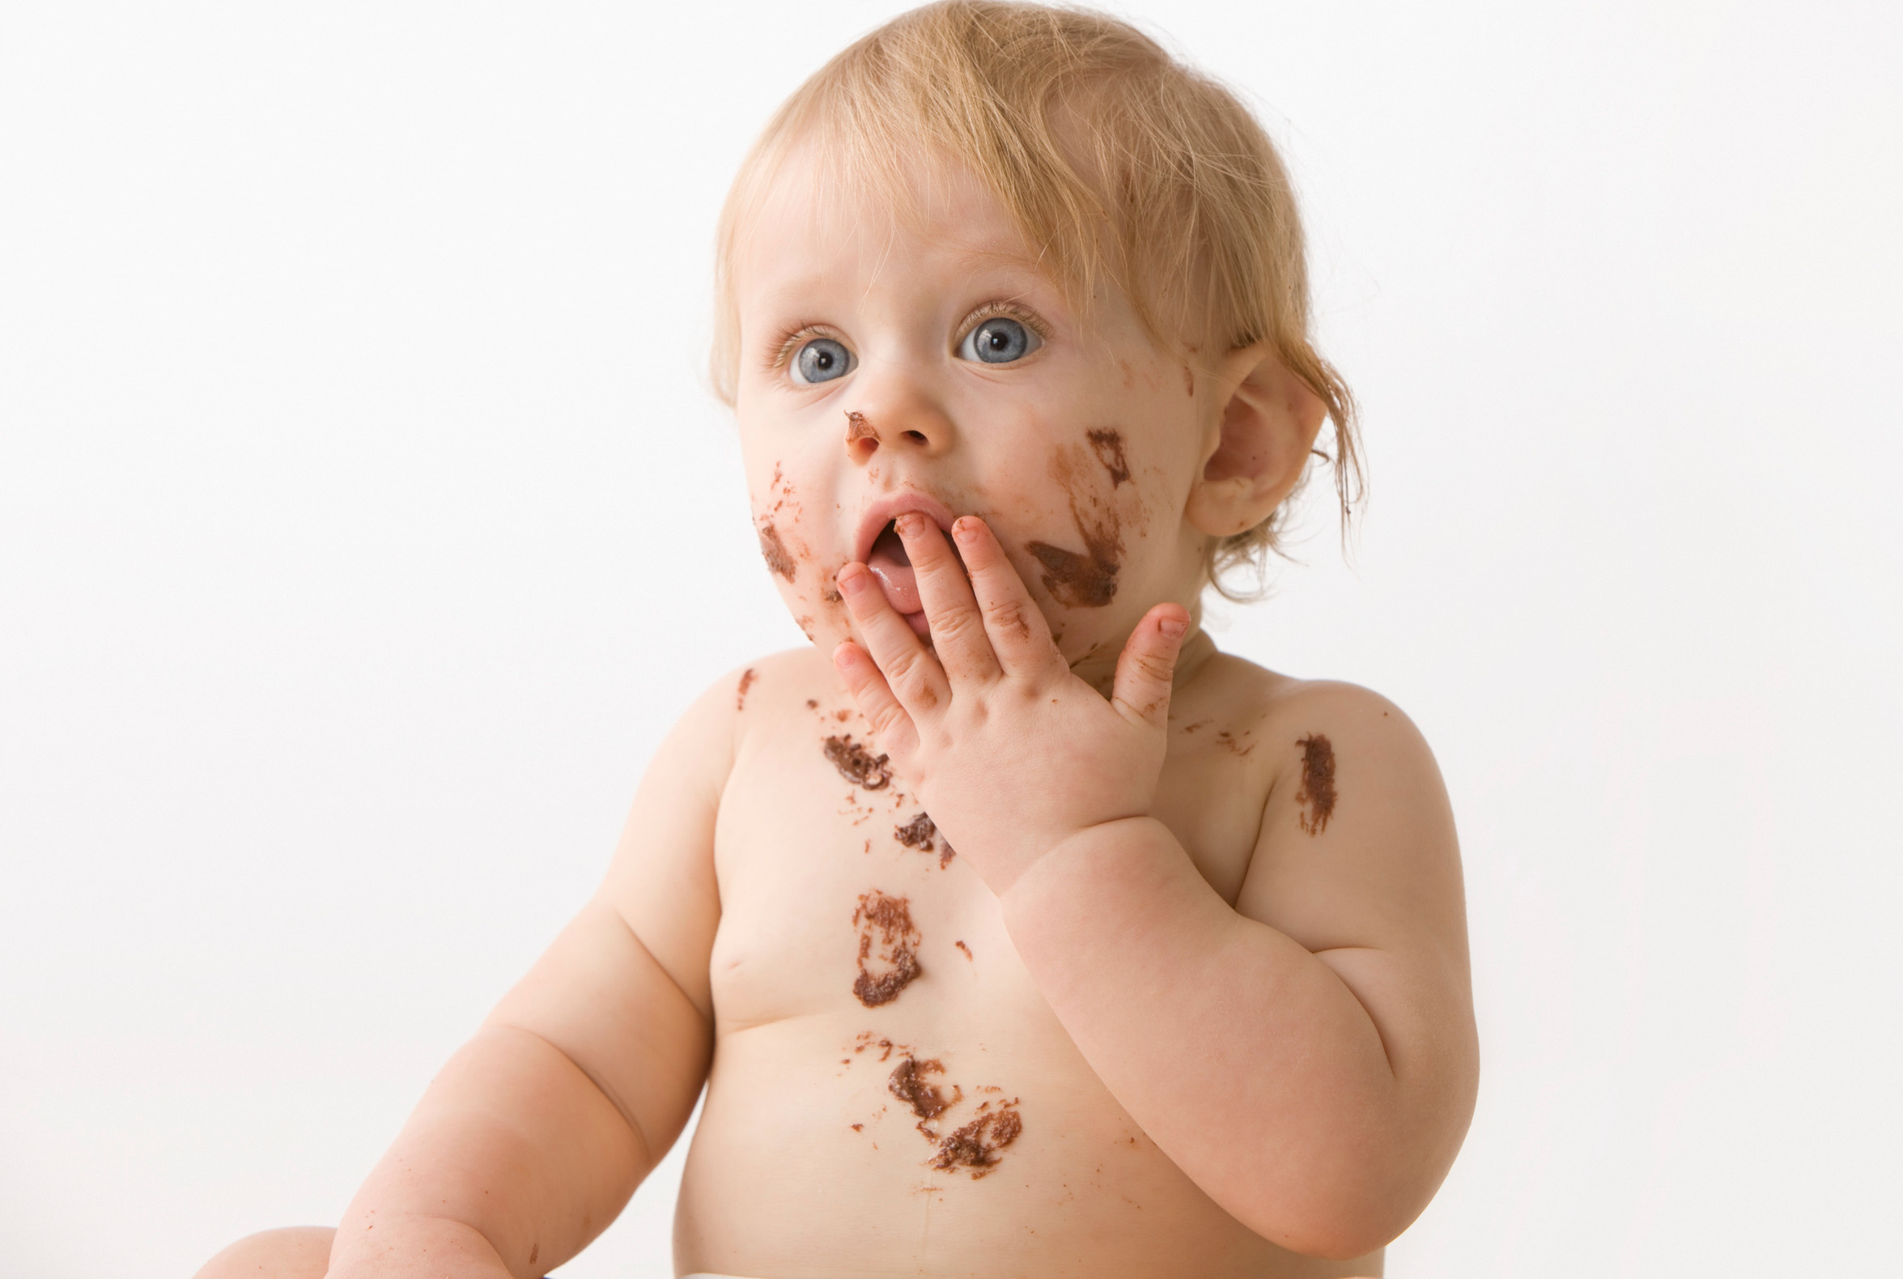
How did you do?

Slide 20
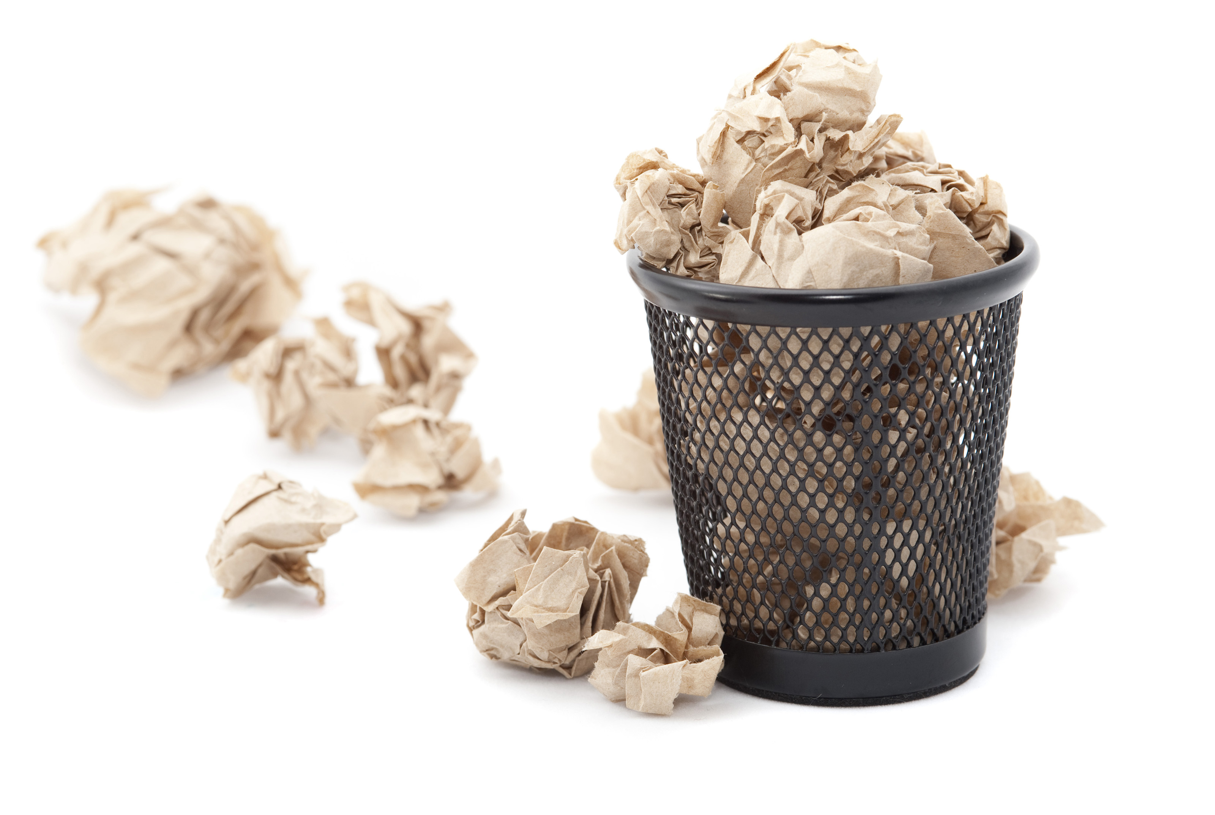
Shoot!

Slide 21
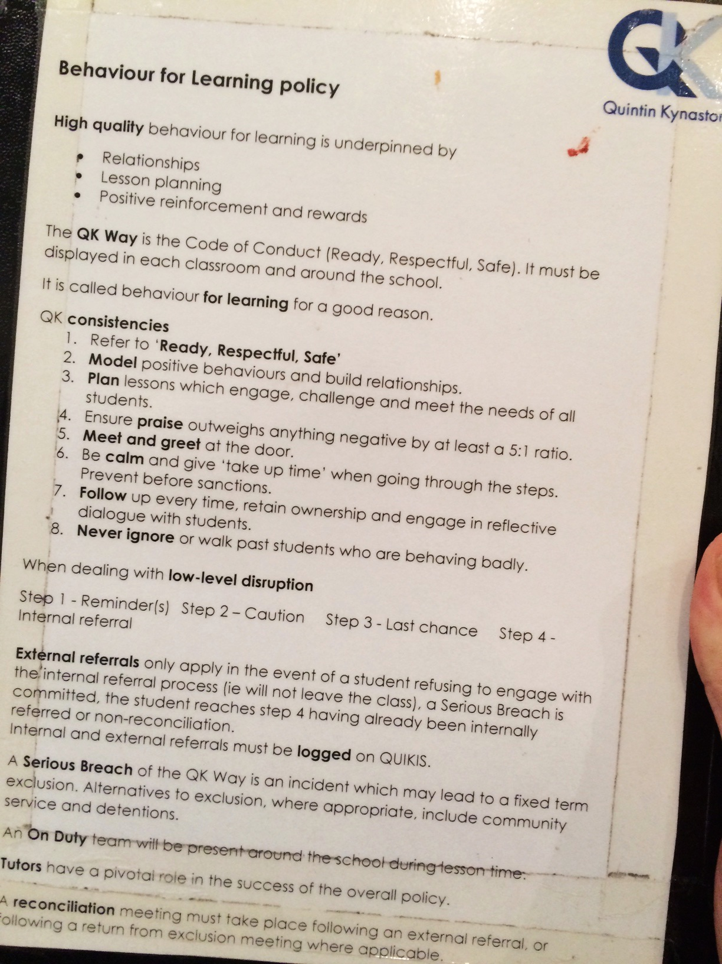
Taken from QK Behaviour for Learning Policy

Slide 22
Self Regulation ?
Self-regulation is a critical competency that underlies the mindful, intentional, and thoughtful behaviours of learners.
The term self-regulation refers to the capacity to control one’s impulses, both to stop doing something, if needed and to start doing something, if needed.

Slide 23
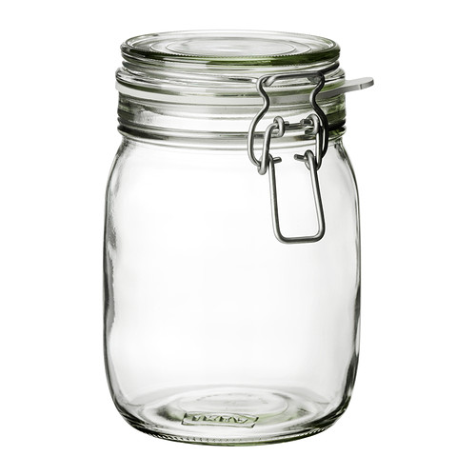
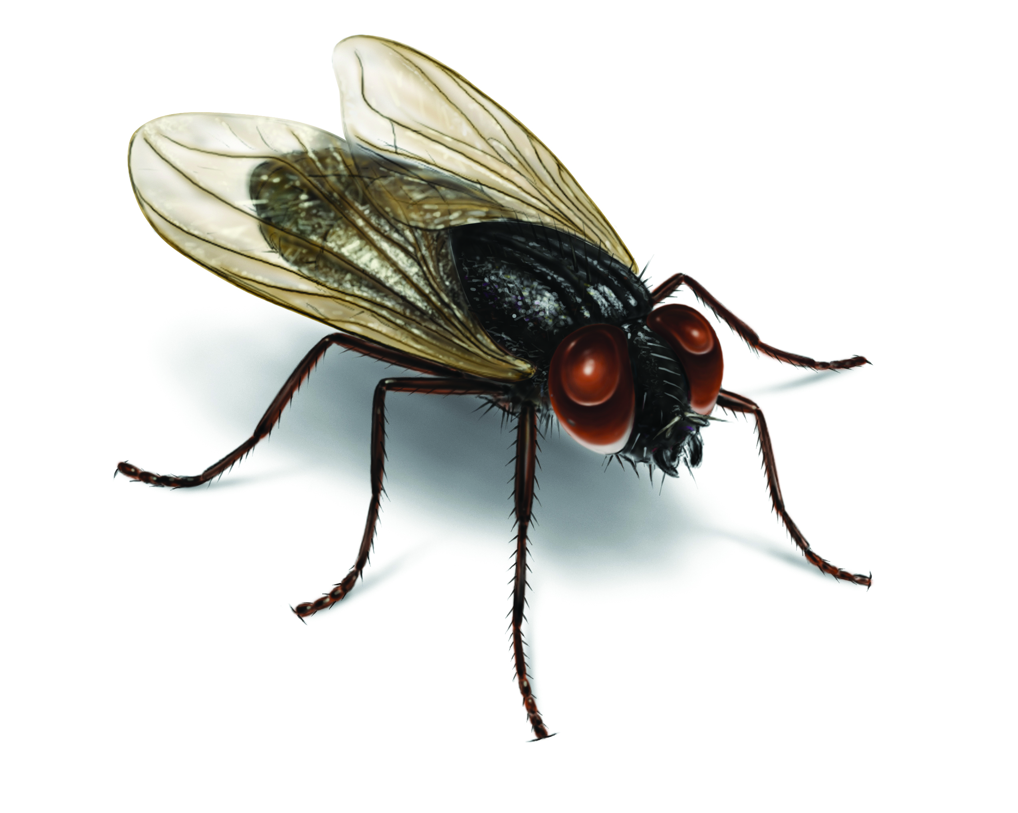
How do we teach our students to self regulate ?
An imaginary lid
Notes:
https://www.youtube.com/watch?v=BND6ox0RV3Y

Slide 24
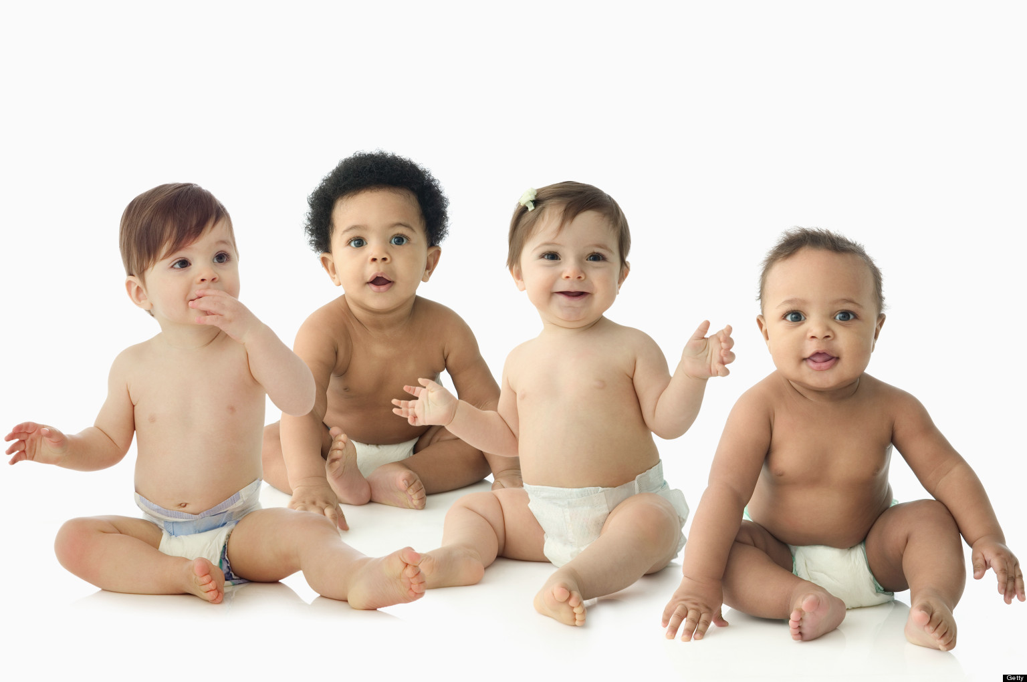
GROUP Discussion

Slide 25
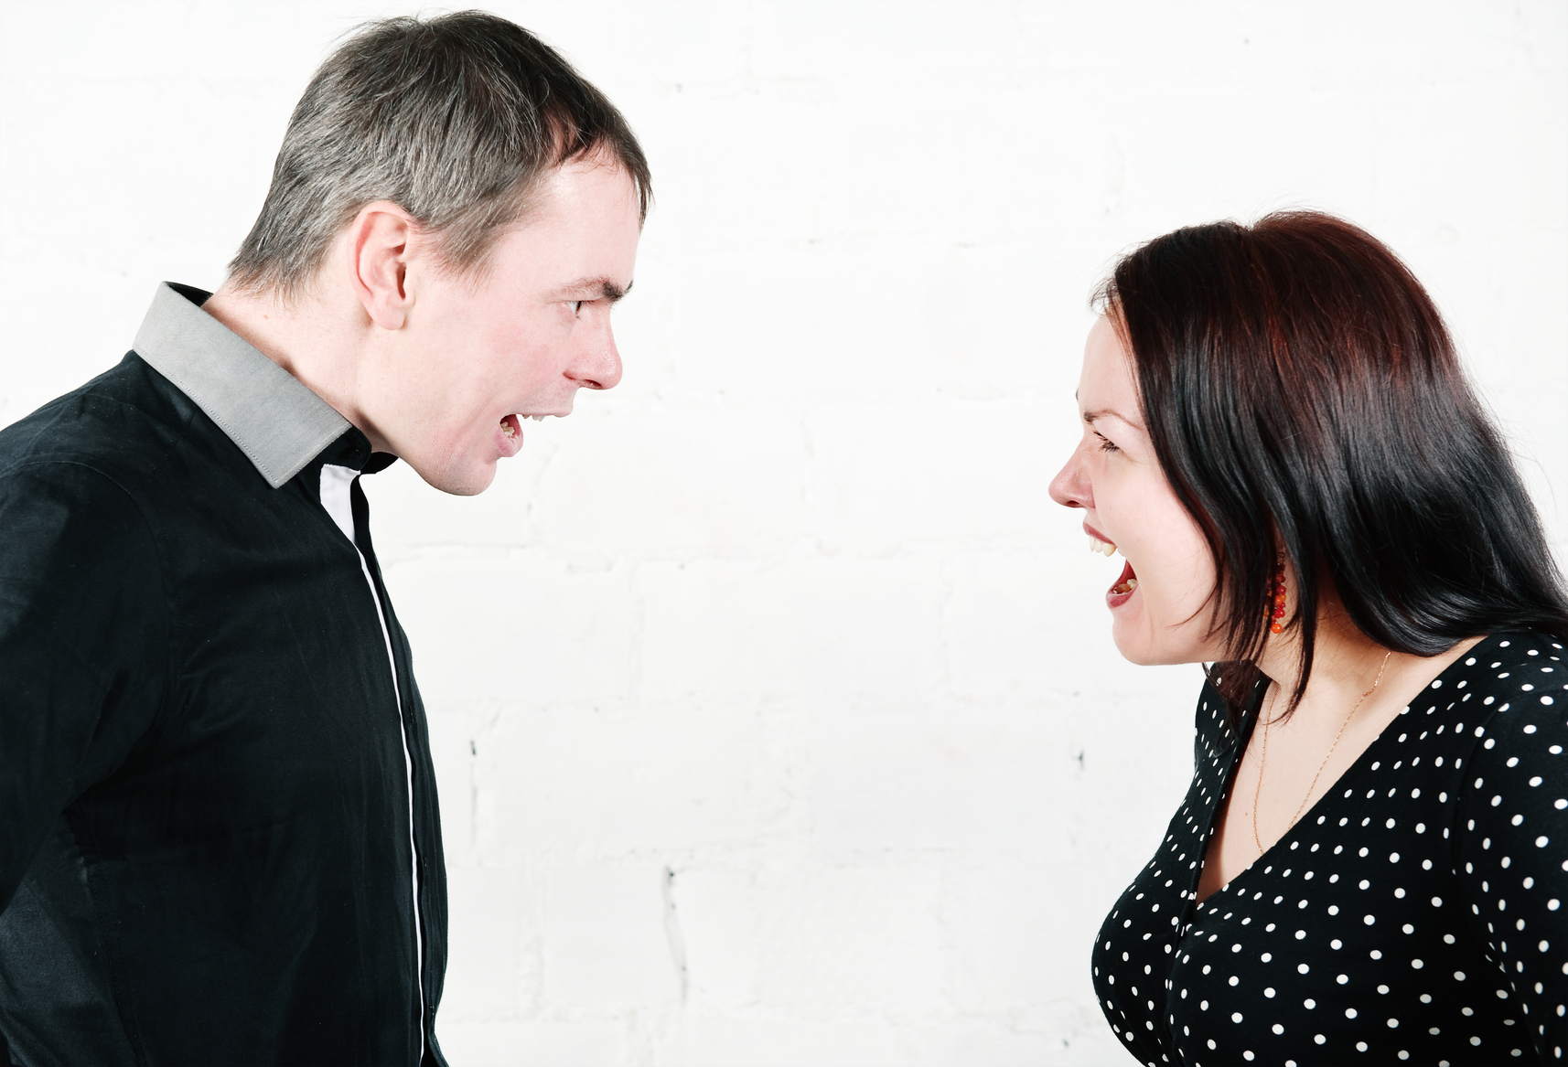
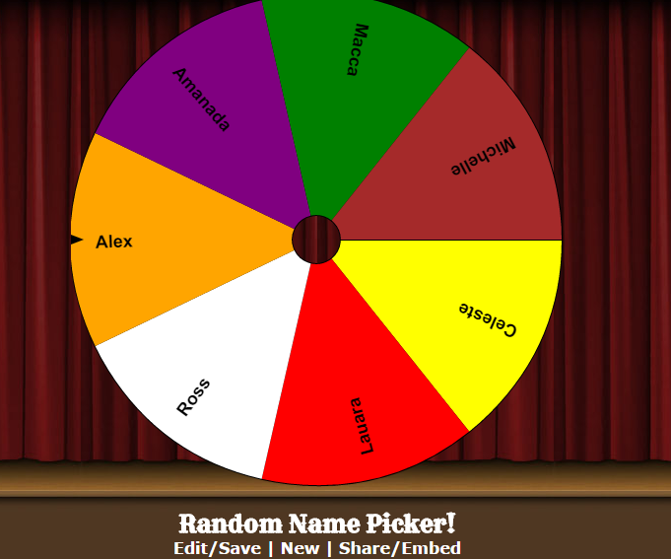
Changing g behaviour.
You do
the talking!

Slide 26
Notes:
http://www.classtools.net/random-name-picker/

Slide 27
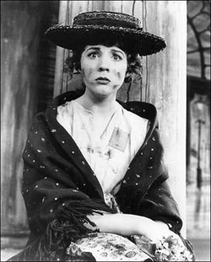
Pygmalion Effect - Context
“Pygmalion is a play by George Bernard Shaw, named after a Greek mythological character.
It was first presented on stage to the public in 1912. (My Fair Lady)
Professor of phonetics Henry Higgins makes
a bet that he can train a bedraggled
Cockney flower girl, Eliza Doolittle, to
pass for a duchess at an ambassador’s
garden party by teaching her to assume
a veneer of gentility…”

Slide 28
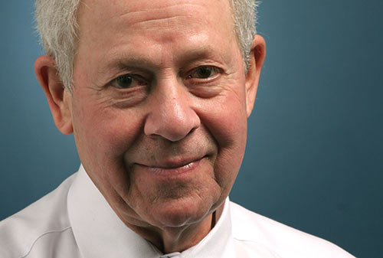
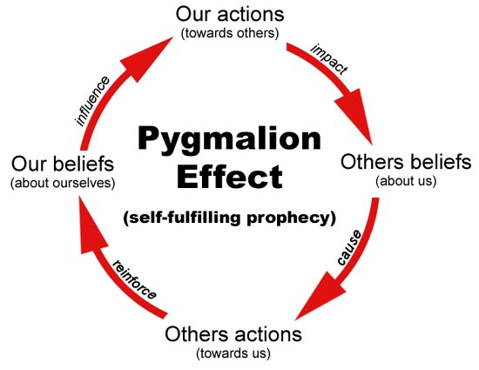
Pygmalion Effect
Dr. Robert Rosenthal - Harvard

Slide 29
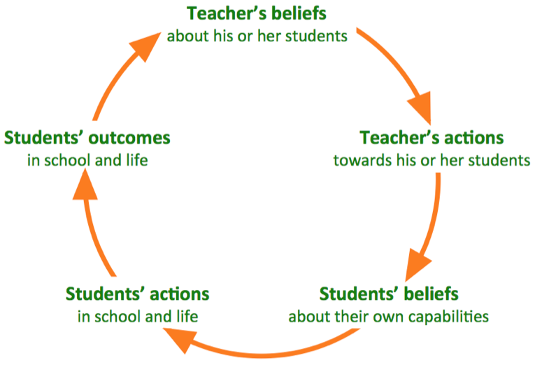
Pygmalion Effect - Teacher

Slide 30
Pygmalion Effect - video
Dr. Robert Rosenthal - Harvard
Notes:
https://www.youtube.com/watch?v=hTghEXKNj7g

Slide 31
GROUP Discussion

Slide 32
Changing g behaviour.
You do
the talking!

Slide 33
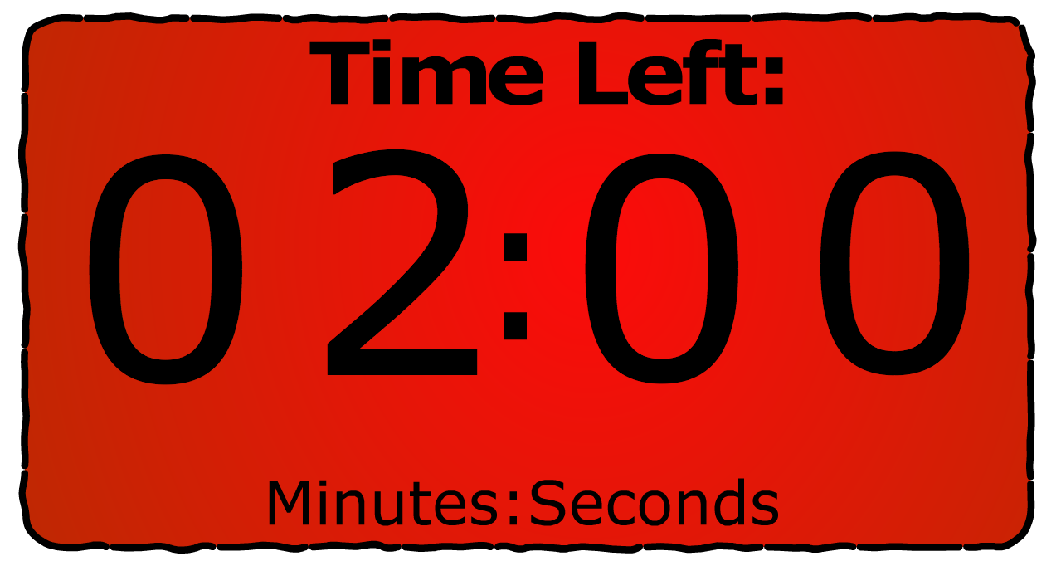
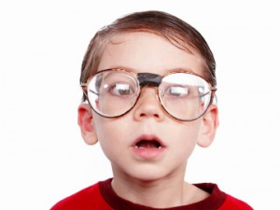
Notes:
http://www.classtools.net/education-games-php/timer

Slide 34
Notes:
http://www.classtools.net/random-name-picker/

Slide 35
Changing a behaviour…..
Notes:
Fun Theory: https://www.youtube.com/watch?v=2lXh2n0aPyw&list=PL49C04ADF7BEAFB06

Slide 36
GROUP Discussion

Slide 37
Changing g behaviour.
You do
the talking!

Slide 38
Notes:
http://www.classtools.net/education-games-php/timer

Slide 39
Notes:
http://www.classtools.net/random-name-picker/

Slide 40
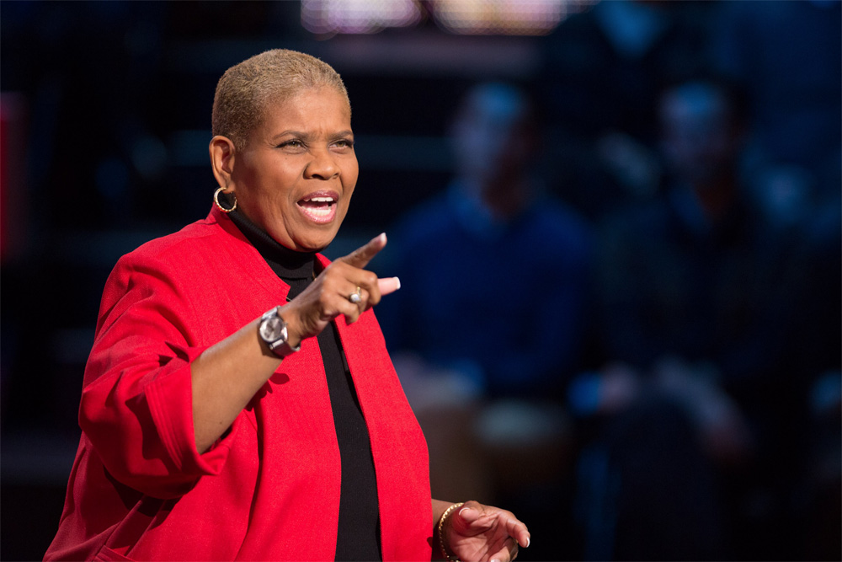
Building a relationship.
Notes:
https://www.ted.com/talks/rita_pierson_every_kid_needs_a_champion

Slide 41
How can we individually, get students to be self regulators at all times ?

Slide 42
GROUP Discussion

Slide 43
Changing g behaviour.
You do
the talking!

Slide 44
Notes:
http://www.classtools.net/education-games-php/timer

Slide 45
Notes:
http://www.classtools.net/random-name-picker/

Slide 46
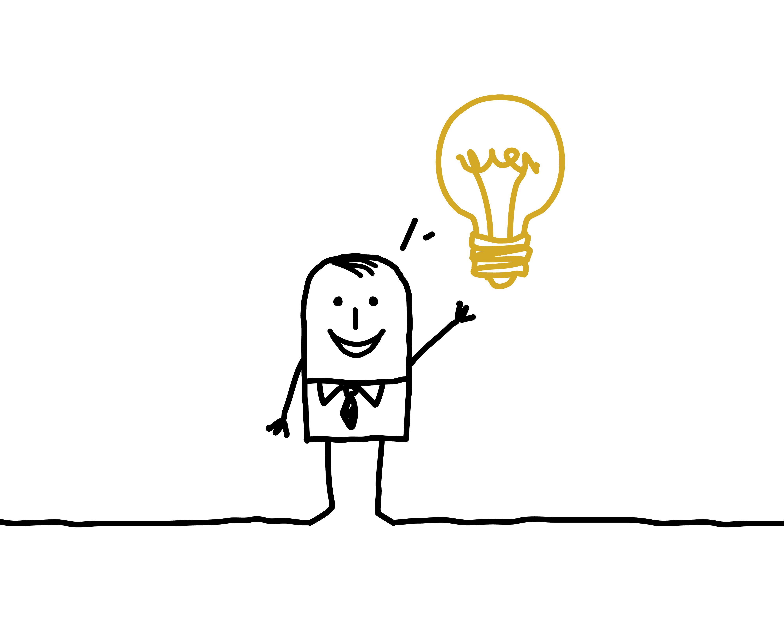

Slide 47
Make your expectations known
Give honest feedback
Make sure you offer a choice
Be patient
Don’t tell them what to do, they decide
Help them understand their cues
Allow for small mistakes – that’s how we learn

Slide 48
Consider …

Slide 49
The 5-Minute Behaviour Fix
… print and scribble your way to an improved, student behaviour strategy.
Seating Plan
Starts and Ends of lessons
Transitions
between activities
Ready
2. Respectful
3. Safe
The class picture?
(What key information do you have about the class and individuals?
Relationships?
Teacher support?
in review of this plan
Assertiveness?
Rules Expectations
Step 1 - Reminder
Step 2 - Caution
Rewards and Sanctions
5:1 ratio
Step 3 – Last Chance
Step 4 – Internal Referral
Step 5 – Referral
R.McGill 2014 - @TeacherToolkit
Notes:
R.McGill 2014 - @TeacherToolkit

Slide 50
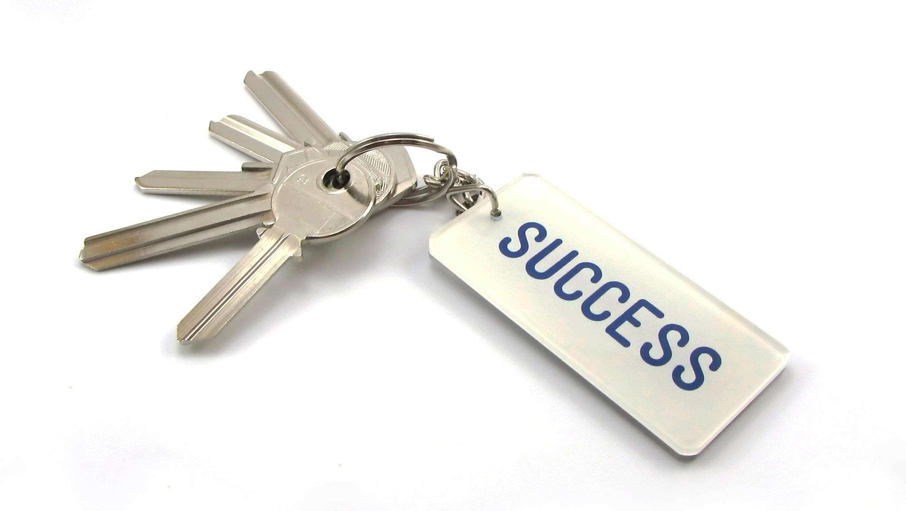
CONSISTENCY
Break time
Lesson change over
At your door
Lunch time
Teamwork
On duty
Always follow up
Non verbal communication

Slide 51
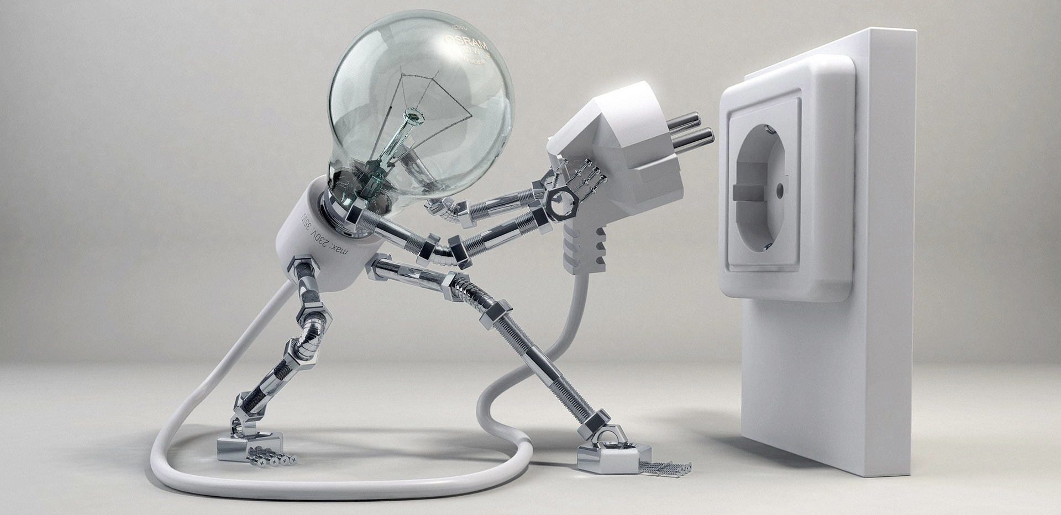
Any questions?

Slide 52
Notes:
This presentation by @TeacherToolkit ( Ross Morrison McGill ) and is licensed under a Creative Commons Attribution-NonCommercial-NoDerivs 3.0 Unported License. Based on all work published at www.teachertoolkit.me
@TeacherToolkit Limited.

Slide 53
Thank you!
by
TeacherToolkit@me.com
@TeacherToolkit
www.TeacherToolkit.me
Notes:
This presentation by @TeacherToolkit ( Ross Morrison McGill ) and is licensed under a Creative Commons Attribution-NonCommercial-NoDerivs 3.0 Unported License.
Based on all work published at www.teachertoolkit.me
@TeacherToolkit Limited.

Slide 54
by
Last slide …

Slide 55
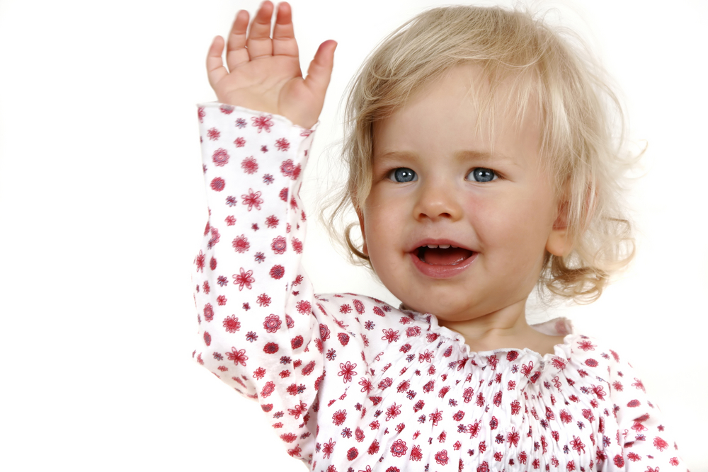
See you later…
Notes:
So today I’d like us to go through the following objectives

Slide 56
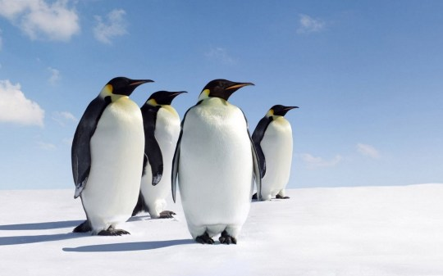
Team work
Before you go …
Notes:
https://www.youtube.com/watch?v=w9j3-ghRjBs

