Slide 1



is setting up…
by
Notes:
Videos needed:
Taylor Mali – What teachers make? = https://www.youtube.com/watch?v=RxsOVK4syxU
Lamont Carey – I can’t read = http://youtu.be/lByDfPOG0LA?t=22s
The 5 Minute Lesson Plan = http://bit.ly/5MinVideo
IRIS myself: https://teachertoolkitdotme.files.wordpress.com/2014/01/year-9-iris-export-for-teachertoolkit-blog.m4v
Resources:
Keywords for literateness?
IPEVO camera?
Latest reading book?
This presentation by @TeacherToolkit ( Ross Morrison McGill ) and is licensed under a Creative Commons Attribution-NonCommercial-NoDerivs 3.0 Unported License.
Based on all work published at www.teachertoolkit.me
@TeacherToolkit Limited.

Slide 2


Fingertips ready?
by
#FoodUEL
Notes:
This presentation by @TeacherToolkit ( Ross Morrison McGill ) and is licensed under a Creative Commons Attribution-NonCommercial-NoDerivs 3.0 Unported License.
Based on all work published at www.teachertoolkit.me
@TeacherToolkit Limited.

Slide 3
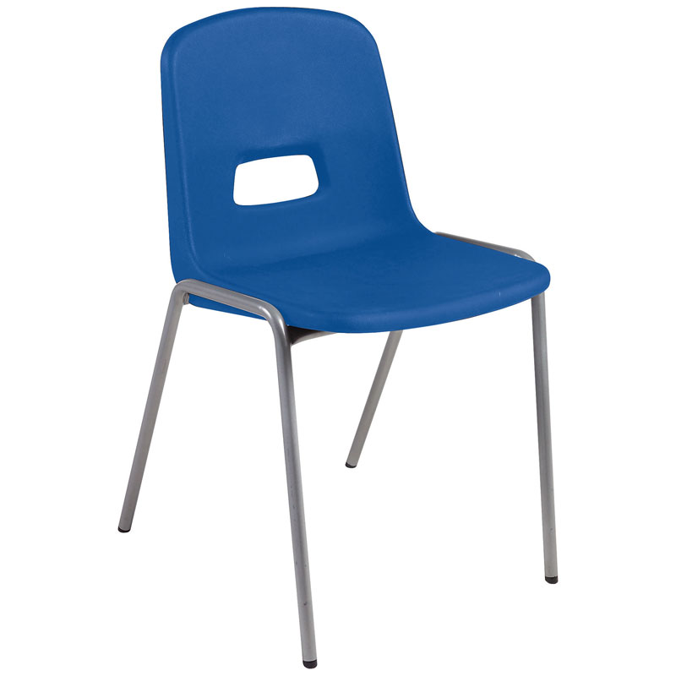
Chair …
by
Notes:
This presentation by @TeacherToolkit ( Ross Morrison McGill ) and is licensed under a Creative Commons Attribution-NonCommercial-NoDerivs 3.0 Unported License.
Based on all work published at www.teachertoolkit.me
@TeacherToolkit Limited.

Slide 4
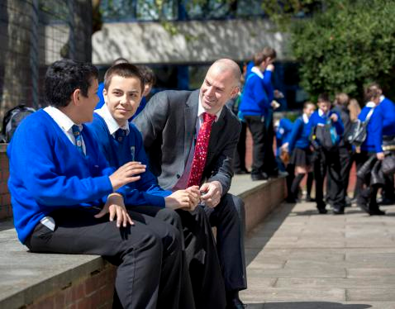
Career snapshot
by
2015 = Debretts – 500 Most Influential People in Britain
2014 = Appointed Deputy Headteacher
2013 = Blog openly about job-hunting via social-media.
2013 = @SLTchat recognised by DfE. (trending across UK)
2011 = Assistant Vice Principal
2011 = Made redundant! Become a father.
2010 = Joined Twitter professionally. (personally in 2008)
2008 – Assistant Principal
2007 = Head of Design Technology and ICT,
2004 = Teacher of the Year award in Secondary School in London
2000 = Head of Design Technology.
1998 = Full time Technology teacher.
1997 = Supply teaching in South and North London
1997 = VSO: Nigeria as NQT / Head of Department
Notes:
This presentation by @TeacherToolkit ( Ross Morrison McGill ) and is licensed under a Creative Commons Attribution-NonCommercial-NoDerivs 3.0 Unported License.
Based on all work published at www.teachertoolkit.me
@TeacherToolkit Limited.

Slide 5

Subject snapshot
by
1993 – 2008:
Graphics
Resistant Materials
Art
2000+ :
Food Technology
Textiles
Electronics
Systems and Control
2007+ :
ICT
2011+ :
Food Technology; Art; History; ICT
2013+ :
Food; Media Studies; Psychology; Textiles
Cover lessons!
Maths; English; PE; Drama; Music; Business; MFL!
Image: www.joejuggler.com
Notes:
This presentation by @TeacherToolkit ( Ross Morrison McGill ) and is licensed under a Creative Commons Attribution-NonCommercial-NoDerivs 3.0 Unported License.
Based on all work published at www.teachertoolkit.me
@TeacherToolkit Limited.

Slide 6

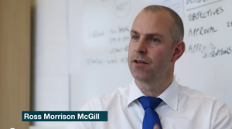
Addressing the Challenges of Teaching
Food Technology
by
by Ross M. McGill
Deputy Headteacher
@TeacherToolkit
www.TeacherToolkit.me
Notes:
This presentation by @TeacherToolkit ( Ross Morrison McGill ) and is licensed under a Creative Commons Attribution-NonCommercial-NoDerivs 3.0 Unported License.
Based on all work published at www.teachertoolkit.me
@TeacherToolkit Limited.

Slide 7

Recipe:
by
Timings | What content?
3pm – 3.15pm: | Introductions / Starter
3.15pm – 3.30pm | Challenge 1
3.30pm – 3.45pm | Challenge 2
3.45pm – 4.00pm | Challenge 3
4.00pm – 4.15pm | Challenge 4
4.15pm – 4.25pm | Advice
4.25pm – 4.30pm | Further Information
Notes:
This presentation by @TeacherToolkit ( Ross Morrison McGill ) and is licensed under a Creative Commons Attribution-NonCommercial-NoDerivs 3.0 Unported License. Based on all work published at www.teachertoolkit.me
@TeacherToolkit Limited.

Slide 8

Grab!
by
A pen
Scrap A4 paper
Photo credit: www.sk-eternalsapience.blogspot.com
Notes:
This presentation by @TeacherToolkit ( Ross Morrison McGill ) and is licensed under a Creative Commons Attribution-NonCommercial-NoDerivs 3.0 Unported License.
Based on all work published at www.teachertoolkit.me
@TeacherToolkit Limited.
Idea 11 in my 100 ideas book.

Slide 9

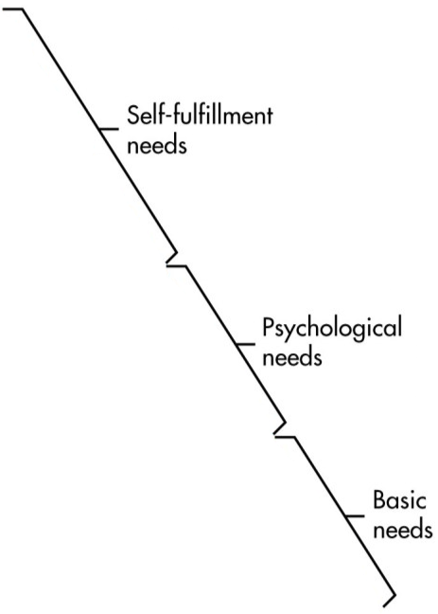
Maslow's Hierarchy of Needs
by
Food Technology
Self-actualisation
Esteem
Belonging
Safety
Physiological
This presentation by @TeacherToolkit ( Ross Morrison McGill ) and is licensed under a Creative Commons Attribution-NonCommercial-NoDerivs 3.0 Unported License. Based on all work published at www.teachertoolkit.me @TeacherToolkit Limited.
Notes:
This presentation by @TeacherToolkit ( Ross Morrison McGill ) and is licensed under a Creative Commons Attribution-NonCommercial-NoDerivs 3.0 Unported License. Based on all work published at www.teachertoolkit.me
@TeacherToolkit Limited.

Slide 10

Priortise these words!
by
Photo credit: www.psychologies.co.uk
Notes:
This presentation by @TeacherToolkit ( Ross Morrison McGill ) and is licensed under a Creative Commons Attribution-NonCommercial-NoDerivs 3.0 Unported License.
Based on all work published at www.teachertoolkit.me
@TeacherToolkit Limited.
Idea 11 in my 100 ideas book.
life skills
2. complex
3. commercial
SWAP
4. analysis
5. vocational
6. specialist
SWAP
7. rigour
8. progression
9. colloids
10. caramelise
Food technology in secondary schools
This report evaluates the effectiveness of provision in secondary schools for food technology within the National Curriculum subject design and technology. It examines strengths and weaknesses in pupils' achievement and the tension between the teaching of food to develop life skills and using food as a means to teach design and technology.

Slide 11
Technician Time
Class Sizes
Great Teaching
Ingredient Provision
Bidding for Equipment
by

Slide 12

Now swap papers!
by
Photo credit: www.kstfamily.com
Notes:
This presentation by @TeacherToolkit ( Ross Morrison McGill ) and is licensed under a Creative Commons Attribution-NonCommercial-NoDerivs 3.0 Unported License.
Based on all work published at www.teachertoolkit.me
@TeacherToolkit Limited.
Idea 11 in my 100 ideas book.

Slide 13

Shoot!

Slide 14
Process
Scenario …
Expert …
Headteacher …
by
Notes:
This presentation by @TeacherToolkit ( Ross Morrison McGill ) and is licensed under a Creative Commons Attribution-NonCommercial-NoDerivs 3.0 Unported License.
Based on all work published at www.teachertoolkit.me
@TeacherToolkit Limited.

Slide 15
Maslow's Hierarchy of Needs
by
Food Technology
Self-actualisation
Esteem
Belonging
Safety
Physiological
Ingredients Provision
This presentation by @TeacherToolkit ( Ross Morrison McGill ) and is licensed under a Creative Commons Attribution-NonCommercial-NoDerivs 3.0 Unported License. Based on all work published at www.teachertoolkit.me @TeacherToolkit Limited.
Notes:
This presentation by @TeacherToolkit ( Ross Morrison McGill ) and is licensed under a Creative Commons Attribution-NonCommercial-NoDerivs 3.0 Unported License. Based on all work published at www.teachertoolkit.me
@TeacherToolkit Limited.

Slide 16
Recipe:
by
Timings | What content?
3pm – 3.15pm: | Introductions / Starter
3.15pm – 3.30pm | No. 5 – Ingredients Provision
3.30pm – 3.45pm | Challenge 2
3.45pm – 4.00pm | Challenge 3
4.00pm – 4.15pm | Challenge 4
4.15pm – 4.25pm | Advice
4.25pm – 4.30pm | Further Information
Notes:
This presentation by @TeacherToolkit ( Ross Morrison McGill ) and is licensed under a Creative Commons Attribution-NonCommercial-NoDerivs 3.0 Unported License. Based on all work published at www.teachertoolkit.me
@TeacherToolkit Limited.

Slide 17

Scenario
by
Notes:
This presentation by @TeacherToolkit ( Ross Morrison McGill ) and is licensed under a Creative Commons Attribution-NonCommercial-NoDerivs 3.0 Unported License.
Based on all work published at www.teachertoolkit.me
@TeacherToolkit Limited.

Slide 18
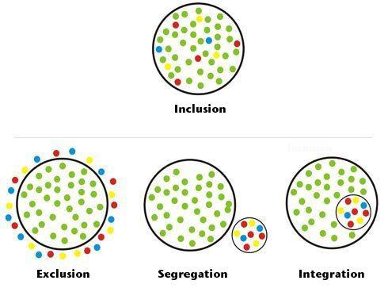
Inclusion or Exclusion?
by
Notes:
This presentation by @TeacherToolkit ( Ross Morrison McGill ) and is licensed under a Creative Commons Attribution-NonCommercial-NoDerivs 3.0 Unported License.
Based on all work published at www.teachertoolkit.me
@TeacherToolkit Limited.

Slide 19

Thoughts?
by

Slide 20

Expert Advice
by
Simon Gray
www.comunicaomuere.com
Notes:
This presentation by @TeacherToolkit ( Ross Morrison McGill ) and is licensed under a Creative Commons Attribution-NonCommercial-NoDerivs 3.0 Unported License.
Based on all work published at www.teachertoolkit.me
@TeacherToolkit Limited.

Slide 21
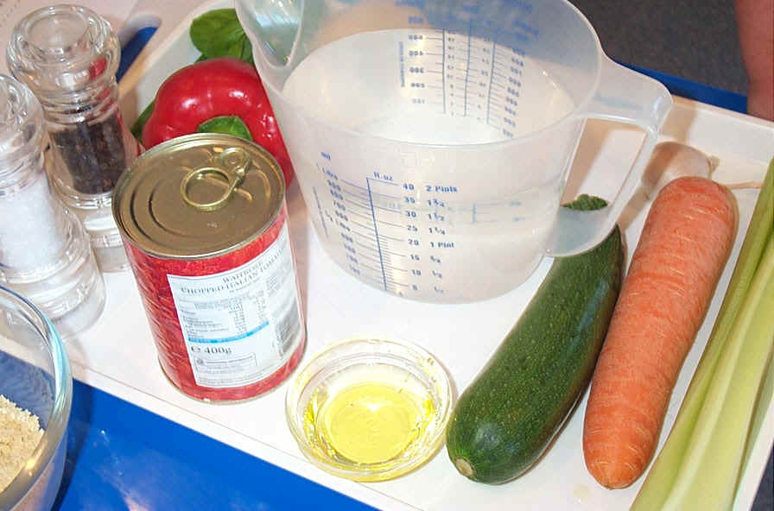

Slide 22
A system for providing and funding ingredients that works!
Simon Gray

Slide 23

Sound Familiar?
I have PE today
I have a note from my dad
Mum forgot I was cooking
We did not have any of those ingredients
Are we cooking today?

Slide 24
The Issues
Bringing ingredients can be a constant problem:
takes up time at the start of a short lesson
may be the same pupils each lesson
these pupils are often those who would benefit most from practical cooking sessions.

Slide 25

Ofsted criticism……
“… in many schools, some pupils often do little cooking because they cannot afford, or will not bring to school, ingredients for practical cookery. This is a form of social exclusion linked to the unique method of funding food teaching, whereby parents have to pay for or supply the food cooked by their children in food lessons in schools and then taken home.” (OFSTED 2006)

Slide 26
Why provide ingredients?
Prompt start to already short practical lessons
Whole class engagement
Reduce stigma with FSM / PP pupils
Reduce cost to parents / carers
Guarantee the correct ingredients
Pupils use and taste different foods

Slide 27
A school policy should state:
The school’s view on who should provide ingredients for learning in lessons
Why this approach is taken by the school
The school’s approach to inclusion, including
    Process for supporting those pupils who are unable to provide ingredients to access learning and exams
    How to ensure those pupils are not identifiable or singled out and are supported sensitively
Procedure for when a pupils forgets their ingredients (one-off and persistent)
Support systems for reminding parents/pupils about what to bring

Slide 28
Policy continued… it should state
Expectations for voluntary contributions and how this is justified (ie if food is provided and then taken home to be eaten)
How the money is collected and administered*
What any money collected is used for
* we do not recommend individual food teachers handling money

Slide 29



What system to use
Provide all ingredients
Provide basic ingredients and ask pupils to bring additional ingredients
Ask pupils to bring all ingredients
Each system has advantages and disadvantages (see our handout).
The philosophy should reflect what happens across the rest of school, for example in music, in PE.

Slide 30
School budget impacts…..
Budget for demonstration ingredients and ingredients for sensory testing etc.
System for pupils who cannot bring ingredients is essential where they are not provided
It is not adequate for a pupil without ingredients to be helping another pupil
Reduce costs working in pairs and divide what is made to take home or for tasting in class.
Insist that cleaning materials come from central supplies (also safer for risk assessment)

Slide 31

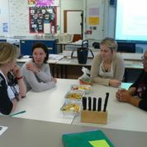
An example of setting up a system
Discuss the policy and system with SLT
SOW – embedded recipes for KS3
Cost recipes – set up a spread sheet
Write a letter – sell advantages to parents
Determine how to collect funds – parent pay
Transfer Pupil Premium Money
Organise suppliers and delivery

Slide 32

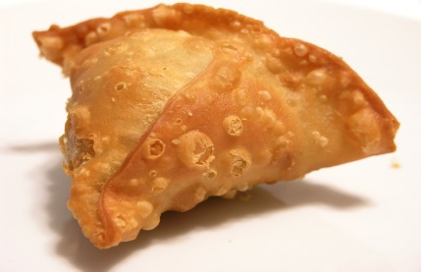
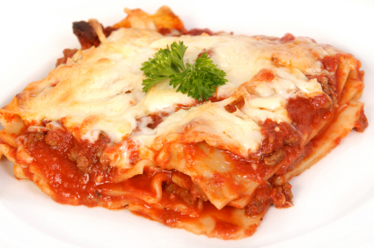
Determining costs starts with your SOW
Year 7
Baked beans on toast
Fruit Fusion
Ratatouille
Bolognaise sauce
Pizza
Vegetable Couscous
Oaty Apple crumble
Breakfast muffin
Year 8
Apple Pie
Quiche
Small cakes
Savoury Rice
Lasagne
Shepherds Pie
Meatballs
Chicken Curry – paste method
Potato Curry - spice methods
Tuna Pasta Bake
Year 9
Thai Green Curry
Spanish omelette
Sweet and sour chicken
Pea and bacon risotto
Samosa
Stir Fry – Chow Mein
Breaded Chicken.

Slide 33
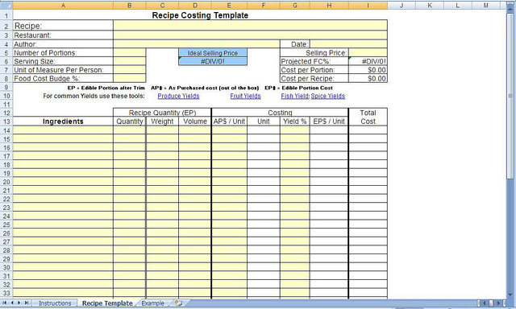
Cost your scheme…..
Set up a spreadsheet of core ingredients
Link to recipes to identify costs
Summarise overall cost per scheme
Identify pupil contribution if any
Produce shopping lists

Slide 34
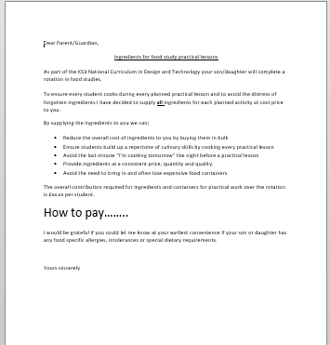
Write to parents / guardian…….

Slide 35

Logistics - ingredients
Technician shops locally
Order through canteen
Supermarket delivery
Cash and carry delivery

Slide 36
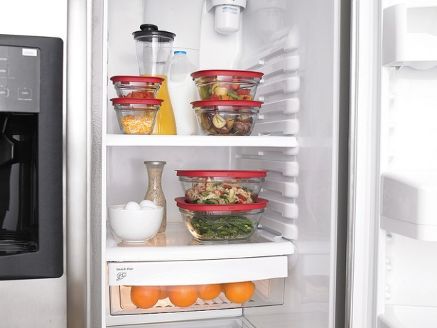
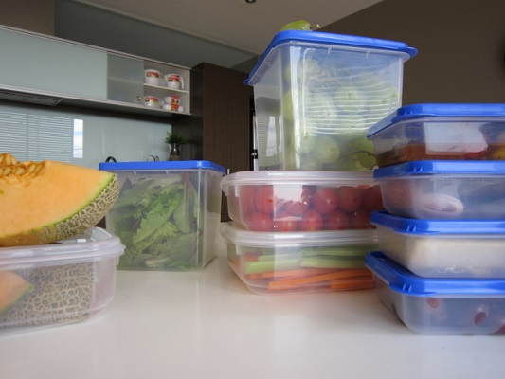
Considerations……
Adequate storage:
Ambient
Chilled
Frozen
Technician support:
Weighing and measuring
Set up time
Food safety management
Stock control

Slide 37
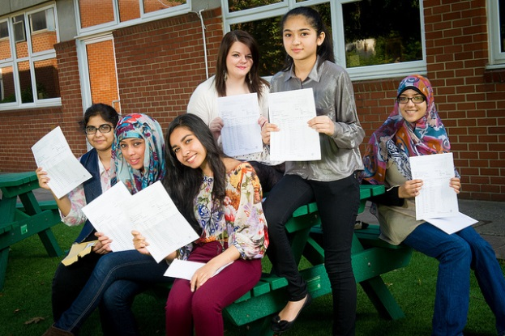
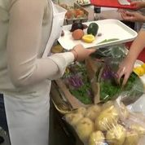
How to get started : approach the Head Teacher
Identify an appropriate ingredients policy
Identify the benefits to teaching and learning
Identify different system options
Discuss costs involved
Determine material needs to run system
Focus on positive effects to pupils learning and progress

Slide 38

Headteacher
by
Notes:
This presentation by @TeacherToolkit ( Ross Morrison McGill ) and is licensed under a Creative Commons Attribution-NonCommercial-NoDerivs 3.0 Unported License.
Based on all work published at www.teachertoolkit.me
@TeacherToolkit Limited.

Slide 39

Bidding for Ingredients
by
Notes:
This presentation by @TeacherToolkit ( Ross Morrison McGill ) and is licensed under a Creative Commons Attribution-NonCommercial-NoDerivs 3.0 Unported License.
Based on all work published at www.teachertoolkit.me
@TeacherToolkit Limited.

Slide 40

Costs:
Per child.
Per lesson / term.
Per year.
Costs vs. Impact.
Rationale: What? Why? How?
Provide 2 solutions!
by
www.shoemoney.com

Slide 41
Maslow's Hierarchy of Needs
by
Food Technology
Self-actualisation
Esteem
Belonging
Safety
Class Sizes
Physiological
Ingredients Provision
This presentation by @TeacherToolkit ( Ross Morrison McGill ) and is licensed under a Creative Commons Attribution-NonCommercial-NoDerivs 3.0 Unported License. Based on all work published at www.teachertoolkit.me @TeacherToolkit Limited.
Notes:
This presentation by @TeacherToolkit ( Ross Morrison McGill ) and is licensed under a Creative Commons Attribution-NonCommercial-NoDerivs 3.0 Unported License. Based on all work published at www.teachertoolkit.me
@TeacherToolkit Limited.

Slide 42
Recipe:
by
Timings | What content?
3pm – 3.15pm: | Introductions / Starter
3.15pm – 3.30pm | No. 5 – Ingredients Provision
3.30pm – 3.45pm | No. 4 – Class Sizes
3.45pm – 4.00pm | Challenge 3
4.00pm – 4.15pm | Challenge 4
4.15pm – 4.25pm | Advice
4.25pm – 4.30pm | Further Information
Notes:
This presentation by @TeacherToolkit ( Ross Morrison McGill ) and is licensed under a Creative Commons Attribution-NonCommercial-NoDerivs 3.0 Unported License. Based on all work published at www.teachertoolkit.me
@TeacherToolkit Limited.

Slide 43

Scenario
by
Notes:
This presentation by @TeacherToolkit ( Ross Morrison McGill ) and is licensed under a Creative Commons Attribution-NonCommercial-NoDerivs 3.0 Unported License.
Based on all work published at www.teachertoolkit.me
@TeacherToolkit Limited.

Slide 44

by
The full time classroom teacher
Teaches on average 20 hours per week.
Teaches for 38 weeks per year.
This equates to 760 hours per year!
That’s a lot of resources!
That’s a lot of students!
Notes:
This presentation by @TeacherToolkit ( Ross Morrison McGill ) and is licensed under a Creative Commons Attribution-NonCommercial-NoDerivs 3.0 Unported License.
Based on all work published at www.teachertoolkit.me
@TeacherToolkit Limited.

Slide 45
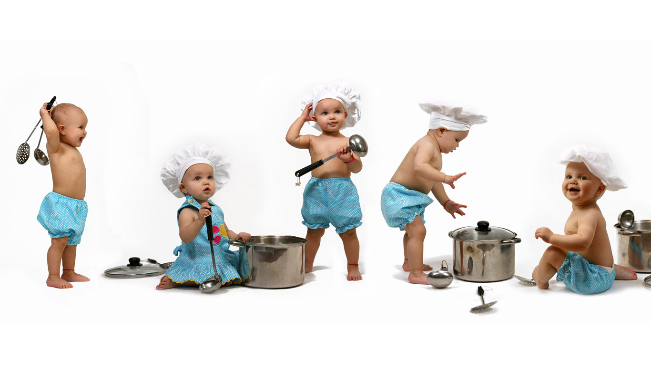
Thoughts:
Small or large class?
by
Notes:
This presentation by @TeacherToolkit ( Ross Morrison McGill ) and is licensed under a Creative Commons Attribution-NonCommercial-NoDerivs 3.0 Unported License.
Based on all work published at www.teachertoolkit.me
@TeacherToolkit Limited.

Slide 46

Expert Advice
by
Suzanne Gray
www.visionsmartcenter.com
Notes:
This presentation by @TeacherToolkit ( Ross Morrison McGill ) and is licensed under a Creative Commons Attribution-NonCommercial-NoDerivs 3.0 Unported License.
Based on all work published at www.teachertoolkit.me
@TeacherToolkit Limited.

Slide 47
The great class size debate
Suzanne Gray

Slide 48




The Great Food Class Size Debate
How big should a class be legally?
Where can teachers go to get help
and support?
What can teachers do if they think their classes are too big?

Slide 49
Using recommendations
Different agencies have differing recommendations. There are currently NO legislations. Some Local Authorities have their own rules about maximum class sizes.
NUT: their policy is a maximum of 20 pupils.
DfE: maximum of 21 in approximately 100sq.m. Classroom.
1985 guidance suggested 4sq.m per pupil , for planning purposes. 20 pupils at KS3 and 15 at KS4.
1918 Education Act: limit of 20 pupils
BS4163:2014: safety in D&T rooms;
21 pupils
DATA: 20 pupils at KS3 18 at KS4
HSE: indicate they would prosecute if
overcrowding were contributory to
an accident, but give no guidance
on numbers per sq. m

Slide 50
BS 4163:2014– Code of practice
The number of learners in any one work area should be carefully considered to ensure safe working and effective supervision.
…….. there should be a maximum of 20 learners with one competent, qualified teacher in any one work area.
Insurance companies employed by Local Authorities have said they are unlikely to provide insurance cover where guidelines are being ignored.

Slide 51

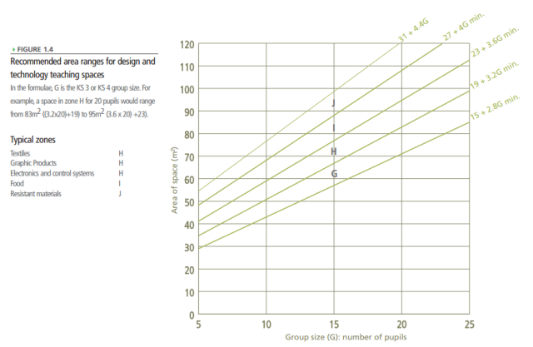
DfE Building Bulletins
1985 DfES BB63 group size in D&T should be taken as 20 in KS3, and 15 in KS4 . 2000 BB 81 quotes 21
2004 BB shows different numbers of pupils for rooms of different sizes, taking account their ages
Food Technology Rooms 95 and 107 m² for 20 pupils.

Slide 52

So who is responsible ?
Head Teacher: for Health and Safety and training of all staff.
Your professional duty to make Head aware. Seek union support where necessary.
Ofsted monitoring Safeguarding –expect evidence in place of qualifications, training , risk assessments and procedures
BUT....I am qualified enough to make judgements?

Slide 53
Am I qualified to judge?
Specialist Food Health and Safety Standards Accredited to approved national standards . D&TA accredit and run courses for this). Level 2 Food Safety is only 1 of the 14 standards.
Are you a Food Tech graduate?
(PGCE or Food Degree)
Prior to any risk assessment you must be qualified to make judgements.
Health and Safety Consultants can assess your school situation.

Slide 54
Who decides on a safe size?
Determining class size is a professional judgement on the part of the Head Teacher, in consultation with Head of Design and Technology, based on risk assessment.
Risk assessments: these should look at the space available; staffing levels; maximum pupil numbers.
NUT: In Special Schools, the specific needs of the pupils should
also inform decisions over class size.

Slide 55
So how do I make a difference?
Find out the reasons for the numbers in the class e.g. staff shortage; facility restrictions.
List teaching activities and lesson content that are not possible due to class size. How does this impact on national curriculum coverage? What are pupils missing out on?
Investigate pupil performance data. Class size has a direct impact on performance of pupils (particularly borderline GCSE grades);
List possible hazards to Health and Safety from cramped conditions e.g. pupil: cooker ratio. Risk assessment

Slide 56
So how do I make a difference?
Ask for pupil feedback
Lack of individual attention for them
Lesson experiences for them
Motivation
Attainment
Visit/contact other schools. Collect and compare information.
Investigate factors that exacerbate the situation; lack of technician rotations of classes, short
Lessons.

Slide 57
Using this information to make a change
Collate your information.
Identify all of the factors that result in large classes.
Formulate possible solutions.
Discuss issues with the Head Teacher. Have specific details of problems and solutions. Make notes in the meeting, (due diligence)

Slide 58
Section 7 of the Health and Safety at Work Act 1974 states that:
Teachers can refuse to participate in activities which risk their, or their pupils, Health and Safety.
It is strongly suggested however, that before this action is taken, seek advice of your union first.
Section 7 of the Health and Safety at Work Act 1974 states that ;-
Teachers can refuse to participate in activities which risk their , or their pupils Health and Safety .
It is strongly suggested however, that before this action is taken, seek advice of your Union first.

Slide 59

Useful resources
Check the guidance handout in Drop Box

Slide 60

Headteacher
by
Notes:
This presentation by @TeacherToolkit ( Ross Morrison McGill ) and is licensed under a Creative Commons Attribution-NonCommercial-NoDerivs 3.0 Unported License.
Based on all work published at www.teachertoolkit.me
@TeacherToolkit Limited.

Slide 61


Qualitative or Quantative information?
by

Slide 62
Vote now!
by
Notes:
This presentation by @TeacherToolkit ( Ross Morrison McGill ) and is licensed under a Creative Commons Attribution-NonCommercial-NoDerivs 3.0 Unported License.
Based on all work published at www.teachertoolkit.me
@TeacherToolkit Limited.

Slide 63
Class sizes:
DfE guidance.
DATA guidance.
It’s only guidance!
Back up requests with academic research.
Own school history … (results / reputation)
by
www.shoemoney.com

Slide 64

Class sizes:
”There is some evidence that pupils in disadvantaged areas in the UK benefit from classes of fewer than 20 pupils in primary schools.”
Effect Size 0.20
by

Slide 65
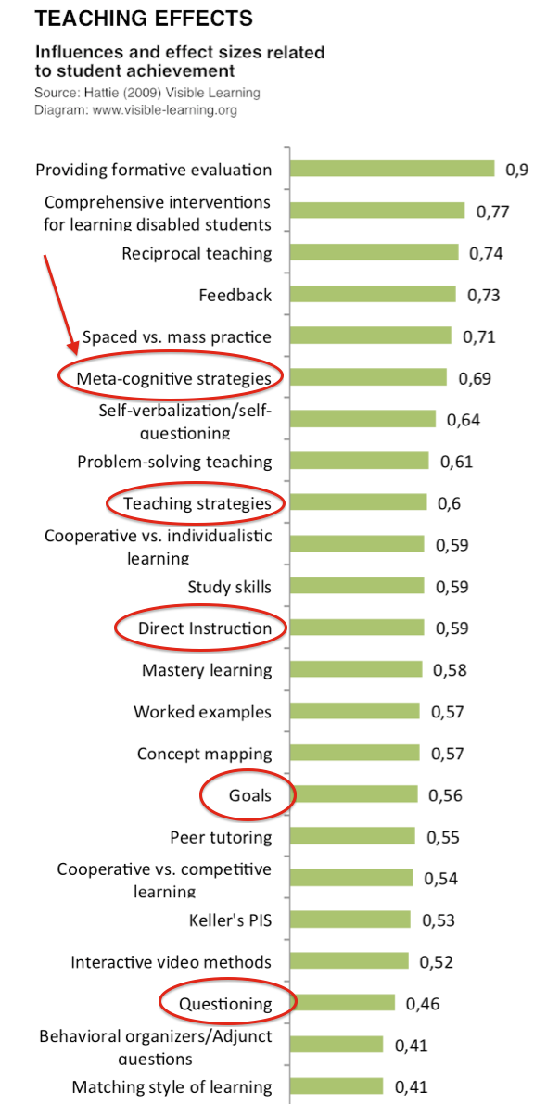
Teacher:
Effect-size and influence above questioning and
setting goals.
Notes:
This presentation by @TeacherToolkit ( Ross Morrison McGill ) and is licensed under a Creative Commons Attribution-NonCommercial-NoDerivs 3.0 Unported License. Based on all work published at www.teachertoolkit.me
@TeacherToolkit Limited.
Hattie effect sizes and influences on student achievement

Slide 66
Class sizes:
Small reductions (e.g. from 30 to 25 pupils) are unlikely to be cost-effective relative to other strategies.
Smaller classes only impact upon learning if the reduced numbers allow teachers to teach differently.
The gains from smaller class sizes are likely to come from the increased flexibility for organising learners and the quality and quantity of feedback the pupils receive.
by

Slide 67
Class sizes:
Have you considered how you will adjust your teaching strategies?
Have you considered how you will organise learning in smaller classes and how you will improve feedback to your pupils?
As an alternative to reducing class sizes, have you considered deploying staff (including teaching assistants) so that teachers can work more intensively with smaller groups?
by

Slide 68

POWER!
by
There are 3 types of power…
Notes:
This presentation by @TeacherToolkit ( Ross Morrison McGill ) and is licensed under a Creative Commons Attribution-NonCommercial-NoDerivs 3.0 Unported License.
Based on all work published at www.teachertoolkit.me
@TeacherToolkit Limited.

Slide 69

3. Knowledge
by
www.kolcraft.com
Notes:
This presentation by @TeacherToolkit ( Ross Morrison McGill ) and is licensed under a Creative Commons Attribution-NonCommercial-NoDerivs 3.0 Unported License.
Based on all work published at www.teachertoolkit.me
@TeacherToolkit Limited.

Slide 70

2. Financial
by
www.ignitebristol.net
Notes:
This presentation by @TeacherToolkit ( Ross Morrison McGill ) and is licensed under a Creative Commons Attribution-NonCommercial-NoDerivs 3.0 Unported License.
Based on all work published at www.teachertoolkit.me
@TeacherToolkit Limited.

Slide 71

1. Position
by
www.driverlayer.com
Notes:
This presentation by @TeacherToolkit ( Ross Morrison McGill ) and is licensed under a Creative Commons Attribution-NonCommercial-NoDerivs 3.0 Unported License.
Based on all work published at www.teachertoolkit.me
@TeacherToolkit Limited.

Slide 72

Return to Work …
by
http://cdn.oxwordsblog.wpfuel.co.uk
Notes:
This presentation by @TeacherToolkit ( Ross Morrison McGill ) and is licensed under a Creative Commons Attribution-NonCommercial-NoDerivs 3.0 Unported License.
Based on all work published at www.teachertoolkit.me
@TeacherToolkit Limited.

Slide 73
Maslow's Hierarchy of Needs
by
Food Technology
Self-actualisation
Esteem
Belonging
Technician Time
Safety
Class Sizes
Physiological
Ingredients Provision
This presentation by @TeacherToolkit ( Ross Morrison McGill ) and is licensed under a Creative Commons Attribution-NonCommercial-NoDerivs 3.0 Unported License. Based on all work published at www.teachertoolkit.me @TeacherToolkit Limited.
Notes:
This presentation by @TeacherToolkit ( Ross Morrison McGill ) and is licensed under a Creative Commons Attribution-NonCommercial-NoDerivs 3.0 Unported License. Based on all work published at www.teachertoolkit.me
@TeacherToolkit Limited.

Slide 74
Recipe:
by
Timings | What content?
3pm – 3.15pm: | Introductions / Starter
3.15pm – 3.30pm | No. 5 – Ingredients Provision
3.30pm – 3.45pm | No. 4 – Bidding for Equipment
3.45pm – 4.00pm | No. 3 – Technician Time
4.00pm – 4.15pm | Challenge 4
4.15pm – 4.25pm | Advice
4.25pm – 4.30pm | Further Information
Notes:
This presentation by @TeacherToolkit ( Ross Morrison McGill ) and is licensed under a Creative Commons Attribution-NonCommercial-NoDerivs 3.0 Unported License. Based on all work published at www.teachertoolkit.me
@TeacherToolkit Limited.

Slide 75

Scenario
by
Notes:
This presentation by @TeacherToolkit ( Ross Morrison McGill ) and is licensed under a Creative Commons Attribution-NonCommercial-NoDerivs 3.0 Unported License.
Based on all work published at www.teachertoolkit.me
@TeacherToolkit Limited.

Slide 76
Technician Recognition
Vote now!
by
Notes:
This presentation by @TeacherToolkit ( Ross Morrison McGill ) and is licensed under a Creative Commons Attribution-NonCommercial-NoDerivs 3.0 Unported License.
Based on all work published at www.teachertoolkit.me
@TeacherToolkit Limited.

Slide 77

The Tip of The Tip of the Iceberg
Wedge: An iceberg with a steep edge on
one side and a slope on the opposite side.
The Tip of the Iceberg
Pinnacle: An iceberg
with one or more spires.
Face to Face
Recognition
Leadership
Wellbeing
Workload
The Workload Conversation by

Slide 78

Expert Advice
by
Barbara Rathmill
www.justrightforkids.org
Notes:
This presentation by @TeacherToolkit ( Ross Morrison McGill ) and is licensed under a Creative Commons Attribution-NonCommercial-NoDerivs 3.0 Unported License.
Based on all work published at www.teachertoolkit.me
@TeacherToolkit Limited.

Slide 79
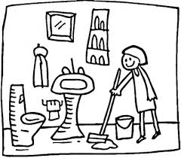
Do PE Staff
Clean the Showers?
Barbara Rathmill
Notes:
Technicians are a vital part of the design and technology team, and should be used in that context. For many years workshop technicians, food technicians and ancillary support staff have supported design and technology teaching in schools. However, while the use of technicians in science education has enabled effective practical work for students and well-organised demonstrations to take place, design and technology has been less well serviced with little coherent national policy on the level of need or the specific role.

Slide 80
Issues
Food lacks subject specific technicians.
Technicians have a vital role in supporting effective practical education.
It’s our job to help SLT understand practical lessons.
Lack of technician
Large class sizes
Shorter lessons
=
Less time and energy to deal with individual pupil’s needs.
Affects academic attainment levels.
Notes:
Technicians are a vital part of the design and technology team, and should be used in that context. For many years workshop technicians, food technicians and ancillary support staff have supported design and technology teaching in schools. However, while the use of technicians in science education has enabled effective practical work for students and well-organised demonstrations to take place, design and technology has been less well serviced with little coherent national policy on the level of need or the specific role.

Slide 81
Recommendations
Carry out a quick survey – other food teachers, other subject areas.
Actively promote the academic benefits of employing a food specialist technician to head teachers.
Produce guidance to head teachers on the effective use of a technician.
Teachers able to make better use of their time, improving academic attainment.
Provide subject specific training and support.

Slide 82
What access do you have to technician support?
Survey of Lead Practitioners (March 2008)

Slide 83

Making your case to the SLT use OFSTED
“……. Teachers, and, increasingly, technicians and learning mentors, gave careful guidance on coursework, individual coaching and, frequently, significant opportunities for students to strengthen their achievements through after-school activities.”
“In Key Stage 4 the school ran a very popular ……course in hospitality ……. This initiative was highly successful because there was:……. a good level of support from a technician.”
  OFSTED Education for a Technologically Advanced Nation
  Design and technology in schools 2004–07

Slide 84
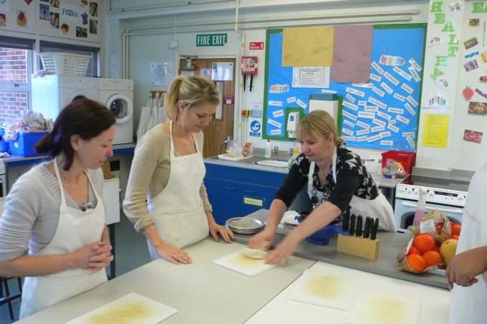
The need for technicians
There is clear evidence that the appropriate deployment of technical support significantly improves the quality of education in design and technology.
Technicians not only contribute to the health and safety, economy and efficiency of the
department, but they also enable teachers to offer varied and stimulating food lessons.
Notes:
There is clear evidence that the appropriate deployment of technical support significantly improves the quality of education in design and technology. In convincing senior management and governors to increase technical support, the following benefits of appointing technicians may be helpful in justifying the subject leader’s case and will also contribute to raising standards:
• teachers can concentrate on improving students’ performance;
• a safer and better organised working environment;
• more effective use of time by staff;
• tasks performed by the appropriately skilled staff;
• the ability to recycle materials and components more effectively;
• better managed project work by students;
• better quality displays of students’ work and of products and their applications;
• supporting children with special needs, especially those with physical disabilities, by adapting tools such as jigs and fixtures to aid learning.

Slide 85
What can a technician do to support Teaching and Learning?
Help pupils to get the most of out learning experiences.
Support teachers in practical classes.
Prepare and maintain equipment and teaching areas for practical activities.
Carry out administrative and other functions to help run the department.
Notes:
The role of the design and technology technician obviously varies according to school organisation, subject, level of work, the way in which lessons and practical work are organised, the skill and experience of the technician, and the expectations of the teaching staff.
Technicians’ tasks can be divided into four main categories:
1. Main activity related to the practical work
• preparing materials for design based work;
• arranging tools, fixtures, materials for focused demonstrations;
• ensuring that all hand tools are available and in good, safe condition for use by students;
• tidying up and checking that all tools are in their racks after the practical sessions;
• in food rooms, cleaning tables and surfaces, cleaning cookers;
• cleaning and disinfecting sinks.
2. Assisting with special lessons and practical sessions
• demonstrations to aid teacher delivery for example, preparation of a sand mould;
• dealing with students’ difficulties during a making task activity;
• modifying apparatus for those with physical disabilities.
3. Repairs and general maintenance
• safety checks;
• sharpening hand tools;
• servicing and cleaning machine tools and equipment;
• repairing tools and equipment;
• maintenance of units, for example, checking vices for damage and serviceability;
• cleaning fridges, cleaning and disinfecting tools;
• ensuring student work storage areas are tidy.
4. Administrative tasks
• photocopying, printing and duplicating;
• stock control: keeping records, ordering material, sorting out invoices and receipts, inventory checks.
The subject leader will need to give guidance to the technician on:
• working with teaching staff;
• confidentiality of some work within school (student circumstances and assessments);
• supporting teaching and learning and helping students with their practical work;
• safe working procedures and the approach to risk assessments;
• setting up and maintaining displays;
• working in other parts of the school;
• working outside school with the community and industry.

Slide 86
What can a technician do to support Teaching and Learning? Who Knows?
Ensuring a safe environment, addressing health and safety.
Maintaining equipment and teaching areas.
“Pupils’ learning experiences are
influenced not just by the teacher but also by the environment in which the subjects are taught.”
Set for success, The supply of people with science, technology, engineering and mathematics skills, Sir Gareth Roberts, April 2002.
Notes:
The role of the design and technology technician obviously varies according to school organisation, subject, level of work, the way in which lessons and practical work are organised, the skill and experience of the technician, and the expectations of the teaching staff.
Technicians’ tasks can be divided into four main categories:
1. Main activity related to the practical work
• preparing materials for design based work;
• arranging tools, fixtures, materials for focused demonstrations;
• ensuring that all hand tools are available and in good, safe condition for use by students;
• tidying up and checking that all tools are in their racks after the practical sessions;
• in food rooms, cleaning tables and surfaces, cleaning cookers;
• cleaning and disinfecting sinks.
2. Assisting with special lessons and practical sessions
• demonstrations to aid teacher delivery for example, preparation of a sand mould;
• dealing with students’ difficulties during a making task activity;
• modifying apparatus for those with physical disabilities.
3. Repairs and general maintenance
• safety checks;
• sharpening hand tools;
• servicing and cleaning machine tools and equipment;
• repairing tools and equipment;
• maintenance of units, for example, checking vices for damage and serviceability;
• cleaning fridges, cleaning and disinfecting tools;
• ensuring student work storage areas are tidy.
4. Administrative tasks
• photocopying, printing and duplicating;
• stock control: keeping records, ordering material, sorting out invoices and receipts, inventory checks.
The subject leader will need to give guidance to the technician on:
• working with teaching staff;
• confidentiality of some work within school (student circumstances and assessments);
• supporting teaching and learning and helping students with their practical work;
• safe working procedures and the approach to risk assessments;
• setting up and maintaining displays;
• working in other parts of the school;
• working outside school with the community and industry.

Slide 87
How can Teaching and Learning be enhanced with a technician?
There is clear evidence that appropriate technical support significantly improves the quality of education.
More efficient use of time improving pupils’ performance.
Providing a safer and better organised working environment.
Tasks are performed by appropriately skilled staff.
Better managed project work by pupils.
Better quality display of pupil’s work.
Supporting pupils with specific needs.
Notes:
There is clear evidence that the appropriate deployment of technical support significantly improves the quality of education in design and technology. In convincing senior management and governors to increase technical support, the following benefits of appointing technicians may be helpful in justifying the subject leader’s case and will also contribute to raising standards:
• teachers can concentrate on improving students’ performance;
• a safer and better organised working environment;
• more effective use of time by staff;
• tasks performed by the appropriately skilled staff;
• the ability to recycle materials and components more effectively;
• better managed project work by students;
• better quality displays of students’ work and of products and their applications;
• supporting children with special needs, especially those with physical disabilities, by adapting tools such as jigs and fixtures to aid learning.
One of the major challenges for a subject leader is ensuring that the environment, processes and equipment being used conform to health and safety requirements. Technicians have a crucial role in supporting the subject leader and department in this work. Particular attention to the provision and maintenance of the following is necessary:
• a safe, clean and healthy working environment;
• safe tools, equipment, machinery and systems of work;
• safe arrangements for the use, handling, storage and transport of articles and substances;
• sufficient information to avoid hazards and contribute positively to users’ own health and safety;
• provision of materials in a usable form for students.
Many tasks and activities that will ensure a safe working environment often can only take place out of normal school hours or during school holiday periods. These include repair and maintenance of hand and machine tools and equipment, checking and maintaining services and furniture, stock checks of materials, tools and equipment, and general cleaning of facilities such as sinks and cookers.
Depending on the qualifications of your technical support you may require maintenance contracts for servicing machine tools, gas and electrical equipment and systems, as well as the testing of electrical appliances.

Slide 88
Calculating the number of technician hours required.
Based on the number of teaching periods in Food Technology
Number of FT teaching hours x 0.6
= Number of Technician hours
Number of FT teaching hours (84) x 0.6
= (50.4) Technician hours
Example
The 0.6 is the service factor and it will change depending on a number of factors, such as an increase in class size, complexity of the activity, etc.
pupils’ approach to individual and group activities;
need to meet the National Curriculum requirements;
health and safety policy requirements;
the approach to assessment of pupils’’ performance;
resources available within Food Technology.

Slide 89

Success
“It was a struggle and led to arguments initially but the food safety case had them seeing sense quickly.”
“The main point I used was food safety and pupil safety. Unlike other subject preparation for our subject must be immediate. Technology technicians can prepare timber/ plastics etc. weeks in advance but our food must be portioned as close to the lesson as possible.”

Slide 90
Success
“We trained ours up to an HLTA so she now does 2 roles but is paid to reflect her work. We had the problem that if a food teacher goes sick and the pupils have brought in their own food - we struggled to get a trained food teacher at short notice. This has been a massive asset to our department.”
“Ours gets paid unqualified teacher rates if leading the room. This seems reasonable.”

Slide 91
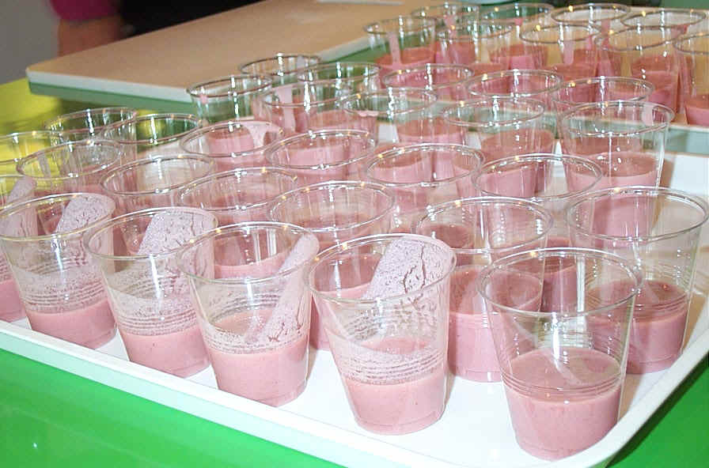

Slide 92

Headteacher
by
Notes:
This presentation by @TeacherToolkit ( Ross Morrison McGill ) and is licensed under a Creative Commons Attribution-NonCommercial-NoDerivs 3.0 Unported License.
Based on all work published at www.teachertoolkit.me
@TeacherToolkit Limited.

Slide 93

Technician
Reputation!
by
www.centrifugeleadership.com
Notes:
This presentation by @TeacherToolkit ( Ross Morrison McGill ) and is licensed under a Creative Commons Attribution-NonCommercial-NoDerivs 3.0 Unported License.
Based on all work published at www.teachertoolkit.me
@TeacherToolkit Limited.

Slide 94
1. What is a Good technician?
by

Slide 95
1. What is a Good technician?
2. How do you know?
by

Slide 96
1. What is a Good technician?
2. How do you know?
3. How do you evidence this?
by

Slide 97

Open vs.
Closed
by

Slide 98
Maslow's Hierarchy of Needs
by
Food Technology
Self-actualisation
Esteem
Bidding for New Equipment
Belonging
Technician Time
Safety
Class Sizes
Physiological
Ingredients Provision
This presentation by @TeacherToolkit ( Ross Morrison McGill ) and is licensed under a Creative Commons Attribution-NonCommercial-NoDerivs 3.0 Unported License. Based on all work published at www.teachertoolkit.me @TeacherToolkit Limited.
Notes:
This presentation by @TeacherToolkit ( Ross Morrison McGill ) and is licensed under a Creative Commons Attribution-NonCommercial-NoDerivs 3.0 Unported License. Based on all work published at www.teachertoolkit.me
@TeacherToolkit Limited.

Slide 99

Recipe:
by
Timings | What content?
3pm – 3.15pm: | Introductions / Starter
3.15pm – 3.30pm | No. 5 – Ingredients Provision
3.30pm – 3.45pm | No. 4 – Class Sizes
3.45pm – 4.00pm | No. 3 – Technician Time
4.00pm – 4.15pm | No.2 – Bidding for Equipment
4.15pm – 4.25pm | Advice
4.25pm – 4.30pm | Further Information …
Notes:
This presentation by @TeacherToolkit ( Ross Morrison McGill ) and is licensed under a Creative Commons Attribution-NonCommercial-NoDerivs 3.0 Unported License. Based on all work published at www.teachertoolkit.me
@TeacherToolkit Limited.

Slide 100

Scenario
by
Notes:
This presentation by @TeacherToolkit ( Ross Morrison McGill ) and is licensed under a Creative Commons Attribution-NonCommercial-NoDerivs 3.0 Unported License.
Based on all work published at www.teachertoolkit.me
@TeacherToolkit Limited.

Slide 101

Test:
by
How many?
Image: http://www.elizabethlyons.com
Notes:
This presentation by @TeacherToolkit ( Ross Morrison McGill ) and is licensed under a Creative Commons Attribution-NonCommercial-NoDerivs 3.0 Unported License.
Based on all work published at www.teachertoolkit.me
@TeacherToolkit Limited.

Slide 102
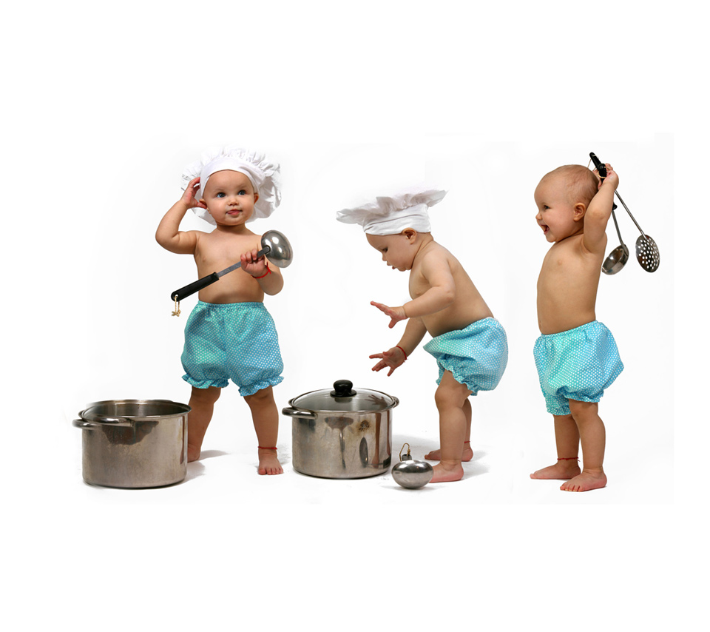
Thoughts?
by
Notes:
This presentation by @TeacherToolkit ( Ross Morrison McGill ) and is licensed under a Creative Commons Attribution-NonCommercial-NoDerivs 3.0 Unported License.
Based on all work published at www.teachertoolkit.me
@TeacherToolkit Limited.

Slide 103
by
Clean fingernails.
Emergency key chain.
Surface scratcher.
Emergency fish hook.
Necklace clasp.
Notes:
This presentation by @TeacherToolkit ( Ross Morrison McGill ) and is licensed under a Creative Commons Attribution-NonCommercial-NoDerivs 3.0 Unported License.
Based on all work published at www.teachertoolkit.me
@TeacherToolkit Limited.

Slide 104

Expert Advice
by
Julie Messenger
www.pixgood.com
Notes:
This presentation by @TeacherToolkit ( Ross Morrison McGill ) and is licensed under a Creative Commons Attribution-NonCommercial-NoDerivs 3.0 Unported License.
Based on all work published at www.teachertoolkit.me
@TeacherToolkit Limited.

Slide 105
Making a Case for
Small and Large Equipment
Julie Messenger

Slide 106
Equipment.
Is it a long term investment?
Is it expensive or low cost?
Are there any hidden costs?
What is the cost per pupil using the equipment?

Slide 107
Benefits of new equipment
The three I’s....
Increased motivation
Increased class time for students
Improved A*-C GCSE grades

Slide 108
Do the Research!!!
Impact on students outcomes
Number of pupils using the equipment.
Cost to purchase? (cost per pupil?)
Special consumables needed?
Maintenance costs?

Slide 109
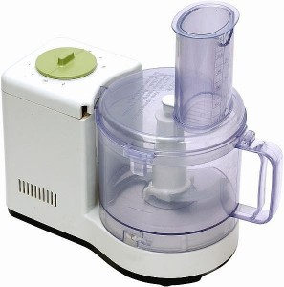
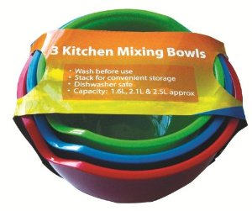
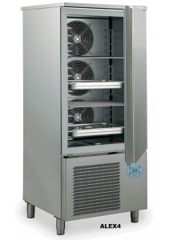
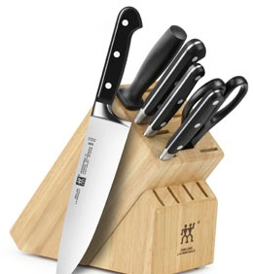
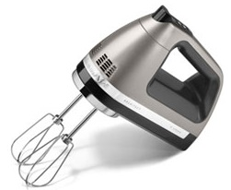
What equipment do you need?
£35.00
£7.00
£1,600.00
£15.00
£20.00

Slide 110
Why does the school need the equipment?
To meet examination board requirements.
To support pupil premium/disabled students?
To improve students GCSE outcomes.
To replace worn out equipment.
Do you have replacement programme for large equipment?

Slide 111
Who might be able to help locally??
School i.e. Head teacher.
Parent Teachers Association (PTA).
Local supermarkets/businesses

Slide 112


Waitrose Community Matters
Each local Waitrose Shop has £1,000.00 to give to 3 local charities on a monthly basis .
Application forms are in stores to be completed an posted to head office for consideration. All customers are given token to help decide who gets the funding.

Slide 113



Asda Community Life
Grants available for:
local charities, projects,
schools – by nomination.
£50 and £250

Slide 114
How can the students help to get the equipment needed?
Match fund, donations by Fundraising.
Collect supermarket vouchers.
Bag packing at supermarkets

Slide 115

Collect vouchers to get equipment.
Get the whole community saving for you.
https://activekids.sainsburys.co.uk/

Slide 116
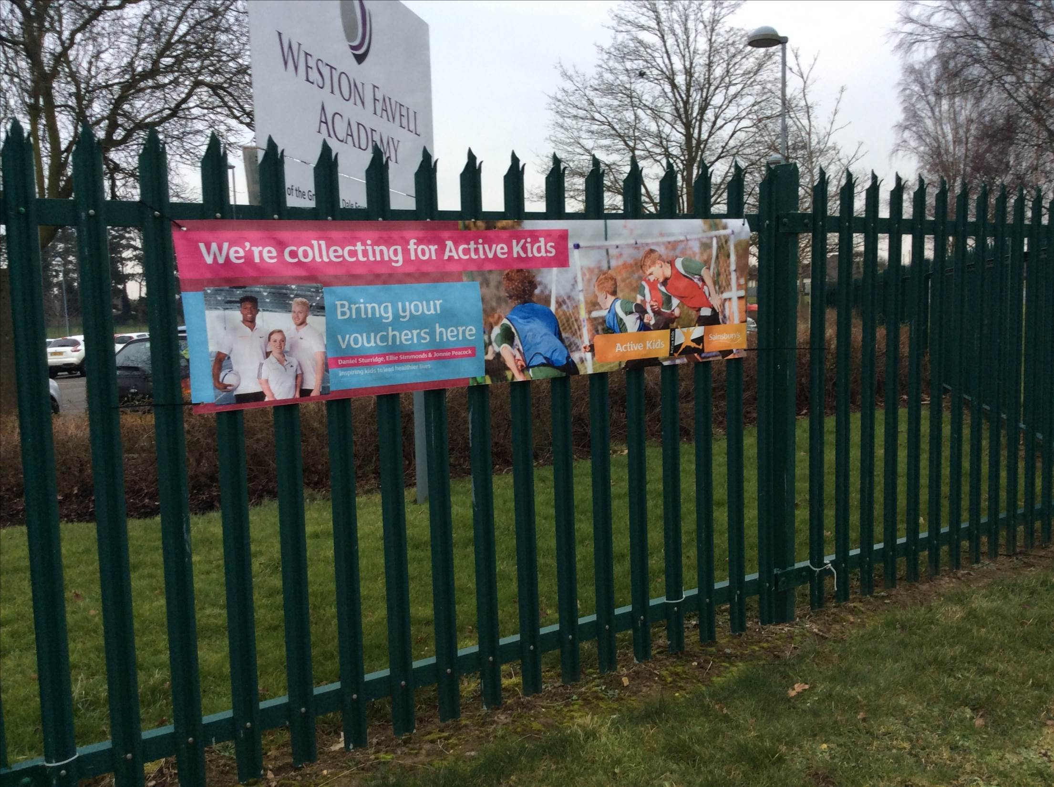

Slide 117


Tesco School Vouchers
Organise a competition in school to see what form can collect the most vouchers!
A trophy for the winning form?

Slide 118
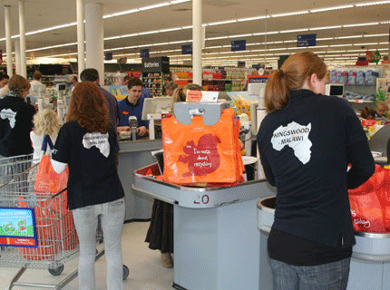
Bag Packing
ASDA, Sainsbury’s Tesco
‘expect to raise around £300 for every two hours if you can
cover 10 tills.’
You will need to arrange this with your local store

Slide 119
Who might be able to help Nationally?
larger scale funding for bigger projects.

Slide 120


Opportunities for Funding.
Food Education Trust
http://www.foodeducationtrust.com/grant.php
‘Food Education Trust seeks to promote the benefits of a home cooked diet by working collaboratively with organisations and institutions, whether by way of financial assistance, investment of time and expertise, or assistance in an advisory capacity.’

Slide 121

Clere Secondary School Hampshire £2,800.00 donation - for small equipment.

Slide 122



The Worshipful Company of Cooks
Charitable giving is the principal objective of The Worshipful Company of Cooks.
http://www.cookslivery.org.uk/page/charitable_activities

Slide 123

The Savoy Educational Trust
....aims to advance and
develop education,
training and
qualifications within
the hospitality industry.
http://www.savoyeducationaltrust.org.uk/grants.cfm

Slide 124


The Tesco Charity Trust Community Awards
Between £500 and £2,500.
‘practical benefits, such as equipment and resources for projects that directly benefit health, sustainability or opportunities for young people’

Slide 125
Cost of the Equipment.
Is it expensive or low cost?
Is it a long term/short term investment?
    Average out the cost per year
Cost per pupil
    using the equipment in 1 year.
Are there any hidden costs?
    Specialised maintenance, consumables

Slide 126
No Errors.
Do check grammar and spell.
Read the letter application form aloud.
Ask a colleague/SLT to check the application form.
Practice the verbal presentation.

Slide 127
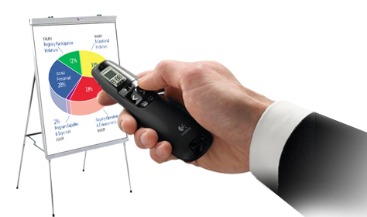
Presenting to who?
Written document: letter/application form.
Verbal presentation: clear and to the point.
Demonstration of the equipment.
Video of the equipment in use.

Slide 128
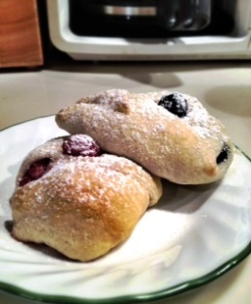

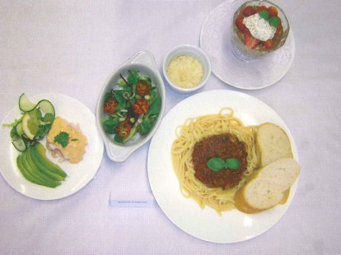

Visual Props
  Photographs of improved students outcomes.
  Statistics i.e. improved GCSE grades by 10%.
  Graphs/charts increased attainment.

Slide 129
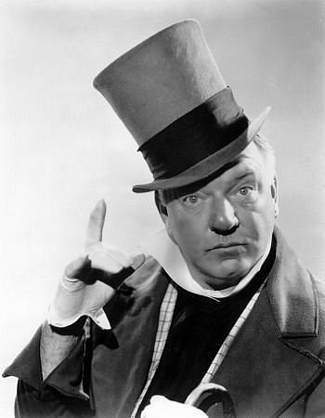
Remember.....
‘If at first you don’t succeed then try and try again’ .
W.C. Fields

Slide 130
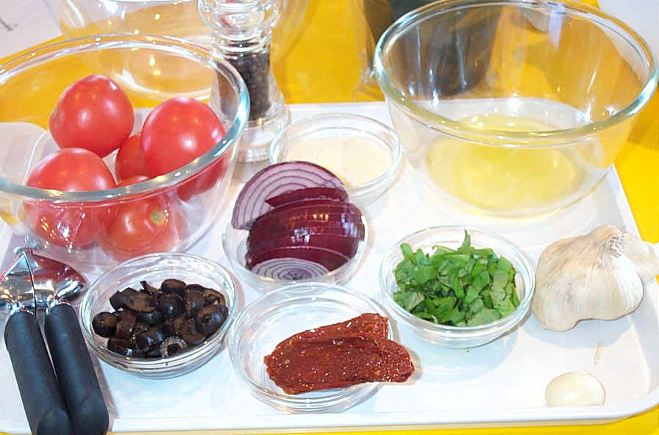

Slide 131

Headteacher
by
Notes:
This presentation by @TeacherToolkit ( Ross Morrison McGill ) and is licensed under a Creative Commons Attribution-NonCommercial-NoDerivs 3.0 Unported License.
Based on all work published at www.teachertoolkit.me
@TeacherToolkit Limited.

Slide 132

Equipment
Provison
by
Notes:
This presentation by @TeacherToolkit ( Ross Morrison McGill ) and is licensed under a Creative Commons Attribution-NonCommercial-NoDerivs 3.0 Unported License.
Based on all work published at www.teachertoolkit.me
@TeacherToolkit Limited.

Slide 133
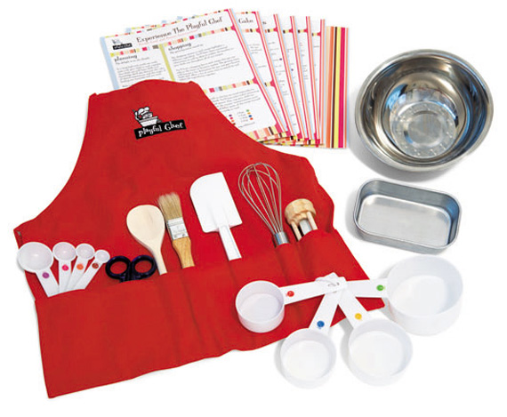

Plan, then bid
by
Notes:
This presentation by @TeacherToolkit ( Ross Morrison McGill ) and is licensed under a Creative Commons Attribution-NonCommercial-NoDerivs 3.0 Unported License.
Based on all work published at www.teachertoolkit.me
@TeacherToolkit Limited.

Slide 134
Costs:
Per child.
Per lesson / term.
Per year.
Costs vs. Impact.
Rationale: What? Why? How?
Provide 2 solutions!
by
www.shoemoney.com

Slide 135
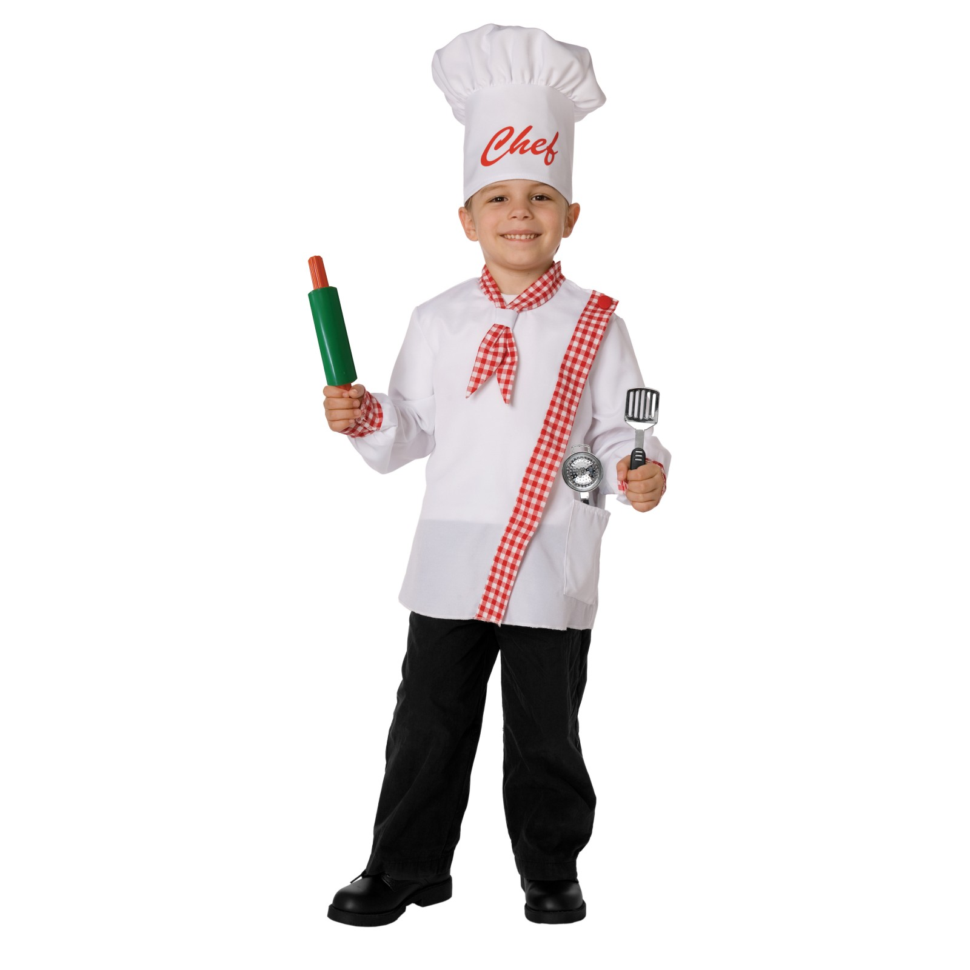
Maslow's Hierarchy of Needs
by
Food Technology
Self-actualisation
Teach Like A Champion!
Esteem
Bidding for New Equipment
Belonging
Technician Time
Safety
Class Sizes
Physiological
Ingredients Provision
This presentation by @TeacherToolkit ( Ross Morrison McGill ) and is licensed under a Creative Commons Attribution-NonCommercial-NoDerivs 3.0 Unported License. Based on all work published at www.teachertoolkit.me @TeacherToolkit Limited.
Notes:
This presentation by @TeacherToolkit ( Ross Morrison McGill ) and is licensed under a Creative Commons Attribution-NonCommercial-NoDerivs 3.0 Unported License. Based on all work published at www.teachertoolkit.me
@TeacherToolkit Limited.

Slide 136

Recipe:
by
Timings | What content?
3pm – 3.15pm: | Introductions / Starter
3.15pm – 3.30pm | No. 5 – Ingredients Provision
3.30pm – 3.45pm | No. 4 – Class Sizes
3.45pm – 4.00pm | No. 3 – Technician Time
4.00pm – 4.15pm | No.2 – Bidding for Equipment
4.15pm – 4.25pm | No. 1 – Teach Like a Champion
4.25pm – 4.30pm | Further Information …
Notes:
This presentation by @TeacherToolkit ( Ross Morrison McGill ) and is licensed under a Creative Commons Attribution-NonCommercial-NoDerivs 3.0 Unported License. Based on all work published at www.teachertoolkit.me
@TeacherToolkit Limited.

Slide 137

Scenario
by
Notes:
This presentation by @TeacherToolkit ( Ross Morrison McGill ) and is licensed under a Creative Commons Attribution-NonCommercial-NoDerivs 3.0 Unported License.
Based on all work published at www.teachertoolkit.me
@TeacherToolkit Limited.

Slide 138
The full time classroom teacher
Teacher Profile:
Teaches: 24 periods.
Classes: 19 different classes .
Books: 374 students per week.
Per 7 week term: 2,618 interactions!
2,618 possible marking opportunities!
Notes:
This presentation by @TeacherToolkit ( Ross Morrison McGill ) and is licensed under a Creative Commons Attribution-NonCommercial-NoDerivs 3.0 Unported License.
Based on all work published at www.teachertoolkit.me
@TeacherToolkit Limited.

Slide 139

Something to hear

Slide 140
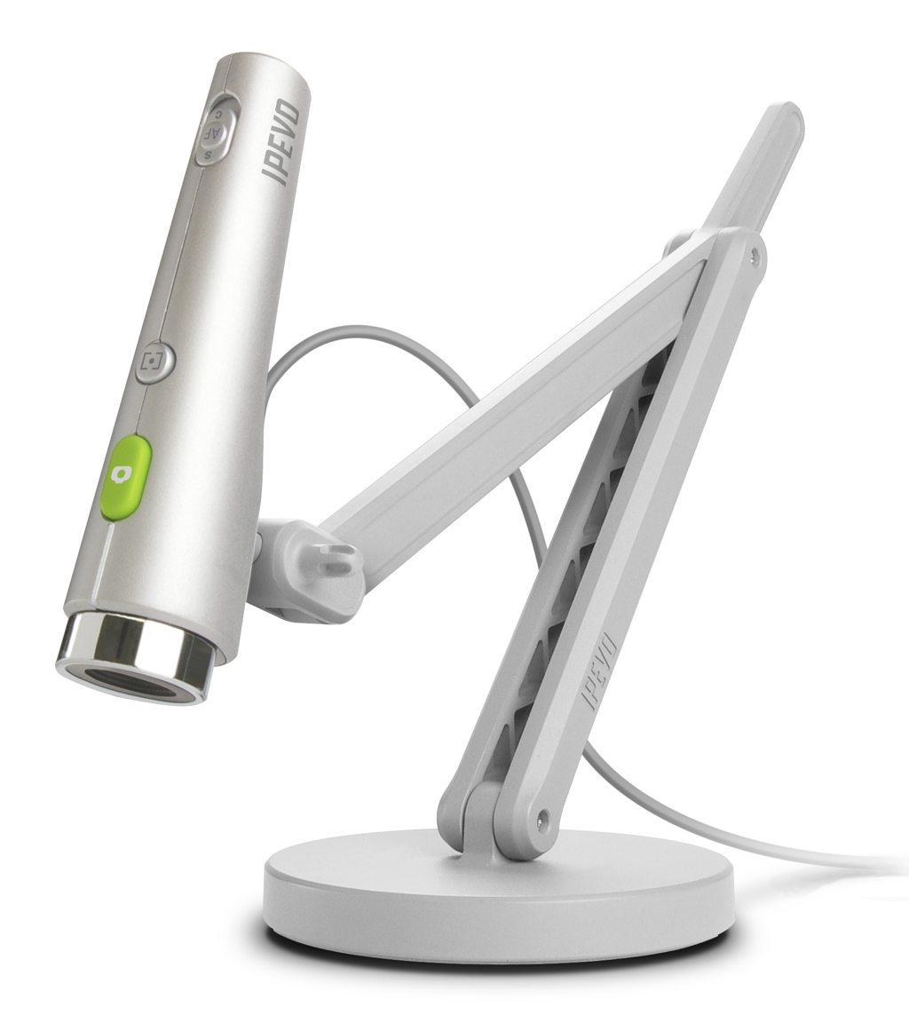
IPEVO
by
Notes:
To hand out camera – have one plugged in

Slide 141
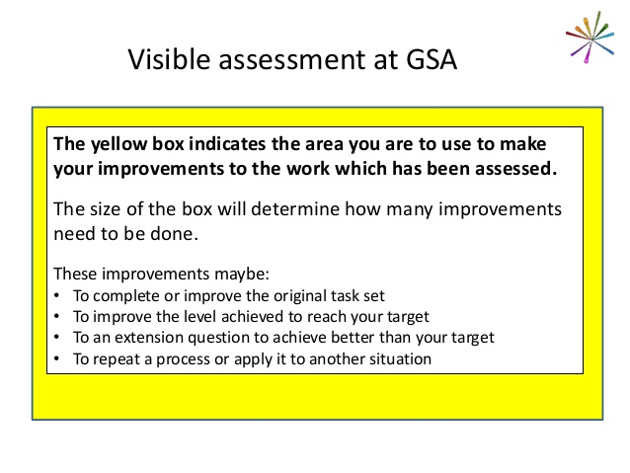
Example Technique
Yellow Box
Notes:
Credit: George Spencer Academy yellow box
http://challengepartners.org/uploads/resources/1396348156-CP_AGM_East_Mids_Conference_Mar_2014_GSA_Teaching_Learning.pdf

Slide 142
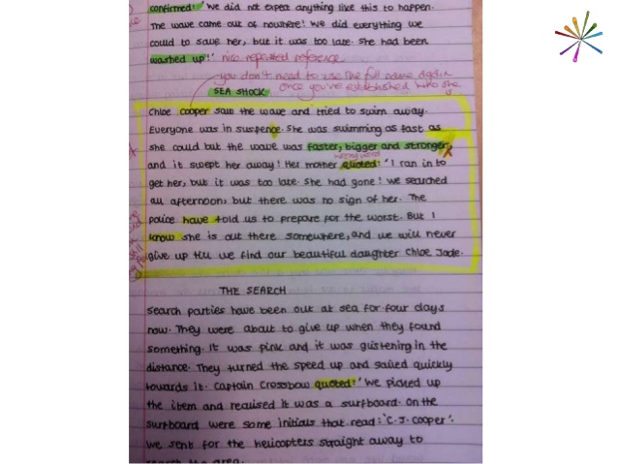
Yellow Box
Notes:
Credit: George Spencer Academy yellow box

Slide 143
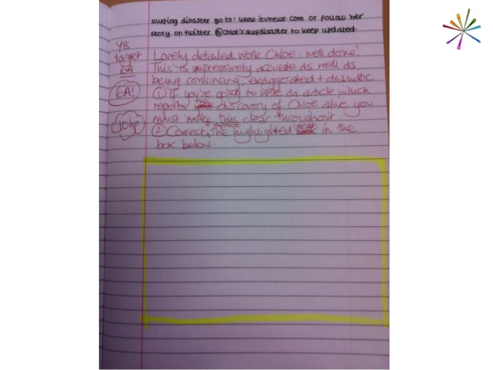
Yellow Box
Notes:
Credit: George Spencer Academy yellow box
Credit: George Spencer Academy yellow box

Slide 144
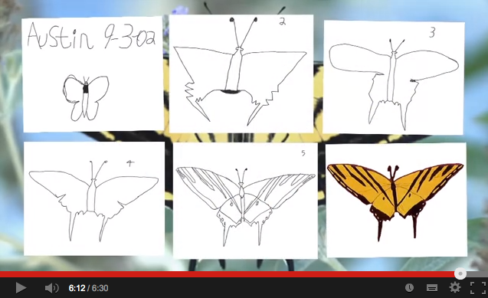
Austin’s Butterfly
https://www.youtube.com/watch?v=hqh1MRWZjms
Notes:
YouTube: https://www.youtube.com/watch?v=hqh1MRWZjms
6 minutes 30 seconds

Slide 145

Example Technique
Not Yet

Slide 146


Slide 147
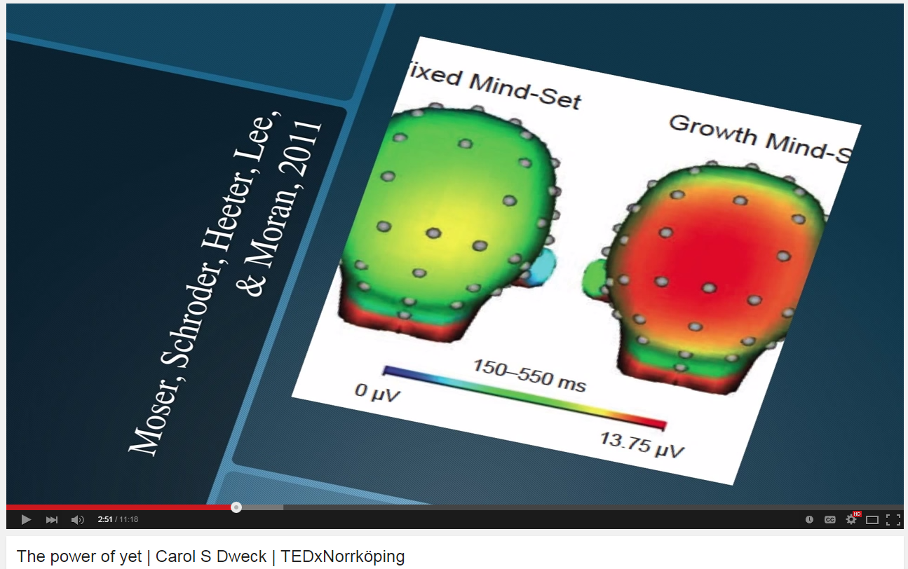
Not Yet
http://youtu.be/J-swZaKN2Ic?t=12s
Notes:
http://youtu.be/J-swZaKN2Ic?t=12s
Show up until 3mins 22 secs

Slide 148


Headteacher
by
Notes:
This presentation by @TeacherToolkit ( Ross Morrison McGill ) and is licensed under a Creative Commons Attribution-NonCommercial-NoDerivs 3.0 Unported License.
Based on all work published at www.teachertoolkit.me
@TeacherToolkit Limited.

Slide 149

Top Teachers …
by
Notice Everything!
Notes:
This presentation by @TeacherToolkit ( Ross Morrison McGill ) and is licensed under a Creative Commons Attribution-NonCommercial-NoDerivs 3.0 Unported License.
Based on all work published at www.teachertoolkit.me
@TeacherToolkit Limited.

Slide 150
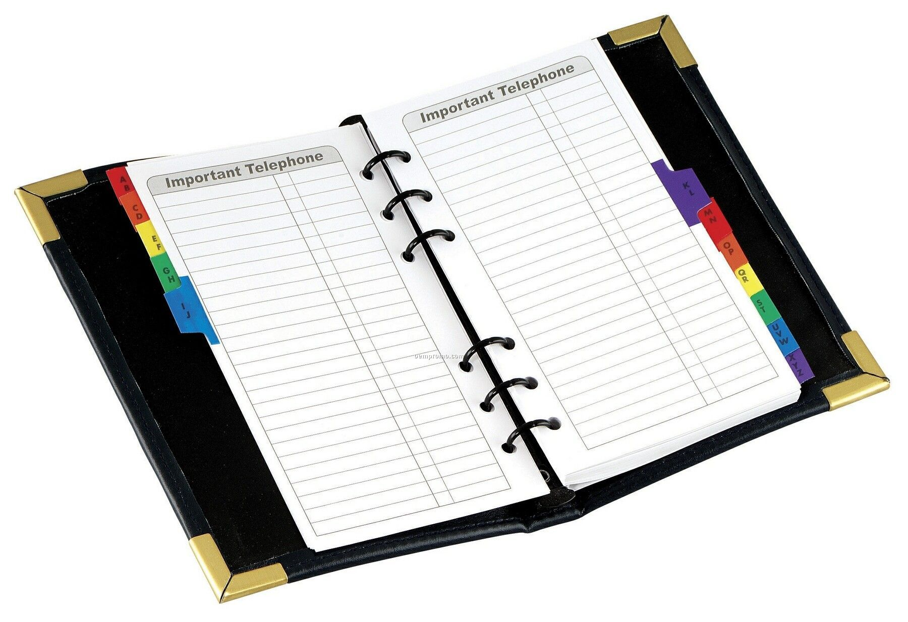
Top Teachers …
by
Know Everything!
www.oempromo.com
Notes:
This presentation by @TeacherToolkit ( Ross Morrison McGill ) and is licensed under a Creative Commons Attribution-NonCommercial-NoDerivs 3.0 Unported License.
Based on all work published at www.teachertoolkit.me
@TeacherToolkit Limited.

Slide 151
Top Teachers …
by
Know the difference between a
reason and an excuse
Notes:
This presentation by @TeacherToolkit ( Ross Morrison McGill ) and is licensed under a Creative Commons Attribution-NonCommercial-NoDerivs 3.0 Unported License.
Based on all work published at www.teachertoolkit.me
@TeacherToolkit Limited.

Slide 152

Top Teachers …
by
Have high levels of energy …
www.edmsauce.com
Notes:
This presentation by @TeacherToolkit ( Ross Morrison McGill ) and is licensed under a Creative Commons Attribution-NonCommercial-NoDerivs 3.0 Unported License.
Based on all work published at www.teachertoolkit.me
@TeacherToolkit Limited.

Slide 153

Top Teachers …
by
are NO nonsense!
librarylostfound.com
Notes:
This presentation by @TeacherToolkit ( Ross Morrison McGill ) and is licensed under a Creative Commons Attribution-NonCommercial-NoDerivs 3.0 Unported License.
Based on all work published at www.teachertoolkit.me
@TeacherToolkit Limited.

Slide 154

Top Teachers …
by
Teach
Blooming Hard!
www.fitnistics.com
Notes:
This presentation by @TeacherToolkit ( Ross Morrison McGill ) and is licensed under a Creative Commons Attribution-NonCommercial-NoDerivs 3.0 Unported License.
Based on all work published at www.teachertoolkit.me
@TeacherToolkit Limited.

Slide 155
Top Teachers …
by
Don’t accept Food Technology myths!
Notes:
This presentation by @TeacherToolkit ( Ross Morrison McGill ) and is licensed under a Creative Commons Attribution-NonCommercial-NoDerivs 3.0 Unported License.
Based on all work published at www.teachertoolkit.me
@TeacherToolkit Limited.

Slide 156

The boring bit . . .
by
Notes:
This presentation by @TeacherToolkit ( Ross Morrison McGill ) and is licensed under a Creative Commons Attribution-NonCommercial-NoDerivs 3.0 Unported License.
Based on all work published at www.teachertoolkit.me
@TeacherToolkit Limited.
Latest guidance
Let me give you an oxymoron to consider…
NO LESSON PLANS
NO JUDGEMENTS EVER
PROGRESS OVER TIME

Slide 157
Soft Subjects!
by
Notes:
This presentation by @TeacherToolkit ( Ross Morrison McGill ) and is licensed under a Creative Commons Attribution-NonCommercial-NoDerivs 3.0 Unported License.
Based on all work published at www.teachertoolkit.me
@TeacherToolkit Limited.

Slide 158
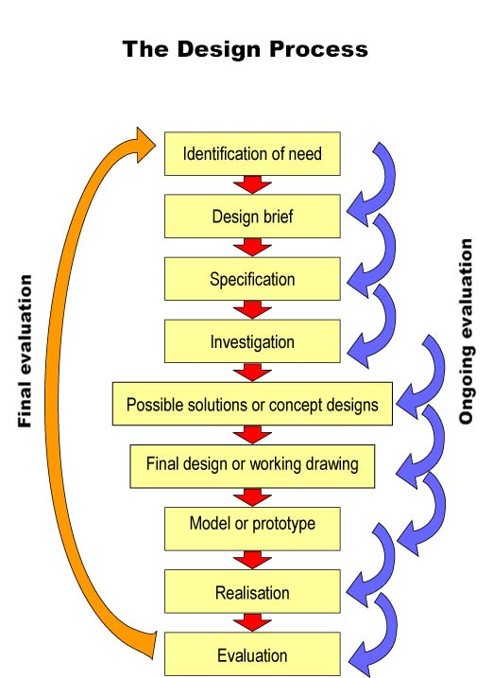
We would typically associate Design Technology and the creative process with a linear process shown :
by
Notes:
This presentation by @TeacherToolkit ( Ross Morrison McGill ) and is licensed under a Creative Commons Attribution-NonCommercial-NoDerivs 3.0 Unported License.
Based on all work published at www.teachertoolkit.me
@TeacherToolkit Limited.

Slide 159
by
The creative process is much more fluid and intertwined than just a linear process. Within any subject discipline, a knowledge-base is required.
As teachers, we cannot assume that there is no structure or form to being ‘creative’, and that creativity depends on talent and inspiration alone.
It doesn’t.
Notes:
This presentation by @TeacherToolkit ( Ross Morrison McGill ) and is licensed under a Creative Commons Attribution-NonCommercial-NoDerivs 3.0 Unported License.
Based on all work published at www.teachertoolkit.me
@TeacherToolkit Limited.

Slide 160
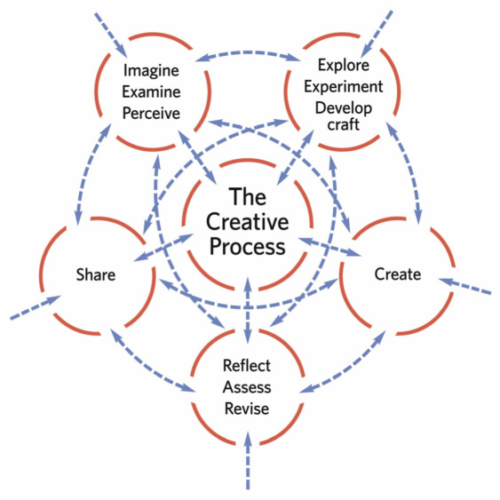
This creative fluidity could be represented as :
by
Image credit: http://www.kennedy-center.org
Notes:
This presentation by @TeacherToolkit ( Ross Morrison McGill ) and is licensed under a Creative Commons Attribution-NonCommercial-NoDerivs 3.0 Unported License.
Based on all work published at www.teachertoolkit.me
@TeacherToolkit Limited.

Slide 161

A suggestion . . .
by
Image: galleryhip.com
Notes:
This presentation by @TeacherToolkit ( Ross Morrison McGill ) and is licensed under a Creative Commons Attribution-NonCommercial-NoDerivs 3.0 Unported License. Based on all work published at www.teachertoolkit.me
@TeacherToolkit Limited.

Slide 162

#TakeAway
Notes:
This presentation by @TeacherToolkit ( Ross Morrison McGill ) and is licensed under a Creative Commons Attribution-NonCommercial-NoDerivs 3.0 Unported License. Based on all work published at www.teachertoolkit.me
@TeacherToolkit Limited.

Slide 163

Read
by
Notes:
This presentation by @TeacherToolkit ( Ross Morrison McGill ) and is licensed under a Creative Commons Attribution-NonCommercial-NoDerivs 3.0 Unported License.
Based on all work published at www.teachertoolkit.me
@TeacherToolkit Limited.

Slide 164
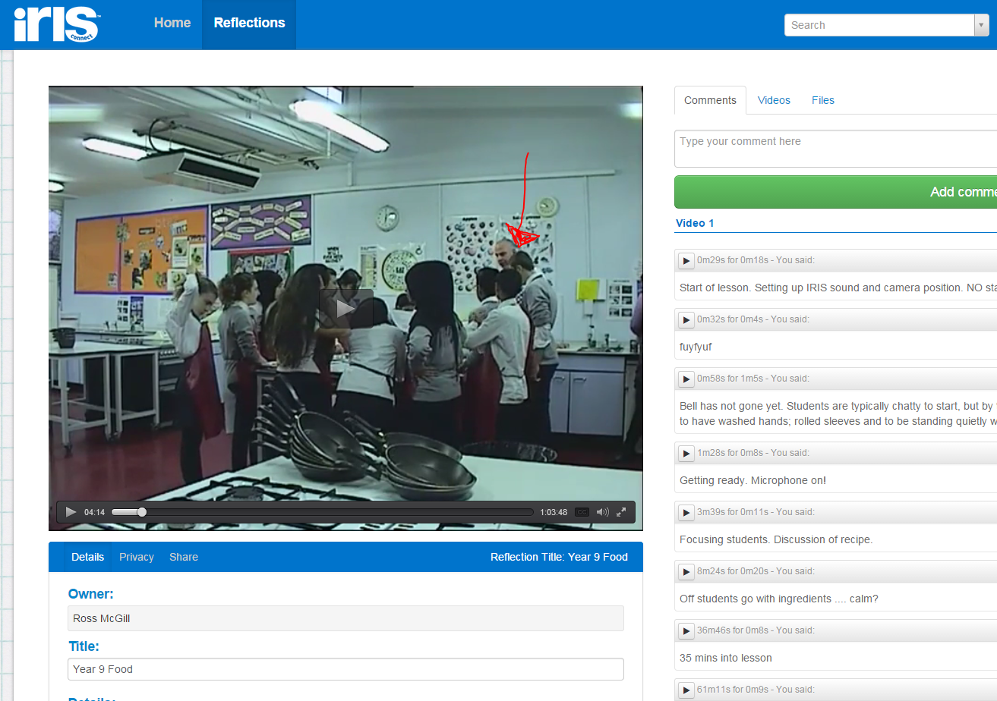
Film
by
https://europe.irisconnect.com/reflections/21757 (3m 45 secs)
Notes:
This presentation by @TeacherToolkit ( Ross Morrison McGill ) and is licensed under a Creative Commons Attribution-NonCommercial-NoDerivs 3.0 Unported License.
Based on all work published at www.teachertoolkit.me
@TeacherToolkit Limited.

Slide 165

3 Course Meal is served!
Champion
What will you celebrate?
Technicians / Class size
Who will you target?
Funding / Equipment
What will you bid for?
Knowledge – Position - Money
Notes:
This presentation by @TeacherToolkit ( Ross Morrison McGill ) and is licensed under a Creative Commons Attribution-NonCommercial-NoDerivs 3.0 Unported License. Based on all work published at www.teachertoolkit.me
@TeacherToolkit Limited.
Move webcam to RIGHT HAND SCREEN so that it is captured in the video

Slide 166

Notes:
This presentation by @TeacherToolkit ( Ross Morrison McGill ) and is licensed under a Creative Commons Attribution-NonCommercial-NoDerivs 3.0 Unported License. Based on all work published at www.teachertoolkit.me
@TeacherToolkit Limited.

Slide 167




Thank you!
by
TeacherToolkit@me.com
@TeacherToolkit
www.TeacherToolkit.me
Notes:
This presentation by @TeacherToolkit ( Ross Morrison McGill ) and is licensed under a Creative Commons Attribution-NonCommercial-NoDerivs 3.0 Unported License.
Based on all work published at www.teachertoolkit.me
@TeacherToolkit Limited.

Slide 168

See you later…
Notes:
So today I’d like us to go through the following objectives

Slide 169

Recipe:
by
Timings | What content?
3pm – 3.15pm: | Introductions / Starter
3.15pm – 3.30pm | No. 5 – Ingredients Provision
3.30pm – 3.45pm | No. 4 – Bidding for Equipment
3.45pm – 4.00pm | No. 3 – Technician Time
4.00pm – 4.15pm | No.2 – Class Sizes
4.15pm – 4.25pm | No. 1 – Teach Like a Champion
4.25pm – 4.30pm | Further Information …
Notes:
This presentation by @TeacherToolkit ( Ross Morrison McGill ) and is licensed under a Creative Commons Attribution-NonCommercial-NoDerivs 3.0 Unported License. Based on all work published at www.teachertoolkit.me
@TeacherToolkit Limited.

Slide 170
by
Last slide …

Slide 171
What is a Good teacher?
by

Slide 172
1. What is a Good teacher?
2. How do you know?
by

Slide 173
1. What is a Good teacher
2. How do you know?
3. How do you evidence this?
by

Slide 174
Open vs.
Closed
by

Slide 175
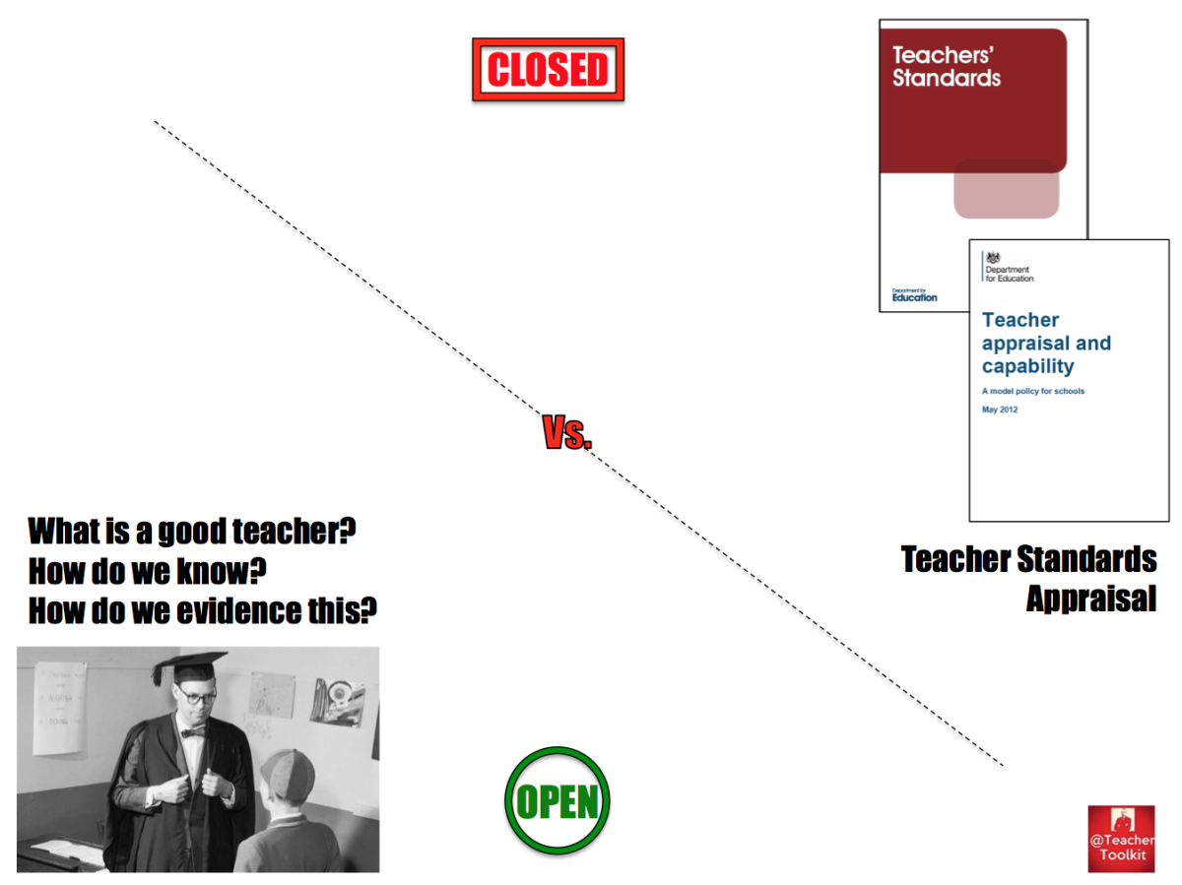

Slide 176
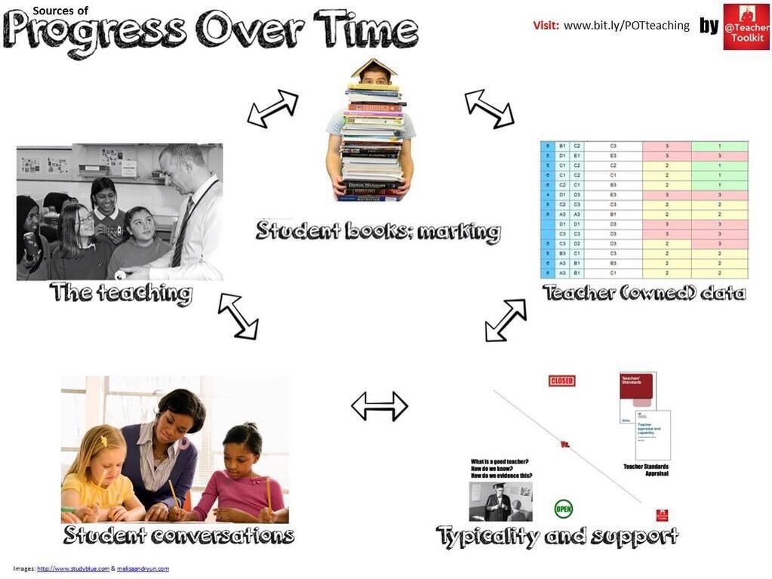

Slide 177

What it is not!
by
Expecting (rapid) progress to be evident in 20 minute snapshots; one-off lessons judgements based on what you see in the classroom; forming an opinion, based solely on what you see in a one-off lesson.

