Slide 1
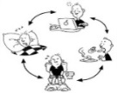
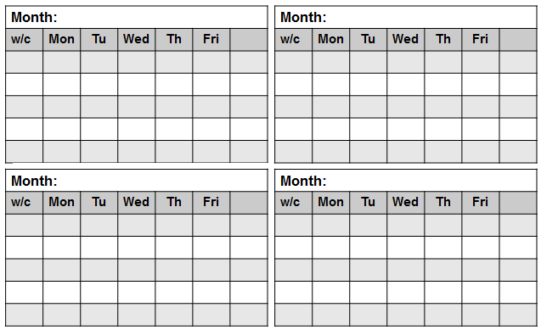
The 5 Minute Main Thing Plan
Development Plan
….print and scribble your way to keeping the Main Things the Main Things.
Routine Activities
Maintenance
Key Meetings
Meeting, Date & Agenda Item
Copyright Licence
This #5MinPlan by @LeadingLearner (Stephen Tierney) & @TeacherToolkit (Ross Morrison McGill)
is licensed under a Creative Commons Attribution-NonCommercial-NoDerivs 4.0 Unported License.
Notes:
Copyright Licence
This #5MinPlan by @LeadingLearner (Stephen Tierney) & @TeacherToolkit (Ross Morrison McGill)
is licensed under a Creative Commons Attribution-NonCommercial-NoDerivs 4.0 Unported License.
Based on all work published at www.teachertoolkit.me & www.leadinglearner.me
@TeacherToolkit Limited & @LeadingLearner Limited

Slide 2
Context – (What each area means?)
Development Plan
Your development or improvement plan should contain the key things that you intend to work on during the academic year. These are likely to be big issues that will require significant time for you and/or your team to discuss and formulate plans. There are likely to be some decisions to be made and professional development needs to be met if a smooth implementation is to ensue. Due to the time intensive nature of development plans you need to keep the number of objectives in your plan to a minimum.
Routine Activities
Routine activities can be found in the school’s calendar. Make a note here of any that are likely to require significant time to prepare, complete or follow up. Avoid listing everything that is in the school calendar, you just want the time consuming ones which will impact on your capacity to get other jobs done. For example, if an assessment data is due there will be time required to prepare examination or tests prior to the assessment cycle and follow up time to analyse results and put in place any interventions afterwards.
Maintenance
In the section on maintenance you should record the revision of schemes of learning, policies, departmental handbooks and other similar activities that are required in schools.
Key Meetings
It could be argued that every meeting is key. When you add up the total time for everyone in a meeting it soon becomes apparent how precious meeting time is. There’s no time to waste. Identify the dates for your key meetings for the term or half term ahead and begin to assign the main agenda items using the development plan priorities, routine activities and maintenance issues you have previously identified. It’s possible to set up the main agenda items for the whole term or even year with a bit of forward planning. Make sure you’ve given the main things plenty of time and that you have the thinking, planning & implementation properly sequenced.
Month by Month Planning
The final thing is to schedule the main things into your monthly planners. The first thing is to transfer across the meetings. In the example below we’ve used a simple numbering system to put the meetings on the appropriate dates. Check your own diary and put a big cross through any dates where you have a full teaching day or back to back meetings and something in the evening. On these days you are not going to get anything else done and it’s no good pretending otherwise.
Think about the preparation you want to do prior to a meeting and make sure you get any preparation colleagues need to do out to them in good time. Once you are into a good rhythm you will develop positive habits like getting agendas and papers out a week in advance and follow up actions (names against each one and deadlines) within 48 hours. Add in other key tasks.

