Slide 1
Please sit anywhere.
Sign in … and then collect a programme.

Slide 2
Kick off!

Slide 3
Action Research
Wednesday 24th June, 2015
“Powerful professional development
helps children succeed and teachers thrive.”

Slide 4
What is Action Research?
Grass-roots, teacher-led research.
Links to academic literature and the classroom.
Dismantling myths and fads.
Using research where it is most needed …

Slide 5
The Headline Findings:
Notes:
CUREE – Centre for Use of Research & Evidence in Education

Slide 6
Why Review CPD?
In recent years, a number of consultations have reported that opportunities for teachers in England:
are insufficiently evidence-based.
do not focus sufficiently on specific pupil needs.
are too inconsistent in quality.
lag behind those experienced by colleagues elsewhere internationally.

Slide 7
Research Finding no. 1
Duration and rhythm of CPD support requires a longer-term focus.
Rhythm: it is important to create a “rhythm” of follow-up, consolidation and support activities. Time here is key – we must consider how to engage and adapt workloads accordingly.

Slide 8
Research Finding no. 2
Step away from a ‘one-size fits all’ approach so individual needs are carefully considered.
Needs: Buy-in is needed; creating a relevance of content for staff, your experiences and aspirations of pupils. We must develop the capacity for teachers to reflect on classroom practice.

Slide 9
Research Finding no. 3
Aligning professional development processes, content and activities
Purpose: A shared sense of purpose is an important factor for success. Within schools, rather than splitting between voluntary and conscripted activities, a coherent and shared sense of purpose across staff, with an explicit relation to everyday experiences and context is vital.

Slide 10
Research Finding no. 4
Content of effective professional development should consider both subject knowledge and subject-specific pedagogy.
Alignment: Effective CPD programmes will feature a variety of activities to reinforce school priorities and test ideas from different perspectives. No single particular type of activity was shown to be universally effective or crucial to success.

Slide 11
Research Finding no. 5
Effective CPD is associated with certain activities, such as explicit discussions.
Effectiveness: professional development focussed on generic pedagogy is insufficient. Instead, we should consider the importance of focussing on generic and subject-specific pedagogy.
Activities: teachers must be able to translate CPD content into the classroom, implementing what they had learned by experimenting in the classroom.

Slide 12
Research Finding no. 6
External input from providers/specialists must challenge orthodoxies within a school & provide diverse perspectives.
Providers: External input is a common factor in successful outcomes, with the most successful programmes act as coaches and/or mentor linked to student outcomes.

Slide 13
Research Finding no. 7
Empower teachers through collaboration and peer learning.
Collaboration: What makes collaboration effective is still contested and that peer support a common feature in effective CPD. There is evidence to suggest that access to some form of collegial support for problem solving is essential, but alone, is not sufficient

Slide 14
Research Finding no. 8
Powerful leadership from middle and senior leadership is pivotal in defining staff opportunities and embedding cultural change.
Leadership: “Effective leaders did not leave the learning to their teachers – they became involved themselves”.
However, school leaders must distinguish between: professional development opportunities that are
aimed at operational and procedural knowledge
(e.g. simple briefing) and professional learning directly aimed at building on teachers’ starting points.

Slide 15
What doesn’t work?
A didactic model in which facilitators simply tell teachers what to do.
Professional development which does not have a strong focus on aspirations for students and assessing the impact of changed teacher practices on pupil learning.

Slide 16
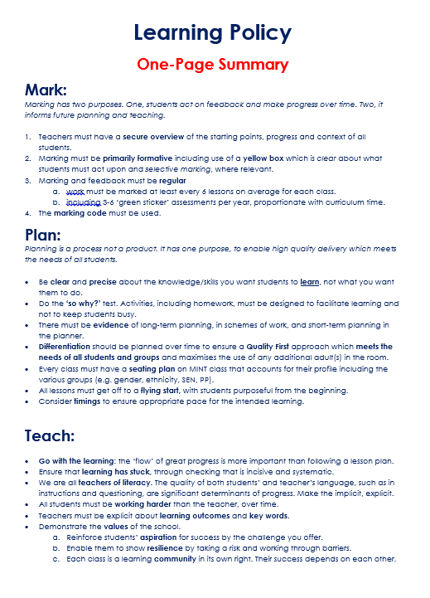
2015/16
CPD informed by
QK Learning Policy.
Mark-Plan-Teach
Over time methodology
Without lesson gradings = focus on development and not performance

Slide 17
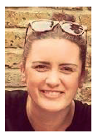
Welcome to the 1st edition of ‘What Works?’ journal by Quintin Kynaston.
This journal is one of the first steps in our (CPD) Continued Professional Development journey to strengthen the culture of action research for all of our staff.
Notes:
Journal
QK School Action Research

Slide 18
Teachers and support staff who engage in action research inevitably find it to be an empowering experience.
Using action research, what we actually mean is extrapolating any of the ways staff reflect on their practice and improve it by self, peer and student evaluation.
Impact on teacher development…
Impact on students progress …
Notes:
Sentence - why

