Slide 1
Notes:
This presentation by @TeacherToolkit ( Ross Morrison McGill ) and is licensed under a Creative Commons Attribution-NonCommercial-NoDerivs 3.0 Unported License.
Based on all work published at www.teachertoolkit.me
@TeacherToolkit Limited.

Slide 2
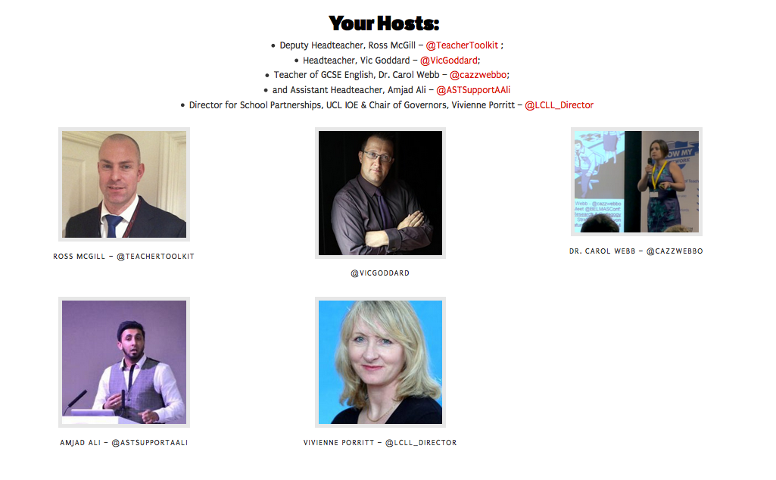
Notes:
This presentation by @TeacherToolkit ( Ross Morrison McGill ) and is licensed under a Creative Commons Attribution-NonCommercial-NoDerivs 3.0 Unported License.
Based on all work published at www.teachertoolkit.me
@TeacherToolkit Limited.

Slide 3
What is #SLTeachMeet?
A TeachMeet is an informal gathering of educators who are taking CPD into their own hands. A TeachMeet is organised for those who want to listen to inspiring teachers who do amazing things in their classrooms every day. It is also an opportunity to network, share ideas and join in a growing community across various regions.
Notes:
This presentation by @TeacherToolkit ( Ross Morrison McGill ) and is licensed under a Creative Commons Attribution-NonCommercial-NoDerivs 3.0 Unported License.
Based on all work published at www.teachertoolkit.me
@TeacherToolkit Limited.

Slide 4
Notes:
This presentation by @TeacherToolkit ( Ross Morrison McGill ) and is licensed under a Creative Commons Attribution-NonCommercial-NoDerivs 3.0 Unported License.
Based on all work published at www.teachertoolkit.me
@TeacherToolkit Limited.

Slide 5
Notes:
This presentation by @TeacherToolkit ( Ross Morrison McGill ) and is licensed under a Creative Commons Attribution-NonCommercial-NoDerivs 3.0 Unported License.
Based on all work published at www.teachertoolkit.me
@TeacherToolkit Limited.

Slide 6
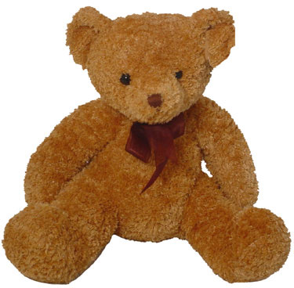
Notes:
This presentation by @TeacherToolkit ( Ross Morrison McGill ) and is licensed under a Creative Commons Attribution-NonCommercial-NoDerivs 3.0 Unported License.
Based on all work published at www.teachertoolkit.me
@TeacherToolkit Limited.

Slide 7
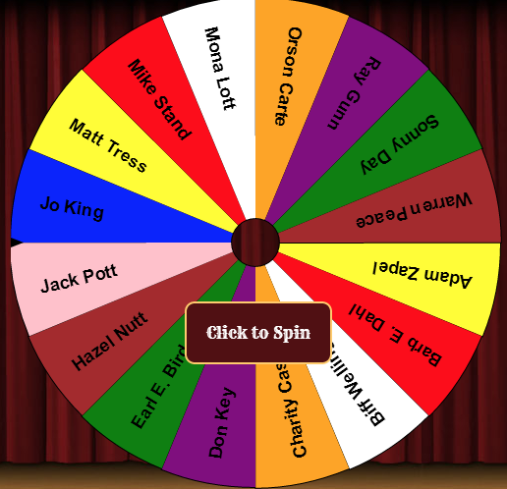
Notes:
This presentation by @TeacherToolkit ( Ross Morrison McGill ) and is licensed under a Creative Commons Attribution-NonCommercial-NoDerivs 3.0 Unported License.
Based on all work published at www.teachertoolkit.me
@TeacherToolkit Limited.

Slide 8
Notes:
This presentation by @TeacherToolkit ( Ross Morrison McGill ) and is licensed under a Creative Commons Attribution-NonCommercial-NoDerivs 3.0 Unported License.
Based on all work published at www.teachertoolkit.me
@TeacherToolkit Limited.

Slide 9
is setting up…
by
Notes:
Videos needed:
Taylor Mali – What teachers make? = https://www.youtube.com/watch?v=RxsOVK4syxU
Lamont Carey – I can’t read = http://youtu.be/lByDfPOG0LA?t=22s
The 5 Minute Lesson Plan = http://bit.ly/5MinVideo
IRIS myself: https://teachertoolkitdotme.files.wordpress.com/2014/01/year-9-iris-export-for-teachertoolkit-blog.m4v
Resources:
Keywords for literateness?
IPEVO camera?
Latest reading book?
This presentation by @TeacherToolkit ( Ross Morrison McGill ) and is licensed under a Creative Commons Attribution-NonCommercial-NoDerivs 3.0 Unported License.
Based on all work published at www.teachertoolkit.me
@TeacherToolkit Limited.

Slide 10
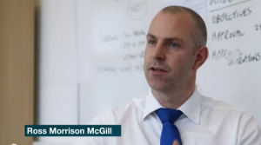
by
by Ross M. McGill Deputy Headteacher @TeacherToolkit www.TeacherToolkit.me
Notes:
This presentation by @TeacherToolkit ( Ross Morrison McGill ) and is licensed under a Creative Commons Attribution-NonCommercial-NoDerivs 3.0 Unported License.
Based on all work published at www.teachertoolkit.me
@TeacherToolkit Limited.

Slide 11
Fingertips ready?
by
#SLTeachMeet
Notes:
This presentation by @TeacherToolkit ( Ross Morrison McGill ) and is licensed under a Creative Commons Attribution-NonCommercial-NoDerivs 3.0 Unported License.
Based on all work published at www.teachertoolkit.me
@TeacherToolkit Limited.

Slide 12
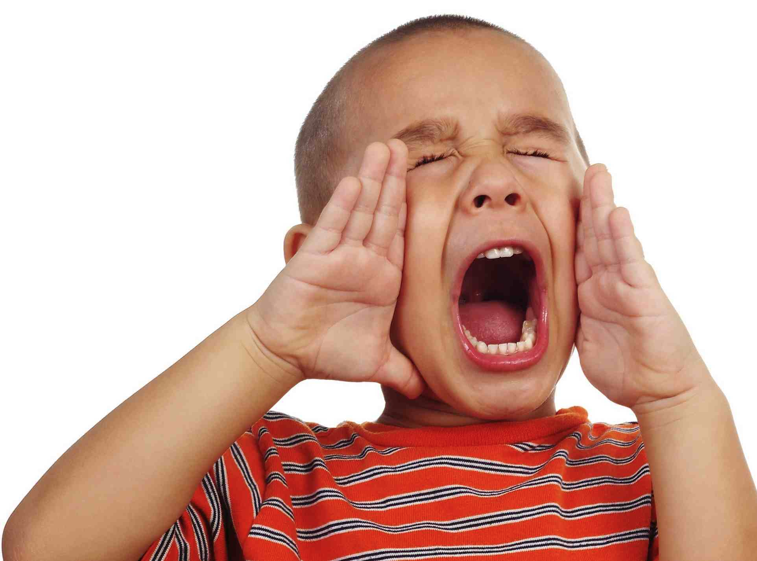
It’s NOT rude!
by
Notes:
This presentation by @TeacherToolkit ( Ross Morrison McGill ) and is licensed under a Creative Commons Attribution-NonCommercial-NoDerivs 3.0 Unported License.
Based on all work published at www.teachertoolkit.me
@TeacherToolkit Limited.

Slide 13
Start thinking …
by
What one factor hindered your engagement with
action research?
Notes:
This presentation by @TeacherToolkit ( Ross Morrison McGill ) and is licensed under a Creative Commons Attribution-NonCommercial-NoDerivs 3.0 Unported License.
Based on all work published at www.teachertoolkit.me
@TeacherToolkit Limited.

Slide 14
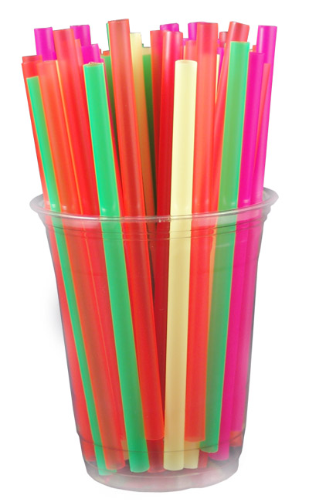
by
Straw poll …
Photo credit: www.memphisflyer.com
Notes:
This presentation by @TeacherToolkit ( Ross Morrison McGill ) and is licensed under a Creative Commons Attribution-NonCommercial-NoDerivs 3.0 Unported License.
Based on all work published at www.teachertoolkit.me
@TeacherToolkit Limited.
Primary?
Secondary?
FE?
Who Tweets?
TeachMeets?
Who reads blogs?
Who writes a blog?
PGCEs = Who has a job?
Who got paid before the summer? And there you go; inequality!

Slide 15
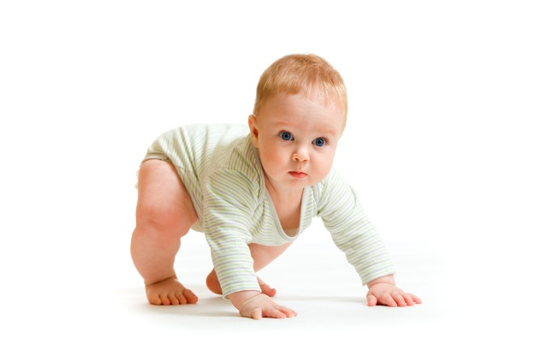
Stand up!
by
Notes:
This presentation by @TeacherToolkit ( Ross Morrison McGill ) and is licensed under a Creative Commons Attribution-NonCommercial-NoDerivs 3.0 Unported License. Based on all work published at www.teachertoolkit.me
@TeacherToolkit Limited.
License:
You are free to:
Share — copy and redistribute the material in any medium or format
The licensor cannot revoke these freedoms as long as you follow the license terms.
Under the following terms:
Attribution — You must give appropriate credit, provide a link to the license, and indicate if changes were made. You may do so in any reasonable manner, but not in any way that suggests the licensor endorses you or your use.
NonCommercial — You may not use the material for commercial purposes.
NoDerivatives — If you remix, transform, or build upon the material, you may not distribute the modified material.
No additional restrictions — You may not apply legal terms or technological measures that legally restrict others from doing anything the license permits.

Slide 16
How can you spot those who are NOT YET researching?
by
Notes:
This presentation by @TeacherToolkit ( Ross Morrison McGill ) and is licensed under a Creative Commons Attribution-NonCommercial-NoDerivs 3.0 Unported License. Based on all work published at www.teachertoolkit.me
@TeacherToolkit Limited.
License:
You are free to:
Share — copy and redistribute the material in any medium or format
The licensor cannot revoke these freedoms as long as you follow the license terms.
Under the following terms:
Attribution — You must give appropriate credit, provide a link to the license, and indicate if changes were made. You may do so in any reasonable manner, but not in any way that suggests the licensor endorses you or your use.
NonCommercial — You may not use the material for commercial purposes.
NoDerivatives — If you remix, transform, or build upon the material, you may not distribute the modified material.
No additional restrictions — You may not apply legal terms or technological measures that legally restrict others from doing anything the license permits.

Slide 17
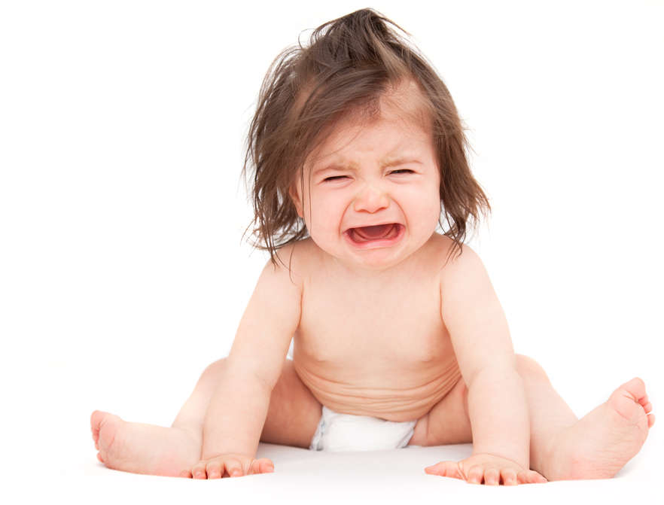
Sit down if …
by
Notes:
This presentation by @TeacherToolkit ( Ross Morrison McGill ) and is licensed under a Creative Commons Attribution-NonCommercial-NoDerivs 3.0 Unported License. Based on all work published at www.teachertoolkit.me
@TeacherToolkit Limited.
License:
You are free to:
Share — copy and redistribute the material in any medium or format
The licensor cannot revoke these freedoms as long as you follow the license terms.
Under the following terms:
Attribution — You must give appropriate credit, provide a link to the license, and indicate if changes were made. You may do so in any reasonable manner, but not in any way that suggests the licensor endorses you or your use.
NonCommercial — You may not use the material for commercial purposes.
NoDerivatives — If you remix, transform, or build upon the material, you may not distribute the modified material.
No additional restrictions — You may not apply legal terms or technological measures that legally restrict others from doing anything the license permits.

Slide 18
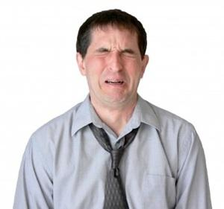
1. An academic who has published books.
Sit down if you are …
by
2. An academic who has published journals.
3. A teacher who has published books.
4. A teacher who has published journals.
5. Who is left?
Notes:
This presentation by @TeacherToolkit ( Ross Morrison McGill ) and is licensed under a Creative Commons Attribution-NonCommercial-NoDerivs 3.0 Unported License. Based on all work published at www.teachertoolkit.me
@TeacherToolkit Limited.
License:
You are free to:
Share — copy and redistribute the material in any medium or format
The licensor cannot revoke these freedoms as long as you follow the license terms.
Under the following terms:
Attribution — You must give appropriate credit, provide a link to the license, and indicate if changes were made. You may do so in any reasonable manner, but not in any way that suggests the licensor endorses you or your use.
NonCommercial — You may not use the material for commercial purposes.
NoDerivatives — If you remix, transform, or build upon the material, you may not distribute the modified material.
No additional restrictions — You may not apply legal terms or technological measures that legally restrict others from doing anything the license permits.

Slide 19
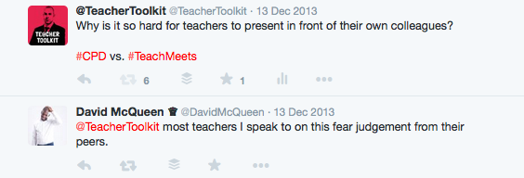
Critique:
by
https://twitter.com/TeacherToolkit/status/411399206688276480
Notes:
This presentation by @TeacherToolkit ( Ross Morrison McGill ) and is licensed under a Creative Commons Attribution-NonCommercial-NoDerivs 3.0 Unported License. Based on all work published at www.teachertoolkit.me
@TeacherToolkit Limited.
License:
You are free to:
Share — copy and redistribute the material in any medium or format
The licensor cannot revoke these freedoms as long as you follow the license terms.
Under the following terms:
Attribution — You must give appropriate credit, provide a link to the license, and indicate if changes were made. You may do so in any reasonable manner, but not in any way that suggests the licensor endorses you or your use.
NonCommercial — You may not use the material for commercial purposes.
NoDerivatives — If you remix, transform, or build upon the material, you may not distribute the modified material.
No additional restrictions — You may not apply legal terms or technological measures that legally restrict others from doing anything the license permits.

Slide 20
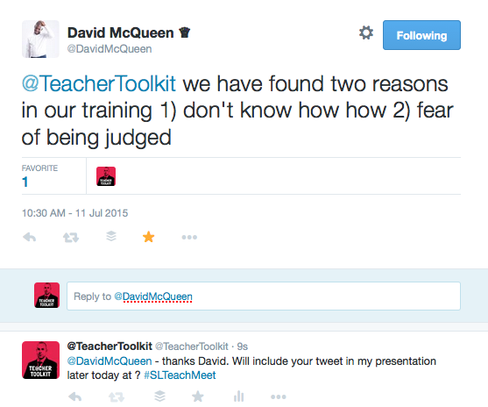
Possibility?
by
https://twitter.com/DavidMcQueen/status/619800874630692864
Notes:
This presentation by @TeacherToolkit ( Ross Morrison McGill ) and is licensed under a Creative Commons Attribution-NonCommercial-NoDerivs 3.0 Unported License. Based on all work published at www.teachertoolkit.me
@TeacherToolkit Limited.
License:
You are free to:
Share — copy and redistribute the material in any medium or format
The licensor cannot revoke these freedoms as long as you follow the license terms.
Under the following terms:
Attribution — You must give appropriate credit, provide a link to the license, and indicate if changes were made. You may do so in any reasonable manner, but not in any way that suggests the licensor endorses you or your use.
NonCommercial — You may not use the material for commercial purposes.
NoDerivatives — If you remix, transform, or build upon the material, you may not distribute the modified material.
No additional restrictions — You may not apply legal terms or technological measures that legally restrict others from doing anything the license permits.

Slide 21
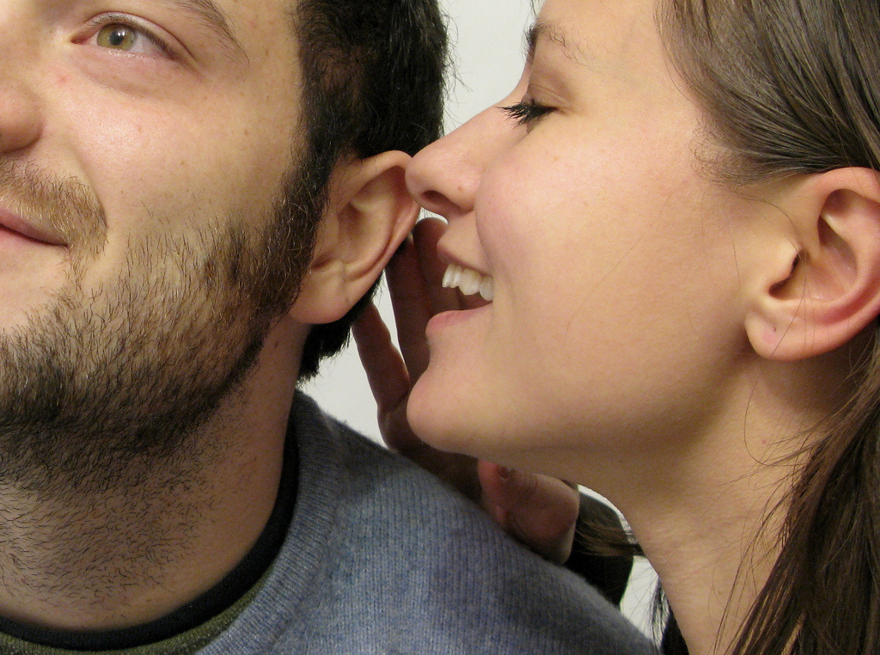
Peer: Hear of Fear?
by
Notes:
This presentation by @TeacherToolkit ( Ross Morrison McGill ) and is licensed under a Creative Commons Attribution-NonCommercial-NoDerivs 3.0 Unported License. Based on all work published at www.teachertoolkit.me
@TeacherToolkit Limited.
License:
You are free to:
Share — copy and redistribute the material in any medium or format
The licensor cannot revoke these freedoms as long as you follow the license terms.
Under the following terms:
Attribution — You must give appropriate credit, provide a link to the license, and indicate if changes were made. You may do so in any reasonable manner, but not in any way that suggests the licensor endorses you or your use.
NonCommercial — You may not use the material for commercial purposes.
NoDerivatives — If you remix, transform, or build upon the material, you may not distribute the modified material.
No additional restrictions — You may not apply legal terms or technological measures that legally restrict others from doing anything the license permits.

Slide 22
The perils of peer review What lies at their root? by Etienne Benson
by
Notes:
This presentation by @TeacherToolkit ( Ross Morrison McGill ) and is licensed under a Creative Commons Attribution-NonCommercial-NoDerivs 3.0 Unported License. Based on all work published at www.teachertoolkit.me
@TeacherToolkit Limited.
License:
You are free to:
Share — copy and redistribute the material in any medium or format
The licensor cannot revoke these freedoms as long as you follow the license terms.
Under the following terms:
Attribution — You must give appropriate credit, provide a link to the license, and indicate if changes were made. You may do so in any reasonable manner, but not in any way that suggests the licensor endorses you or your use.
NonCommercial — You may not use the material for commercial purposes.
NoDerivatives — If you remix, transform, or build upon the material, you may not distribute the modified material.
No additional restrictions — You may not apply legal terms or technological measures that legally restrict others from doing anything the license permits.

Slide 23
“critical peer reviews [academic papers] clearly cross the line between a vigorous critique and an unprofessional attack.”
by
Notes:
This presentation by @TeacherToolkit ( Ross Morrison McGill ) and is licensed under a Creative Commons Attribution-NonCommercial-NoDerivs 3.0 Unported License. Based on all work published at www.teachertoolkit.me
@TeacherToolkit Limited.
License:
You are free to:
Share — copy and redistribute the material in any medium or format
The licensor cannot revoke these freedoms as long as you follow the license terms.
Under the following terms:
Attribution — You must give appropriate credit, provide a link to the license, and indicate if changes were made. You may do so in any reasonable manner, but not in any way that suggests the licensor endorses you or your use.
NonCommercial — You may not use the material for commercial purposes.
NoDerivatives — If you remix, transform, or build upon the material, you may not distribute the modified material.
No additional restrictions — You may not apply legal terms or technological measures that legally restrict others from doing anything the license permits.

Slide 24
1. Attacks that focus on the teacher instead of the learning.
by
Notes:
This presentation by @TeacherToolkit ( Ross Morrison McGill ) and is licensed under a Creative Commons Attribution-NonCommercial-NoDerivs 3.0 Unported License. Based on all work published at www.teachertoolkit.me
@TeacherToolkit Limited.
License:
You are free to:
Share — copy and redistribute the material in any medium or format
The licensor cannot revoke these freedoms as long as you follow the license terms.
Under the following terms:
Attribution — You must give appropriate credit, provide a link to the license, and indicate if changes were made. You may do so in any reasonable manner, but not in any way that suggests the licensor endorses you or your use.
NonCommercial — You may not use the material for commercial purposes.
NoDerivatives — If you remix, transform, or build upon the material, you may not distribute the modified material.
No additional restrictions — You may not apply legal terms or technological measures that legally restrict others from doing anything the license permits.

Slide 25
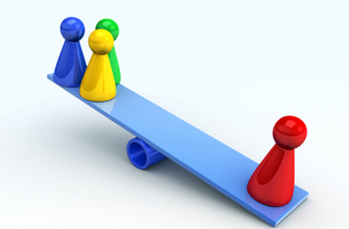
2. Bias
by
Notes:
This presentation by @TeacherToolkit ( Ross Morrison McGill ) and is licensed under a Creative Commons Attribution-NonCommercial-NoDerivs 3.0 Unported License. Based on all work published at www.teachertoolkit.me
@TeacherToolkit Limited.
License:
You are free to:
Share — copy and redistribute the material in any medium or format
The licensor cannot revoke these freedoms as long as you follow the license terms.
Under the following terms:
Attribution — You must give appropriate credit, provide a link to the license, and indicate if changes were made. You may do so in any reasonable manner, but not in any way that suggests the licensor endorses you or your use.
NonCommercial — You may not use the material for commercial purposes.
NoDerivatives — If you remix, transform, or build upon the material, you may not distribute the modified material.
No additional restrictions — You may not apply legal terms or technological measures that legally restrict others from doing anything the license permits.

Slide 26
3. Superficial review.
by
Notes:
This presentation by @TeacherToolkit ( Ross Morrison McGill ) and is licensed under a Creative Commons Attribution-NonCommercial-NoDerivs 3.0 Unported License. Based on all work published at www.teachertoolkit.me
@TeacherToolkit Limited.
License:
You are free to:
Share — copy and redistribute the material in any medium or format
The licensor cannot revoke these freedoms as long as you follow the license terms.
Under the following terms:
Attribution — You must give appropriate credit, provide a link to the license, and indicate if changes were made. You may do so in any reasonable manner, but not in any way that suggests the licensor endorses you or your use.
NonCommercial — You may not use the material for commercial purposes.
NoDerivatives — If you remix, transform, or build upon the material, you may not distribute the modified material.
No additional restrictions — You may not apply legal terms or technological measures that legally restrict others from doing anything the license permits.

Slide 27
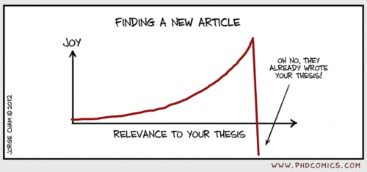
4. Dismissive or inappropriate critique.
by
Notes:
This presentation by @TeacherToolkit ( Ross Morrison McGill ) and is licensed under a Creative Commons Attribution-NonCommercial-NoDerivs 3.0 Unported License. Based on all work published at www.teachertoolkit.me
@TeacherToolkit Limited.
License:
You are free to:
Share — copy and redistribute the material in any medium or format
The licensor cannot revoke these freedoms as long as you follow the license terms.
Under the following terms:
Attribution — You must give appropriate credit, provide a link to the license, and indicate if changes were made. You may do so in any reasonable manner, but not in any way that suggests the licensor endorses you or your use.
NonCommercial — You may not use the material for commercial purposes.
NoDerivatives — If you remix, transform, or build upon the material, you may not distribute the modified material.
No additional restrictions — You may not apply legal terms or technological measures that legally restrict others from doing anything the license permits.

Slide 28
The article suggests; “that if academics/teachers consistently undervalue each other’s work, funding agencies will shift their support to fields whose researchers don’t.” Could this be applied to schools?
by
Notes:
This presentation by @TeacherToolkit ( Ross Morrison McGill ) and is licensed under a Creative Commons Attribution-NonCommercial-NoDerivs 3.0 Unported License. Based on all work published at www.teachertoolkit.me
@TeacherToolkit Limited.
License:
You are free to:
Share — copy and redistribute the material in any medium or format
The licensor cannot revoke these freedoms as long as you follow the license terms.
Under the following terms:
Attribution — You must give appropriate credit, provide a link to the license, and indicate if changes were made. You may do so in any reasonable manner, but not in any way that suggests the licensor endorses you or your use.
NonCommercial — You may not use the material for commercial purposes.
NoDerivatives — If you remix, transform, or build upon the material, you may not distribute the modified material.
No additional restrictions — You may not apply legal terms or technological measures that legally restrict others from doing anything the license permits.

Slide 29
Discouraging beginning researchers can only discourage people from participating again if they receive any damming critique.
by
Notes:
This presentation by @TeacherToolkit ( Ross Morrison McGill ) and is licensed under a Creative Commons Attribution-NonCommercial-NoDerivs 3.0 Unported License. Based on all work published at www.teachertoolkit.me
@TeacherToolkit Limited.
License:
You are free to:
Share — copy and redistribute the material in any medium or format
The licensor cannot revoke these freedoms as long as you follow the license terms.
Under the following terms:
Attribution — You must give appropriate credit, provide a link to the license, and indicate if changes were made. You may do so in any reasonable manner, but not in any way that suggests the licensor endorses you or your use.
NonCommercial — You may not use the material for commercial purposes.
NoDerivatives — If you remix, transform, or build upon the material, you may not distribute the modified material.
No additional restrictions — You may not apply legal terms or technological measures that legally restrict others from doing anything the license permits.

Slide 30
Share and compare
by
What one factor hindered your engagement with
action research?
Notes:
This presentation by @TeacherToolkit ( Ross Morrison McGill ) and is licensed under a Creative Commons Attribution-NonCommercial-NoDerivs 3.0 Unported License.
Based on all work published at www.teachertoolkit.me
@TeacherToolkit Limited.

Slide 31
The barriers for teachers accessing academic research:
by
Notes:
This presentation by @TeacherToolkit ( Ross Morrison McGill ) and is licensed under a Creative Commons Attribution-NonCommercial-NoDerivs 3.0 Unported License. Based on all work published at www.teachertoolkit.me
@TeacherToolkit Limited.
License:
You are free to:
Share — copy and redistribute the material in any medium or format
The licensor cannot revoke these freedoms as long as you follow the license terms.
Under the following terms:
Attribution — You must give appropriate credit, provide a link to the license, and indicate if changes were made. You may do so in any reasonable manner, but not in any way that suggests the licensor endorses you or your use.
NonCommercial — You may not use the material for commercial purposes.
NoDerivatives — If you remix, transform, or build upon the material, you may not distribute the modified material.
No additional restrictions — You may not apply legal terms or technological measures that legally restrict others from doing anything the license permits.

Slide 32
The barriers for teachers accessing academic research:
by
1. Time 2. Funding 3. Focus / Validity 4. Peer review 5. Publication
Notes:
This presentation by @TeacherToolkit ( Ross Morrison McGill ) and is licensed under a Creative Commons Attribution-NonCommercial-NoDerivs 3.0 Unported License. Based on all work published at www.teachertoolkit.me
@TeacherToolkit Limited.
License:
You are free to:
Share — copy and redistribute the material in any medium or format
The licensor cannot revoke these freedoms as long as you follow the license terms.
Under the following terms:
Attribution — You must give appropriate credit, provide a link to the license, and indicate if changes were made. You may do so in any reasonable manner, but not in any way that suggests the licensor endorses you or your use.
NonCommercial — You may not use the material for commercial purposes.
NoDerivatives — If you remix, transform, or build upon the material, you may not distribute the modified material.
No additional restrictions — You may not apply legal terms or technological measures that legally restrict others from doing anything the license permits.

Slide 33
by
Notes:
This presentation by @TeacherToolkit ( Ross Morrison McGill ) and is licensed under a Creative Commons Attribution-NonCommercial-NoDerivs 3.0 Unported License. Based on all work published at www.teachertoolkit.me
@TeacherToolkit Limited.

Slide 34
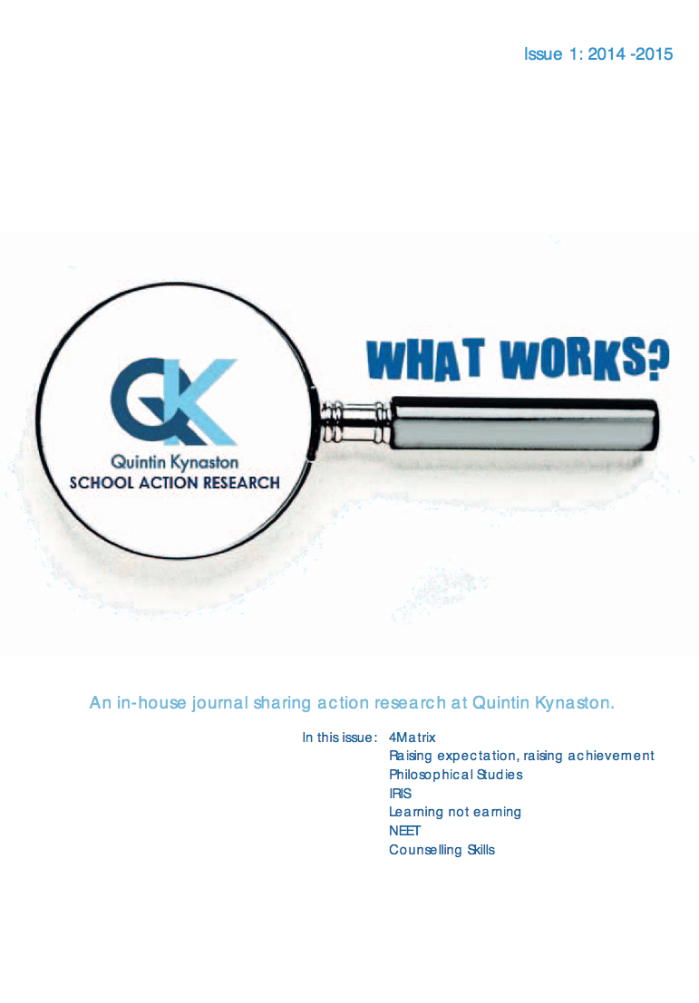
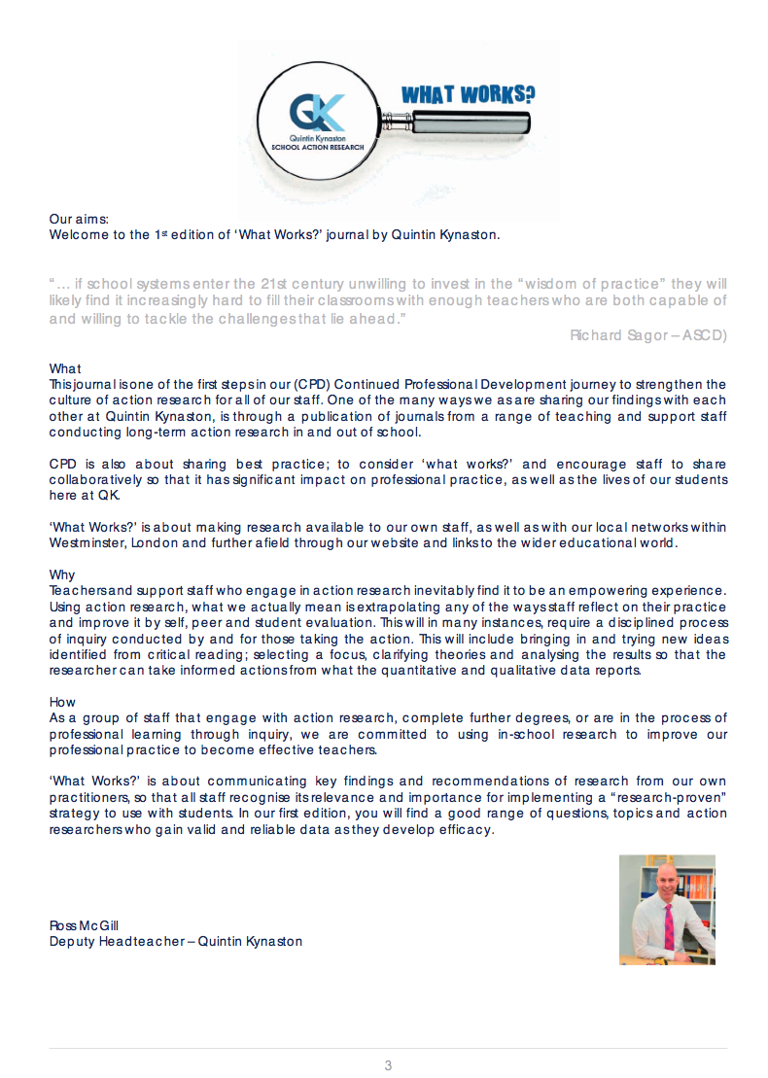
by
Notes:
This presentation by @TeacherToolkit ( Ross Morrison McGill ) and is licensed under a Creative Commons Attribution-NonCommercial-NoDerivs 3.0 Unported License. Based on all work published at www.teachertoolkit.me
@TeacherToolkit Limited.

Slide 35
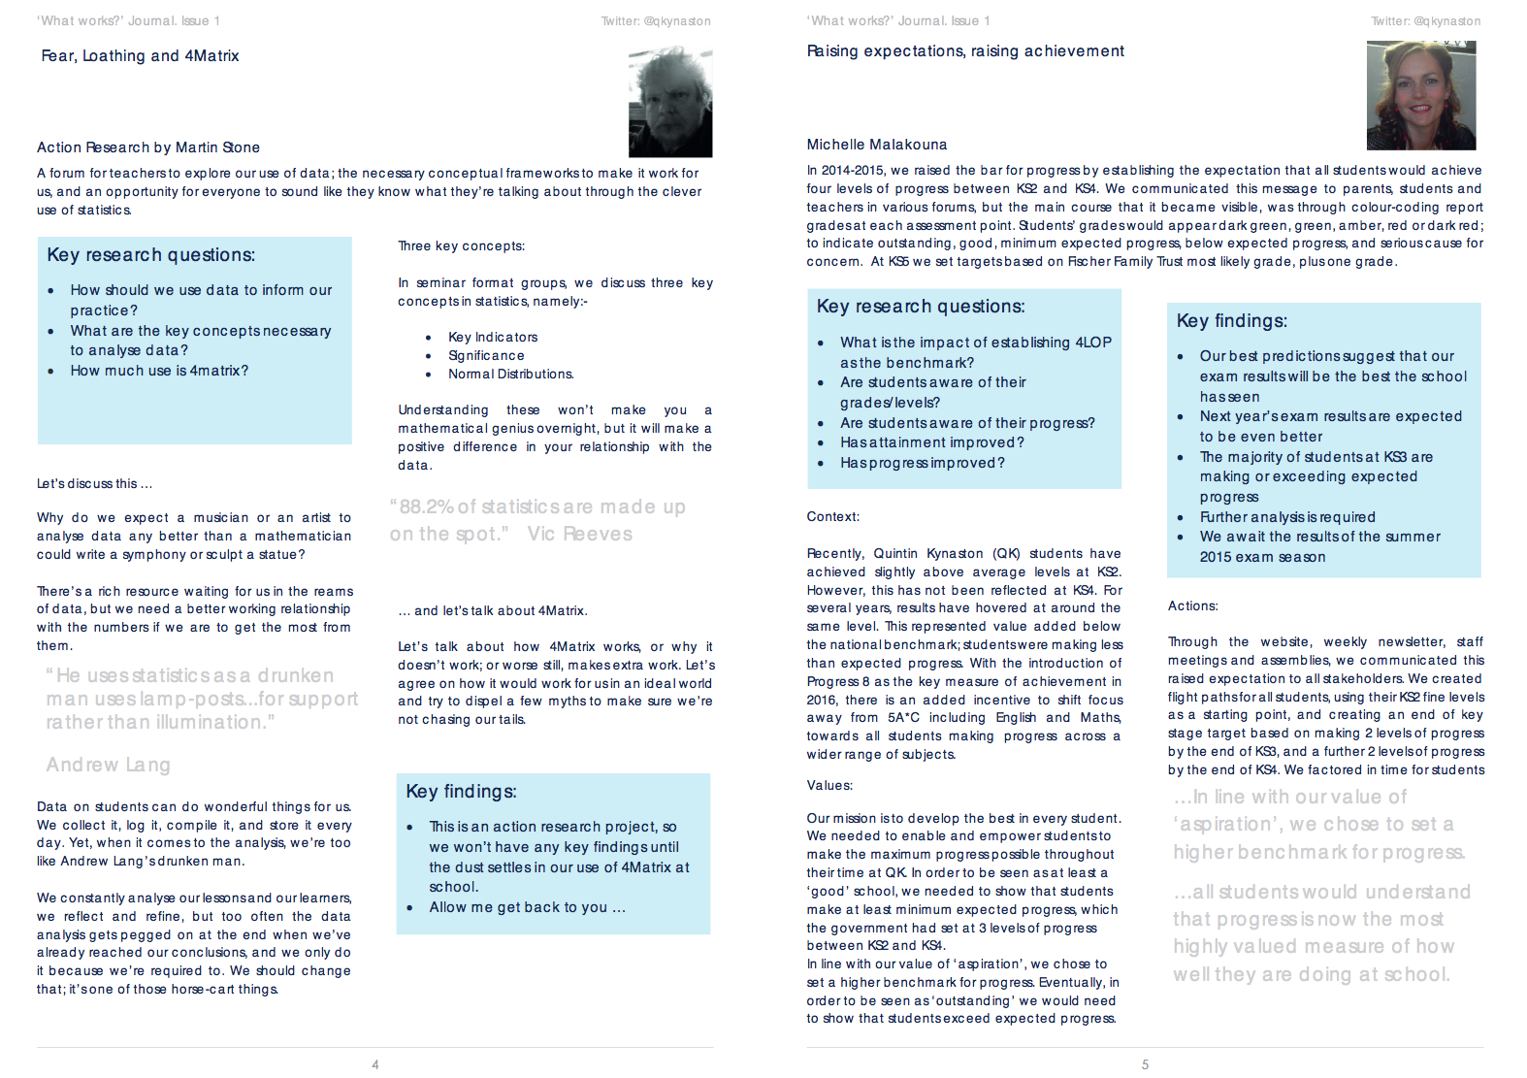
by
Notes:
This presentation by @TeacherToolkit ( Ross Morrison McGill ) and is licensed under a Creative Commons Attribution-NonCommercial-NoDerivs 3.0 Unported License. Based on all work published at www.teachertoolkit.me
@TeacherToolkit Limited.

Slide 36
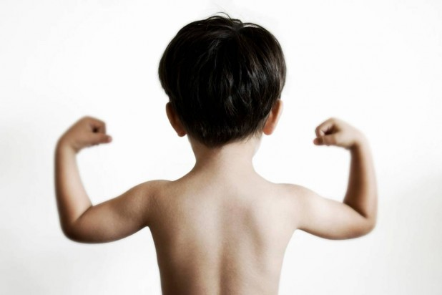
Resilience
by
by
Notes:
This presentation by @TeacherToolkit ( Ross Morrison McGill ) and is licensed under a Creative Commons Attribution-NonCommercial-NoDerivs 3.0 Unported License.
Based on all work published at www.teachertoolkit.me
@TeacherToolkit Limited.

Slide 37
The perfect teacher?
by
by
Image: http://vampireexplored.wordpress.com
Notes:
This presentation by @TeacherToolkit ( Ross Morrison McGill ) and is licensed under a Creative Commons Attribution-NonCommercial-NoDerivs 3.0 Unported License.
Based on all work published at www.teachertoolkit.me
@TeacherToolkit Limited.

Slide 38
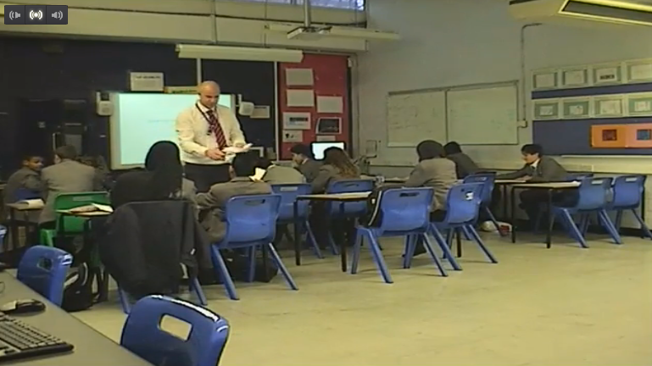
Resilience – Staying Stuck
by
by
https://europe.irisconnect.com/reflections/106582 - 5 mins
Notes:
https://europe.irisconnect.com/reflections/106582
This presentation by @TeacherToolkit ( Ross Morrison McGill ) and is licensed under a Creative Commons Attribution-NonCommercial-NoDerivs 3.0 Unported License.
Based on all work published at www.teachertoolkit.me
@TeacherToolkit Limited.

Slide 39
by
Notes:
This presentation by @TeacherToolkit ( Ross Morrison McGill ) and is licensed under a Creative Commons Attribution-NonCommercial-NoDerivs 3.0 Unported License. Based on all work published at www.teachertoolkit.me
@TeacherToolkit Limited.

Slide 40
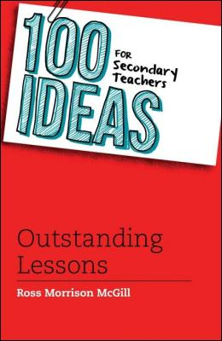
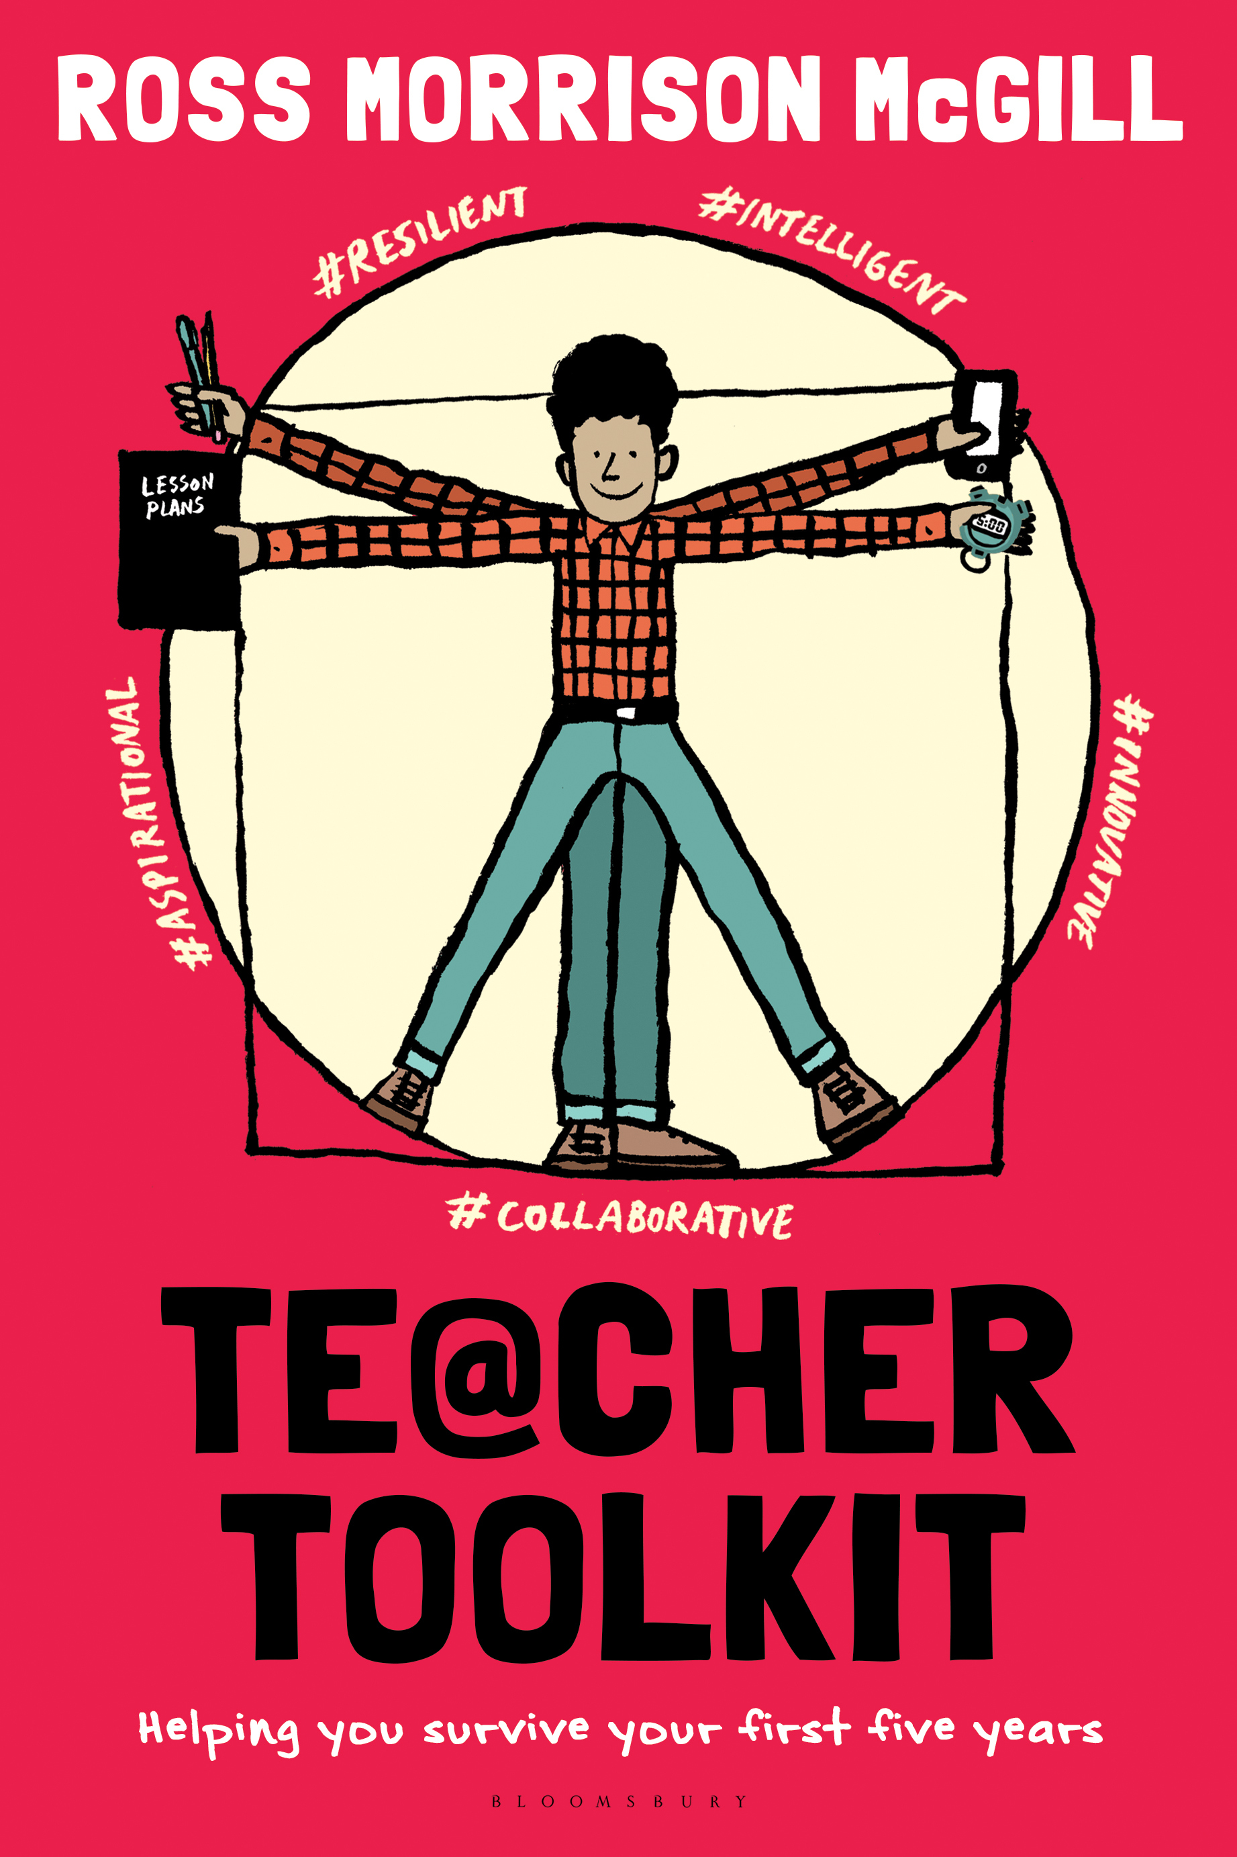
Thank you!
TeacherToolkit@me.com
@TeacherToolkit
www.TeacherToolkit.me
Notes:
This presentation by @TeacherToolkit ( Ross Morrison McGill ) and is licensed under a Creative Commons Attribution-NonCommercial-NoDerivs 3.0 Unported License.
Based on all work published at www.teachertoolkit.me
@TeacherToolkit Limited.

Slide 41
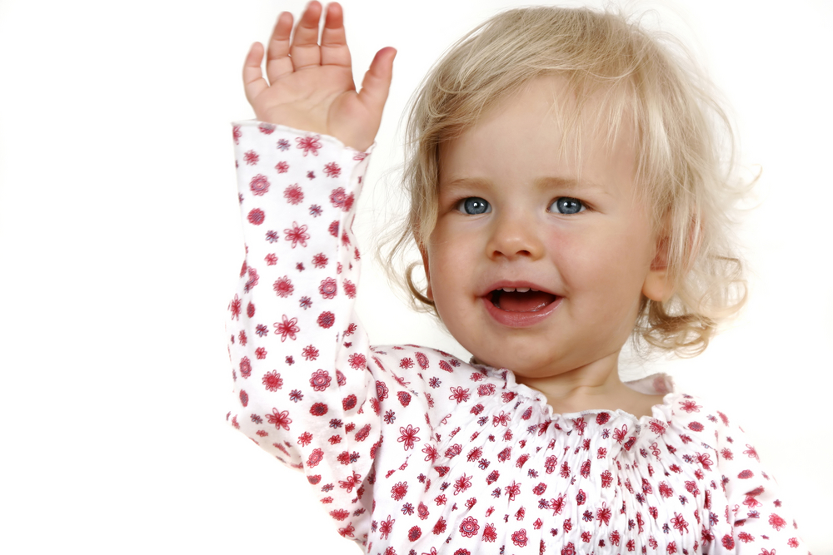
See you later…
Notes:
So today I’d like us to go through the following objectives

Slide 42
End
Notes:
This presentation by @TeacherToolkit ( Ross Morrison McGill ) and is licensed under a Creative Commons Attribution-NonCommercial-NoDerivs 3.0 Unported License. Based on all work published at www.teachertoolkit.me
@TeacherToolkit Limited.
License:
You are free to:
Share — copy and redistribute the material in any medium or format
The licensor cannot revoke these freedoms as long as you follow the license terms.
Under the following terms:
Attribution — You must give appropriate credit, provide a link to the license, and indicate if changes were made. You may do so in any reasonable manner, but not in any way that suggests the licensor endorses you or your use.
NonCommercial — You may not use the material for commercial purposes.
NoDerivatives — If you remix, transform, or build upon the material, you may not distribute the modified material.
No additional restrictions — You may not apply legal terms or technological measures that legally restrict others from doing anything the license permits.

Slide 43
Disclaimer
This slideshow has been created to be purchased online; it has been designed to be presented as a formal presentation and has not been published elsewhere.
Thank you for purchasing this resource!
You can find others here.
@TeacherToolkit
(Feedback appreciated)
This presentation by @TeacherToolkit ( Ross Morrison McGill ) and is licensed under a Creative Commons Attribution-NonCommercial-NoDerivs 3.0 Unported License.
Based on all work published at www.teachertoolkit.me
@TeacherToolkit Limited
Notes:
This presentation by @TeacherToolkit ( Ross Morrison McGill ) and is licensed under a Creative Commons Attribution-NonCommercial-NoDerivs 3.0 Unported License. Based on all work published at www.teachertoolkit.me
@TeacherToolkit Limited.
License:
You are free to:
Share — copy and redistribute the material in any medium or format
The licensor cannot revoke these freedoms as long as you follow the license terms.
Under the following terms:
Attribution — You must give appropriate credit, provide a link to the license, and indicate if changes were made. You may do so in any reasonable manner, but not in any way that suggests the licensor endorses you or your use.
NonCommercial — You may not use the material for commercial purposes.
NoDerivatives — If you remix, transform, or build upon the material, you may not distribute the modified material.
No additional restrictions — You may not apply legal terms or technological measures that legally restrict others from doing anything the license permits.

