Slide 1
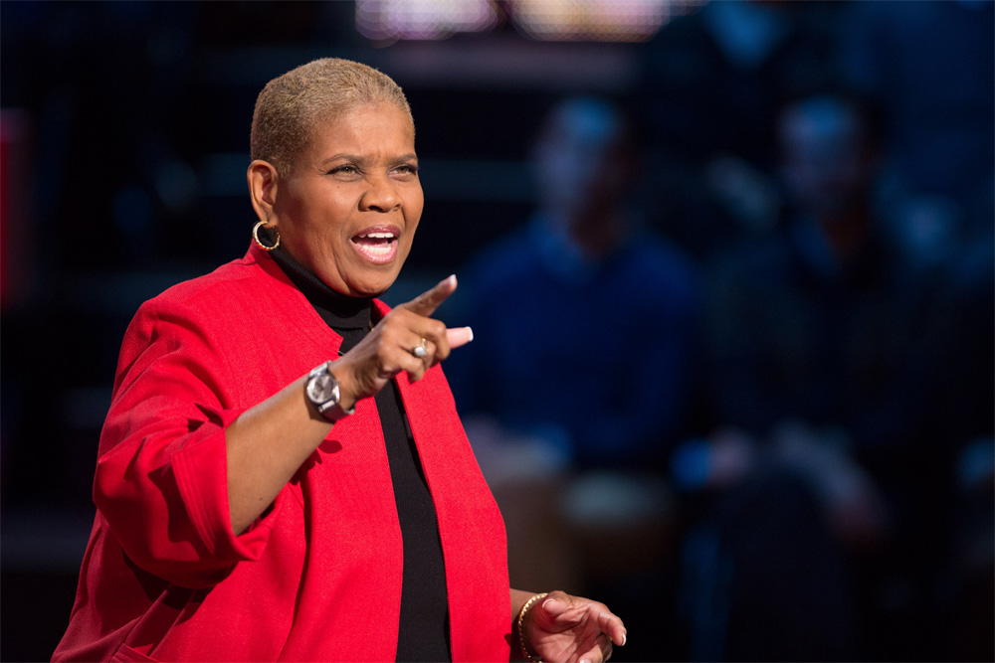
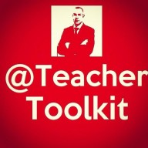
“How powerful would our world be if we had kids not afraid to take risks, who were not afraid to think, and who had a champion.
Every child deserves a champion; an adult who will never give up on them. Who understands the power of connection and insists that they become the best that they can possibly be.
Is this job tough? You bet-cha. But it is not impossible. We can do this. We’re educators. We’re born to make a difference.”
Rita Pierson

