Slide 1
Please sit where you are comfortable

Slide 2
Kick off!

Slide 3
Something CPD

Slide 4
Something to hear Something for free Something to do …

Slide 5
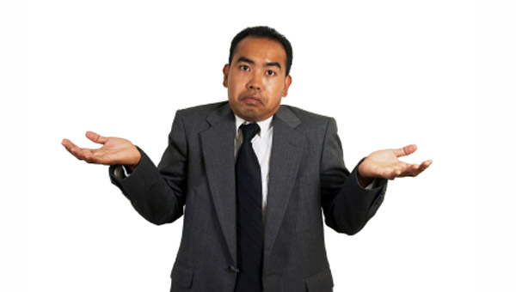
CPD agenda

Slide 6
CPD agenda Good CPD in school?
Fad or genuine school priority?

Slide 7
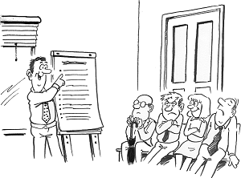
CPD agenda Good CPD in school? Good CPD for you?
More than going on a course?

Slide 8
CPD agenda Good CPD in school? Good CPD for you? Evidence to suggest impact on students?

Slide 9
CPD agenda Good CPD in school? Good CPD for you? Where is the evidence? Will this CPD help my students?

Slide 10
CPD agenda Good CPD in school? Good CPD for you? Where is the evidence? Will this CPD help my students? What follow up support offered?

Slide 11
CPD agenda Good CPD in school? Good CPD for you? Where is the evidence? Will this CPD help my students? What follow up support offered? Evaluate the impact on classroom practice?

Slide 12
CPD agenda Good CPD in school? Good CPD for you? Where is the evidence? Will this CPD help my students? What follow up support offered? Evaluate the impact on classroom practice?

Slide 13
CPD agenda Good CPD in school? Good CPD for you? Where is the evidence? Will this CPD help my students? What follow up support offered? Evaluate the impact on classroom practice?

Slide 14
CPD agenda Good CPD in school? Good CPD for you? Where is the evidence? Will this CPD help my students? What follow up support offered? Evaluate the impact on classroom practice?

Slide 15
CPD agenda Good CPD in school? Good CPD for you? Where is the evidence? Will this CPD help my students? What follow up support offered? Evaluate the impact on classroom practice?

Slide 16
CPD agenda Good CPD in school? Good CPD for you? Where is the evidence? Will this CPD help my students? What follow up support offered? Evaluate the impact on classroom practice?

Slide 17
CPD agenda Good CPD in school? Good CPD for you? Where is the evidence? Will this CPD help my students? What follow up support offered? Evaluate the impact on classroom practice?

Slide 18
CPD agenda Good CPD in school? Good CPD for you? Where is the evidence? Will this CPD help my students? What follow up support offered? Evaluate the impact on classroom practice?

Slide 19
CPD agenda Good CPD in school? Good CPD for you? Where is the evidence? Will this CPD help my students? What follow up support offered? Evaluate the impact on classroom practice?

Slide 20
Effective CPD! 1. Shared responsibility (CPD/T&L) 2. On-going process 3. Everyone evaluates the impact on students 4. Support / Observing each other 5. Research, innovation, evidence.

Slide 21
Something to hear Something for free Something to do …

Slide 22
Something to hear

Slide 23
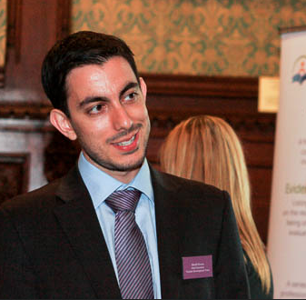
Introducing
David Weston,
Chief Executive of The Teacher Development Trust
A non-profit organisation promoting world-leading approaches to teacher learning and effective teacher development.

Slide 24
Something to hear Something for free Something to do …

Slide 25
. Something for free .

Slide 26
Introducing Edu-Book Club

Slide 27
What?
As part of our Action Research CPD,
we want to disseminate 15 educational books.

Slide 28
Edu-Book club

Slide 29
Why
We think it will make a difference to teacher practice at QK.

Slide 30
Why?
To discuss the content and
how it has made an impact on classroom practice.

Slide 31
How?
1. The idea is simple …
2. Every teacher will select a book to read.

Slide 32
Make 1st and 2nd choice …

Slide 33
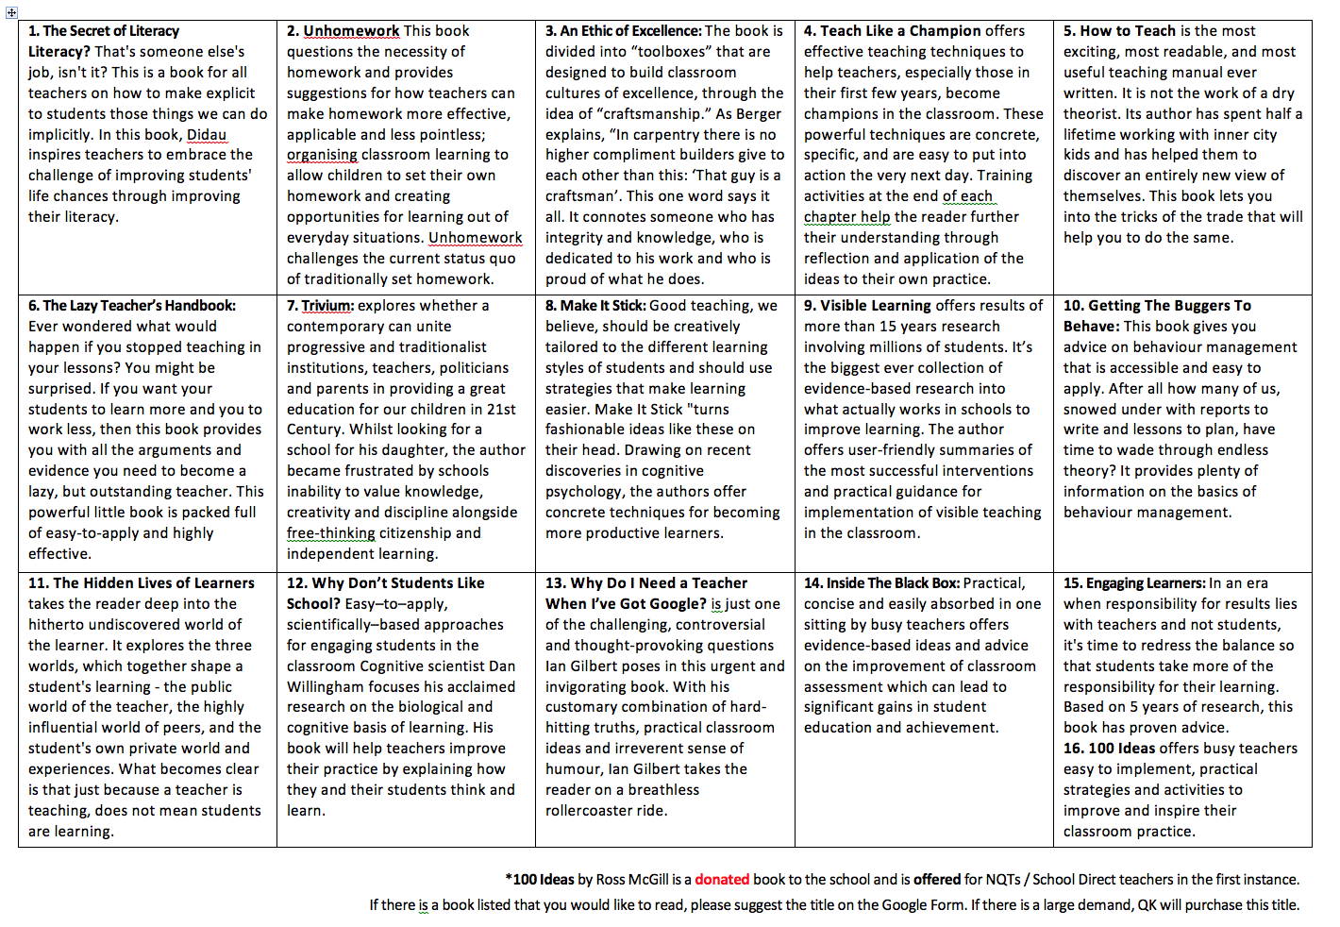
Edu-Book club preview:

Slide 34
How?
QK purchases a copy for every member of staff.
During INSET and in some Wednesday CPD sessions, we’ll meet and give time to discuss.

Slide 35
Read the previews:
Visit http://bit.ly/QKBookClubForm
Choose your 1st choice book.
Choose your 2nd choice book.
Indicate if you’d like to be a ‘facilitator.’

Slide 36
How?
During the year, we will aim to have
‘transfer windows’
where staff can change books and groups.

Slide 37
Make sure you have your book with you.
Dates will be published.

Slide 38
Something to hear Something for free Something to do …

Slide 39
Introducing

Slide 40
Guide to MintClass at QK

Slide 41
First login in to the VLE

Slide 42
On the right side under Staff Links click on Mint Class

Slide 43
Username = Your staff code (BGN)Password = Your staff code & staff code backwards (BGNNGB) All in CAPITALS

Slide 44
Secret code = Your date of birth (DDMMYY)

Slide 45
Then set your own password

Slide 46
We have already mapped your classroom for you. To see them, go to templates in the top left corner

Slide 47
You can see the pre mapped classrooms by hovering over the magnifying glass

Slide 48
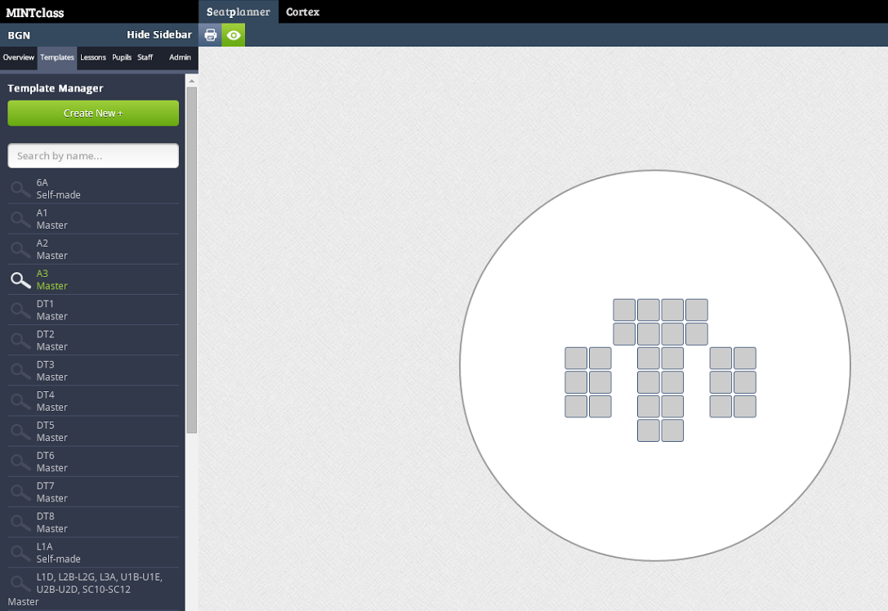

Slide 50
When in Overview your SIMs classroom timetable shows on the left

Slide 51
From here you can select the different lesson you have throughout the week

Slide 52
You can set your seating plan automatically with pre set groups

Slide 53
Or you can seat them manually

Slide 54
From here you drag and drop the students to their seats

Slide 55
Once done you can get a more detailed view of each student by pressing the green eye symbol at the top

Slide 56
This view gives you their Target grade, Current grade, KS2 average score, Pupil premium and SEN

Slide 57
Click on the arrow to get EAL, Attendance, Reading age and KS2 APS

Slide 58
If you are covering a lesson, search for the member of staff using their staff code and click on their name

Slide 59
This shows their timetable, click on Cover this teacher to view their seating plans.

Slide 60
Click on Return to my lesson to go back to your own timetable

Slide 61
For help click on the button in the top right corner

Slide 62
Here you can watch tutorial videos

Slide 63
End.

Slide 64
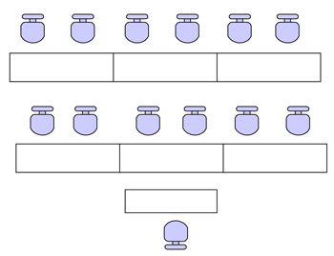
EVERY CLASS SHOULD HAVE A SEATING PLAN MINT class or on paper

Slide 65
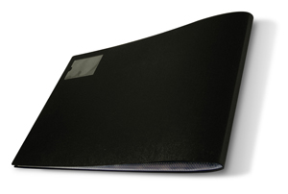
A professional portfolio

Slide 66
Introducing Blue Sky

Slide 67
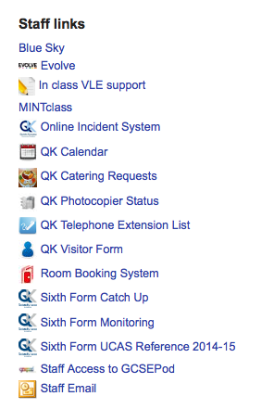
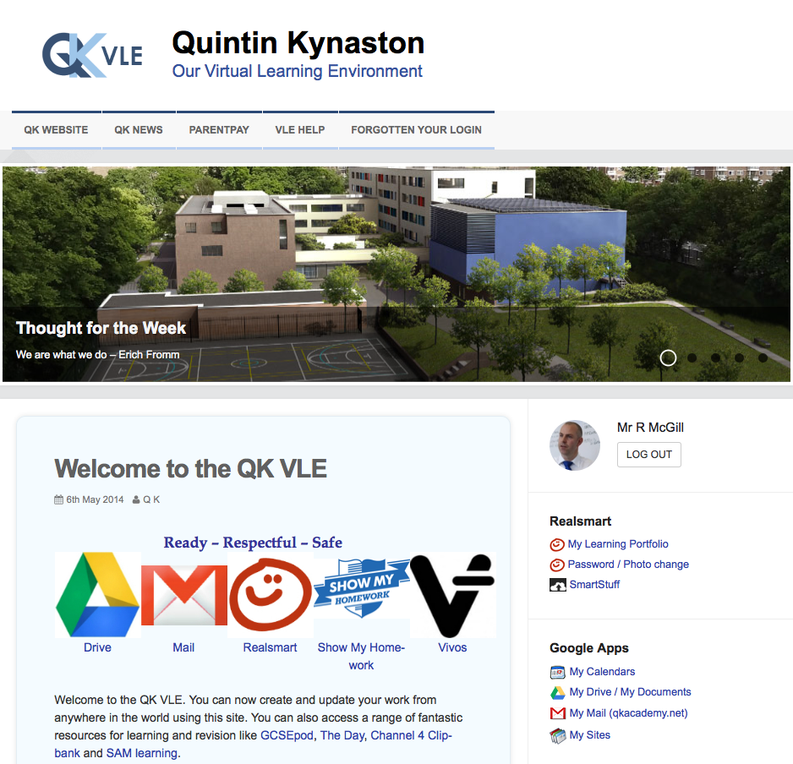
Login in to the VLE

Slide 68
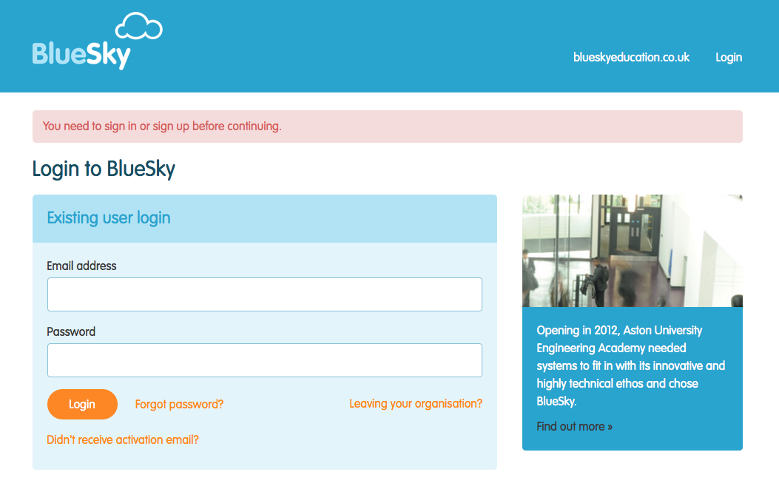
Login in to Blue Sky

Slide 69
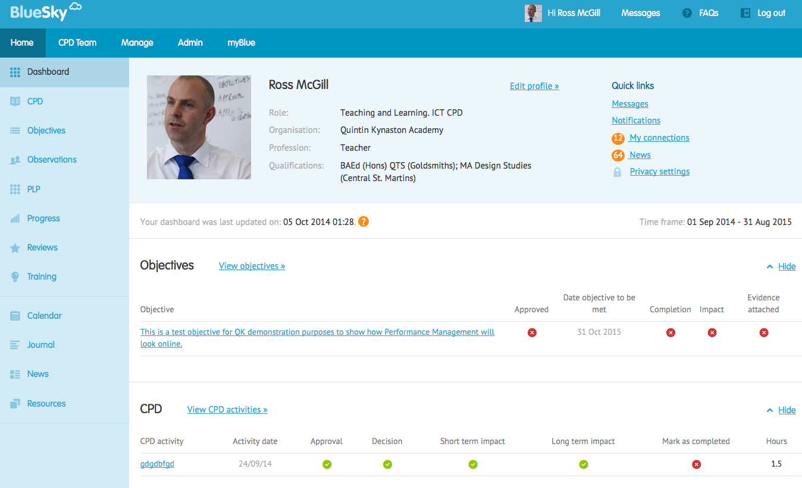
Homepage

Slide 70
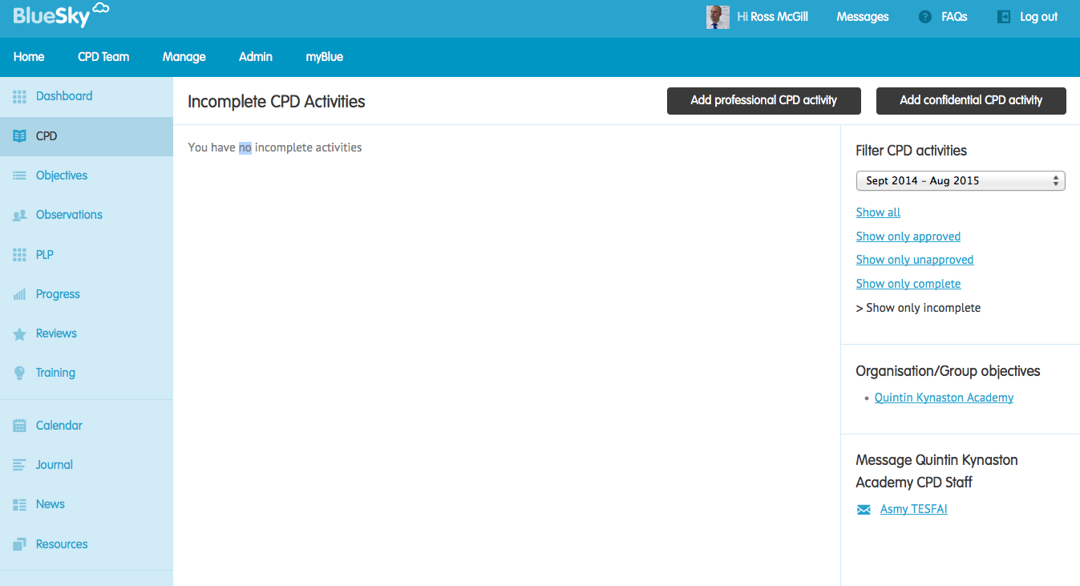
CPD tab

Slide 71
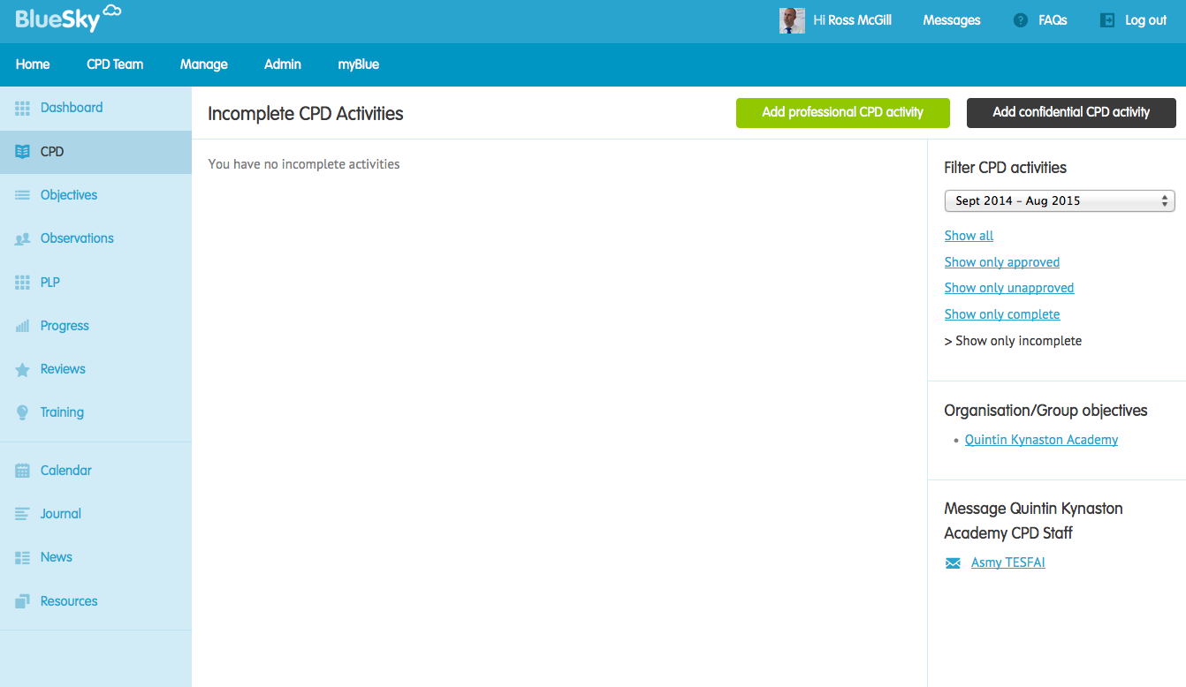
Add professional CPD activity

Slide 72
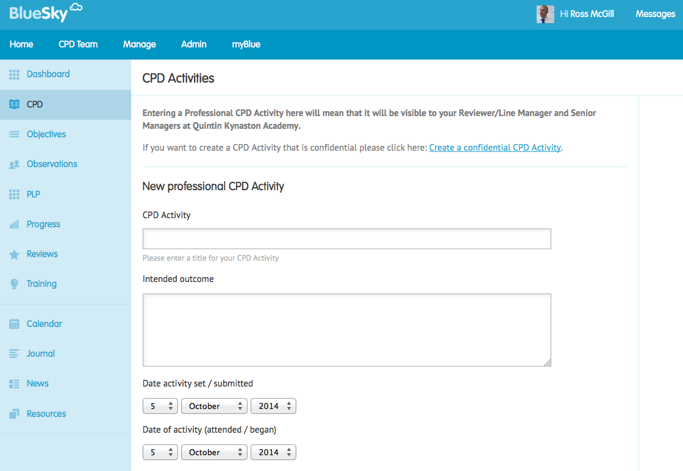
CPD activity page

Slide 73
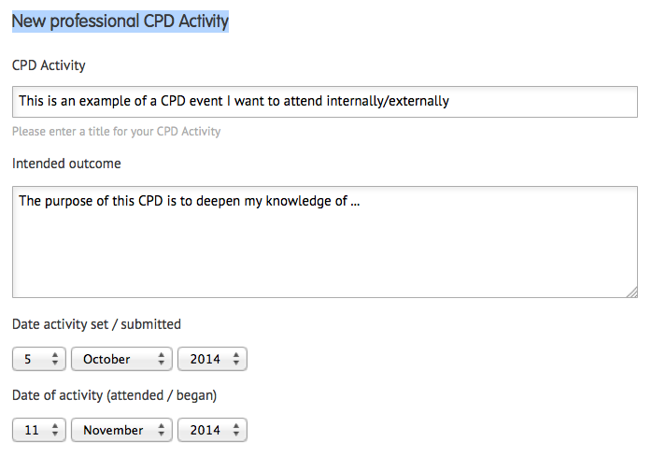
CPD details – part 1

Slide 74
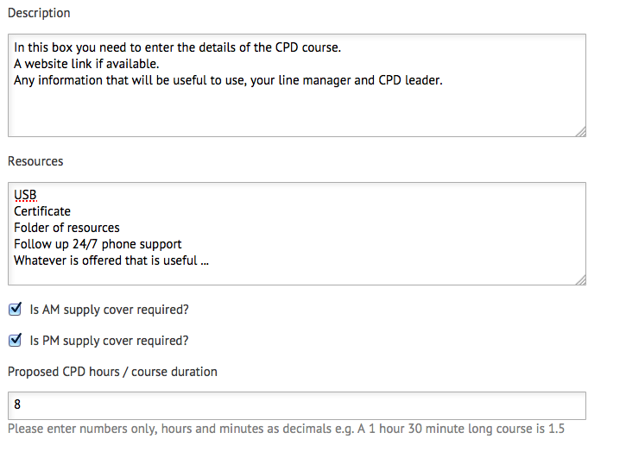
CPD details – part 2

Slide 75
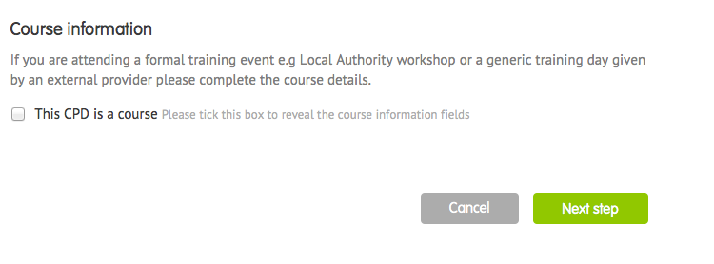
Select ‘Next step’ if this is a log of CPD

Slide 76
If you select ‘This is a CPD course.’
You will need to input costs

Slide 77
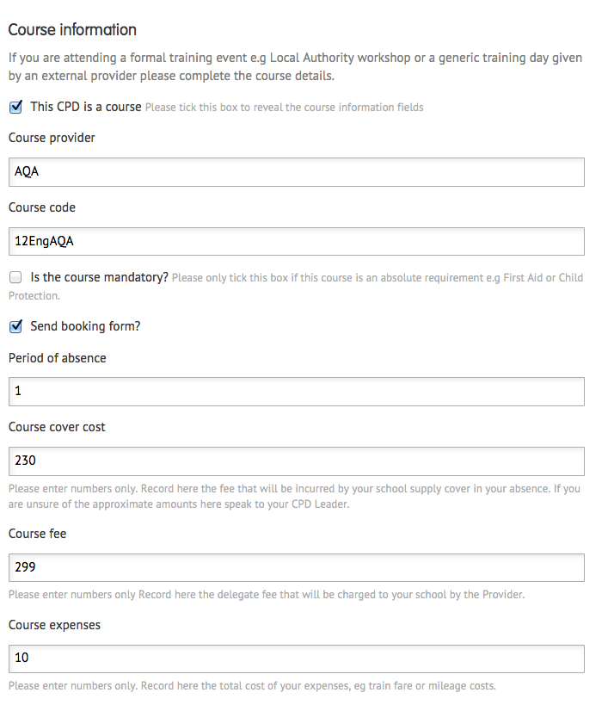
The following asks for simple numbers

Slide 78
Source of funding?

Slide 79
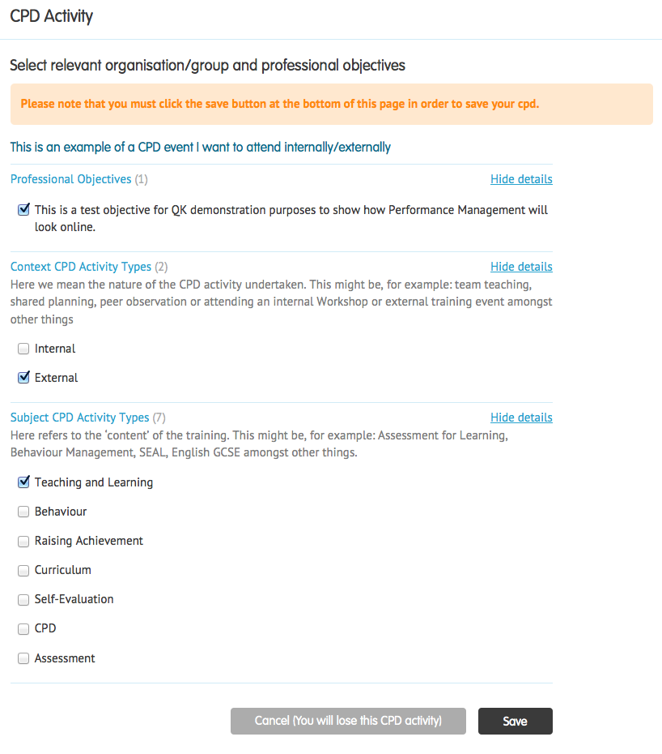
The final step – matched to priorities

Slide 80
Any questions?
Blue Sky FAQs
Blue Sky CPD handout
This presentation
Link to Google form to choose a reading book
MINT class login – go away and play with one seating plan
Blue Sky login – go away and add a CPD example

Slide 81
Go and play!
DEPARMENT COMPUTER ROOM ALLOCATION
DEPARTMENT | ROOM
Technology | DT2
Science | SC10
Languages & Art | DT4
Performing Arts & PE | LB2
Humanities & Opening Minds | LB7
Business | L1A
English/ Media & EAL | L4A
Computing | L4G
Maths | U2A

